Slide 1




Activity Overview
Atlas Box Challenge

Slide 2

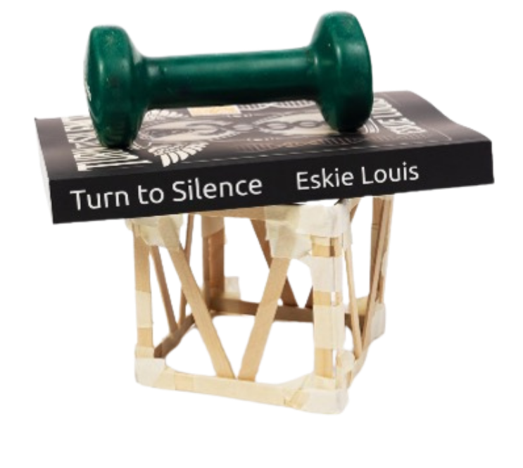


Atlas Box Challenge

Slide 3
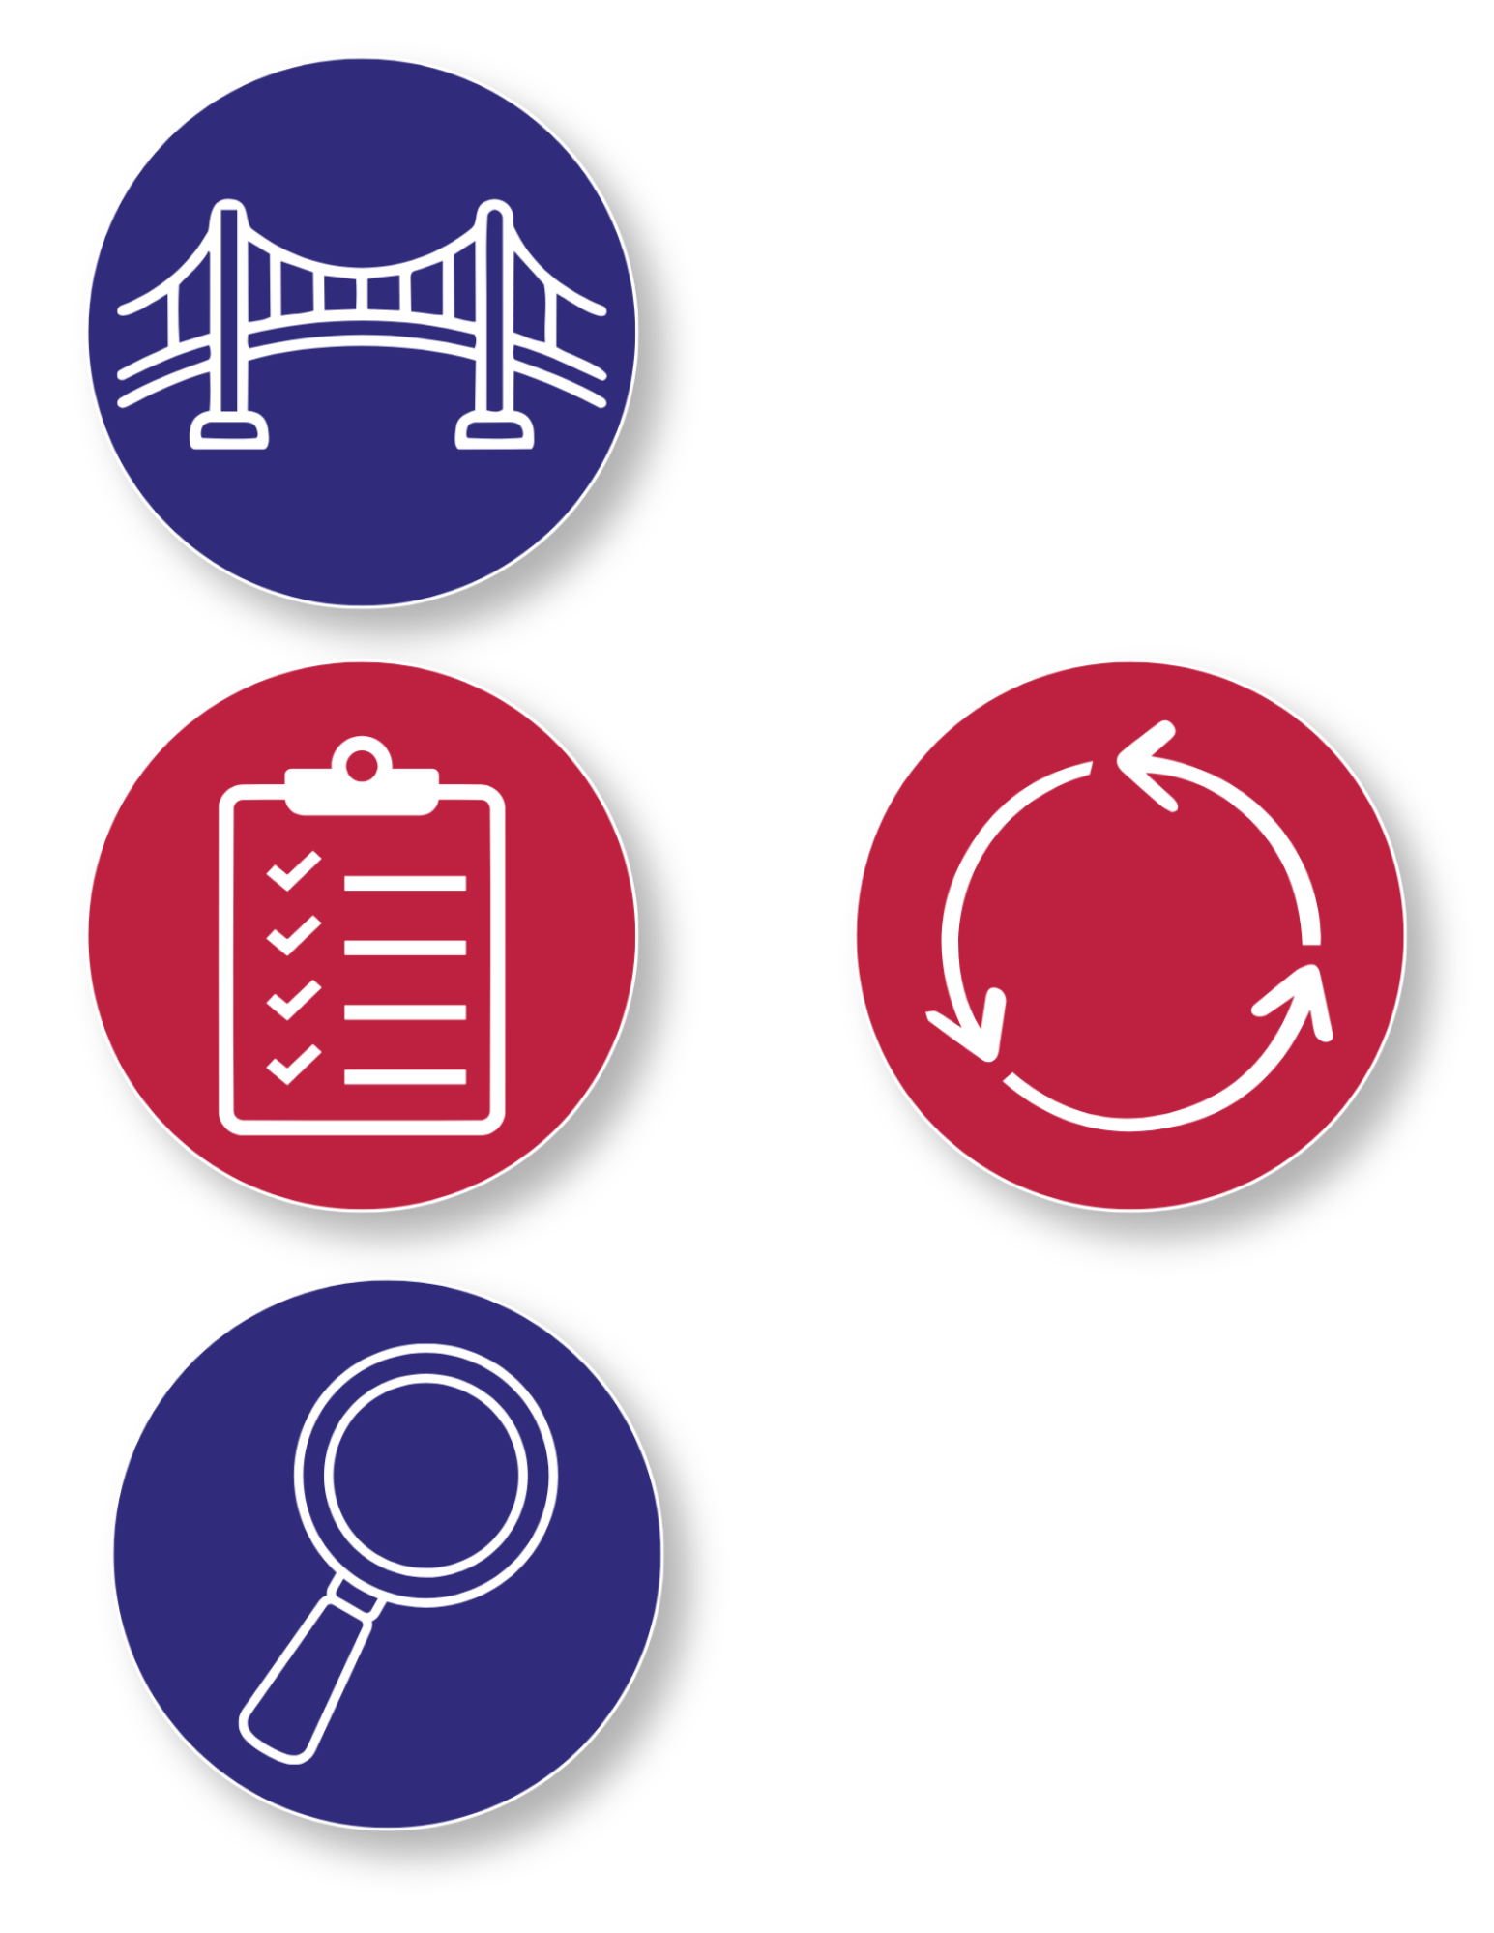
The Foundations of Structural Design
A structure is something that is designed to hold its shape and support weight. How a structure is shaped and how its parts are connected both affect how well it can carry a load.
Designers work within limits called constraints, like only using certain materials or meeting size and strength requirements. These constraints influence the choices they make and force them to think carefully about where material is most effective.
Notes:
A structure is something that is designed to hold its shape and support weight. How a structure is shaped and how its parts are connected both affect how well it can carry a load.
Designers work within limits called constraints, like only using certain materials or meeting size and strength requirements. These constraints influence the choices they make and force them to think carefully about where material is most effective.

Slide 4
The Foundations of Structural Design
When creating a new structure, builders often begin with a prototype, or first version, to test an idea. Testing helps reveal weak spots where a structure may bend, shift, or fail. After testing, designers make targeted changes to improve performance. This process of testing, observing, and making changes is called iteration.
Through iteration, structures can become stronger, more stable, and more efficient—just like in real-world engineering and construction.
Notes:
When creating a new structure, builders often begin with a prototype, or first version, to test an idea. Testing helps reveal weak spots where a structure may bend, shift, or fail. After testing, designers make targeted changes to improve performance. This process of testing, observing, and making changes is called iteration.
Through iteration, structures can become stronger, more stable, and more efficient—just like in real-world engineering and construction.
You are about to use these ideas in the Atlas Box Challenge. Working in teams of three, you will design and build a box that can support a heavy load using limited materials. After testing your box, you will observe how well it holds up and compare it with designs from other teams in the classroom. If your structure bends, shifts, or collapses, you will have a chance to redesign it and test again. By making careful changes and learning from what you see, you will work to create one of the strongest box designs in the room.

Slide 5
Background Info
You are about to use these ideas in the Atlas Box Challenge. Working in teams of three, you will design and build a box that can support a heavy load using limited materials. After testing your box, you will observe how well it holds up and compare it with designs from other teams in the classroom. If your structure bends, shifts, or collapses, you will have a chance to redesign it and test again. By making careful changes and learning from what you see, you will work to create one of the strongest box designs in the room!
Notes:
You are about to use these ideas in the Atlas Box Challenge. Working in teams of three, you will design and build a box that can support a heavy load using limited materials. After testing your box, you will observe how well it holds up and compare it with designs from other teams in the classroom. If your structure bends, shifts, or collapses, you will have a chance to redesign it and test again. By making careful changes and learning from what you see, you will work to create one of the strongest box designs in the room.

Slide 6
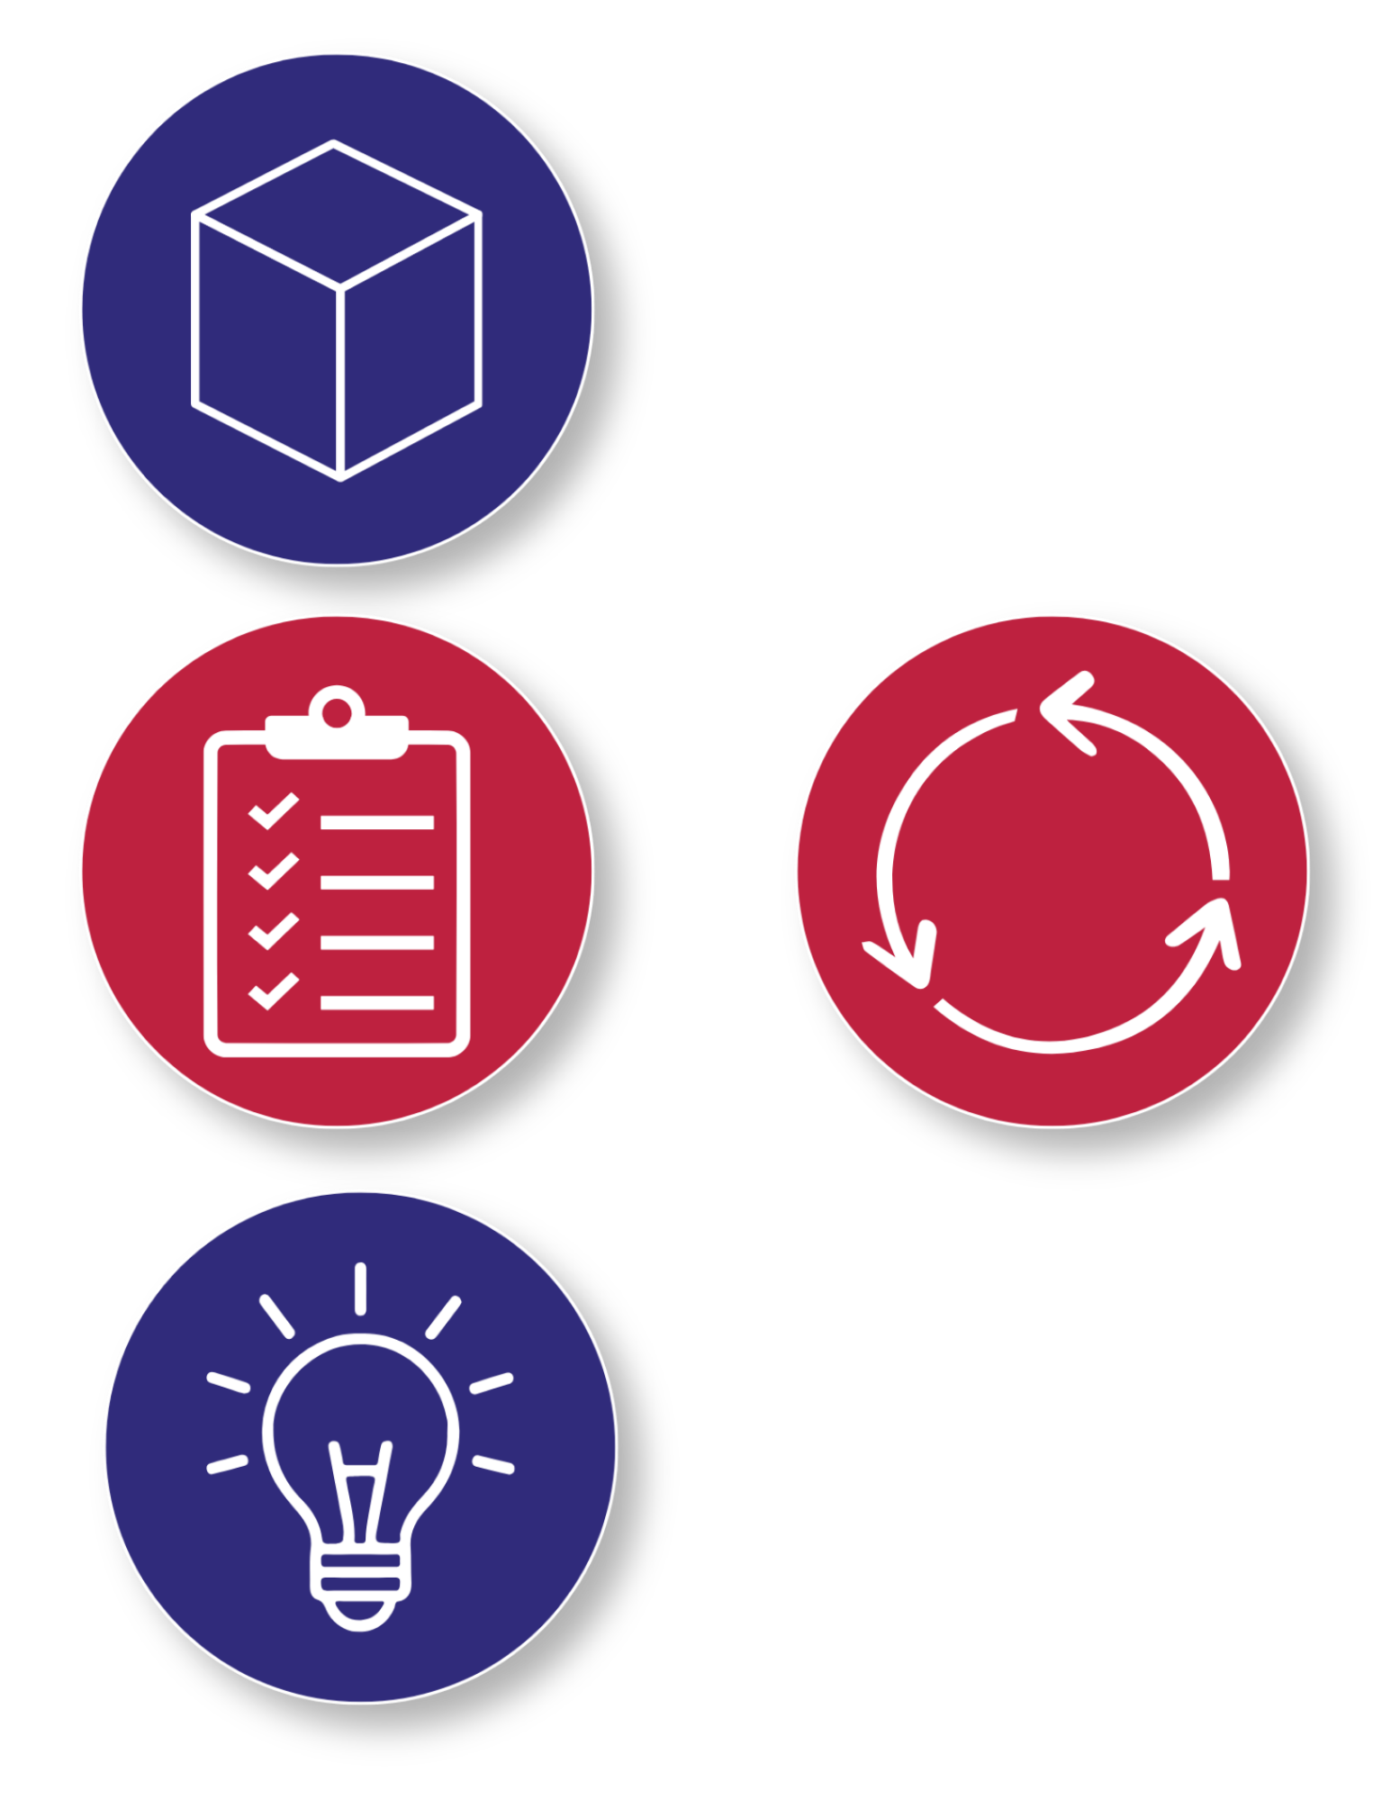
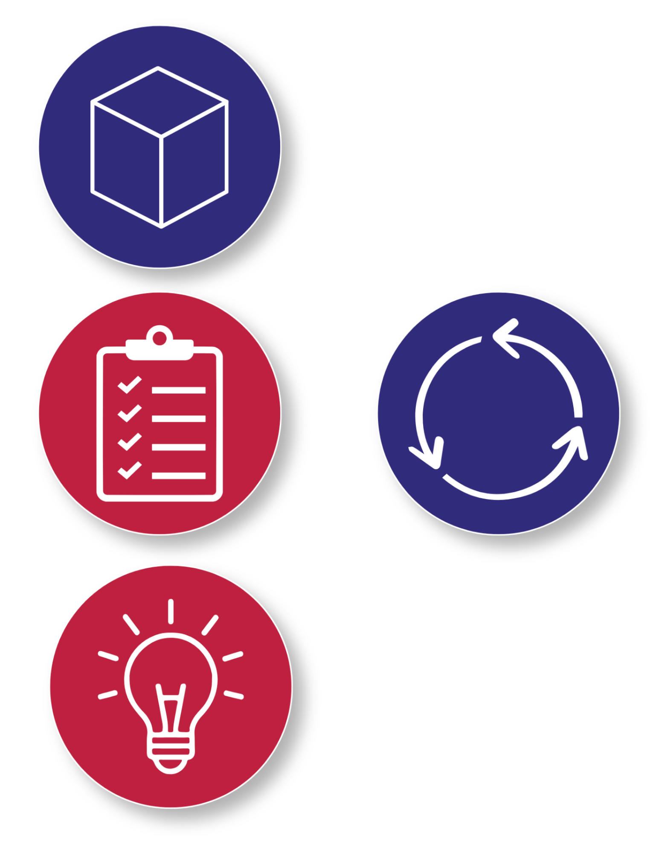
Key Words to Know
Constraints
- Rules and limits that shape how you design and build
Structure
- Something designed to hold its shape and support weight
Prototype
- A first version, or rough draft, used to test an idea
Iteration
- Making changes based on what you learned from testing
Notes:
Constraints - Rules and limits that shape how you design and build
Structure - Something designed to hold its shape and support weight
Prototype - A first version, or rough draft, used to test an idea
Iteration - Making changes based on what you learned from testing

Slide 7
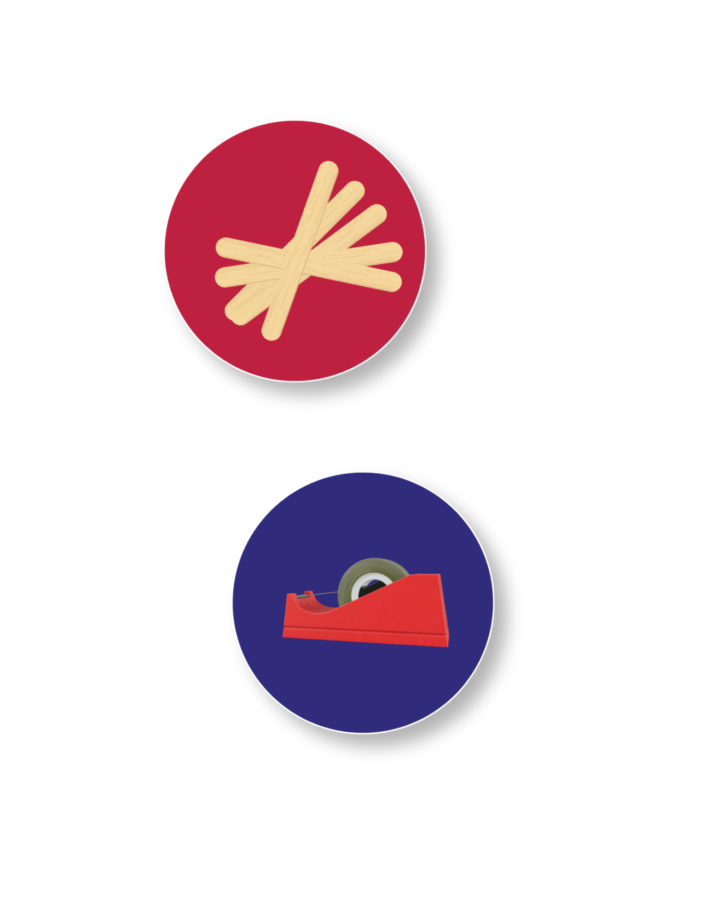
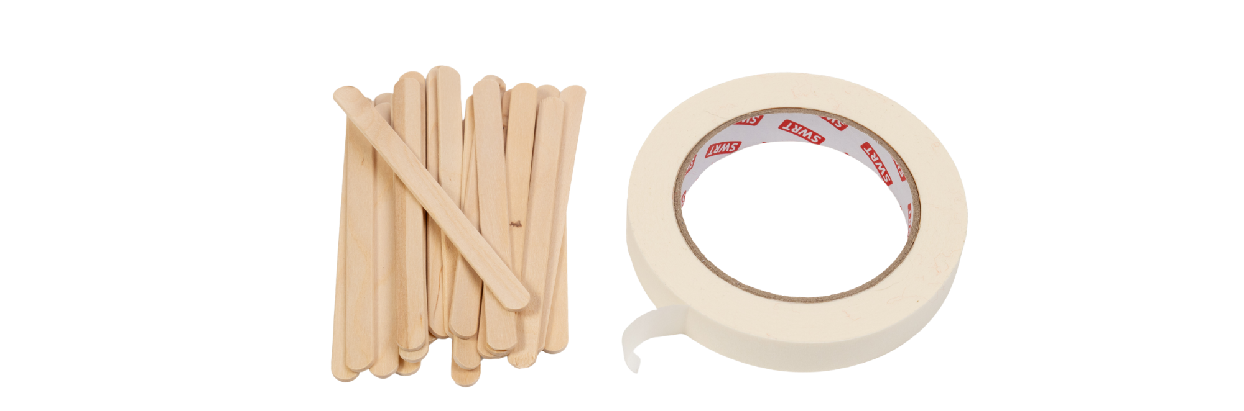
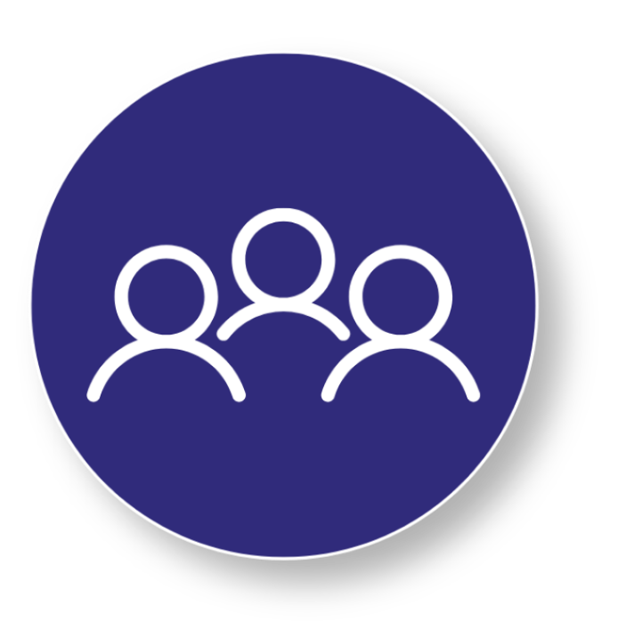
Today’s Materials
Craft Sticks
Masking Tape
Your Challenge:
Working in teams, you'll design and test a load-bearing box using limited materials. Analyze your results, compare your design with other teams, and use iteration to improve your structure's performance.

Slide 8
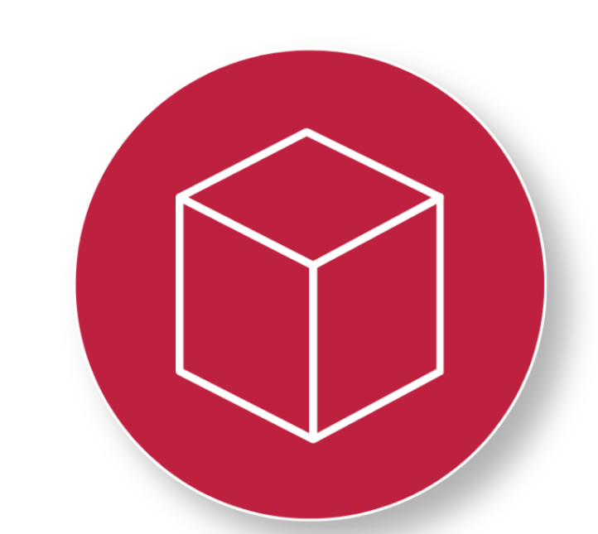
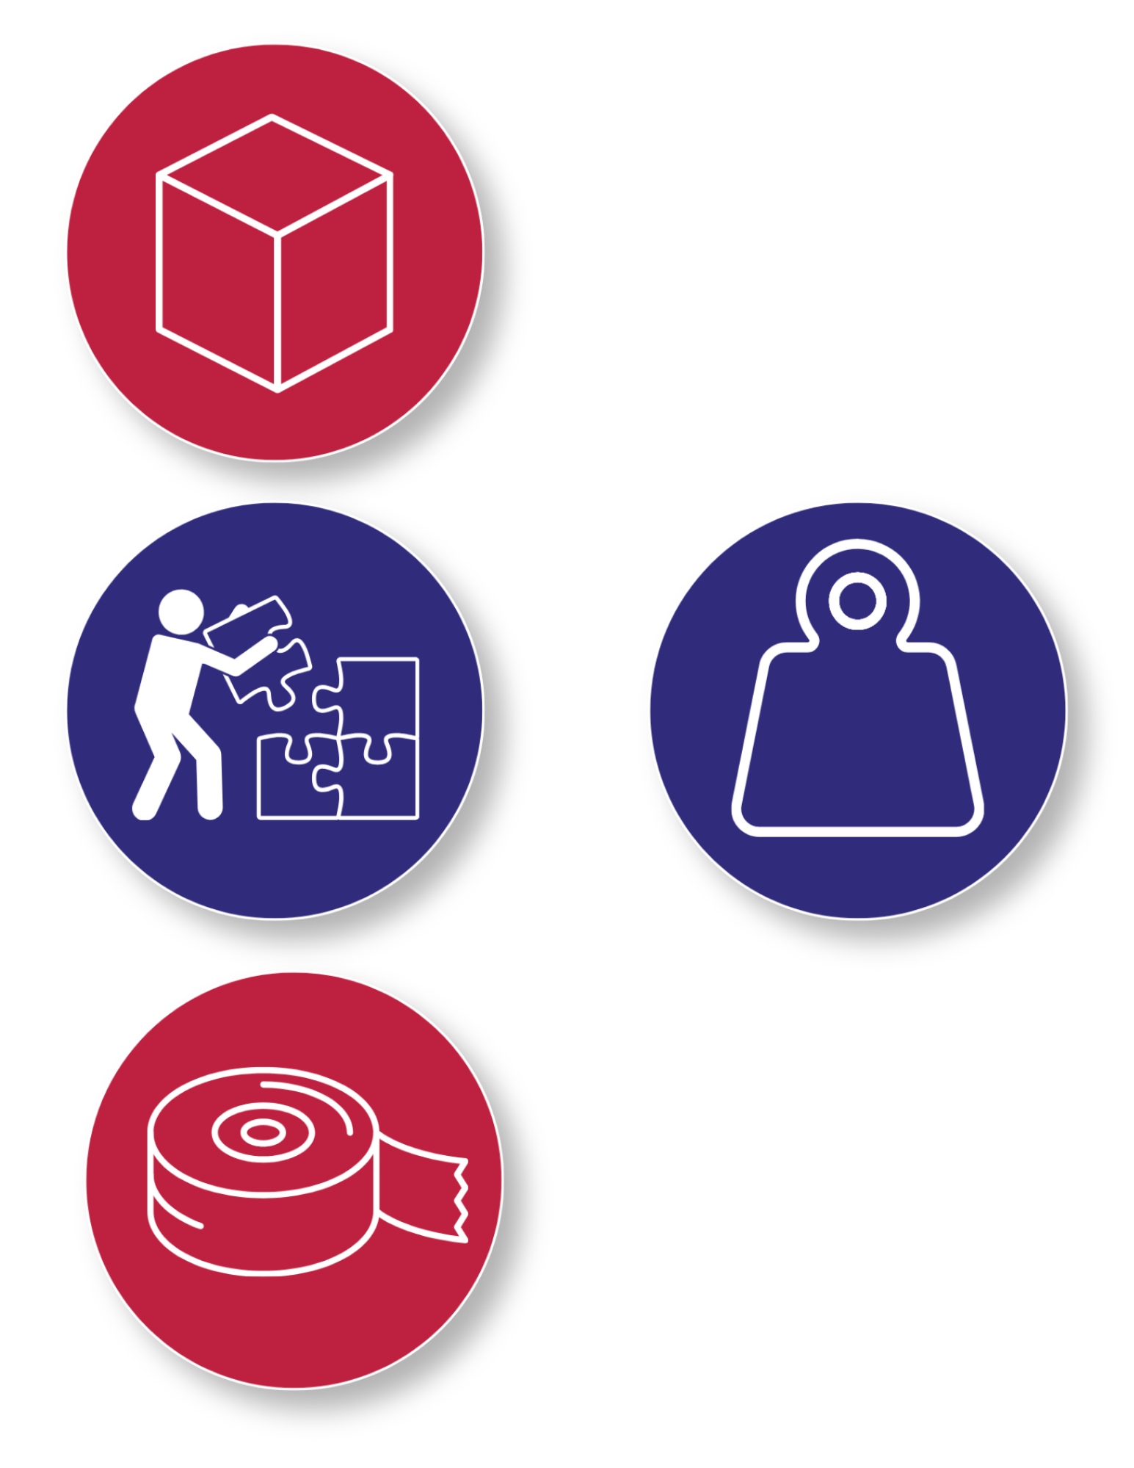

Step 1
Today’s Constraints
What are Today’s Constraints?
The structure must be in the shape of a cube
Students must build their first structure only using 20 craft sticks
Individual pieces of tape used to connect craft sticks should be no larger than one's thumb ​
The strength of an Atlas Box should be tested by placing the same weighted object on top of each box
Reminder:
Constraints help engineers create smart, strong, and innovative designs with the materials they have!

Slide 9
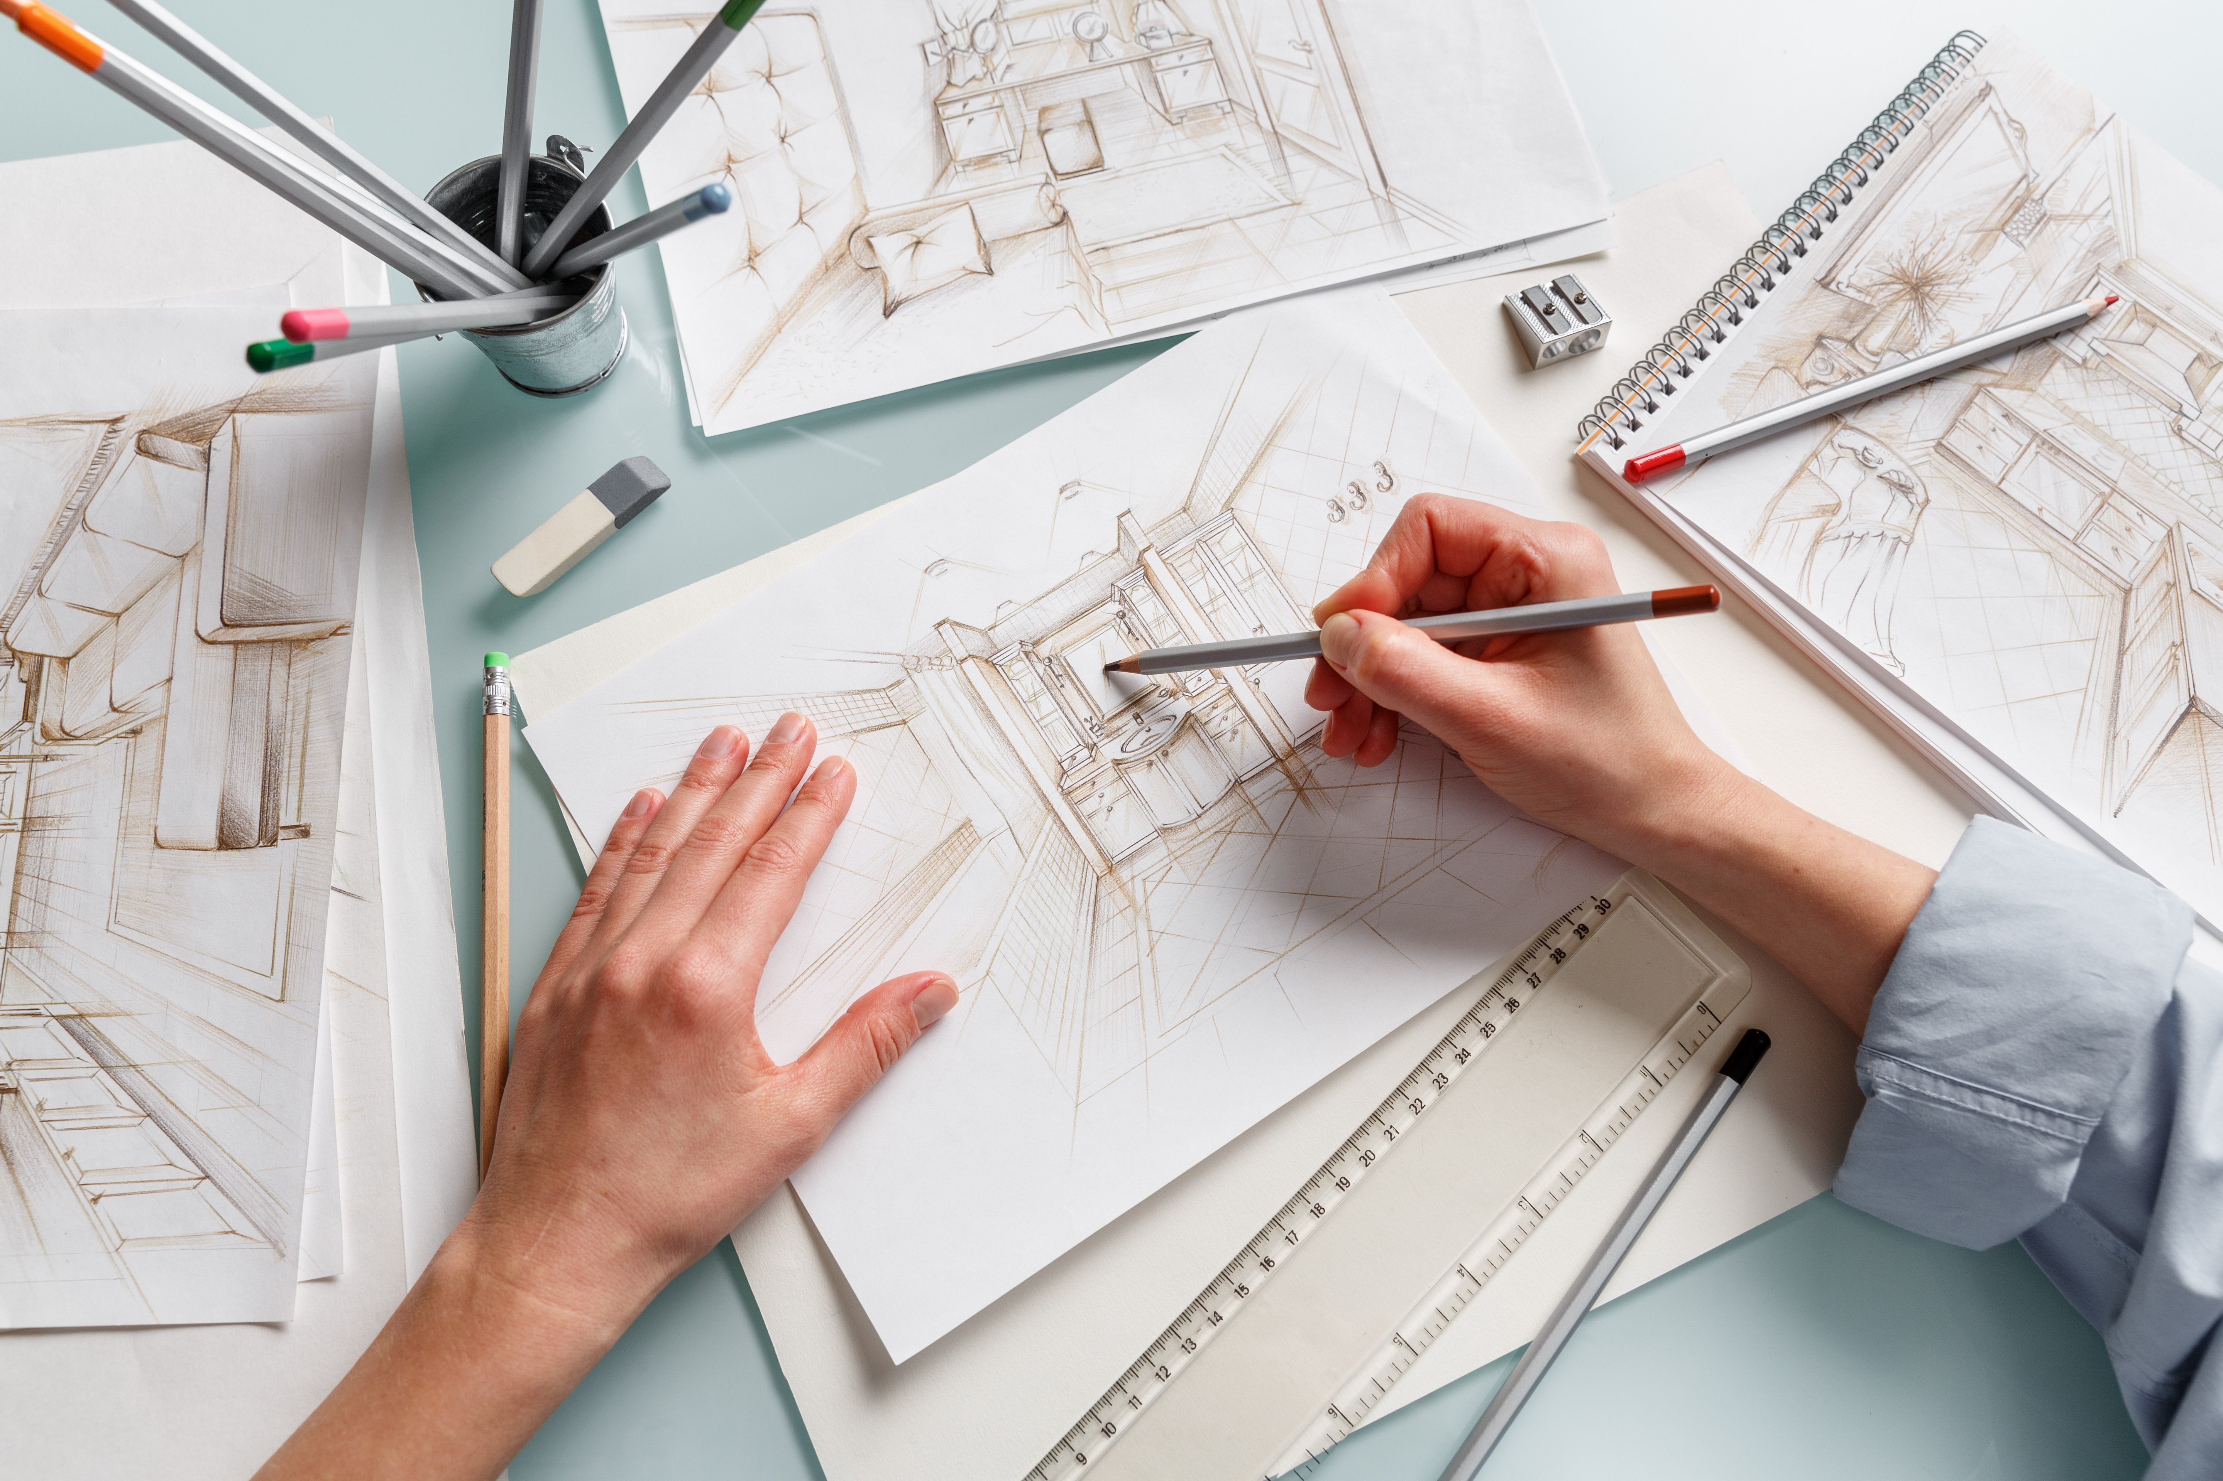
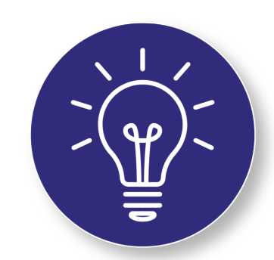
Step 2
Plan a Prototype
Working in teams of three, students should use pencil and paper to create a simple sketch of their Atlas Box plan.
Plans should show an understanding of the constraints.
Reminder:
Constraints help engineers create smart, strong, and innovative designs with the materials they have!
Notes:
Plan a Prototype
Working in teams of three, students should use pencil and paper to create a simple sketch of their Atlas Box plan
Plans should show an understanding of the constraints

Slide 10
Step 3
Build and Test the Prototype
1
Students should build their prototype using 20 craft sticks and the constraints from Step 1. ​
1
Once their box is complete, each structure is tested by placing a heavy load on top, such as a textbook or a pack of computer paper.
2
Students are encouraged to watch as other groups test their Atlas Boxes to think about what worked, and what did not.
3
Use your observations to prepare for the final step- Iterate and Redesign!
3
Notes:
Build and Test the Prototype
Students should build their prototype using 20 craft sticks and the constraints from step 1 ​
Once their box is complete, each structure is tested by placing a heavy load on top, such as a textbook or a pack of computer paper ​
Students are encouraged to watch as other groups test their Atlas Boxes to think about what worked, and what did not

Slide 11

Step 4
Iterate and Redesign
After testing, identify strengths and areas of weakness in the first Atlas Box design ​
Based on these observations, teams may redesign their Atlas Box using all 30 of the provided craft sticks in preparation for additional tests
Notes:
Iterate and Redesign ​
After testing, identify strengths and areas of weakness in the first Atlas Box design ​
Based on these observations, teams may redesign their Atlas Box using all 30 of the provided craft sticks in preparation for additional tests

Slide 12
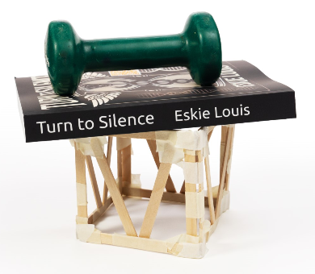
You just created an Atlas Box.

Slide 13


Turn and Talk Time!
Questions to Consider
Which groups made a box that could hold a lot of weight?
Talk about the design of those boxes.
What was different?
What was the same?
Tip:
Listening to others helps us learn new ideas and improve our own designs!
Notes:
Turn and Talk Time!
Which groups made a box that could hold a lot of weight?
Talk about the design of those boxes. What was different? What was the same?

Slide 14

Wrap Up!
What Careers Did We Explore Today?
Construction Workers and Builders follow plans and constraints to assemble strong structures. They pay close attention to joints, supports, and stability to make sure structures hold up over time. ​
Structural Engineers design buildings, bridges, and towers that must support heavy loads while using limited materials. They test designs and make changes to improve strength and safety.
Notes:
​
Construction Workers and Builders follow plans and constraints to assemble strong structures. They pay close attention to joints, supports, and stability to make sure structures hold up over time ​
​
Structural Engineers design buildings, bridges, and towers that must support heavy loads while using limited materials. They test designs and make changes to improve strength and safety

