Slide 1




Activity Overview
Additive Adventures

Slide 2


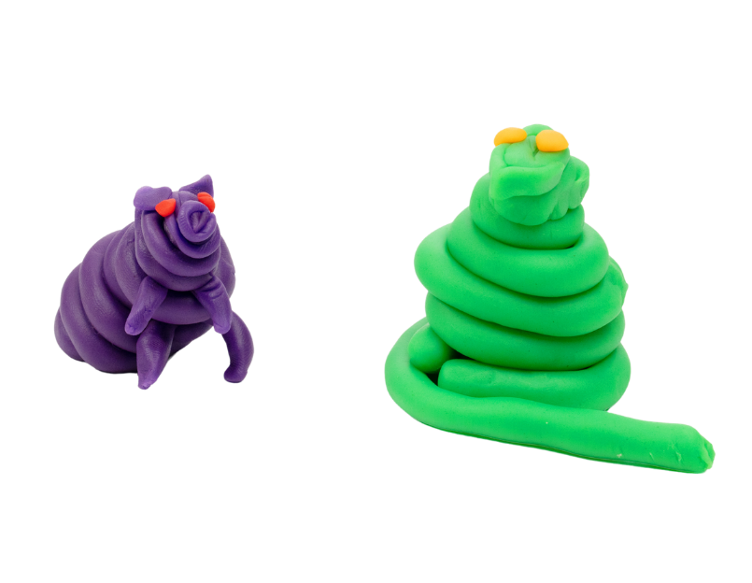

Additive Adventures

Slide 3
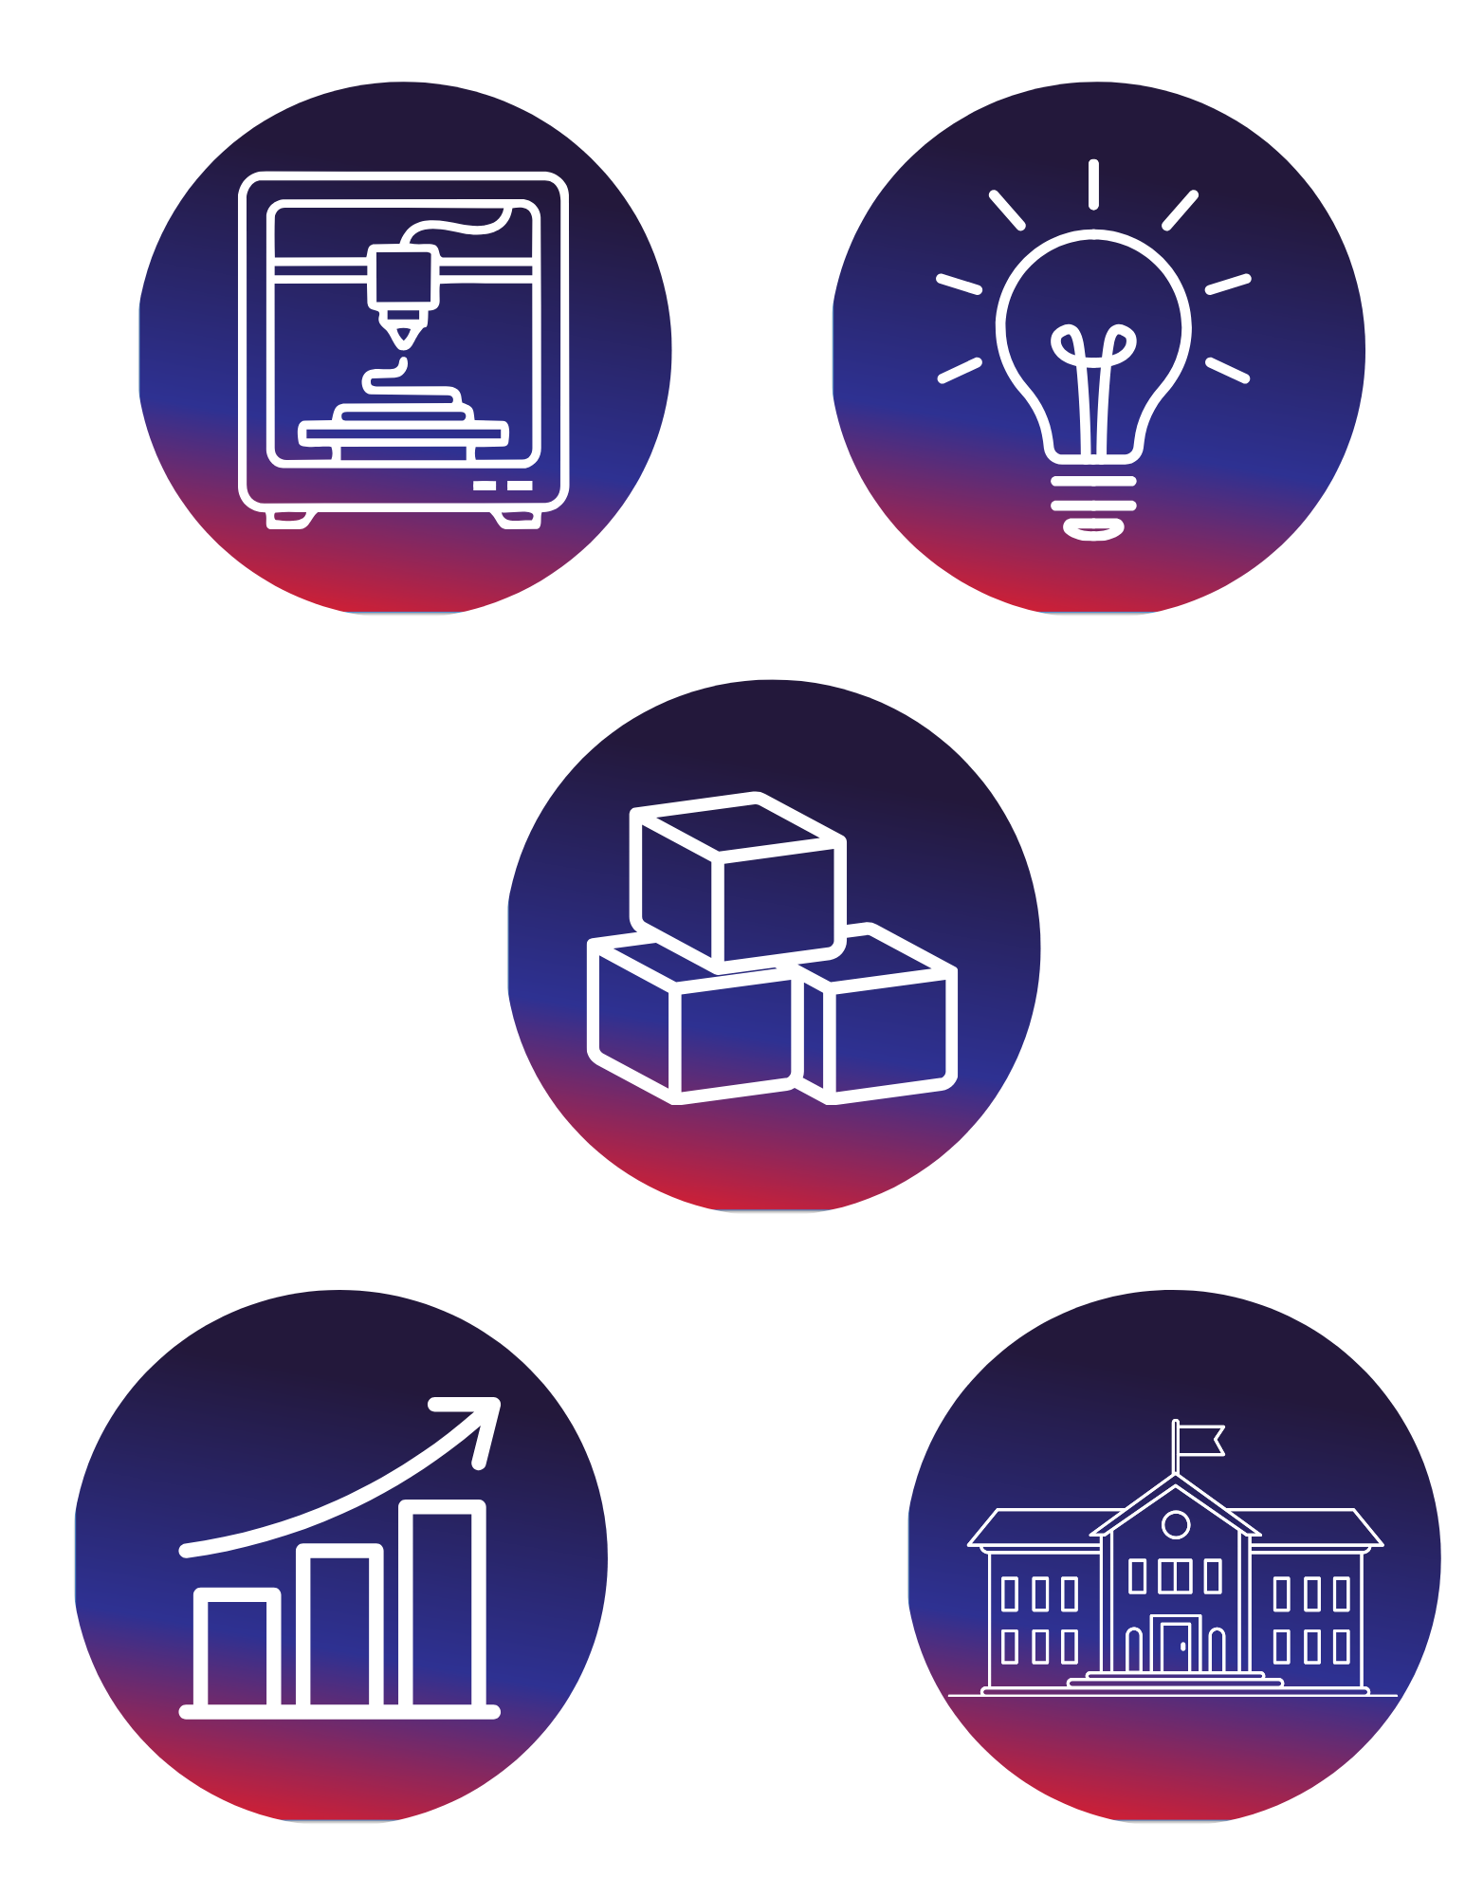
Why Do We Use Additive Manufacturing?
Have you ever stacked blocks to build something tall? That’s how many modern products are made today. Instead of carving something from a large piece, some builders use a process called additive manufacturing. This means building something by adding one thin layer at a time.
3D printers work this way. They follow a design and place tiny layers of material on top of each other until the object is complete.
Today, you will become a 3D printer. You will roll out thin layers and stack them to build your own object. Just like real builders, you’ll follow a plan, build step-by-step, and see how your design comes together.
Notes:
Have you ever stacked blocks to build something tall? That’s how many modern products are made today. Instead of carving something from a large piece, some builders use a process called additive manufacturing. This means building something by adding one thin layer at a time. 3D printers work this way. They follow a design and place tiny layers of material on top of each other until the object is complete.
Today, you will become a 3D printer. You will roll out thin layers and stack them to build your own object. Just like real builders, you’ll follow a plan, build step-by-step, and see how your design comes together.
Why do we use additive manufacturing?
People use additive manufacturing to create shapes that are hard, or even impossible to make with traditional tools. With additive manufacturing, you can build:
Toys and figures
Phone stands, and tools
Machine parts
Medical devices
And even full-sized houses and bridges

Slide 4

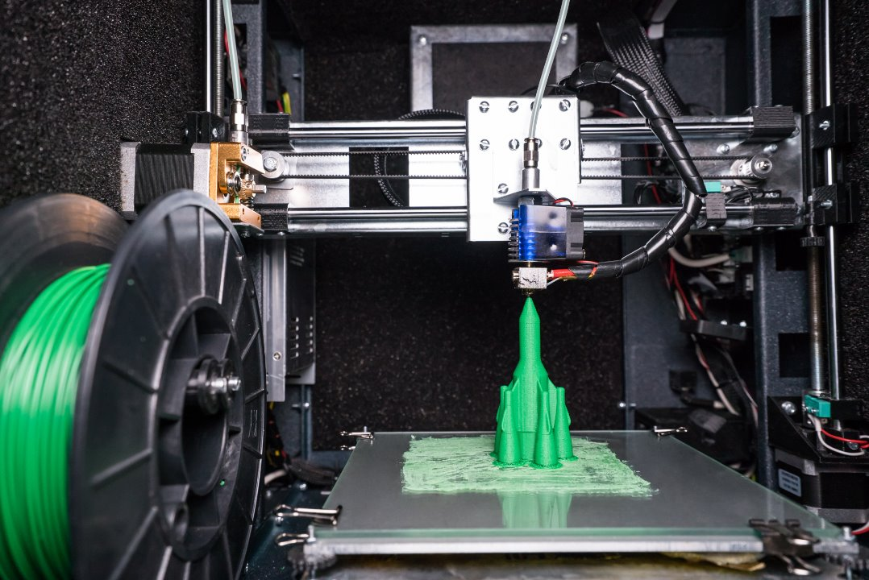
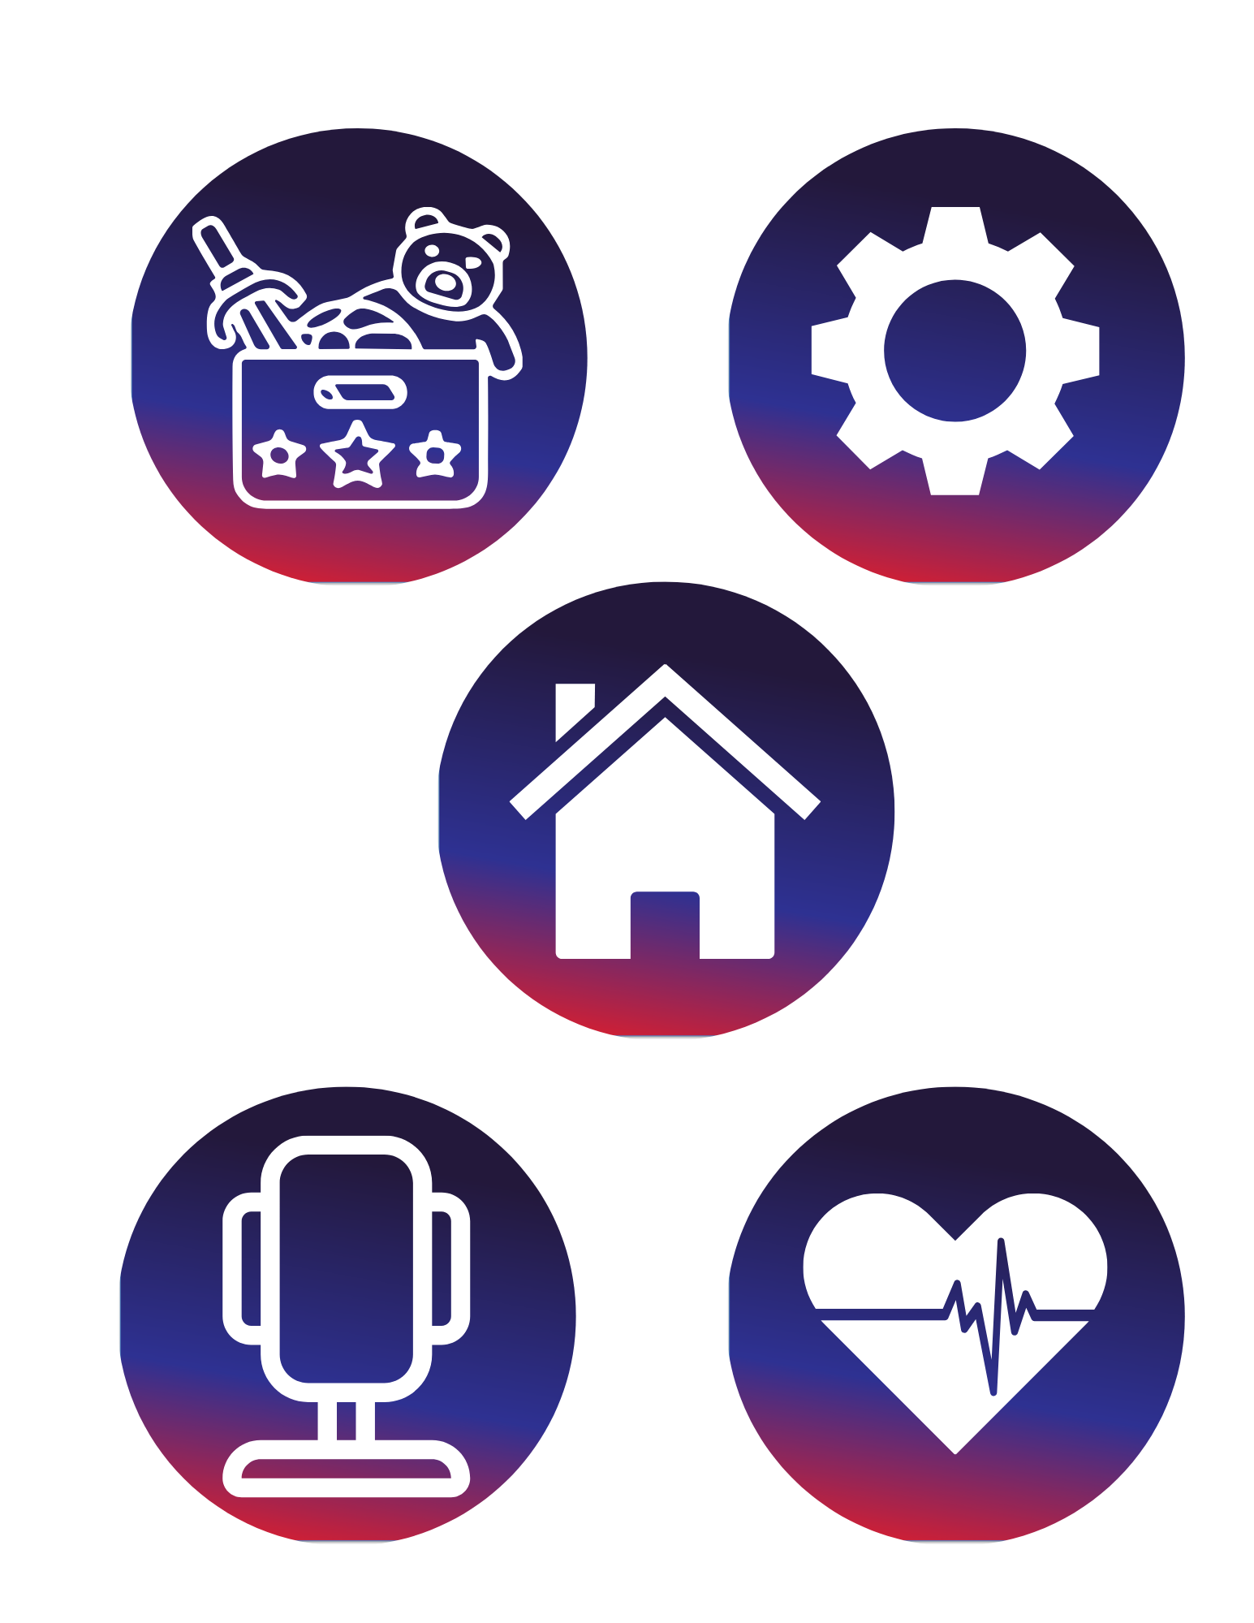
Why Do We Use Additive Manufacturing?
With additive manufacturing you can build:
Toys and figures
Phone stands and tools
Houses and bridges
Medical devices
Machine parts
Notes:
Why do we use additive manufacturing?
People use additive manufacturing to create shapes that are hard, or even impossible to make with traditional tools. With additive manufacturing, you can build:
Toys and figures
Phone stands, and tools
Machine parts
Medical devices
And even full-sized houses and bridges

Slide 5
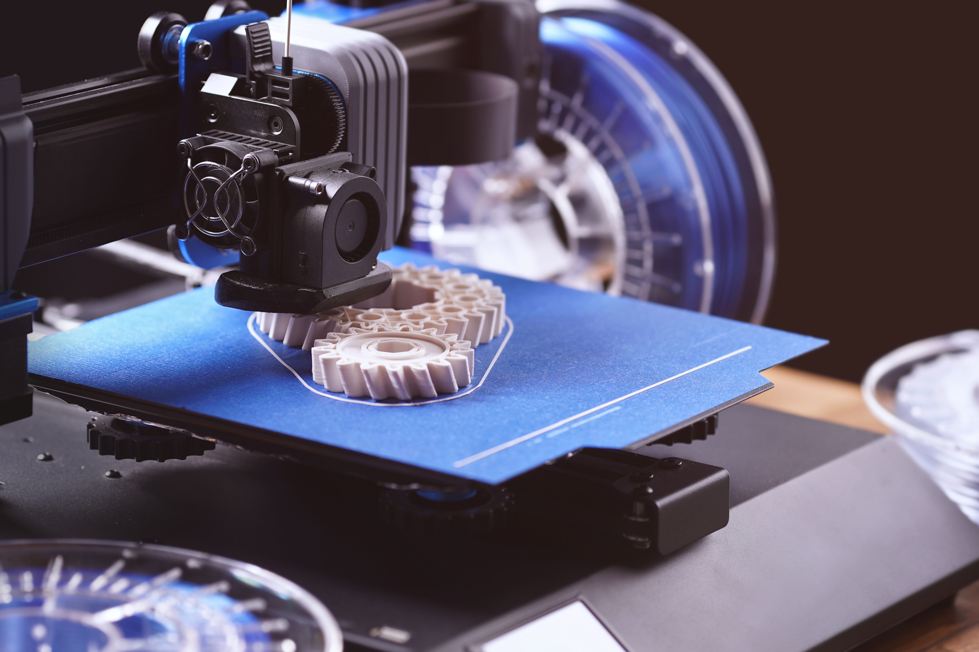
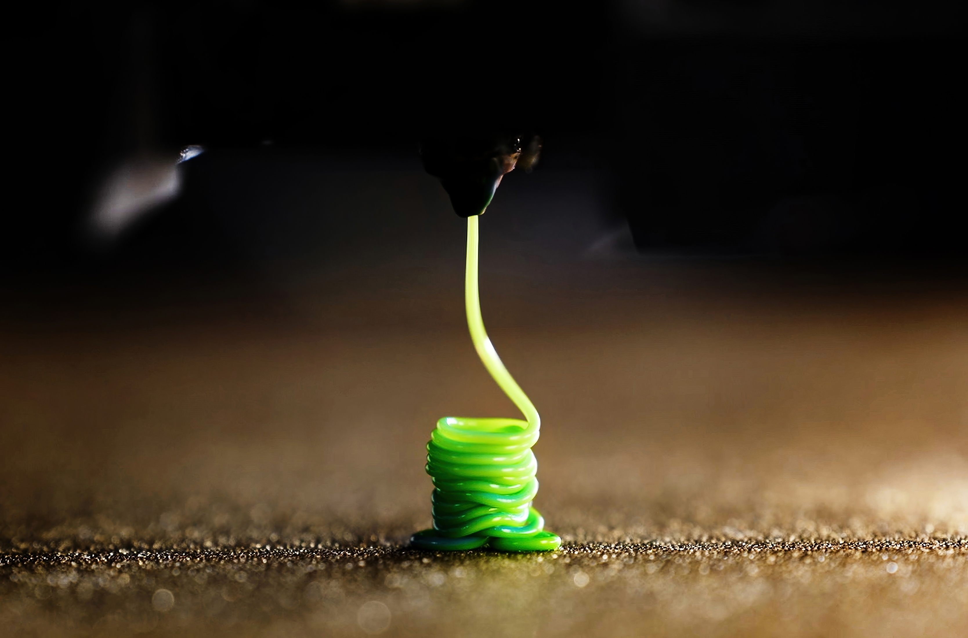

Key Words to Know
Additive
Manufacturing
Layer
Additive Manufacturing
Building something one layer at a time
Layer
A thin, flat piece of material added to the top of another to create a 3D shape
Design
A flat surface that helps guide motion and keep an object moving in a straight direction
Precision
Making something carefully so it matches the intended shape
Precision
Design
Notes:
Additive manufacturing: Building something one layer at a time
Layer: A thin, flat piece of material added to the top of another to create a 3D shape
Design: A plan or drawing that shows how something will look before it is built
Precision: Making something carefully so it matches the intended shape

Slide 6
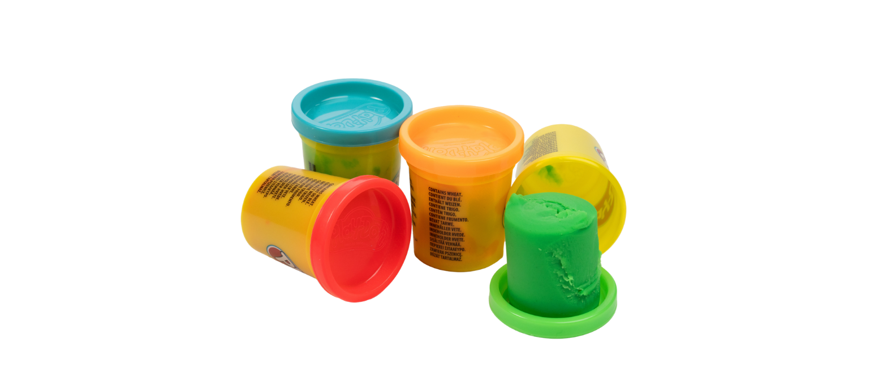


Today’s Materials
One container of play dough
Get Ready to Create!
Use what you learned about additive manufacturing and the keywords: layer, design, and precision to create your vision!

Slide 7
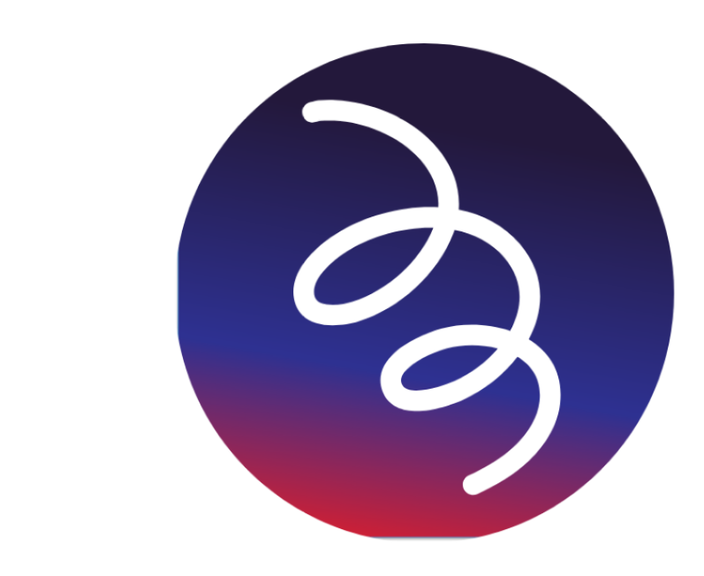
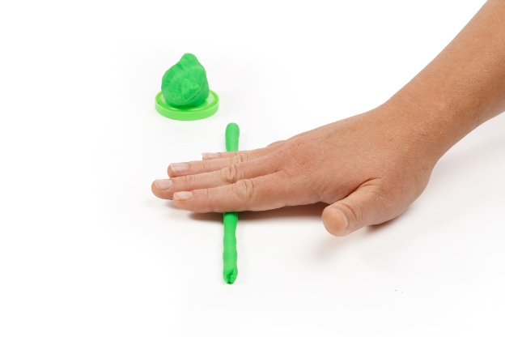

Step 1
Build the Coiled Body
Roll a long, thin line of play dough.
TIP:
Roll with gentle, even pressure to keep your line smooth and even.
Ready to Build!
Roll your play dough line to start creating your creature!
Notes:
Part 1: Build the Coiled Body
Step 1: Roll a long, thin line of play dough

Slide 8
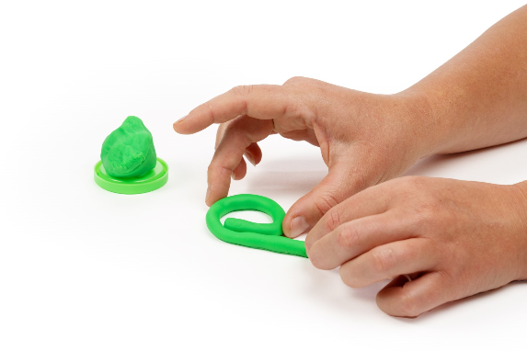
Step 2
Create the Body
Coil it into a shape on the table. Slowly curve it around into a shape that looks like the number 9 or the letter P ​
TIP:
Slowly curve it around into a shape that looks like the number 9 or the letter P.
Great Job!
You have coiled the body of your creature! Let’s keep building!
Notes:
Step 2: Coil it into a shape on the table. Slowly curve it around into a shape that looks like the number 9 or the letter P ​

Slide 9
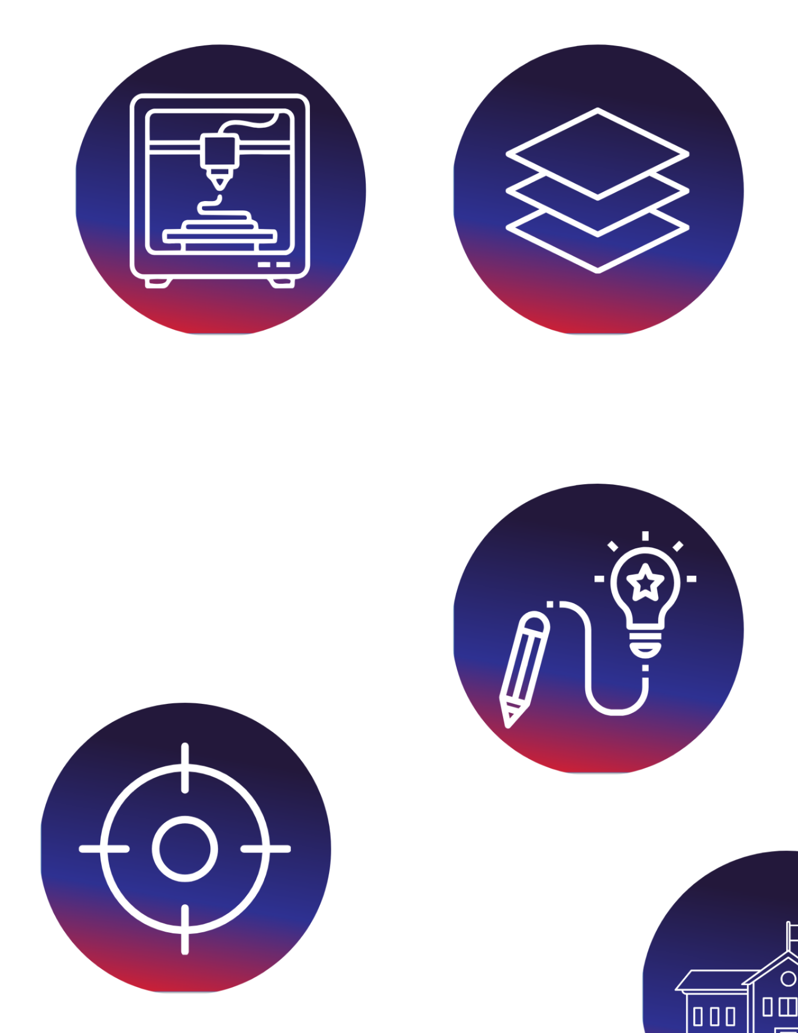
Step 3
Layers!
Roll another thin line and place it on top.
TIP:
Press lightly to ensure that the layers stick together.
Build Strong Layers!
Pressing gently helps the layers stick together, keeping your shape srong.
Notes:
Roll another thin line and place it on top. Press lightly to make sure that the layers stitch together

Slide 10
Step 4
Stack!
Continue stacking letters to build height.
TIP:
Repeat step 3 as many times as desired to build a taller, thicker snake body
Notes:
Continue stacking letters to build height. Repeat step 3 as many times as desired to build a taller, thicker snake body

Slide 11
Step 5
Keep Building!
Form the head shape by rolling out another short layer line.
TIP:
Coil it into a tight spiral, like a cinnamon roll. This should be a little smaller than the body.
Notes:
Form the head shape by rolling out another short layer line. Coil it into a tight spiral, like a cinnamon roll. This should be a little smaller than the body.

Slide 12
Step 6
Layering
Continue adding layers to the head. Repeat step 5 a couple more times with slightly shorter layer lines so that you end up with a small half-dome shape for the head.
TIP:
Repeat step 3 as many times as desired to build a taller, thicker snake body
Big Idea
This is how 3D printers build round shapes: lots of small, shrinking layers- you are working like a 3D printer!
Notes:
Continue adding layers to the head. Repeat step 5 a couple more times with slightly shorter layer lines so that you end up with a small half-dome shape for the head. This is how 3D printers build round shapes: lots of small, shrinking layers

Slide 13
Step 7
Finishing Touches
Add the eyes and tongue.
TIP:
Roll two tiny balls of a different color and press them onto the head. Roll out a tiny layer line and flatten it to create a tongue, then press it into the snake's head
Notes:
Add the eyes and tongue. Roll two tiny balls of a different color and press them onto the head. Roll out a tiny layer line and flatten it to create a tongue, then press it into the snake's head

Slide 14
Step 8
Final Step
Attach the head.
TIP:
Press the bottom of the head onto the coiled body. Your snake is now complete!
Great Job!
You built your snake just like a 3D printer- layer by layer!
Notes:
Attach the head. Press the bottom of the head onto the coiled body. Your snake is now complete and built much like a 3D printer would do it –layer by layer!

Slide 15
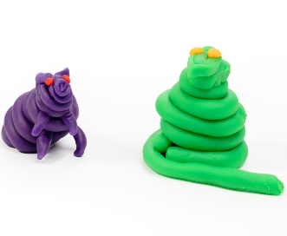
You just created a 3D layered snake.

Slide 16
Now it’s FREE BUILD TIME!
Here are some things to think about as you build:
Layers can’t float on air:
Every new layer must sit on top of the layer below it. If nothing is underneath, the layer will fall or stretch out, just like a real 3D printer.
Use shapes that get smaller as they get taller:
Cones, pyramids, hills, towers, volcanoes, and animals with wide bases all work best.
Keep layers thin and even. Thick layers are harder to shape, control, and stack.
Uneven layers produce wobbly or lopsided prints.
A little pressure keeps things stable but too much pressure squishes the whole shape.
​
Notes:
Layers can’t float on air: Every new layer has to sit on top of the layer below it. If nothing is underneath, the layer will fall or stretch out, just like a real 3D printer. ​
Use shapes that get smaller as they get taller ​
Cones, pyramids, hills, towers, volcanoes, and animals with wide bases all work best ​
Keep layers thin and even ​
Thick layers are harder to shape, control, and stack ​
Uneven layers are wobbly or lopsided prints ​
A little pressure keeps things stable but too much pressure squishes the whole shape

Slide 17
Turn and
TALK TIME
Did any part collapse, warp, or stretch? What might have caused that?
What challenges did you run into while building your layers?
What decisions did you make before you started building?
If you were to redesign your object, what would you change about the shape or layers?
Notes:
What decisions did you make before you started building?
If you were to redesign your object, what would you change about the shape or layers?
What challenges did you run into while building your layers?
Did any part collapse, warp, or stretch? What might have caused that?

Slide 18

Career Exploration
Engineers use additive manufacturing to design tools, machine parts, airplanes, cars, and robots. They must carefully plan the shape, size, and structure of every layer so the finished product is strong and accurate.
Some construction workers and architects use 3D printing to build walls, homes, and bridges. Just like in this activity, these men and women print layer on top of layer, but with concrete instead of clay.
Toy and product designers use 3D printing to create new toys, action figures, board game pieces, phone accessories, and product prototypes before they are mass-produced.
Notes:
Engineers use additive manufacturing to design tools, machine parts, airplanes, cars, and robots. They must carefully plan the shape, size, and structure of every layer so the finished product is strong and accurate.
Some construction workers and architects use 3D printing to build walls, homes, and bridges. Just like in this activity, these men and women print layer on top of layer, but with concrete instead of clay.
Toy and product designers use 3D printing to make new toys, action figured, board game pieces, phone accessories, and prototypes of products before they are mass-produced.

