Slide 1




Activity Overview
Air-Powered Car

Slide 2

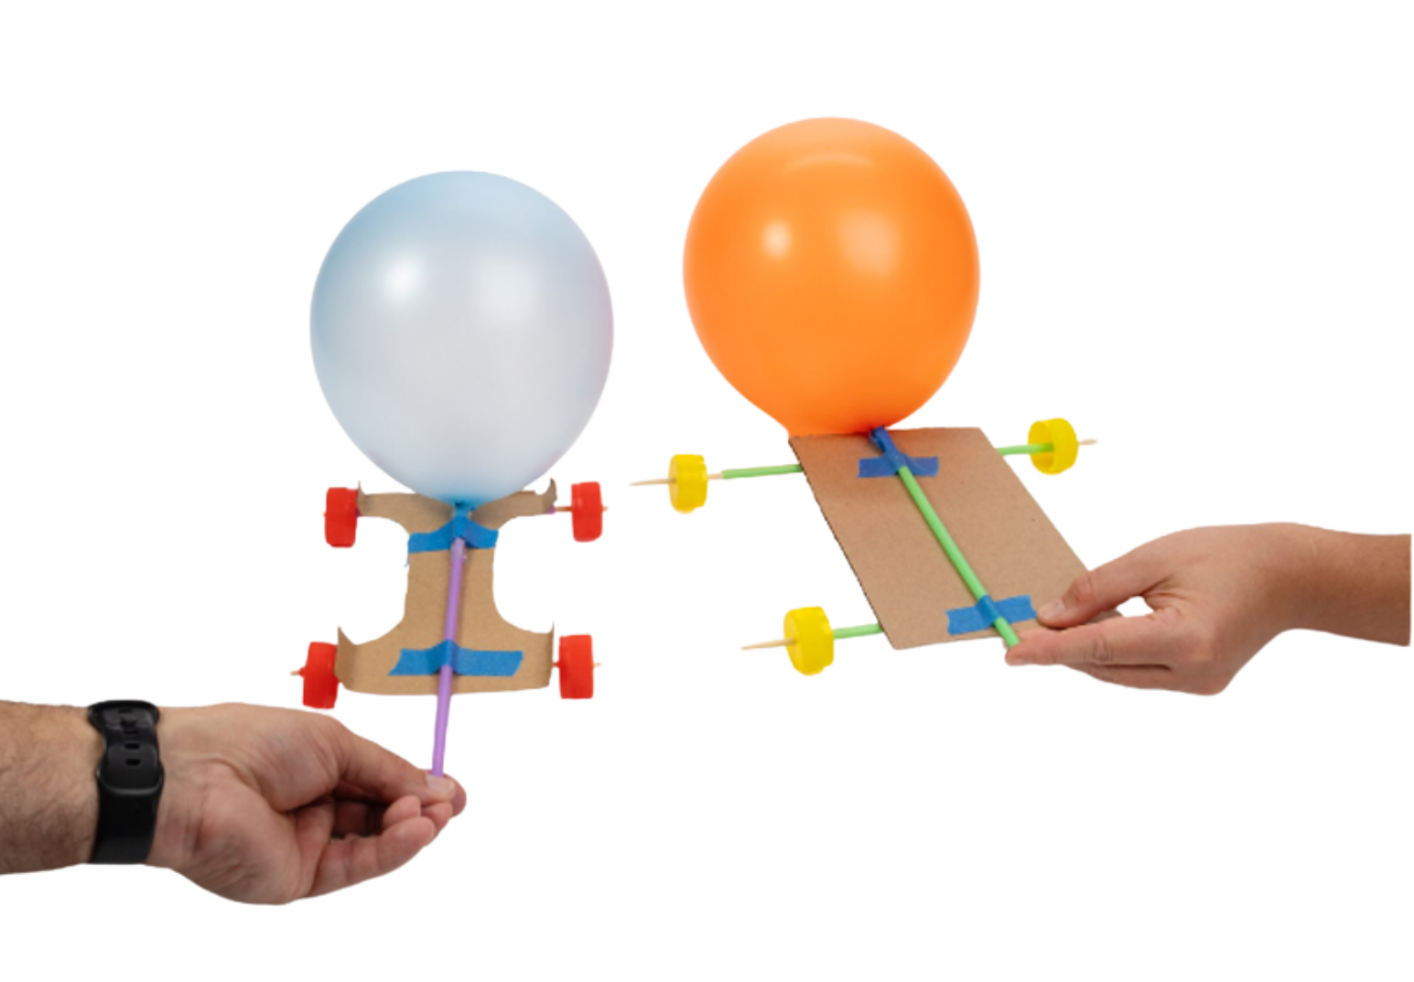


Air-Powered Car

Slide 3

Foundations of Energy
When the balloon is released, the air rushes out. As the car starts to roll, the energy changes into movement.
Motion doesn’t happen by itself. Something has to cause an object to move.
When air is blown into a balloon, the balloon holds energy. This stored energy is called potential energy. The balloon is not moving yet, but it is ready to do something.
Moving energy is called kinetic energy.
The air pushing out of the balloon gives the car a push that makes it move forward.
Think Like an Engineer
Engineers understand how energy works so they can design solutions that make things move, work, and improve our world!
Notes:
Motion doesn’t happen by itself. Something has to cause an object to move.
When air is blown into a balloon, the balloon is holding energy. This stored energy is called potential energy. The balloon is not moving yet, but it is ready to do something.
When the balloon is released, the air rushes out. As the car starts to roll, the energy changes into movement.
Moving energy is called kinetic energy.
The air pushing out of the balloon gives the car a push that makes it move forward.

Slide 4
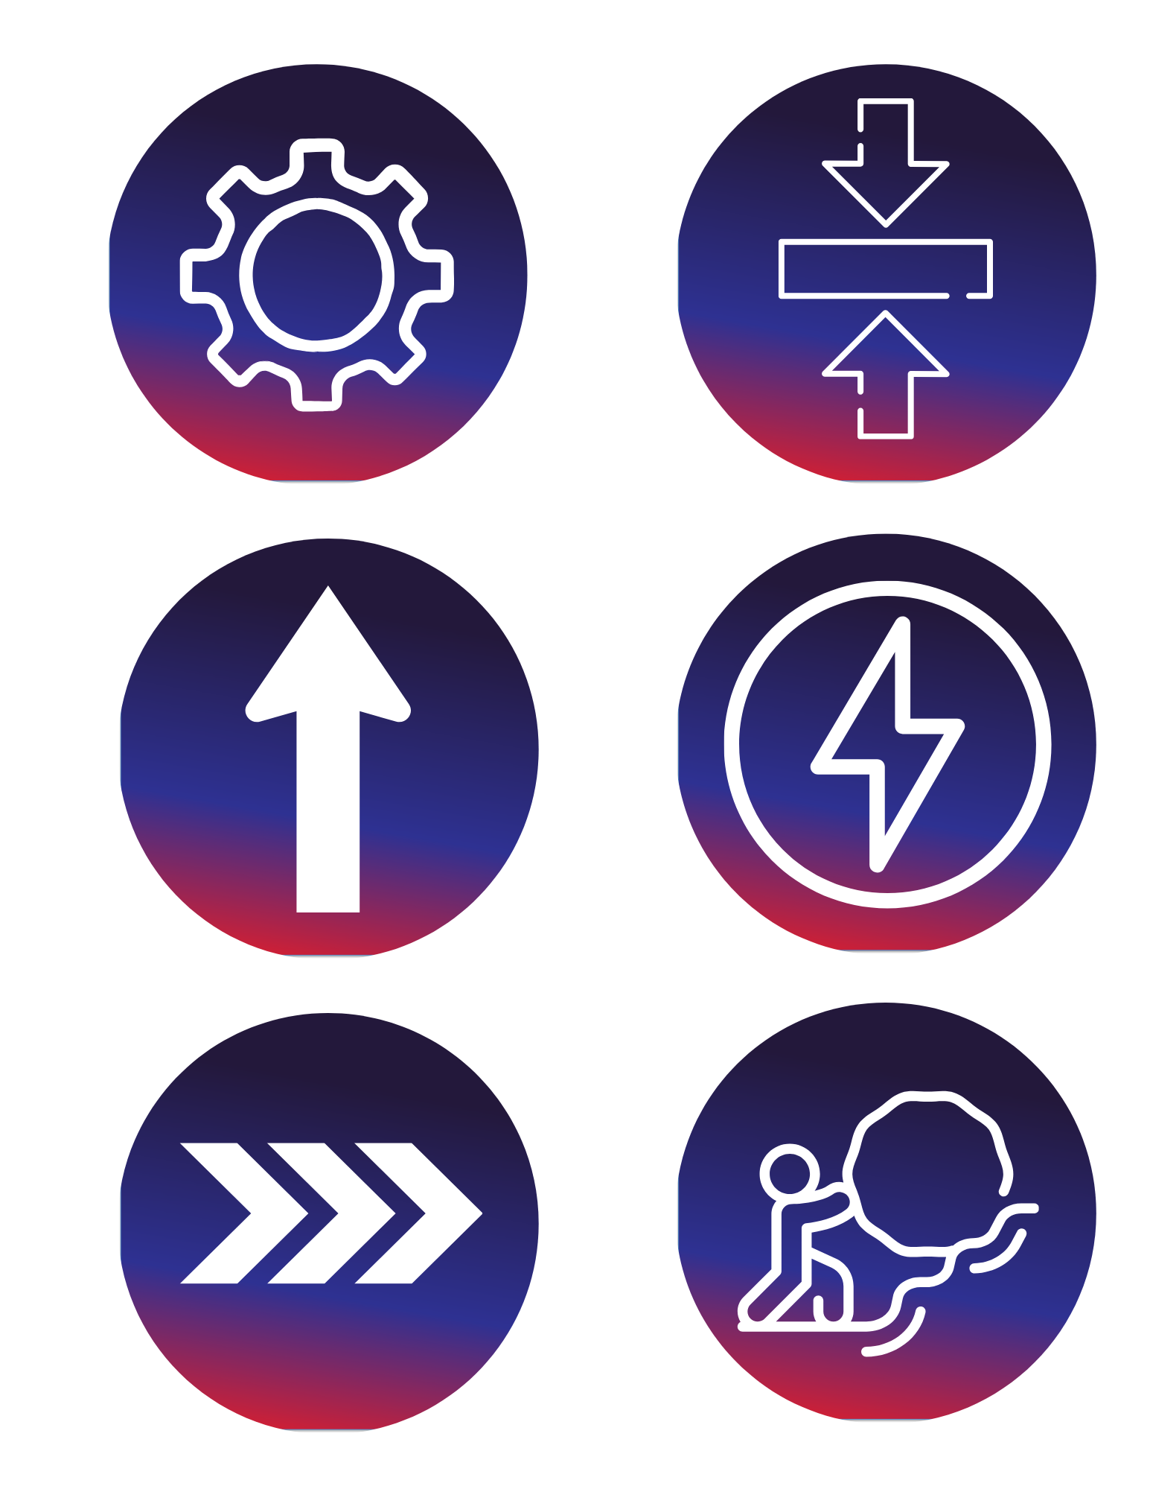
Key Words to Know
Potential Energy
Energy that is stored and ready to be used. The air inside
the balloon is stored energy.
Kinetic Energy
Energy of motion. When your car is rolling, it is
using kinetic energy.
Force
A push or pull that makes something move. The air escaping from a balloon creates a force.
Straight
Lined up in a direct path. Keeping parts straight helps your car move forward instead of turning.
Notes:
Potential Energy: Energy that is stored and ready to be used. The air inside the balloon is stored energy.
Kinetic Energy: Energy of motion. When your car is rolling, it is using kinetic energy.
Force: A push or pull that makes something move. The air escaping from a balloon creates a force.
Straight: Lined up in a direct path. Keeping parts straight helps your car move forward instead of turning.

Slide 5
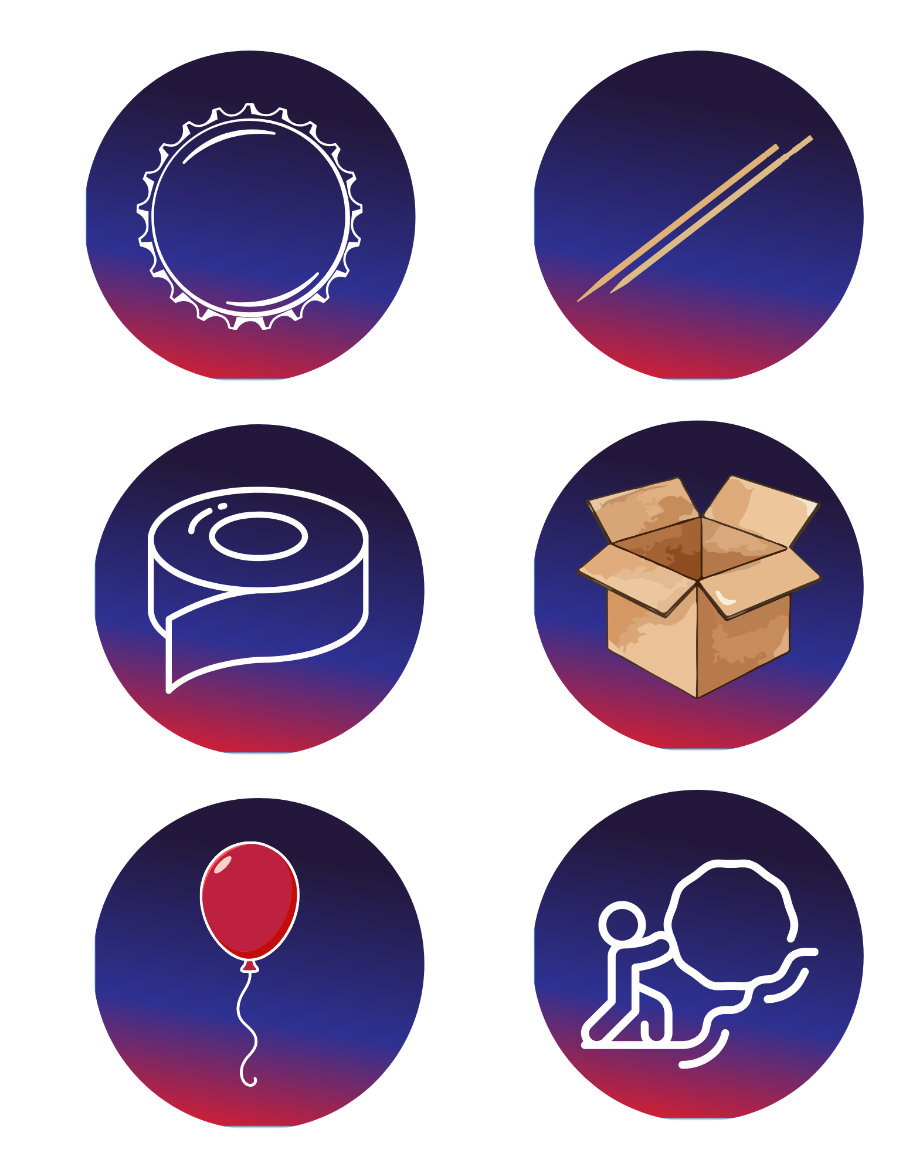
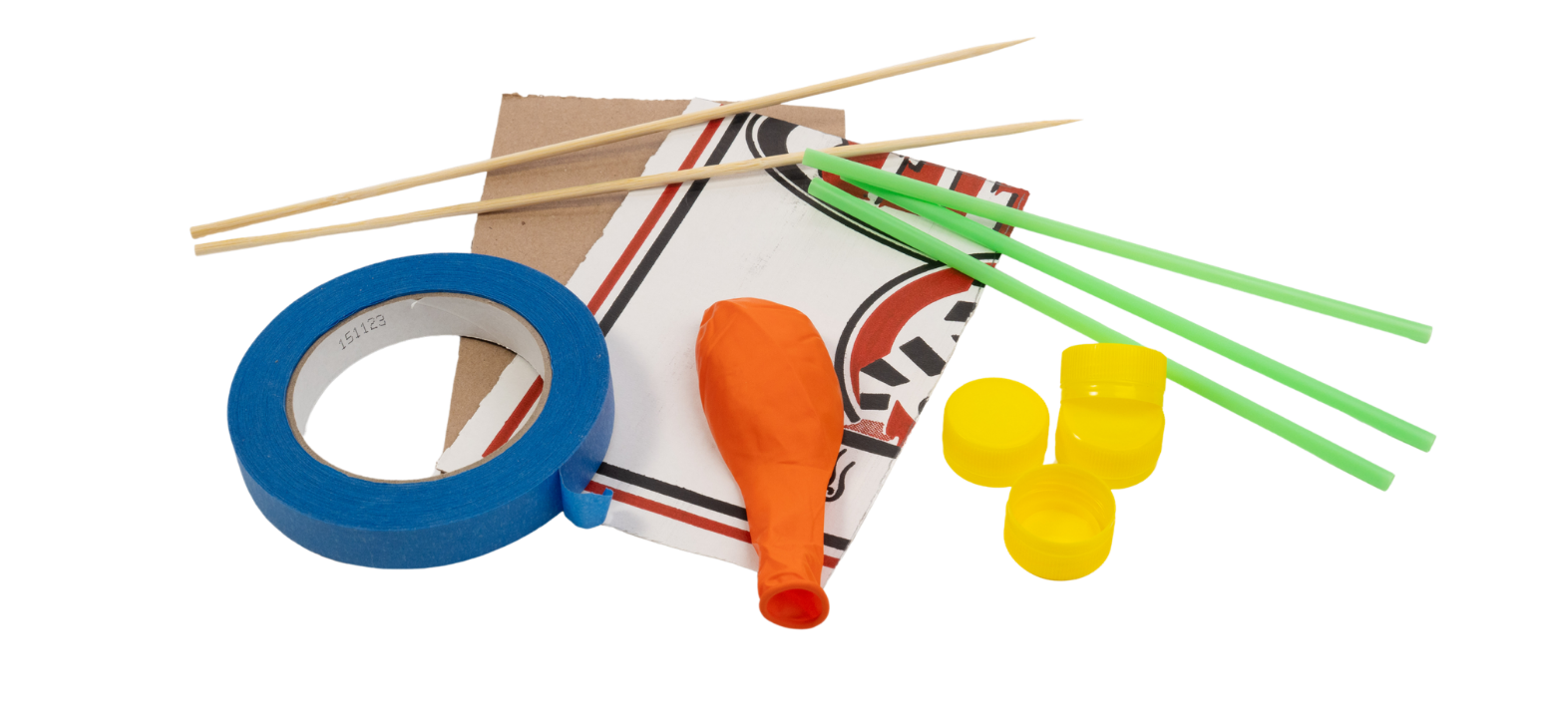
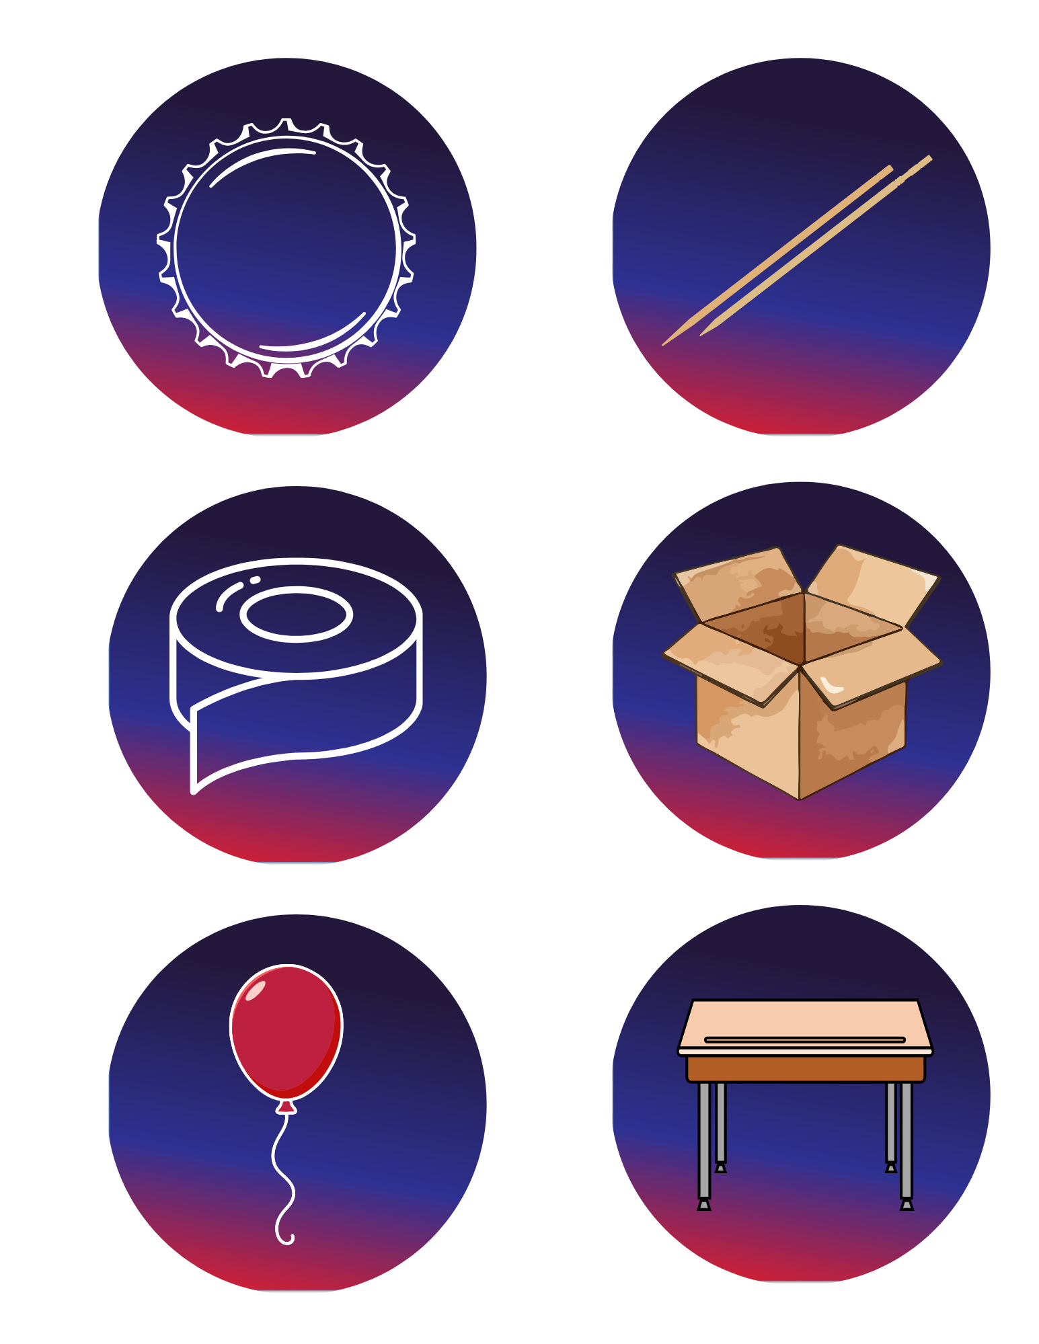

Today’s Materials
2 Wooden Skewers
4 Bottle Caps
1 Balloon
Tape Rolls
Cardboard
Flat Testing Surface
3 Straws
Notes:
4 bottle caps
2 wooden skewers
3 straws
1 balloon
Tape rolls
Cardboard
Flat testing surface

Slide 6
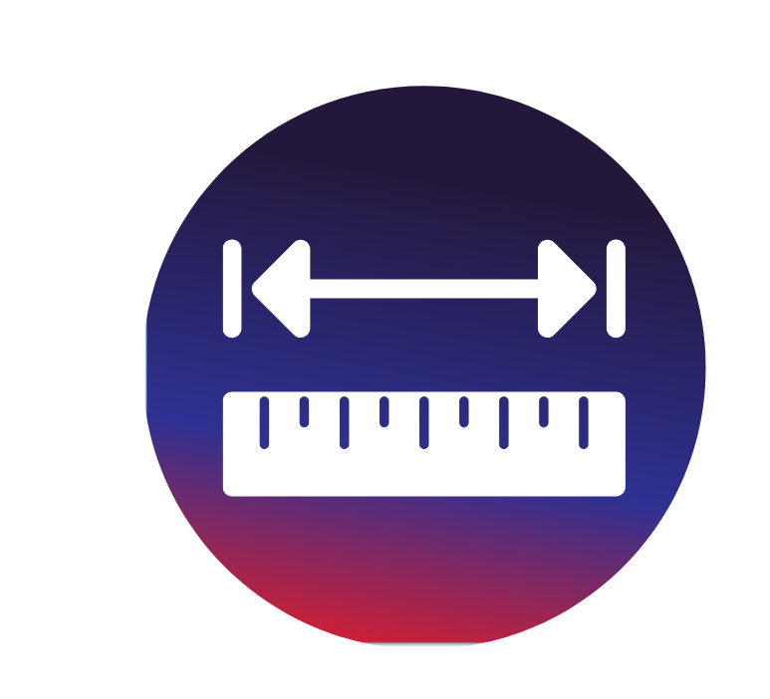
Step 1
Let’s Measure!
Who all brought in cardboard from home?
Let’s measure our piece of cardboard and see if it’s the correct size! Each piece of cardboard should be 5 inches by 7 inches.
Notes:
Who all brought in cardboard from home? Let’s measure our piece of cardboard and see if it’s the correct size! Each piece of cardboard should be 5 inches by 7 inches.

Slide 7
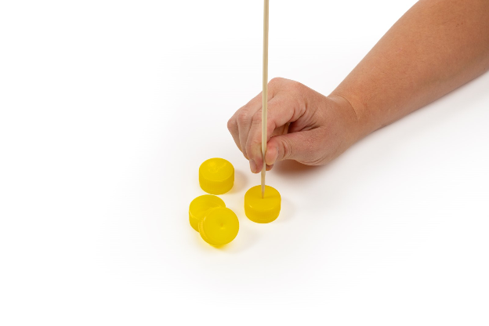
Step 2
Prepare the Wheels
Place each of the 4 bottle caps on a table or hard surface with the smooth side up.
1
Use the pointed end of a skewer to prick a hole in the center of each cap. Keep hands away from the tip of the skewer.
2
Notes:
Prepare the wheels
Place each of the 4 bottle caps on a table or hard surface with the smooth side up
Use the pointed end of a skewer to prick a hole in the center of each cap. Keep hands away from the tip of the skewer.

Slide 8
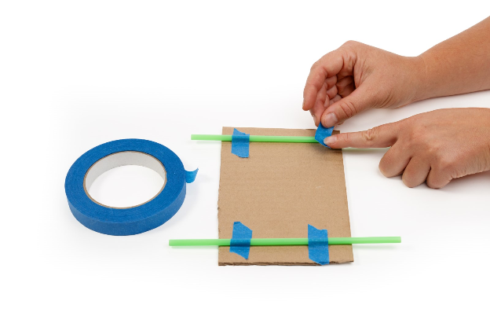
Step 3
Prepare the Axle Housings
Tape one straw across the front edge of the cardboard car body
3
Tape a second straw across the back edge of the cardboard car body
4
Notes:
Prepare the axle housings
Tape one straw across the front edge of the cardboard car body
Tape a second straw across the back edge of the cardboard car body

Slide 9
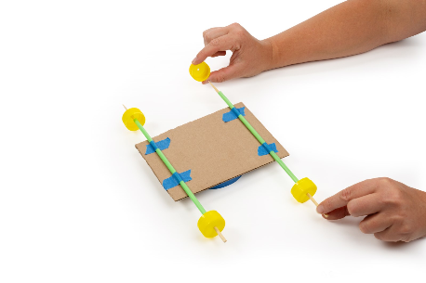
Step 4:
Create the Wheel and Axle Assemblies
Push one bottle cap onto each bamboo skewer
5
Insert the free end of each skewer through each of the straw axle housings
6
Push a second bottle cap onto the opposite end of each skewer to complete the wheel and axle assemblies
7
Notes:
Push one bottle cap onto each bamboo skewer
Insert the free end of each skewer through each of the straw axle housings
Push a second bottle cap onto the opposite end of each skewer to complete the wheel and axle assemblies

Slide 10
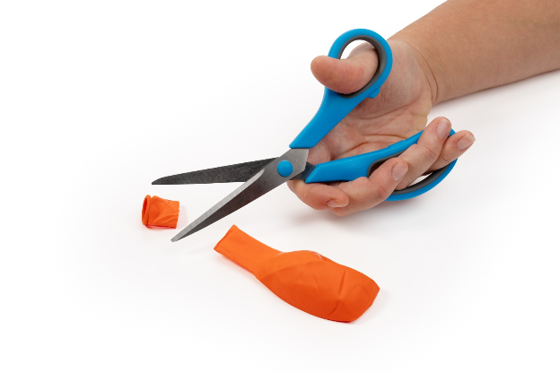
Step 5
Prepare the Balloon
Use scissors to cut off the rolled opening at the end of the balloon.
11
Notes:
Prepare the balloon
Use scissors to cut off the rolled opening at the end of the balloon.

Slide 11
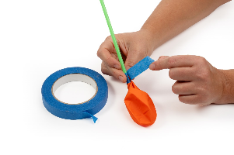
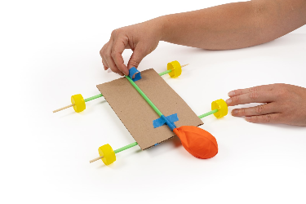
Step 6
Prepare the Engine
Insert the third straw into the opening of the balloon
Using duct tape or masking tape, tightly wrap the balloon opening and straw to create an airtight seal
Tape the straw to the top face of the car so that the deflated balloon does not make contact with the surface below
Notes:
Prepare the engine

Slide 12
Step 7
Test the Car
Inflate the balloon by blowing through the straw
Pinch the opening of the balloon shut, or place a finger over the opening of the straw to prevent air loss
Notes:
Inflate the balloon by blowing through the straw
Pinch the opening of the balloon shut, or place a finger over the opening of the straw to prevent air loss

Slide 13
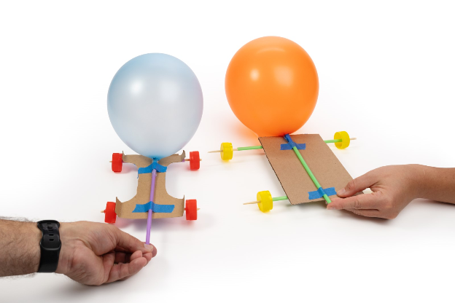

You just created an Air-Powered Car!

Slide 14
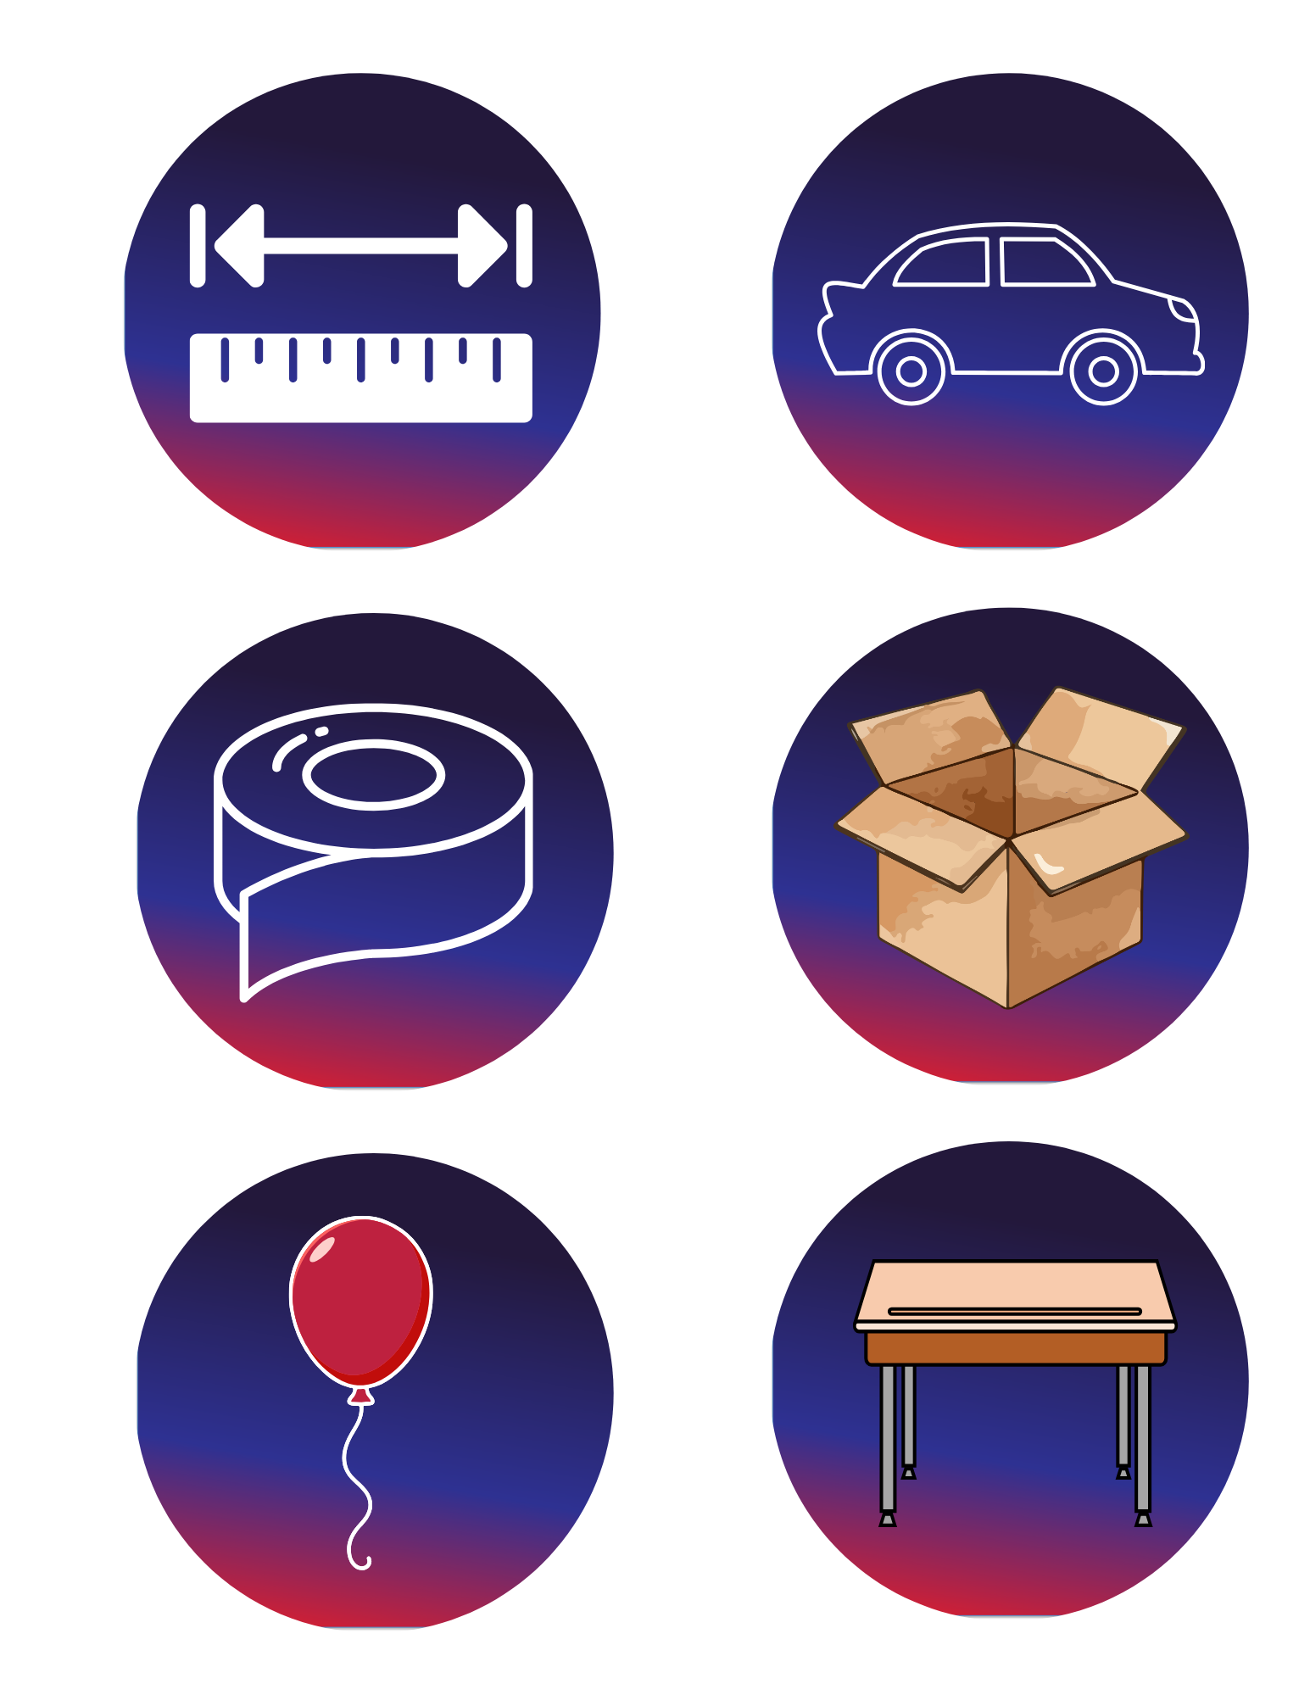
Now it is Time to Improve Your Design!
Change the shape of your car
Measure how far your car went. Compare that to someone else’s car. Graph both of those measurements.
Notes:
Change the shape of your car
Measure how far your car went. Compare that to someone else’s car. Graph both of those measurements.

Slide 15

Turn and
TALK TIME
What gave your car the energy to move?
Did your car move straight?
Why or why not?
What did you notice when the air rushed out of the balloon?
Did you make any changes to your car that made it move better?
Notes:
What gave your car the energy to move?
What did you notice when the air rushed out of the balloon?
Did your car move straight? Why or why not?
Did you make any changes to your car that made it move better?

Slide 16
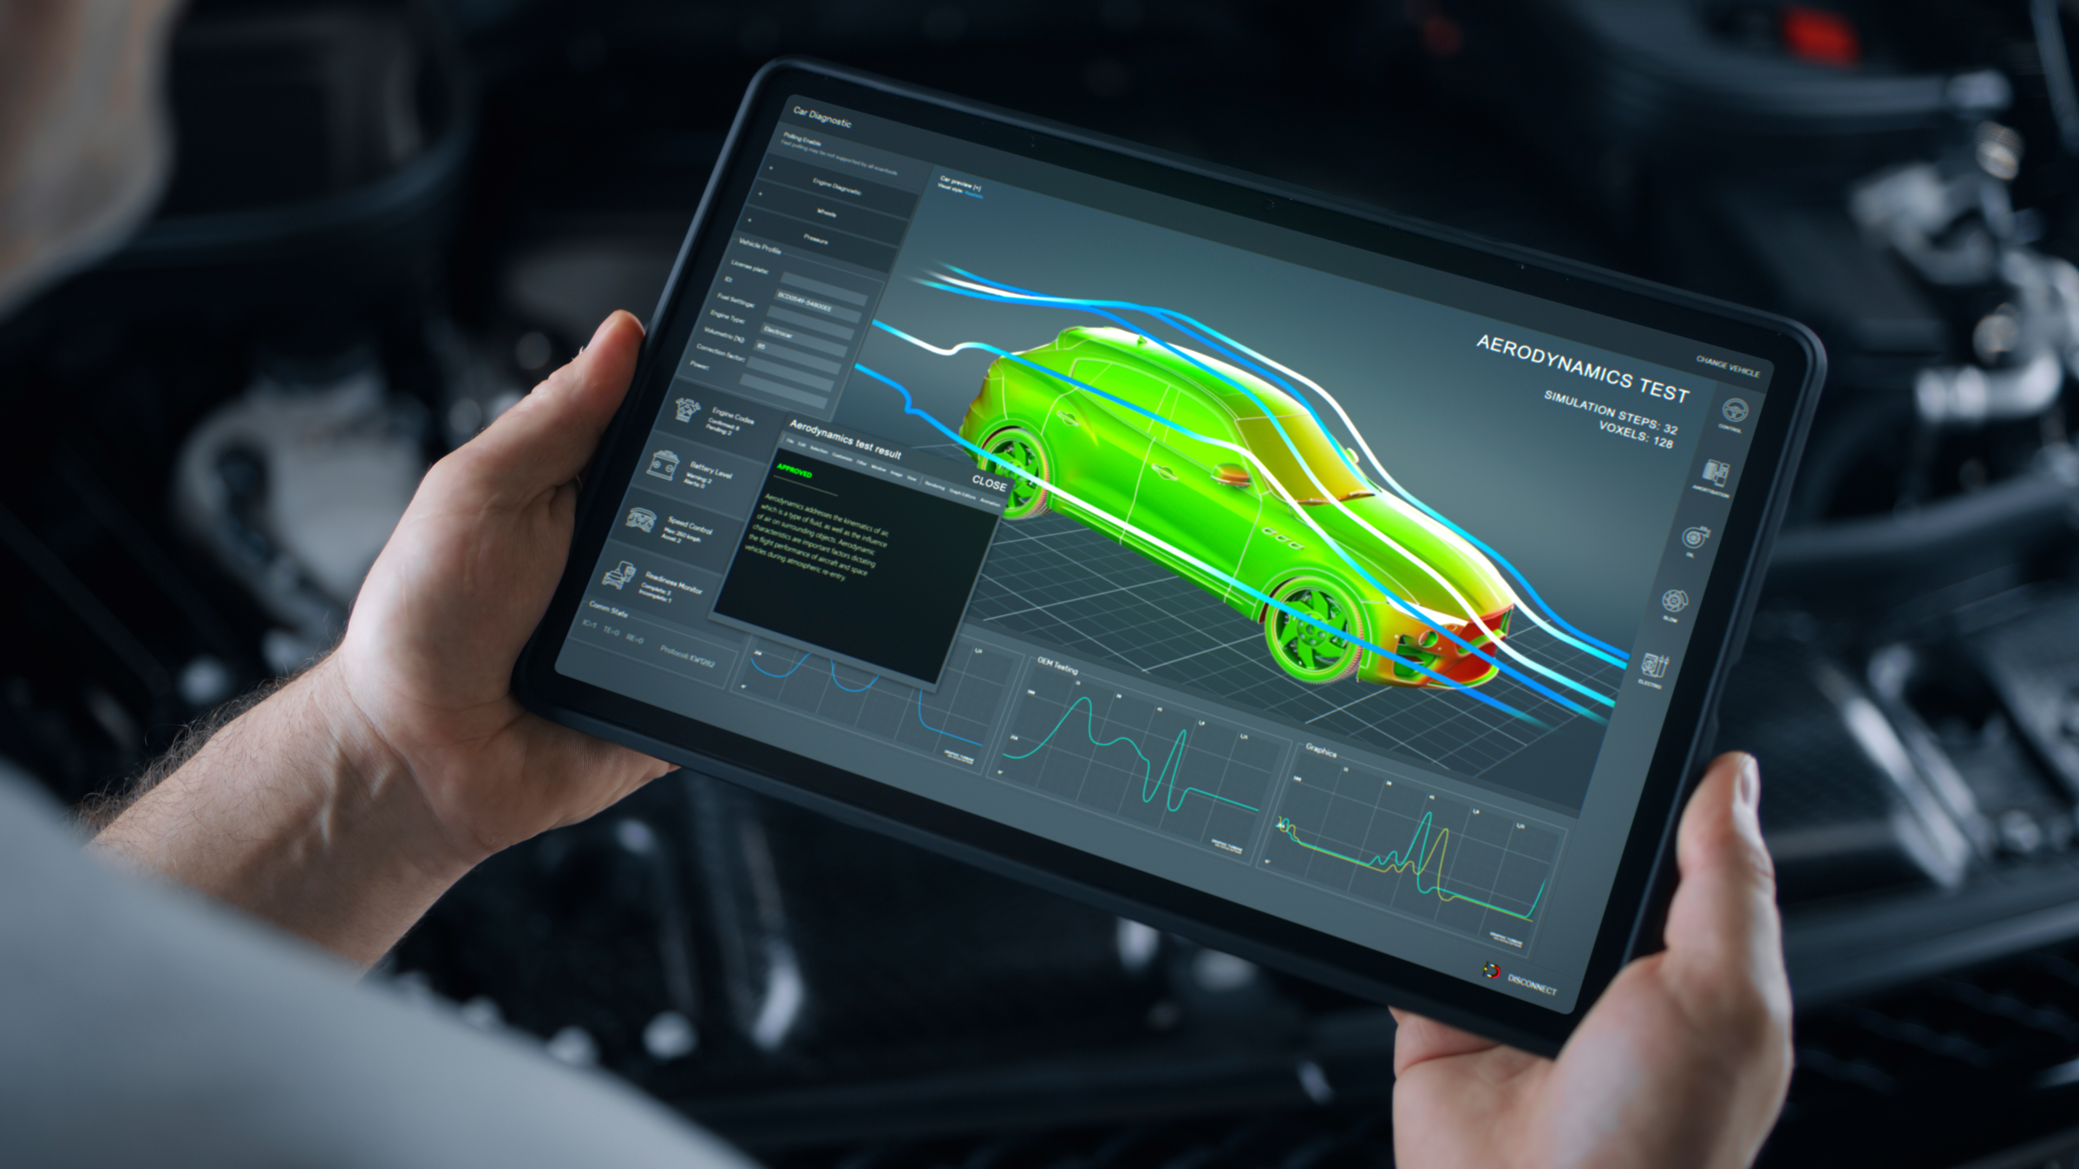

Career Exploration
Car engineers design and test cars to help them move safely and smoothly. They think about how stored energy can turn into motion
A mechanical engineer builds machines with parts that move, like wheels and axles. They use energy to help machines roll, spin, or move faster
Race car technicians help cars go fast by checking the wheels and axles. They understand how energy and motion work together to make a car as fast as possible
Notes:
Car engineers design and test cars to help them move safely and smoothly. They think about how stored energy can turn into motion
A mechanical engineer builds machines with parts that move, like wheels and axles. They use energy to help machines roll, spin, or move faster
Race car technicians help cars go fast by checking the wheels and axles. They understand how energy and motion work together to make a car as fast as possible

