Slide 1




Activity Overview
Catapults

Slide 2

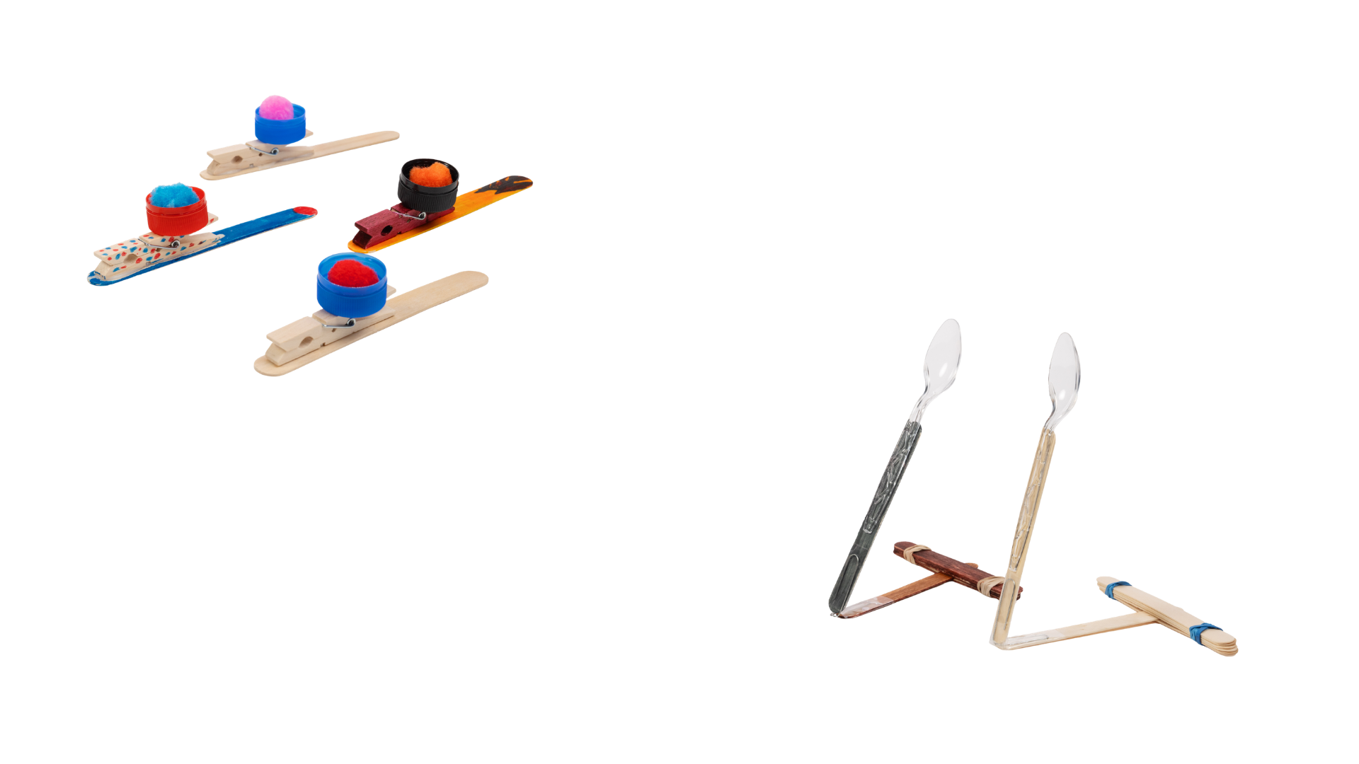


Catapults: Force, Motion, and Design!

Slide 3
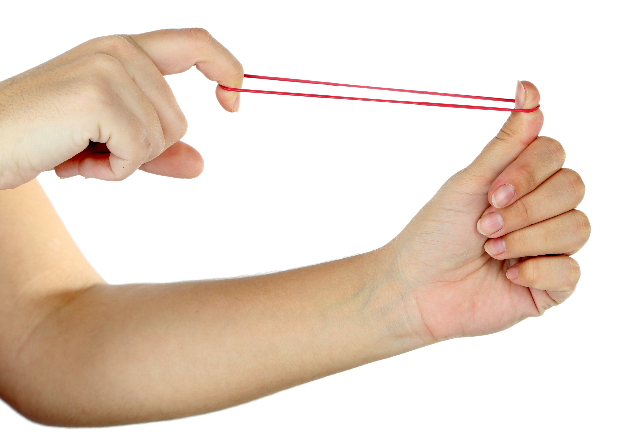
Foundations of Force, Motion, and Stored Energy
Have you ever pulled back a rubber band and let it snap forward, or pressed down on something and watched it spring back? When you do this, energy is stored and then released.
A catapult works using stored energy. When you press down on the catapult arm, energy builds up in the launcher. When you let go, that stored energy is transferred to the object, causing it to move through the air.
The way a catapult is built can change how this energy moves. A stable base, a strong launcher arm, or pressing down farther can affect how the catapult performs. Some designs may launch objects farther, while others may be more consistent.
Notes:
Have you ever pulled back a rubber band and let it snap forward, or pressed down on something and watched it spring back? When you do this, energy is stored and then released.
A catapult works using stored energy. When you press down on the catapult arm, energy builds up in the launcher. When you let go, that stored energy is transferred to the object, causing it to move through the air.
The way a catapult is built can change how this energy moves. A stable base, a strong launcher arm, or pressing down farther can affect how the catapult performs. Some designs may launch objects farther, while others may be more consistent.

Slide 4
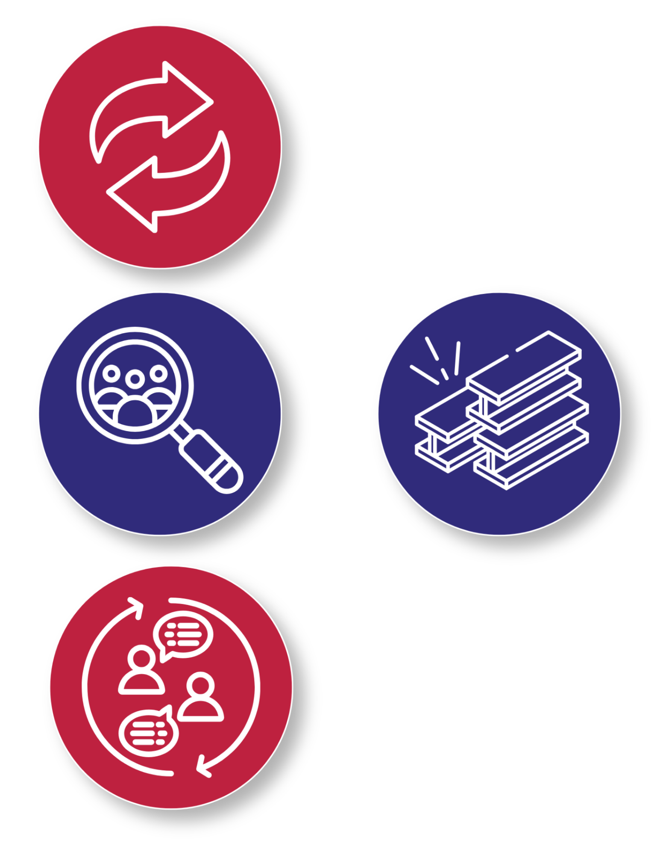
Key Words to Know
Force
- A push or pull that can cause an object to move.
Stored Energy
- Energy held in an object when it is bent, stretched, or pressed.
Observation
- Carefully watching and noticing what happens.
Iteration
- Repeating a process to make them better.
Notes:
Force: A push or pull that can cause an object to move.
Stored Energy: Energy held in an object when it is bent, stretched, or pressed.
Observation: Carefully watching and noticing what happens.
Iteration: Repeating a process to make them better.

Slide 5
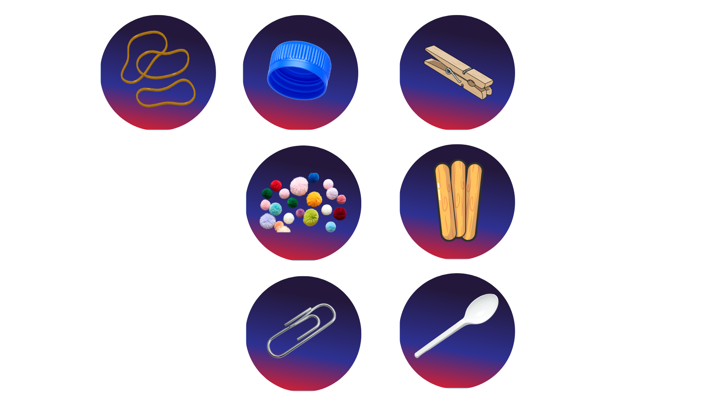
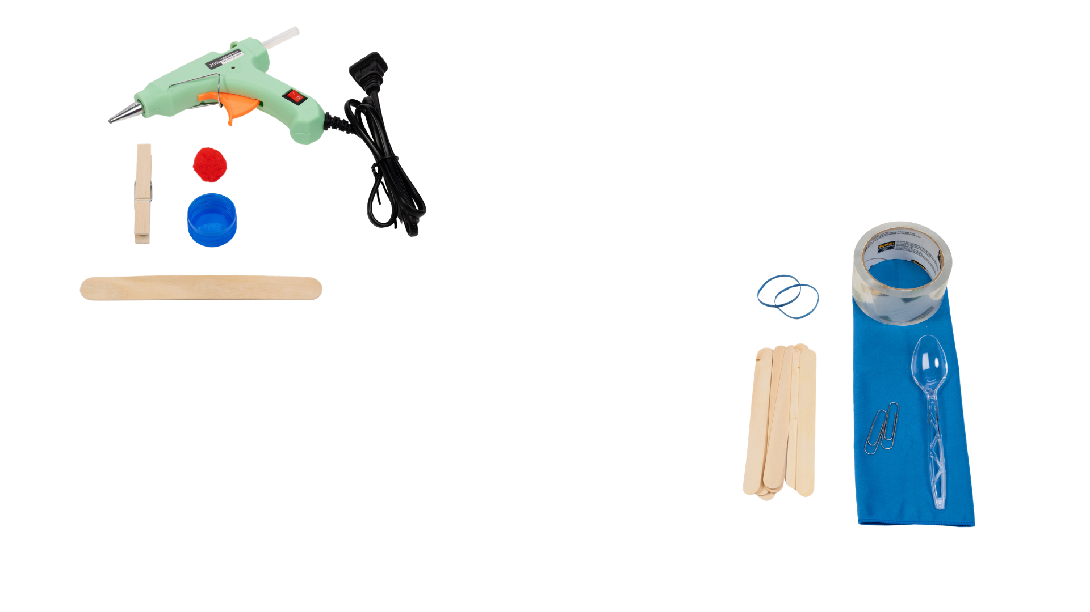
Today’s Materials
Option A:
Craft Stick
Clothespin
Plastic Bottle Cap
Pom Pom
Notes:
1 craft stick
1 clothespin
1 plastic bottle cap
1 pom pom
OR
7 jumbo craft sticks
2 large paperclips
1 plastic spoon
2 rubber bands
1 pom pom

Slide 6
Today’s Materials
Option B:
7 Jumbo Craft Sticks
2 Large Paperclips
Plastic Spoon
2 Rubber Bands
1 Pom Pom
Notes:
1 craft stick
1 clothespin
1 plastic bottle cap
1 pom pom
OR
7 jumbo craft sticks
2 large paperclips
1 plastic spoon
2 rubber bands
1 pom pom

Slide 7
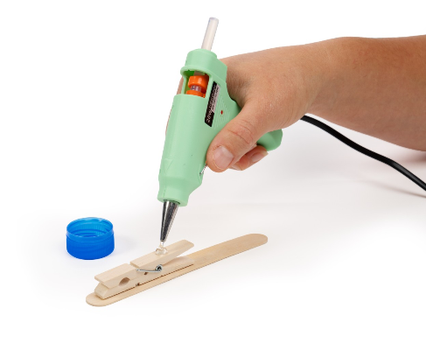
Step 1
Clothespin Launcher
Option A:
Using hot glue, glue a clothespin to a craft stick as pictured. The closed end of the clothespin should be near the edge of the craft stick
Notes:
Using hot glue, glue a clothespin to a craft stick as pictured. The closed end of the clothespin should be near the edge of the craft stick

Slide 8
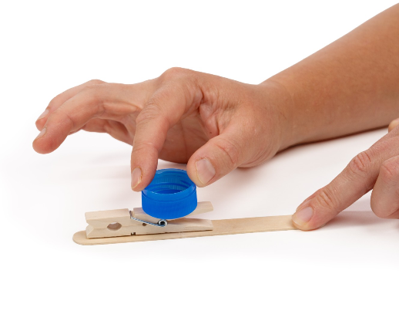
Step 2
Clothespin Launcher
Option A:
Using hot glue, glue a bottle cap upside-down on the end of the clothes pin opposite of the closed end
Notes:
Using hot glue, glue a bottle cap upside-down on the end of the clothes pin opposite of the closed end

Slide 9
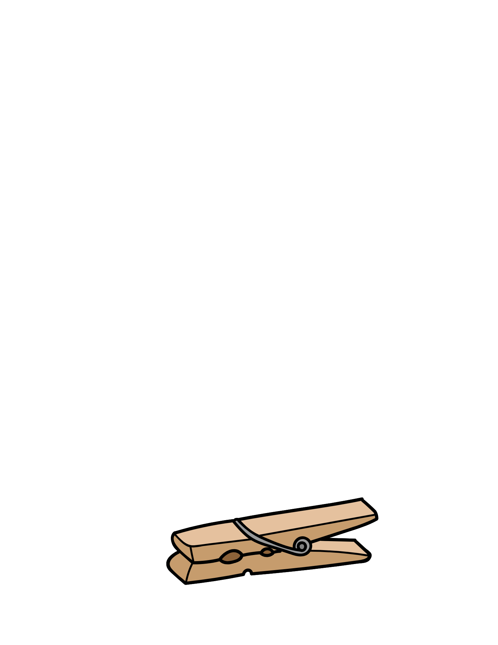
Step 3
Clothespin Launcher
Option A:
Let it Dry!
Your paint needs a little time to set before we move on.
Place your painted pieces in the designed drying area.
Try not to touch or move the painted surfaces while they dry.
While you wait..
Clean up your area
Make sure your name is on your project
Get ready for the next steps!
Notes:
Allow the glue to dry

Slide 10
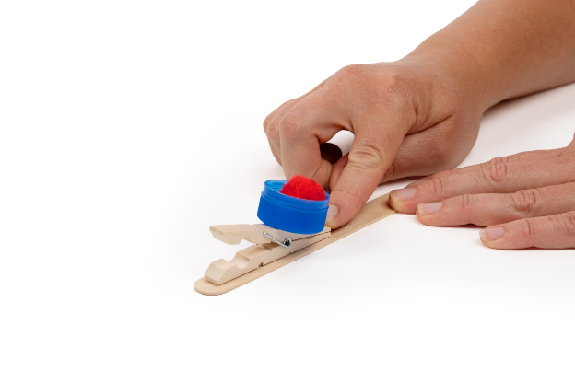
Step 4
Clothespin Launcher
Option A:
Place the pom pom on the cap
Notes:
Place a pom pom in the cap

Slide 11
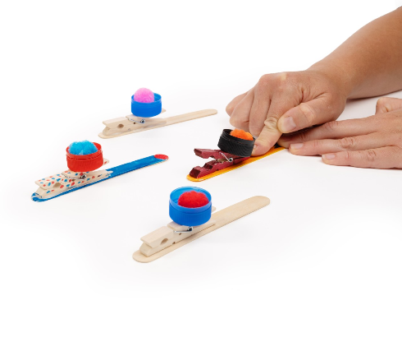
Step 5
Clothespin Launcher
Option A:
Press down on the launcher arm and release it to launch the pom pom.
Notes:
Press down on the launcher arm and release it to launch the pom pom.

Slide 12
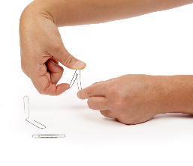
Craft Stick Catapult
Step 1
Option B:
Create a hinge
Take a paperclip and lift the inner bend upwards until the paperclip forms an “L” shape
Notes:
Create a hinge
Take a paperclip and lift the inner bend upwards until the paperclip forms an “L” shape

Slide 13
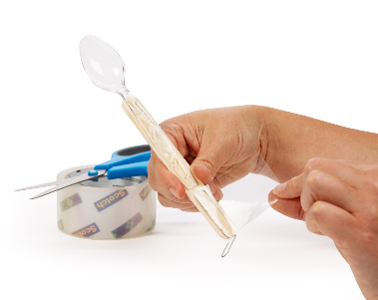
Step 2
Craft Stick Catapult
Option B:
Tape a spoon to one end of a jumbo craft stick and tape the other end of the jumbo craft stick to the raised part of the paperclip
Tape another jumbo craft stick to the remaining part of the paperclip “L”
Notes:
Tape a spoon to one end of a jumbo craft stick and tape the other end of the jumbo craft stick to the raised part of the paperclip
Tape another jumbo craft stick to the remaining part of the paperclip “L”

Slide 14
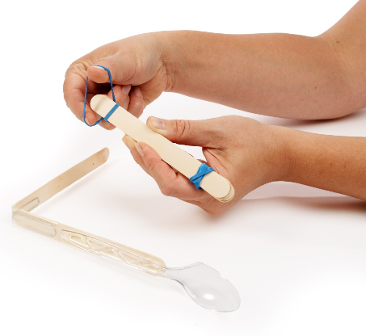
Step 3
Craft Stick Catapult
Option B:
Stack 5 jumbo craft sticks and wrap one rubberband around each end to secure the craft sticks to each other to form a base
Notes:
Stack 5 jumbo craft sticks and wrap one rubberband around each end to secure the craft sticks to each other to form a base

Slide 15
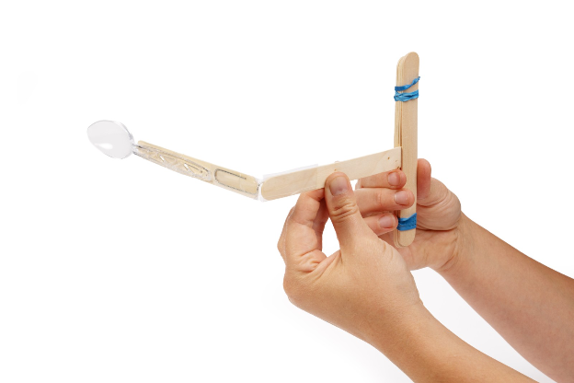
Step 4
Craft Stick Catapult
Option B:
Insert the free end of the launcher in between the bottom two craft sticks in the base as pictured
Notes:
Stack 5 jumbo craft sticks and wrap one rubberband around each end to secure the craft sticks to each other to form a base

Slide 16
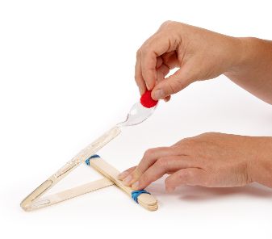
Step 4
Craft Stick Catapult
Option B:
Place the pom-pom in the spoon, press down, and release to launch.
Notes:
Place the pom-pom in the spoon, press down, and release to launch.

Slide 17
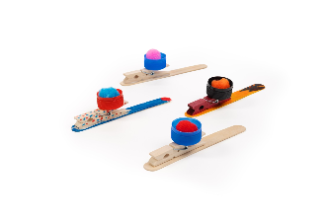
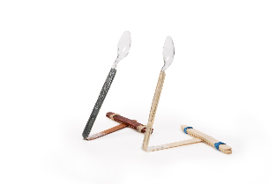
You just made a catapult!

Slide 18

Turn and Talk Time!
Questions to Consider
What did you do to store energy in your catapult?
Which catapult design seemed to be able to store more energy? How could you tell?
What part of your catapult do you think is most important? Why?
What is one part of your catapult that you could change to make it better?
Notes:
What did you do to store energy in your catapult?
Which catapult design seemed to be able to store more energy? How could you tell?
What part of your catapult do you think is most important? Why?
What is one part of your catapult that you could change to make it better?

Slide 19

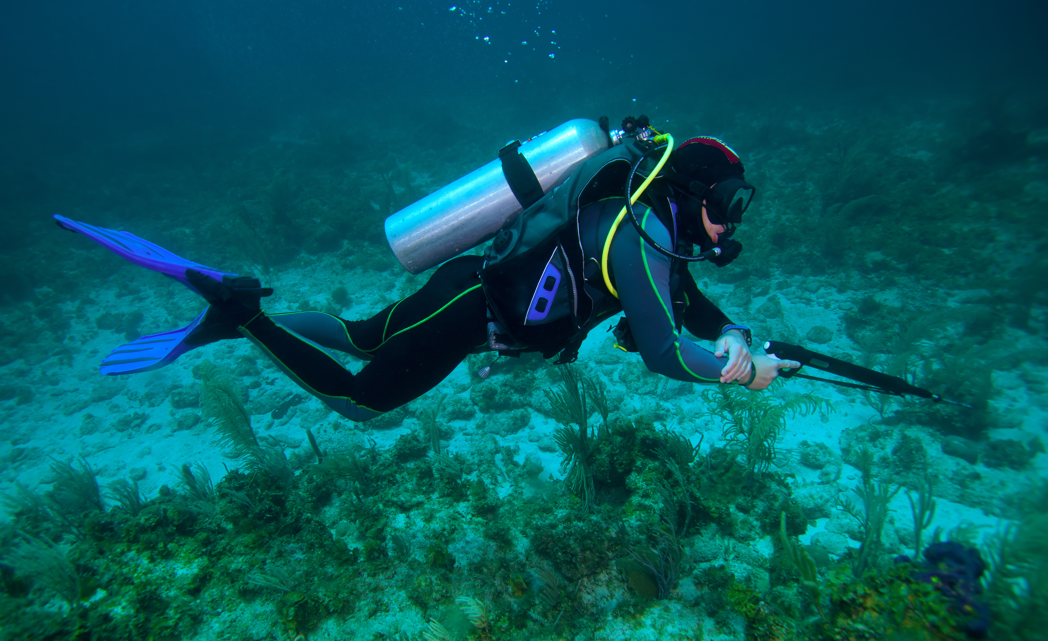
Wrap Up!
What Careers Did We Explore Today?
Mechanical engineers design machines with moving parts. They use stored energy to help machines push, lift, or launch objects
Spear fishers use tools with stretched bands that store energy. When the bands are released, the stored energy moves the spear forward, like how energy launches an object from a catapult
Notes:
Mechanical engineers design machines with moving parts. They use stored energy to help machines push, lift, or launch objects
Spear fishers use tools with stretched bands that store energy. When the bands are released, the stored energy moves the spear forward, like how energy launches an object from a catapult

