Slide 1




Activity Overview
Chemical Changes

Slide 2




Chemical Changes

Slide 3
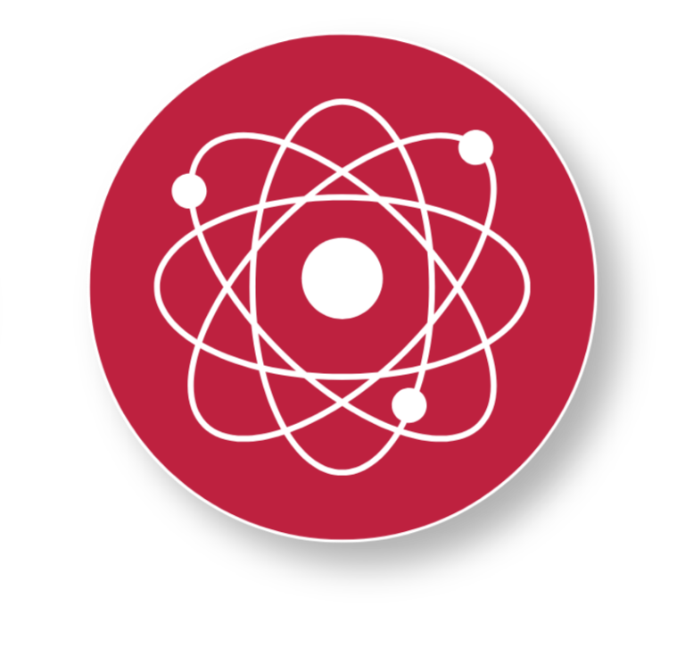
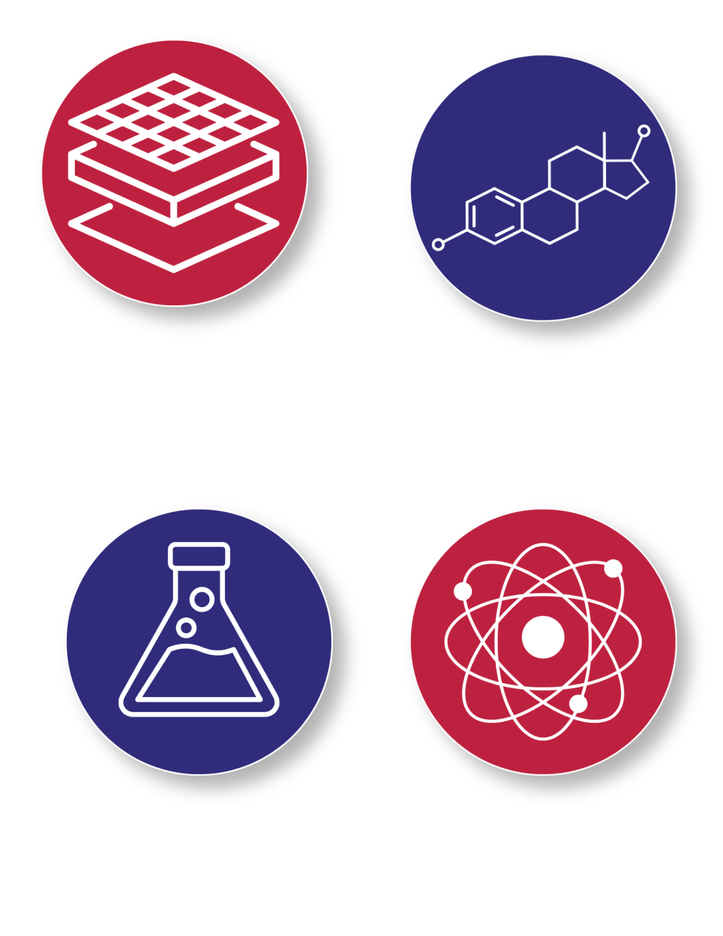
Foundations of Changes in Matter
When you work with materials, they can change in different ways.
Some changes are physical changes, and some are chemical changes.
A physical change happens when something changes in size, shape, or form, but it is still the same material.
A chemical change happens when materials are mixed or used in a way that creates something new.
Composites can also involve chemical changes. A composite is made when two or more materials work together to make something stronger, lighter, or more useful than one material by itself.
Notes:
When you work with materials, they can change in different ways. Some changes are physical changes, and some are chemical changes.
A physical change happens when something changes in size, shape, or form, but it is still the same material. For example, stretching a balloon, bending a paperclip, or pouring water into a new container are physical changes. No new material is made.
A chemical change happens when materials are mixed or used in a way that creates something new. Evidence of a chemical change may include fizzing, bubbling, a new smell or sound, changes in temperature, such as heat being released or absorbed, the formation of a gas, the production of light, or a change that cannot easily be undone.
Composites can also involve chemical changes. A composite is made when two or more materials work together to make something stronger, lighter, or more useful than one material by itself. In some composites, strong fibers are placed inside a liquid resin. The fibers give the part strength, and then the resin goes through a chemical change as it hardens. Once it hardens, the resin holds the fibers in place and helps turn the materials into one strong part.

Slide 4

Key Words to Know
PHYSICAL CHANGE
A change in how something looks, feels, or is shaped that does not create a new substance, such as changing size, shape, or state
CHEMICAL CHANGE
A change that makes a new substance with different properties
GAS
Matter that spreads out to fill the space around it. It does not have its own shape or volume
EVIDENCE OF CHEMICAL CHANGE
Signs that show a new substance has formed, such as bubbling, fizzing, gas forming, sound, or a change that cannot easily be reversed
Think Like a Scientist!
Scientists observe, compare, and test materials to understand how and why they change
Notes:
Physical Change – A change in how something looks, feels, or is shaped that does not create a new substance, such as changing size, shape, or state
Chemical Change – A change that makes a new substance with different properties
Gas - Matter that spreads out to fill the space around it. It does not have its own shape or volume
Evidence of a Chemical Change – Signs that show a new substance has formed, such as bubbling, fizzing, gas forming, sound, or a change that cannot easily be reversed

Slide 5
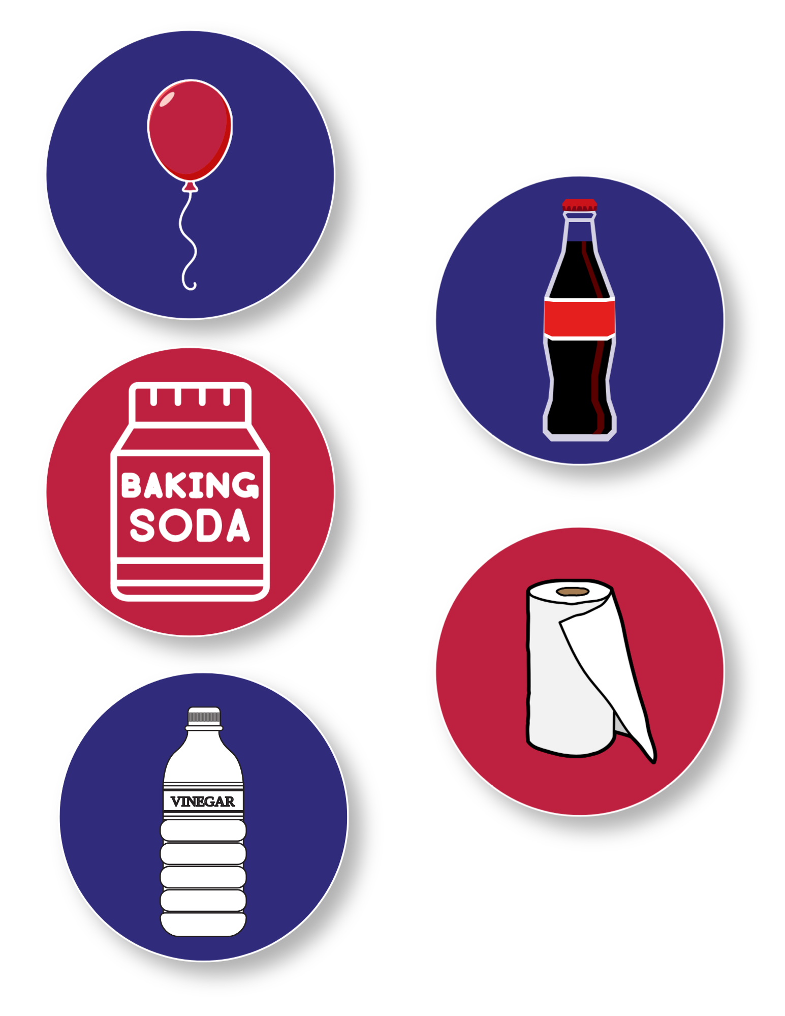
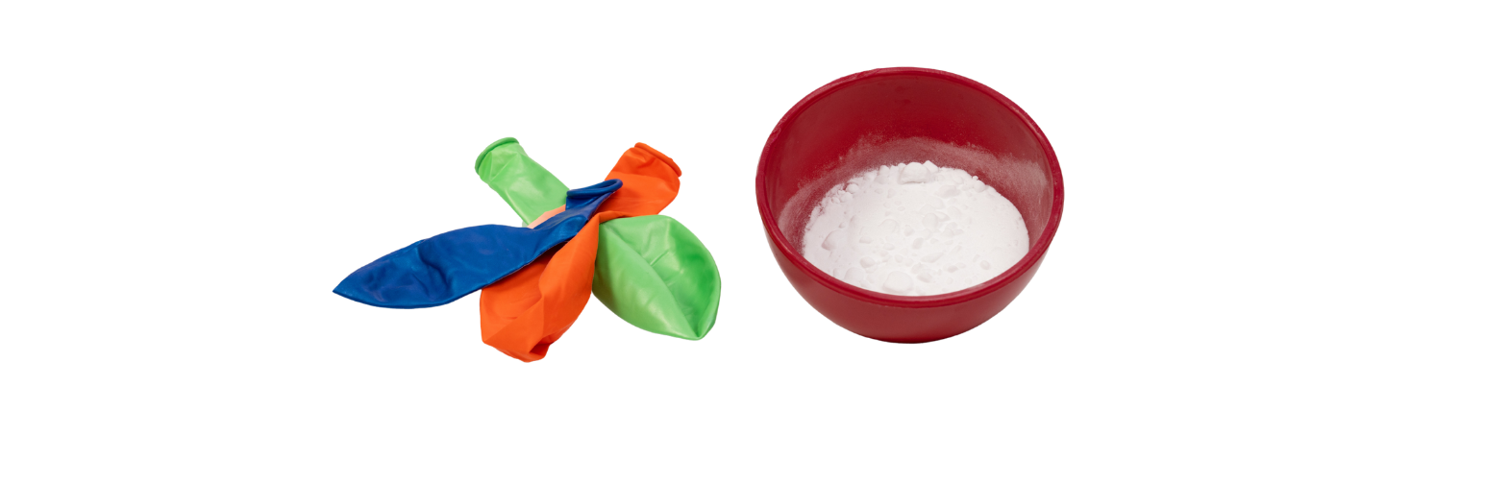
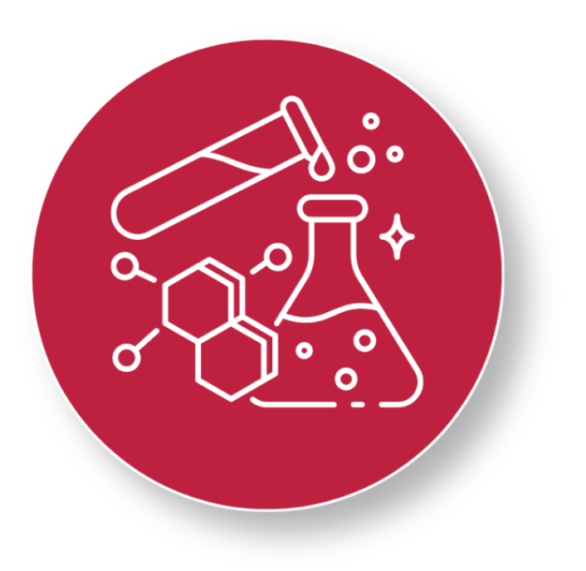
Today’s Materials
1 Balloon
20 oz. Soda Bottle
Vinegar
Baking Soda
Workspace Protection:
Paper Towels, Trays, Table Coverings etc.
Get Ready to Experiment!
Gather your materials and get ready to discover what happens when everyday substances react with one another.
Notes:
1 balloon
Baking soda
Vinegar
Recycled: Bottles (20 oz. Soda bottles)
Workspace protection (paper towels, trays, or table coverings)

Slide 6
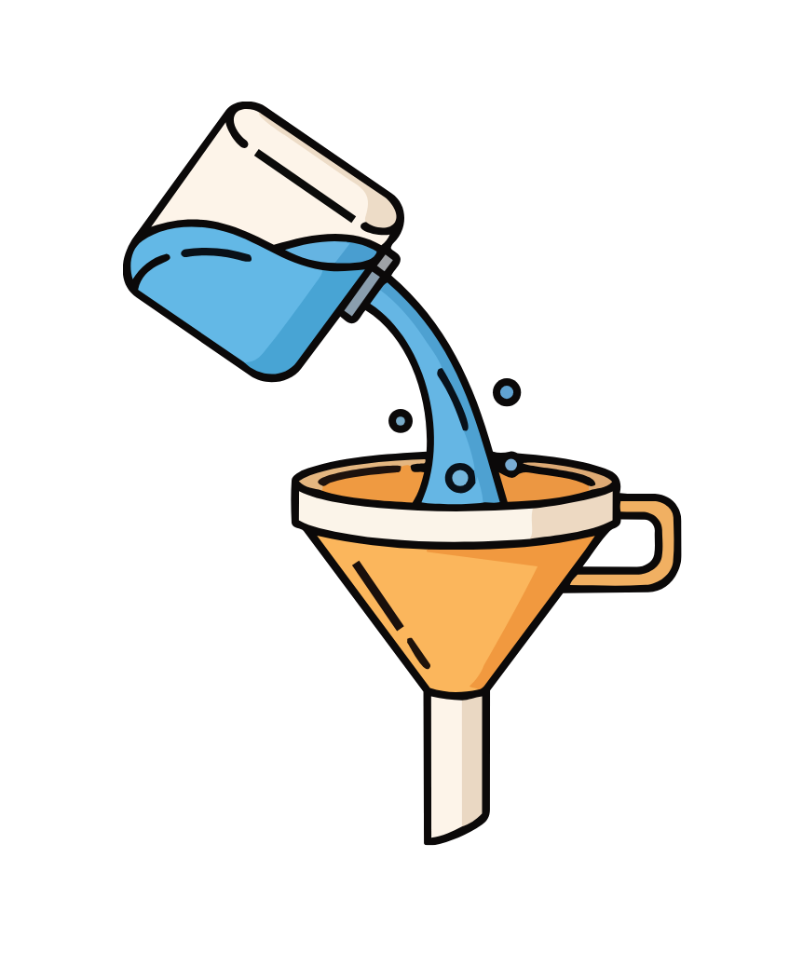
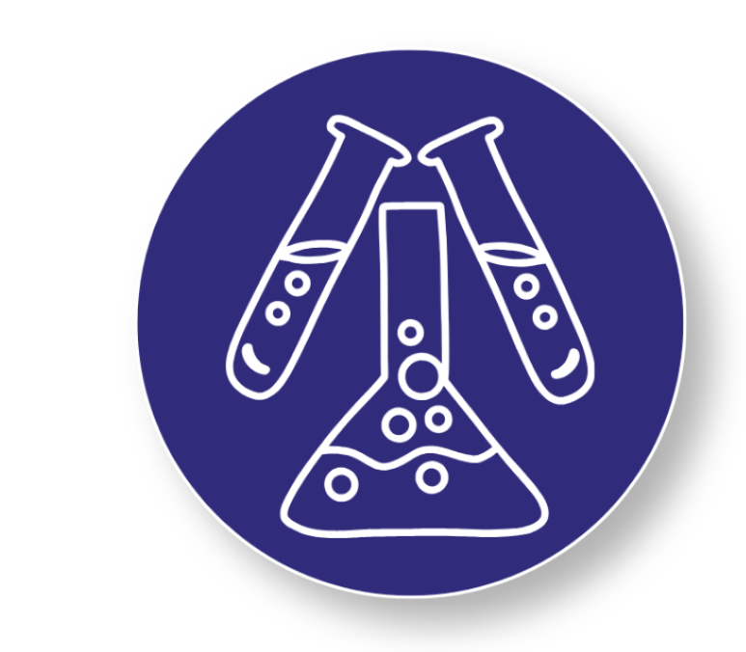
Step 1 & 2
Pour vinegar into the plastic water bottle until it is about one-third full
Step 2: Roll a piece of paper into a funnel-like cone and insert it into the opening of the balloon.
1
2
Scientist Tip:
Measuring carefully helps the reaction work the way scientists expect.
Notes:
Pour vinegar into the plastic water bottle until it is about one-third full

Slide 7
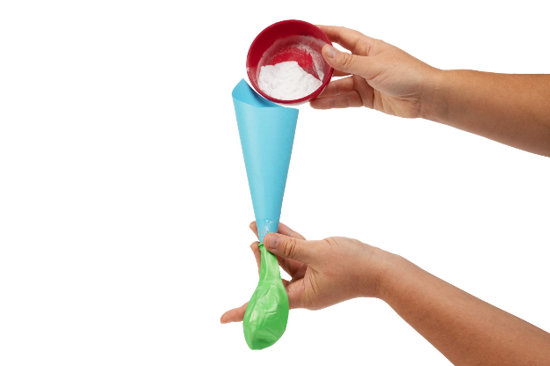
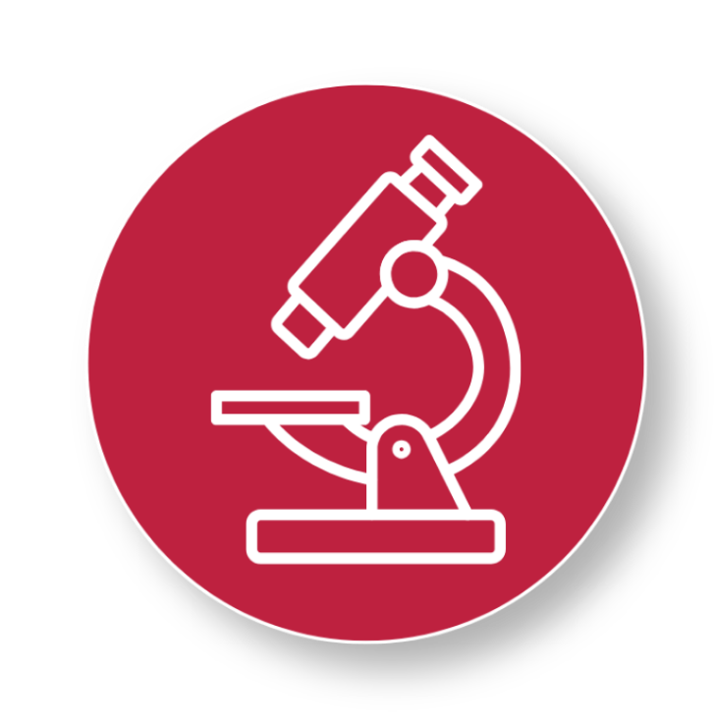
Step 3
Add the Baking Soda
Pour a small amount of baking soda into the paper funnel to partially fill the balloon.
3
Scientist Tip:
Mixing baking soda and vinegar creates a chemical change because a new substance forms. One piece of evidence of a chemical change is the gas (carbon dioxide) that inflates the balloon.
Notes:
Pour a small amount of baking soda into the paper funnel to partially fill the balloon

Slide 8


Step 4
Attach the Balloon
Carefully stretch the open end of the balloon over the mouth of the bottle, keeping the baking soda inside the balloon
4
Ready for a Reaction?!
In the next step, you'll let the baking soda fall into the vinegar and watch for signs of a chemical change. Keep your eyes on the balloon—you might be surprised by what happens!
Notes:
Carefully stretch the open end of the balloon over the mouth of the bottle, keeping the baking soda inside the balloon

Slide 9

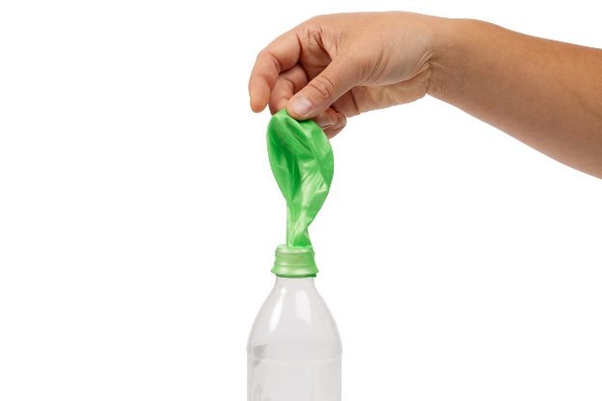
Step 5
Launch the Reaction!
Whats Happening?!
Lift the balloon so the baking soda falls into the vinegar and watch the magic!
The baking soda and vinegar mix to create a gas called carbon dioxide
5
The Result:
The gas fills the balloon, causing it to inflate!
Scientist Tip:
Mixing baking soda and vinegar creates a chemical change
because a new substance forms!
Notes:
Lift the balloon so the baking soda falls into the vinegar and watch the magic!

Slide 10
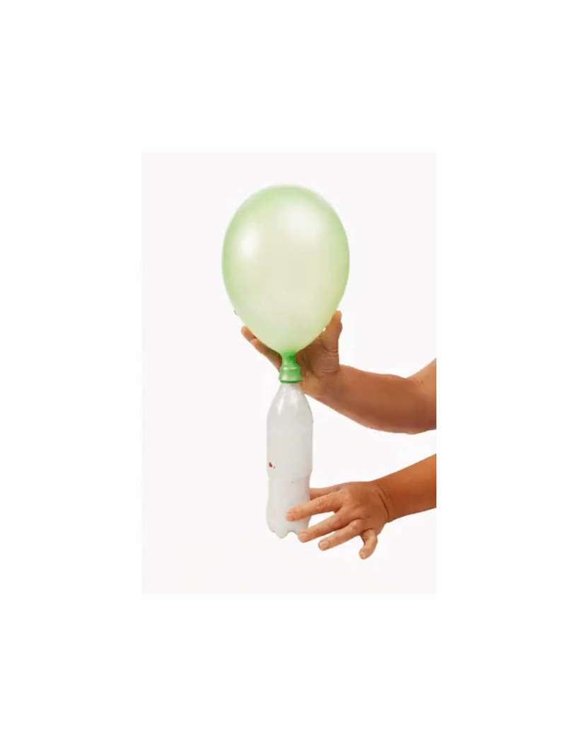

Chemical Changes

Slide 11
Turn and Talk Time
What did you notice when the baking soda and vinegar mixed?
Which observations show that a chemical change occurred?
What physical changes did you notice during the activity, and how do you know they were physical changes?
Why is it important for scientists and engineers to recognize when materials are changing in different ways?

Slide 12


Career Exploration
Materials Scientists may design new materials that change color, clean water, store energy, protect people, or even help astronauts live and work in space. To do that, they’ll need to understand how materials mix, react, and change.
Chemists study how different
materials mix and change. They test chemicals to learn what happens when they are combined.
Safety Specialists make sure that chemicals are used carefully to people and the environment are protected
Notes:
Chemists study how different materials mix and change. They test chemicals to learn what happens when they are combined
Safety Specialists make sure that chemicals are used carefully to people and the environment are protected
Future materials scientists may design new materials that change color, clean water, store energy, protect people, or even help astronauts live and work in space. To do that, they’ll need to understand how materials mix, react, and change.

