Slide 1




Activity Overview
Clay Forging

Slide 2


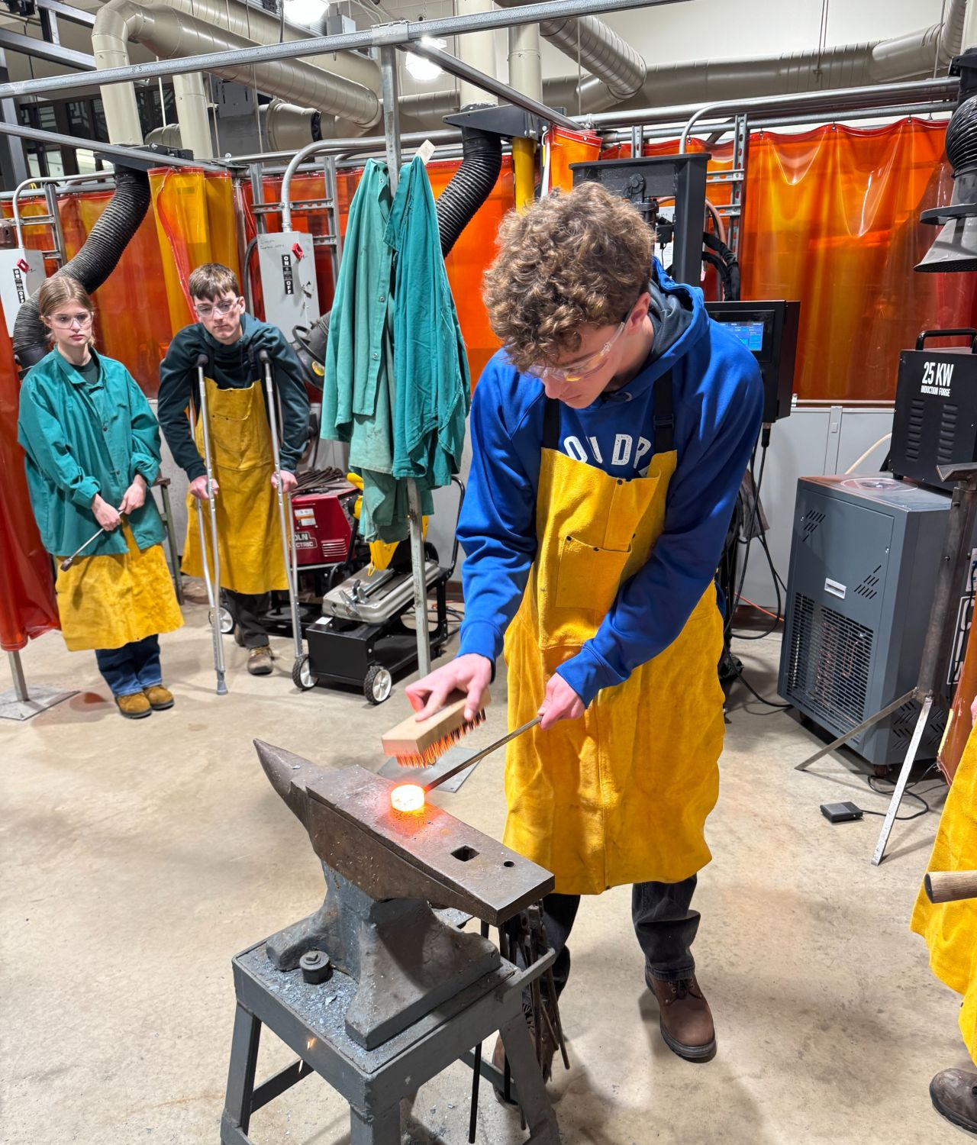
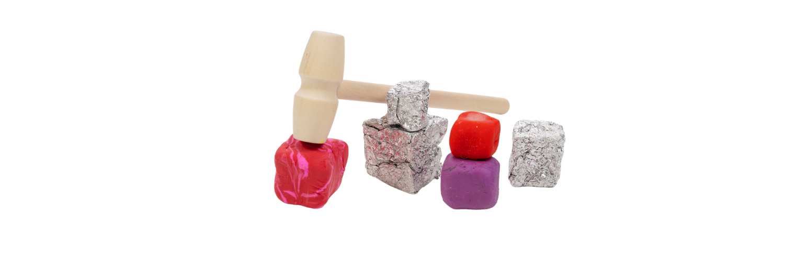

Clay Forging

Slide 3

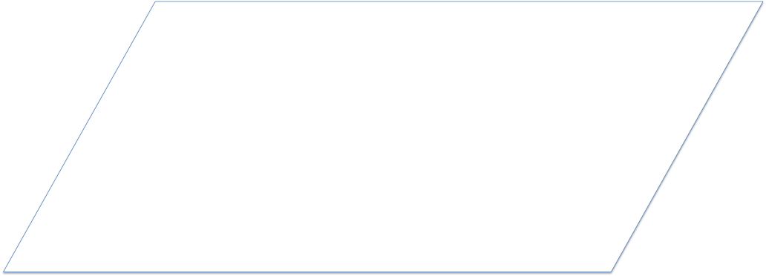


Why Does Matching Matter?
Have you ever noticed that blocks stack neatly,
or that puzzle pieces fit where they are supposed to?
That’s because they are made to match in shape and size.
When people make things, they often make many copies of the same object. If the shapes or sizes are not the same, the pieces may not fit together, may not work the same way, or may not be fair for everyone who uses them. Making things match helps them work better.
Engineers and materials scientists work to make sure things are made the right way- so they match, fit and work for everyone.
Notes:
Have you ever noticed that blocks stack neatly, or that puzzle pieces fit where they are supposed to? That’s because they are made to match in shape and size.
When people make things, they often make many copies of the same object. If the shapes or sizes are not the same, the pieces may not fit together, may not work the same way, or may not be fair for everyone who uses them. Making things match helps them work better.

Slide 4
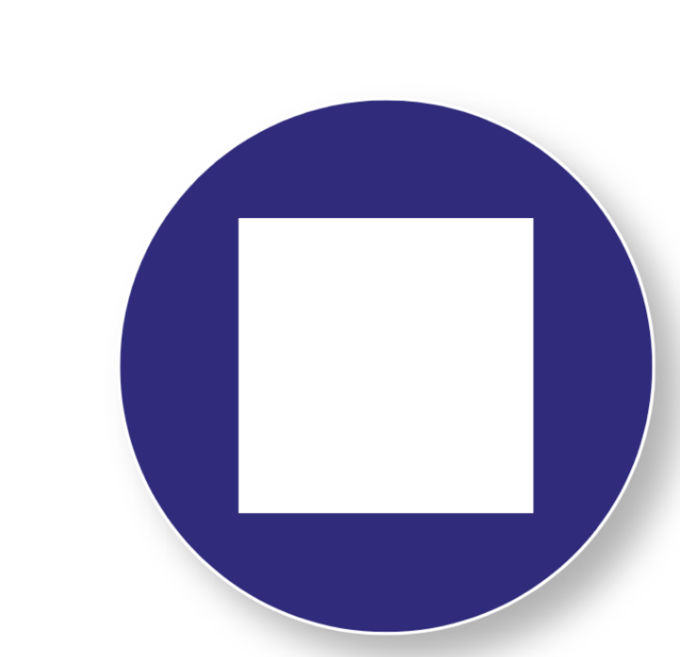
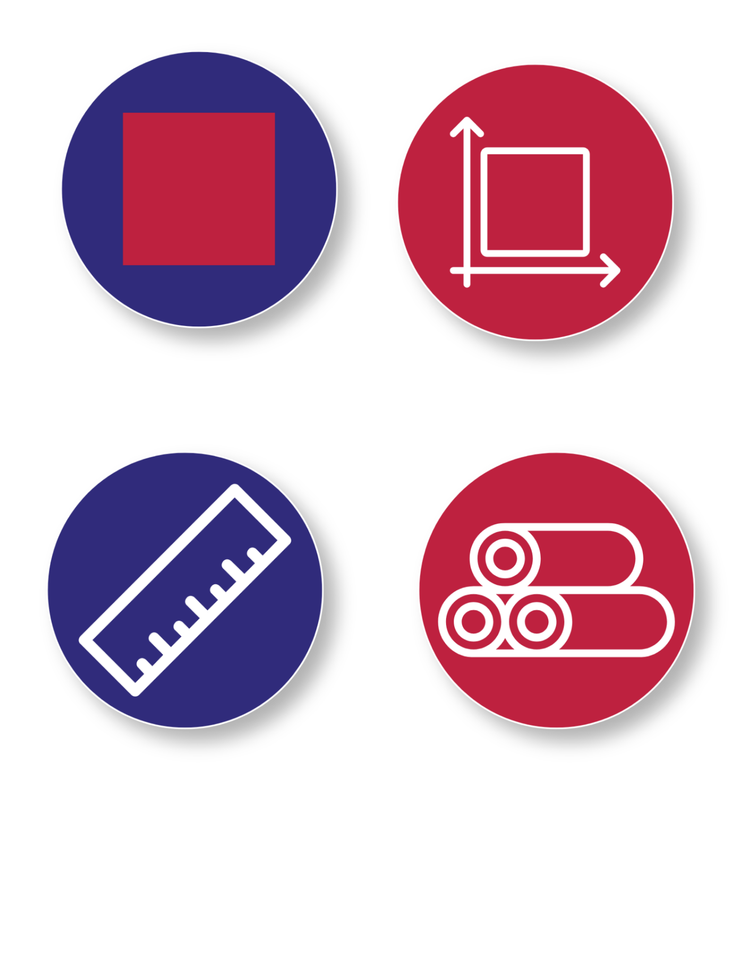
Key Words to Know
Shape
- What something looks like (like a square or circle).
Size
- How big or small something is.
Measure
- To check how big something is.
Material
- What something is made of.
Notes:
Shape - What something looks like (like a square or circle).
Size - How big or small something is.
Measure - To check how big something is.
Material - What something is made of.

Slide 5
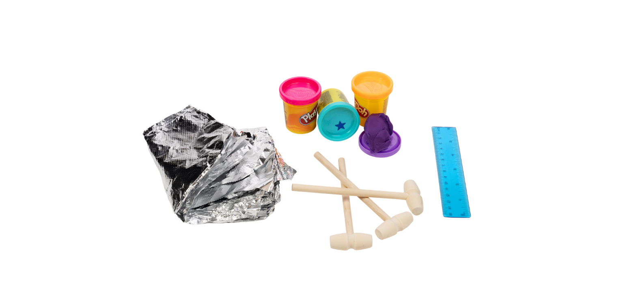
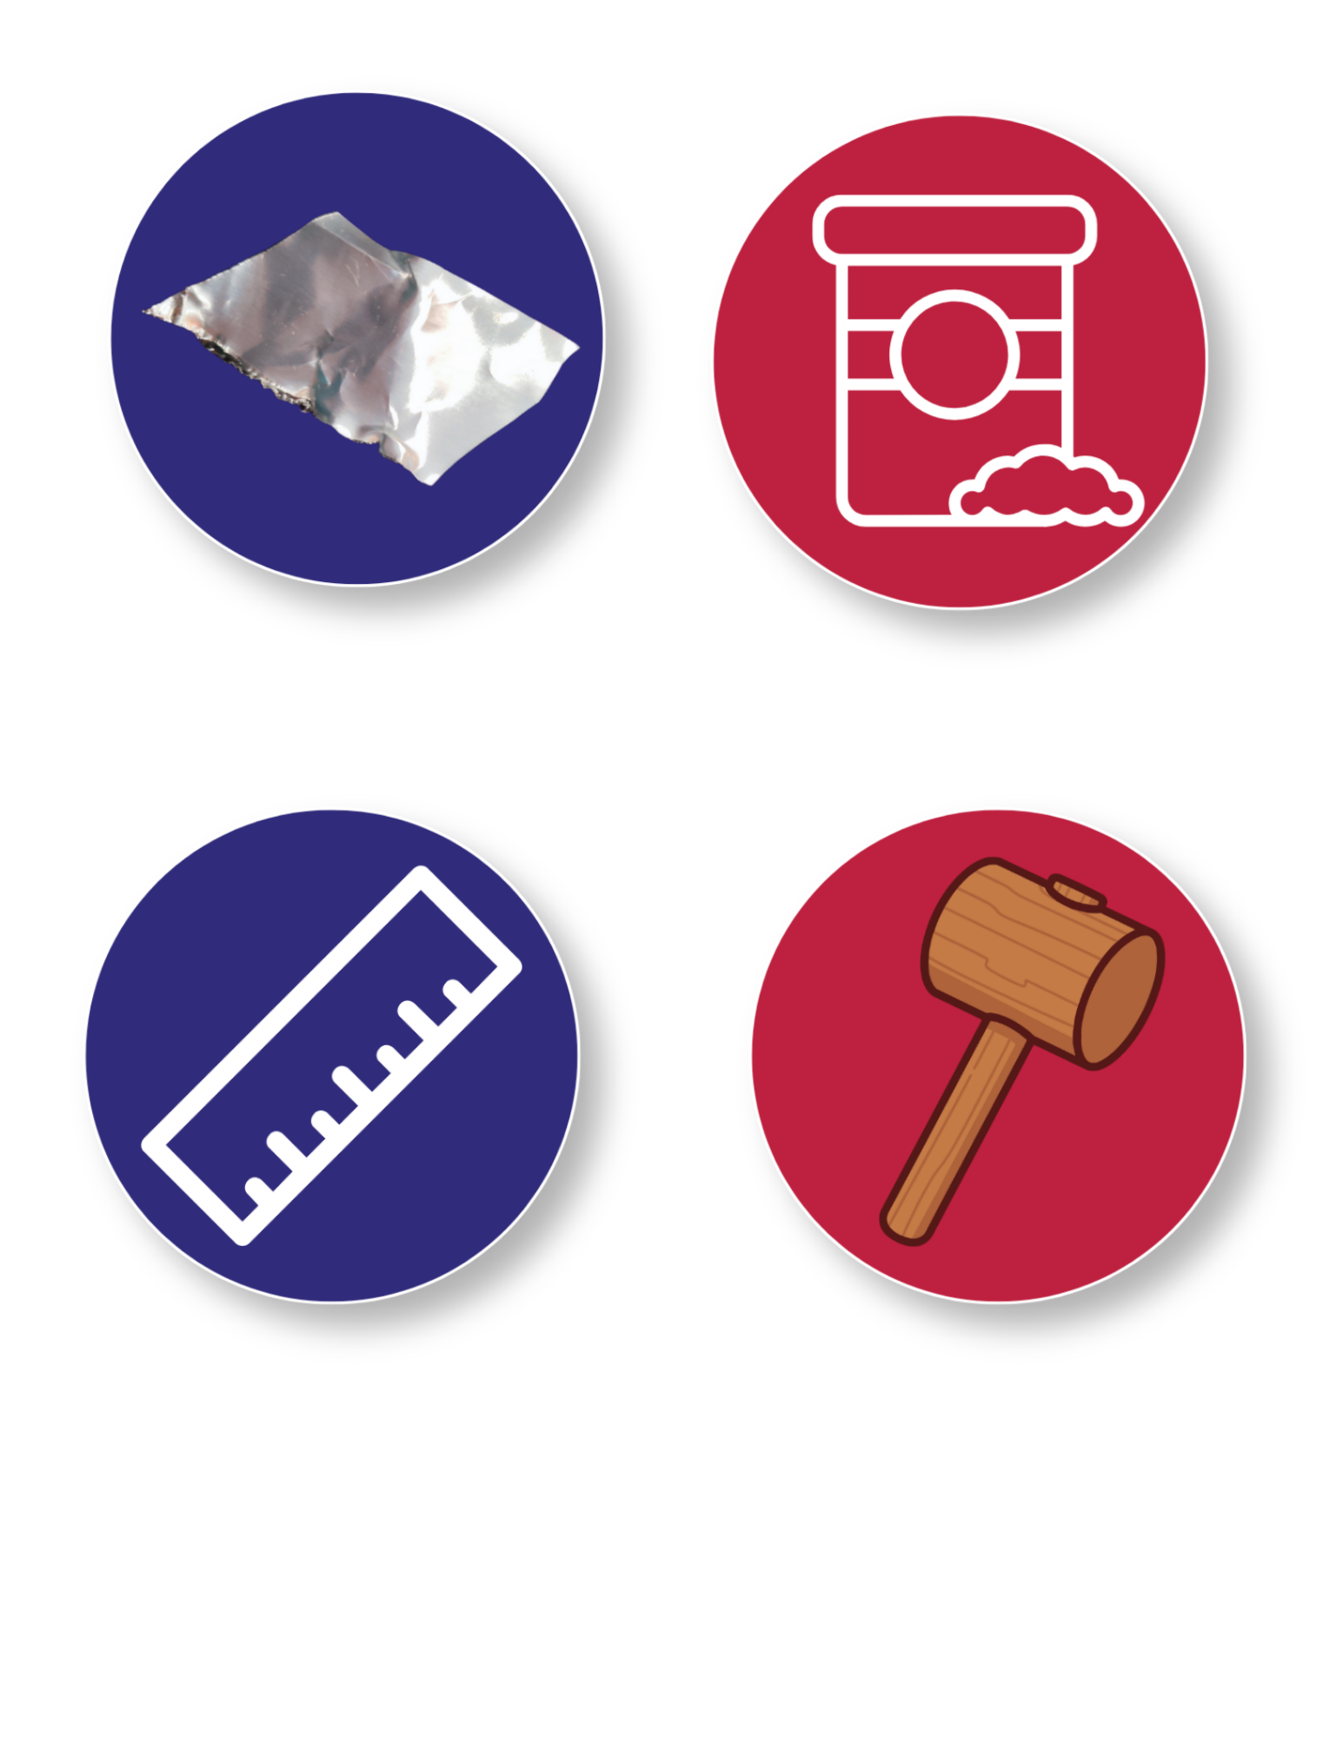

Today’s Materials
Wooden Mallet
Six-Inch Ruler
½ Container of playdough
Aluminum Foil Sheets
Get Your Materials Ready!
Today you'll use simple tools to shape clay and discover why making things the same size and shape is so important.
Notes:
1 six-inch ruler
½ a container of play dough
1 Wooden mallet
2 aluminum foil sheets Get your materials ready!

Slide 6
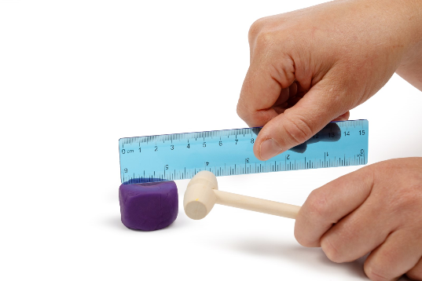
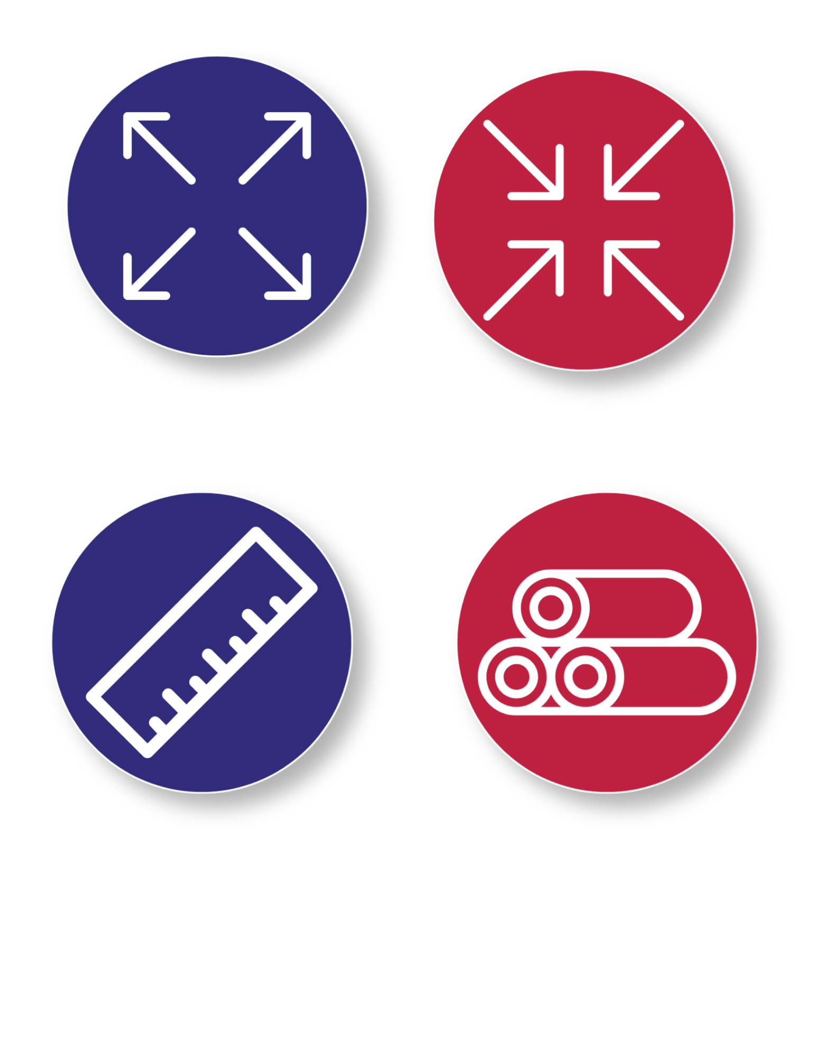
Step 1
Forge the Playdough Cube
1
Form a small ball or cube of playdough
Use the mallet to gently tap the sides of the playdough to help flatten and shape the dough into a cube
2
3
Use the ruler to check if the sides of the cube are roughly one inch
If the cube is too big,
continue hammering the
cube to compress it or
remove some excess material
If the cube is too small, add more playdough and continue hammering until each side is about 1 inch
Tips:
Notes:
: Forge the play dough Cube
Form a small ball or cube of play dough
Use the mallet to gently tap the sides of the play dough to help flatten and shape the dough into a cube
Use the ruler to check if the sides of the cube are roughly one inch
If the cube is too big, continue hammering the cube to compress it or remove some excess material
If the cube is too small, add more play dough and continue hammering until each side is about 1 inch

Slide 7


Step 2
Forge the Foil Cube
Crumple 2 sheets of aluminum foil into a tight ball
1
Gently tap the foil ball with the mallet to forge it into a cube
2
3
Use a ruler to try to make the foil cube roughly one inch on each side
Take a Look:
The finished foil cube should be about the same size as the playdough cube
Notes:
Forge the Foil Cube
Crumple [PLACEHOLDER AMOUNT] sheets of aluminum foil into a tight ball
Gently tap the foil ball with the mallet to forge it into a cube
Use a ruler to try to make the foil cube roughly one inch on each side
The finished foil cube should be about the same size as the play dough cube

Slide 8

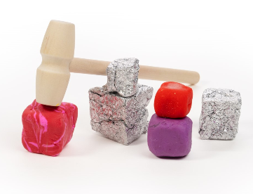
You just practiced the art of forging!

Slide 9

Turn and Talk Time!
Questions to Consider
Which material was easier to shape? Why?
How did you measure or check the size of your cubes to see if they matched?
Why might it be important to be able to make parts the same size?
Why do you think people want the things they make to be the same size and shape?

Slide 10


Wrap Up!
What Careers Did We Explore Today?
Toy makers shape parts so toys fit together and work the same every time
Builders measure and shape materials so pieces fit together and stay strong
Furniture makers make parts that need to match so that tables or chairs don’t wobble
Factory workers help make many copies of the same object so they all match
Notes:
​Toy makers shape parts so toys fit together and work the same every time
Builders measure and shape materials so pieces fit together and stay strong
Furniture makers make parts that need to match so that tables or chairs don’t wobble
Factory workers help make many copies of the same object so they all match

