Slide 1




Activity Overview
Color Changing Slime

Slide 2

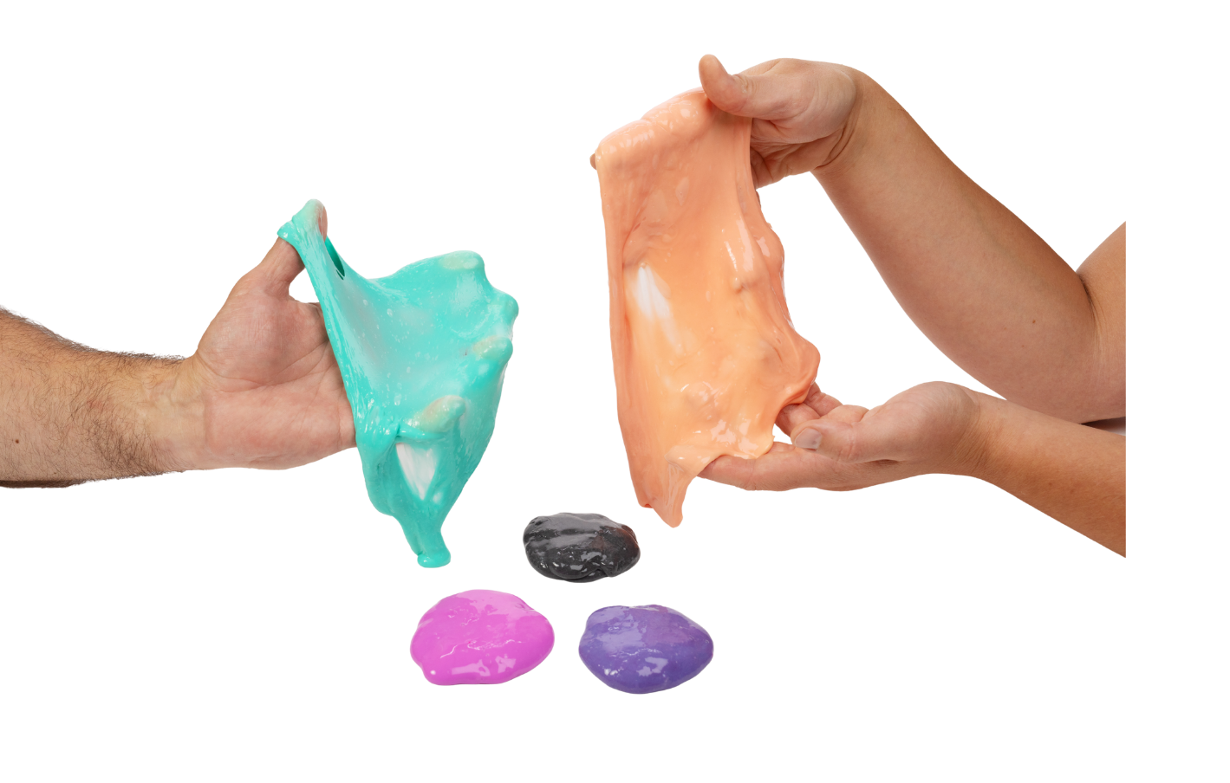

Color-Changing Slime

Slide 3

Key Words to Know
Material
- What something is made of
Change
- When something becomes different
Observe
- To look closely and notice what is happening
Respond
- When something changes because of what is happening around it
Notes:
Here are some vocabulary words you might need to know:
Material - What something is made of
Change - When something becomes different
Observe - To look closely and notice what is happening
Respond - When something changes because of what is happening around it

Slide 4
The Foundations of Super Materials
Today, we are going to explore something squishy, stretchy, and surprising: slime! At first, slime might look ordinary, but it has a special secret. When we touch it and play with it, it can change color right before our eyes.
Meet a Super Material!
Scientists love to ask questions about things like this:
The slime we will make today is a super material because it can change color when you hold it, stretch it, or squish it in your hands.
This slime contains a special powder with tiny pieces that respond to how warm or cold something is. When you hold the slime, your warm hands help those color pieces change, and the slime looks like a new color. When the slime cools down, it can change back again. That’s what makes this slime a super material.
What is it made of?
What can it do?
What makes it change?
Today- you are the scientist!
Notes:
Today, we are going to explore something squishy, stretchy, and surprising: slime! At first, slime might look ordinary, but it has a special secret. When we touch it and play with it, it can change color right before our eyes.
Scientists love to ask questions about things like this:
What is this made of?
What can it do?
What makes it change?
Today, you are the scientist!
Meet a Super Material
The slime we will make today is a super material because it can change color when you hold it, stretch it, or squish it in your hands.
This slime has a special powder in it with tiny pieces inside that respond to how warm or cold something is. When you hold the slime, your warm hands help those color pieces change, and the slime looks like a new color. When the slime cools down, it can change back again. That’s what makes this slime a super material.

Slide 5
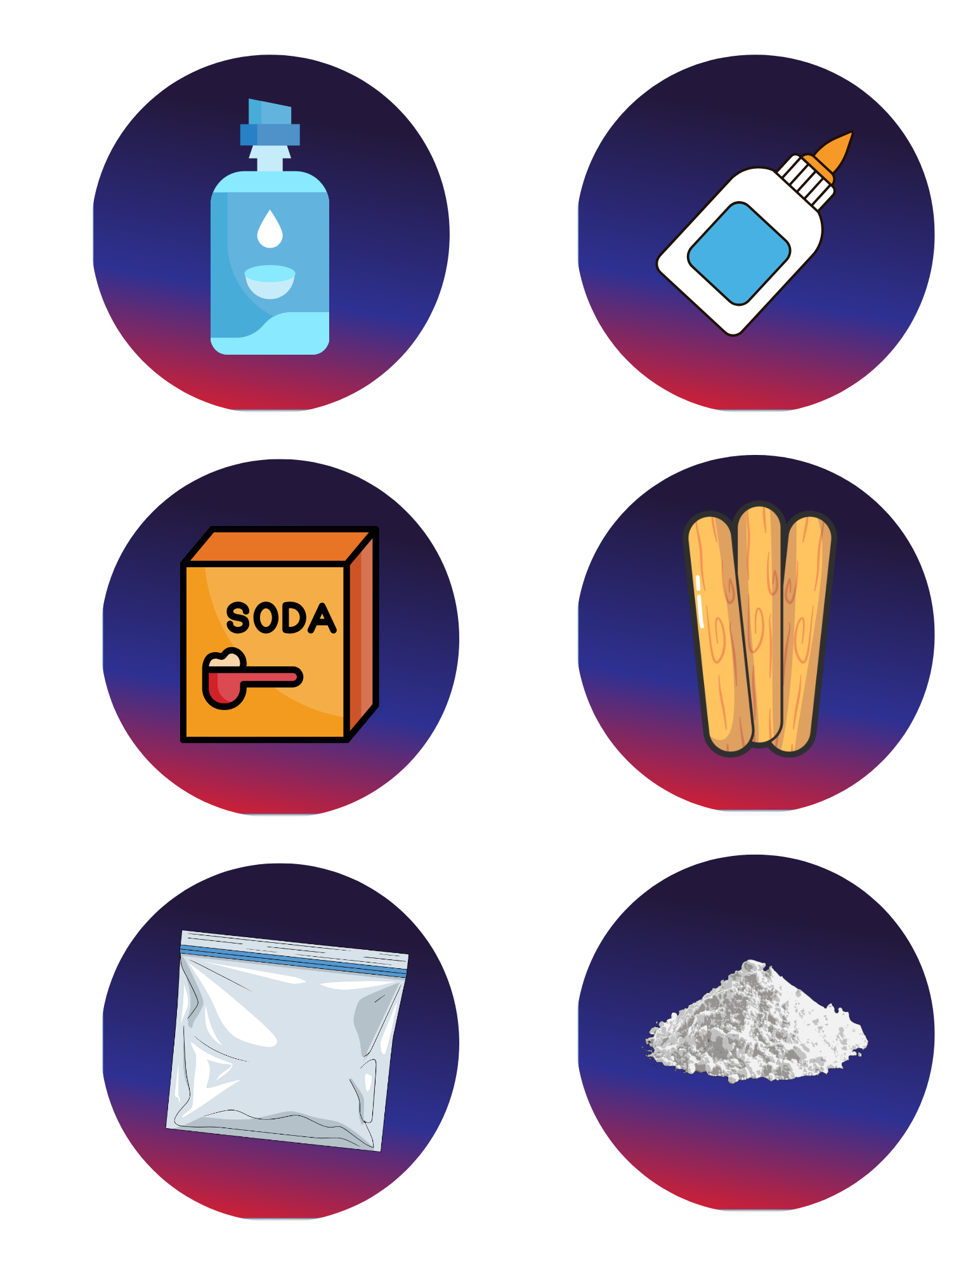
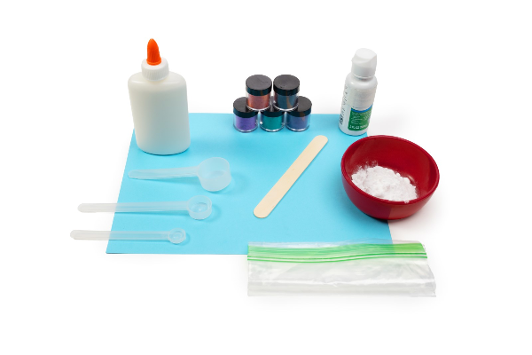

Today’s Materials
Elmer’s Glue
Contact Solution
Thermochromic Powder
Ziplock Bag
Baking Soda
Craft Stick
Measuring Scoops
Notes:
2 tablespoons of Elmer’s glue
1 spoon of thermochromic powder
Three 1/8 teaspoons of baking soda
¾ teaspoon of contact solution
1 Ziploc bag
1 craft stick
Elmer’s glue
Baking soda
Eye contact solution
Measuring scoops

Slide 6
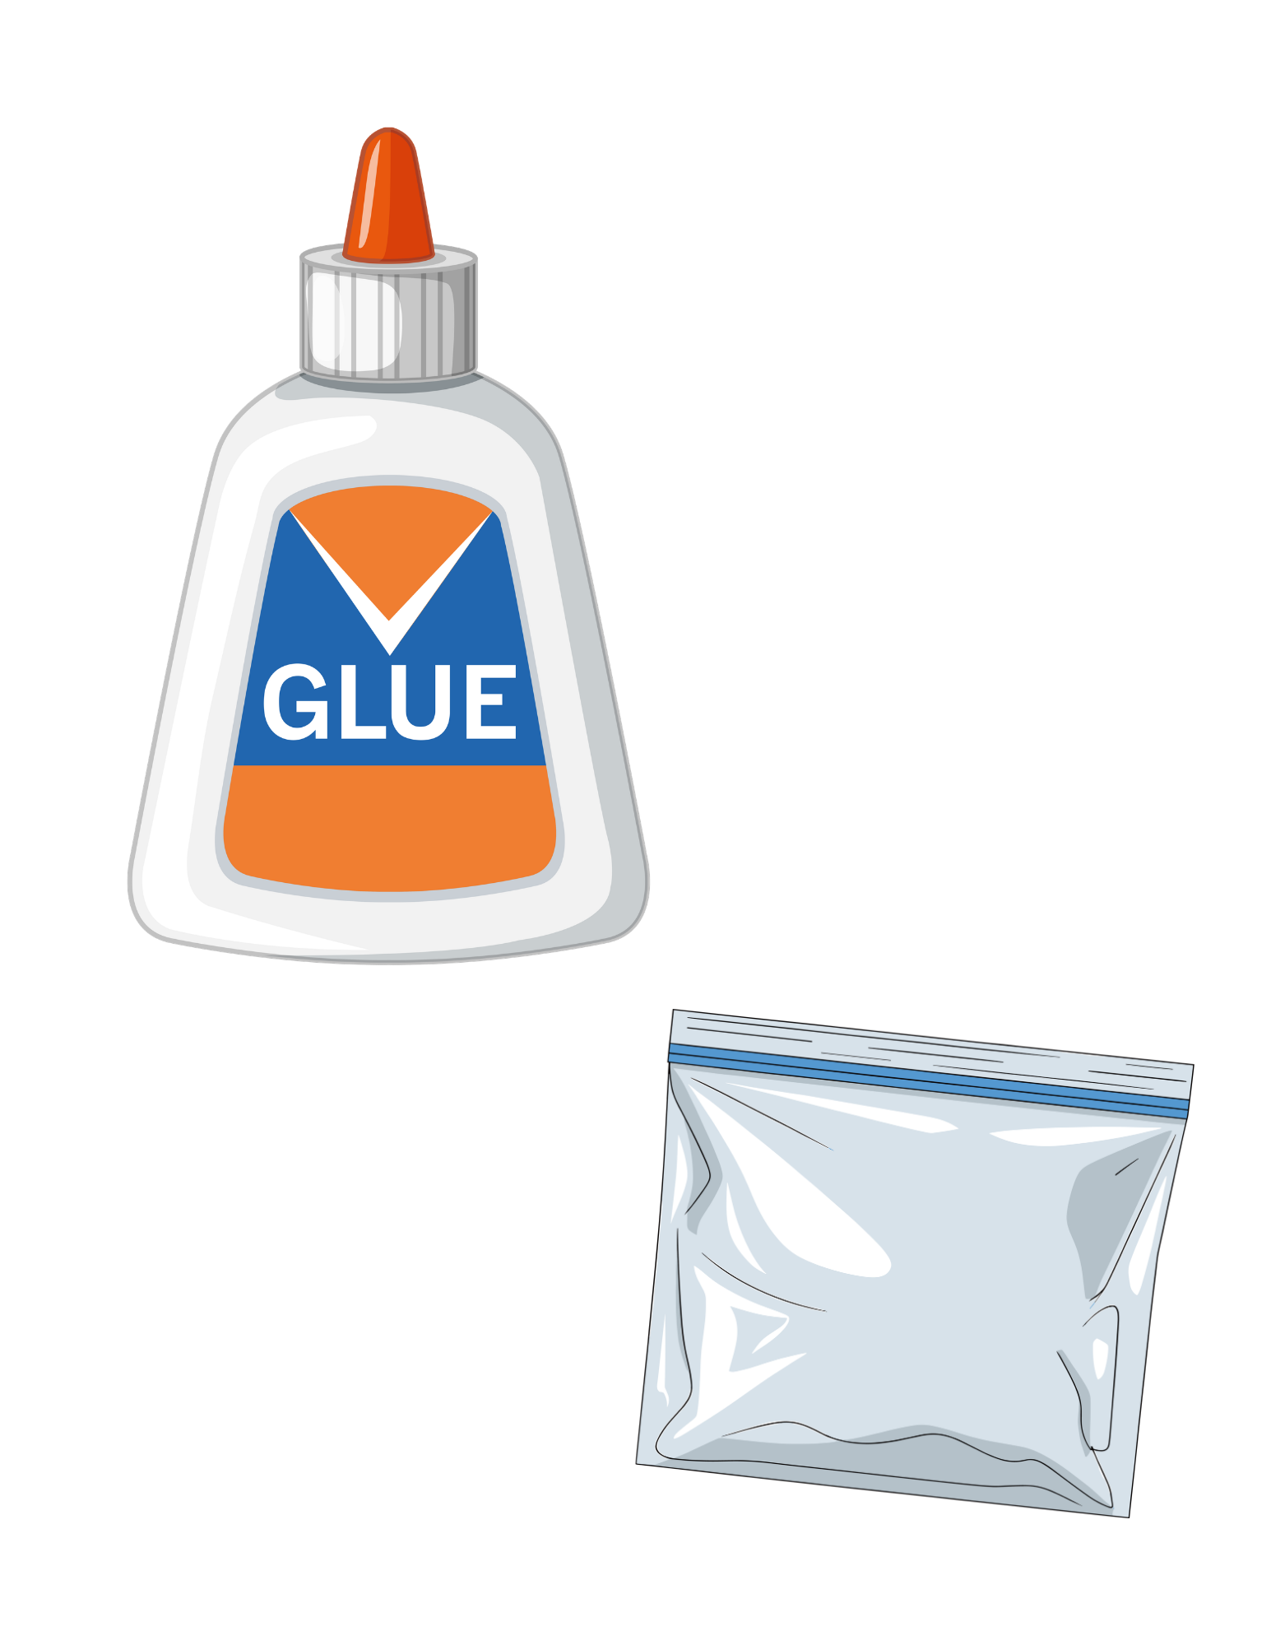
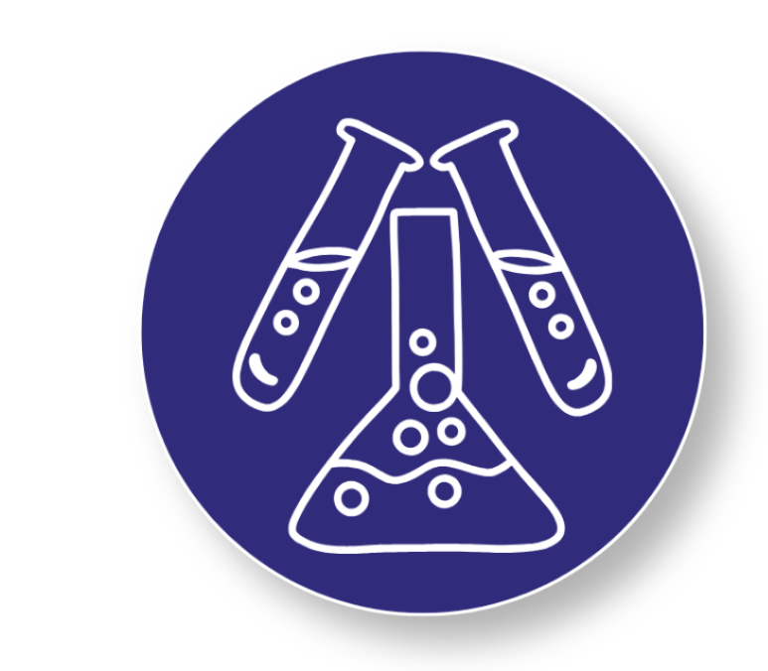
Step 1
Start With the Base
1
Place 2 tablespoons of glue into your plastic bag
Add 1 spoonful of color-changing powder to the bag
2
3
Seal the bag tightly
Use your hands to gently mush and squish the bag until the glue and powder are mixed together
4
It’s Time to Become a Materials Scientist!
Mix your ingredients carefully and get ready to create a slime with a superpower.
Notes:
: Start with the Base
Place 2 tablespoons of glue into your plastic bag
Add 1 spoonful of color-changing powder to the bag
Seal the bag tightly
Use your hands to gently mush and squish the bag until the glue and powder are mixed together

Slide 7
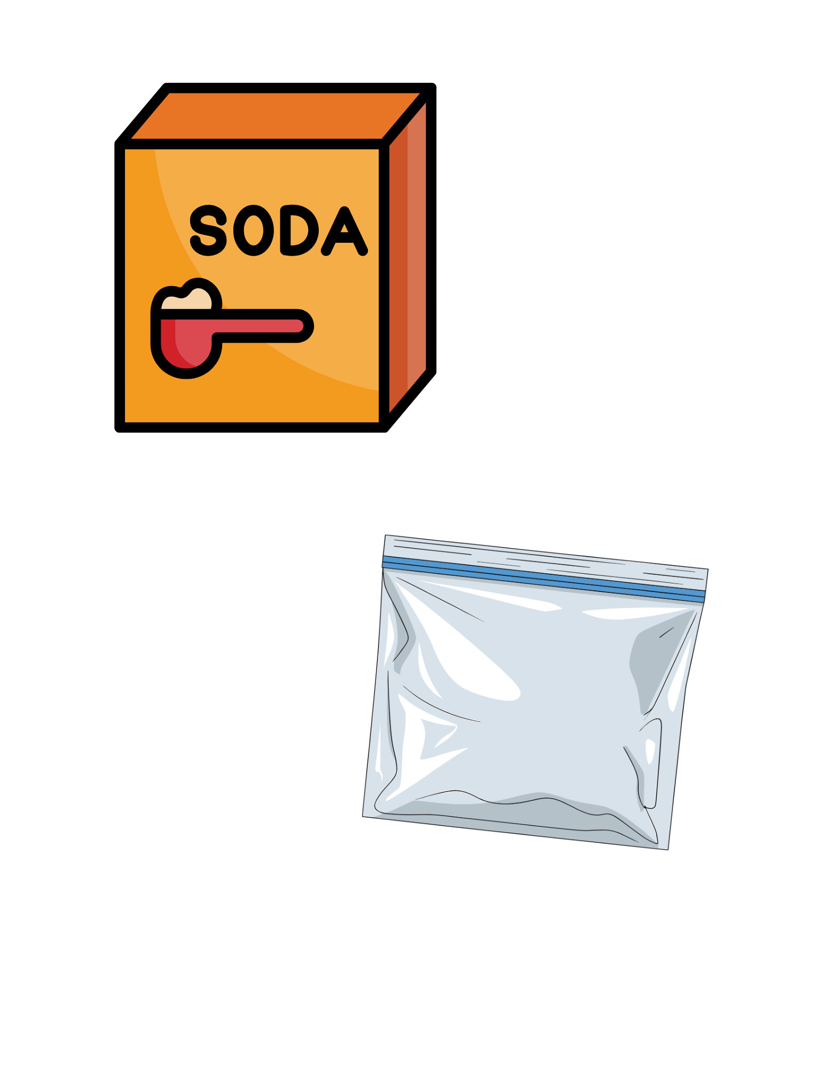
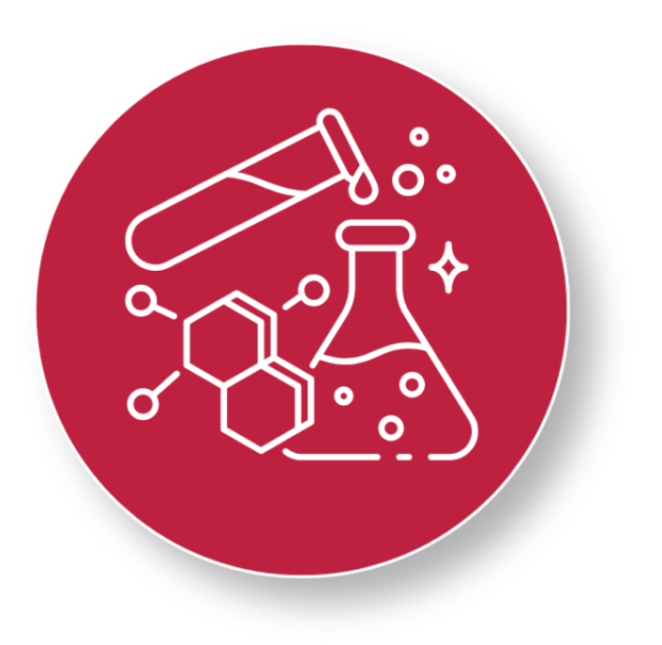
Step 2
Add the Activator
Open the bag and add three 1/8 teaspoons of baking soda
5
6
Seal the bag again
Use your hands to mush and mix the ingredients through the bag until everything is combined
7
You’re Almost There!
You're one step closer to creating a super material! Mix everything well and get ready to see your slime come to life.
Notes:
Add the Activator
Open the bag and add three 1/8 teaspoons of baking soda
Seal the bag again
Use your hands to mush and mix the ingredients through the bag until everything is combined

Slide 8
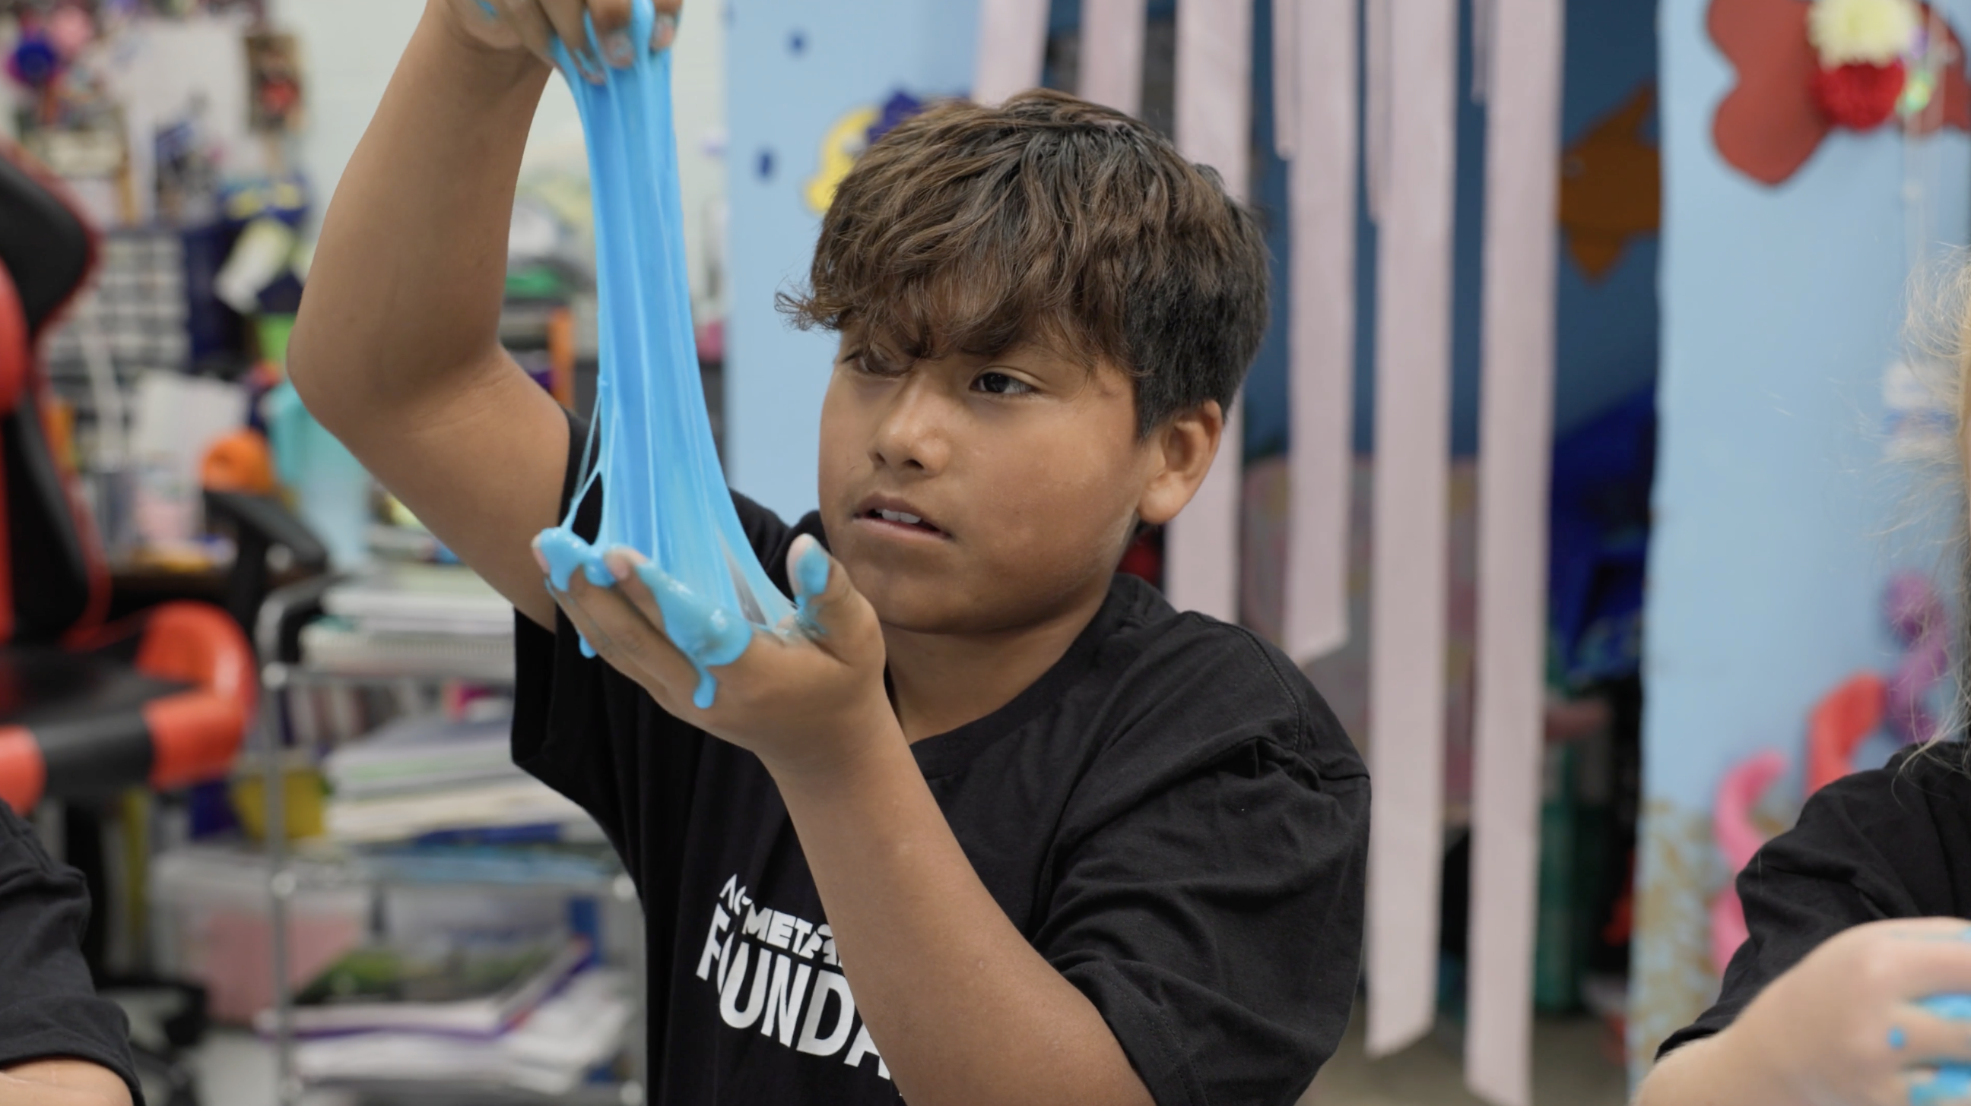
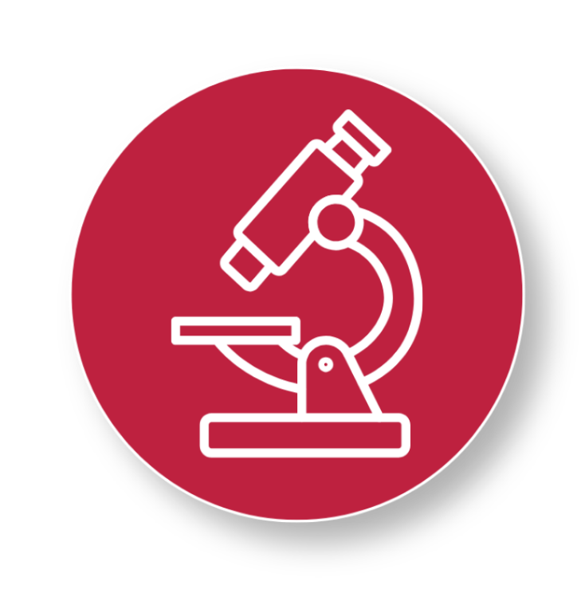
Step 3
Watch the Slime Form
Open the bag and carefully add ¾ teaspoon of contact solution
8
9
Seal the bag one last time
Mush, squeeze, and press the bag with your hands
10
Keep mixing until the slime starts to pull together and looks stretchy instead of runny
11
Scientist Tip:
Watch your material transform! The contact solution helps the ingredients link together, turning the mixture into a stretchy slime with amazing new properties.
Notes:
Watch the Slime Form
Open the bag and carefully add ¾ teaspoon of contact solution
Seal the bag one last time
Mush, squeeze, and press the bag with your hands
Keep mixing until the slime starts to pull together and looks stretchy instead of runny

Slide 9
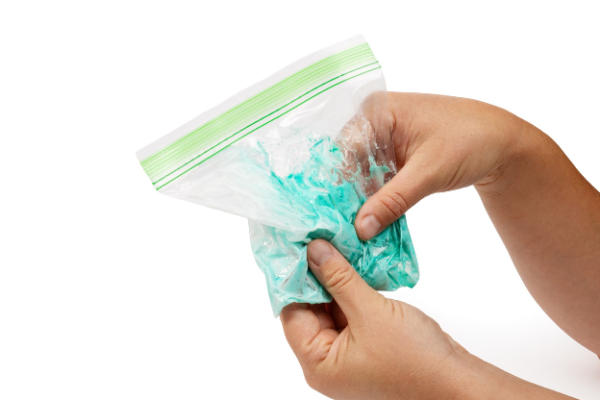
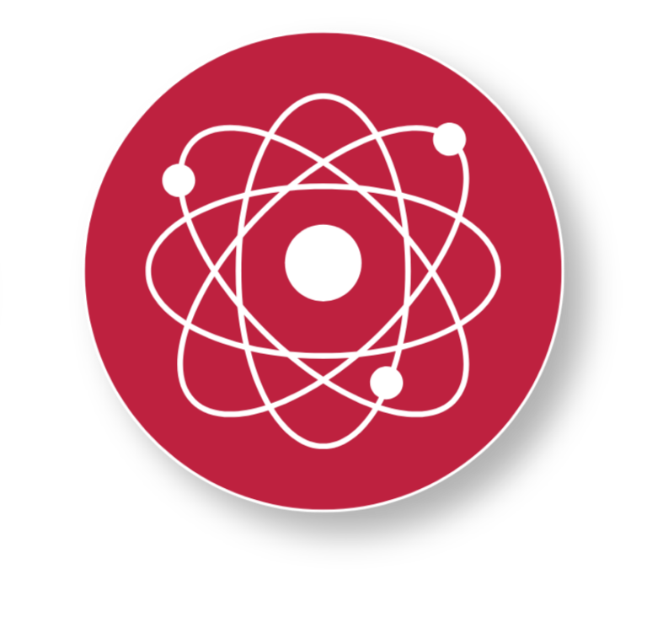
Step 4
Watch the Color Change!
12
Hold the bag in your hands
Stretch and squish the slime through the bag
13
14
Watch closely and note the color change as your hands warm up the slime
You Made a Super Material!
Heat from your hands is triggering tiny color-changing particles inside the slime, creating a reversible color change.
Notes:
Hold the bag in your hands
Stretch and squish the slime through the bag
Watch closely and note the color change as your hands warm up the slime

Slide 10

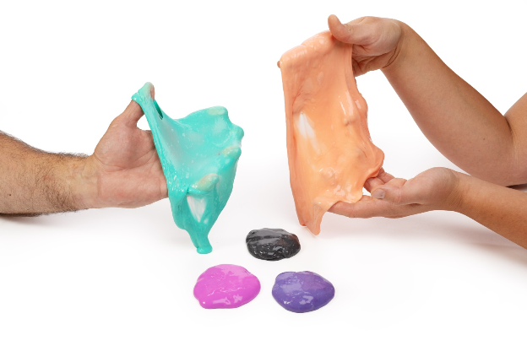
You just created color-changing slime!

Slide 11

Turn and Talk Time!
What do you know about slime or gooey materials?
What happened as you held the slime in your hands?
Why do you think your hands help change the color of the slime?
Is your slime a ”super material”? What makes it super?
Notes:
What do you know about slime or gooey materials?
What happened as you held the slime in your hands?
Why do you think your hands help change the color of the slime?
Is your slime a ”super material”? What makes it super?

Slide 12

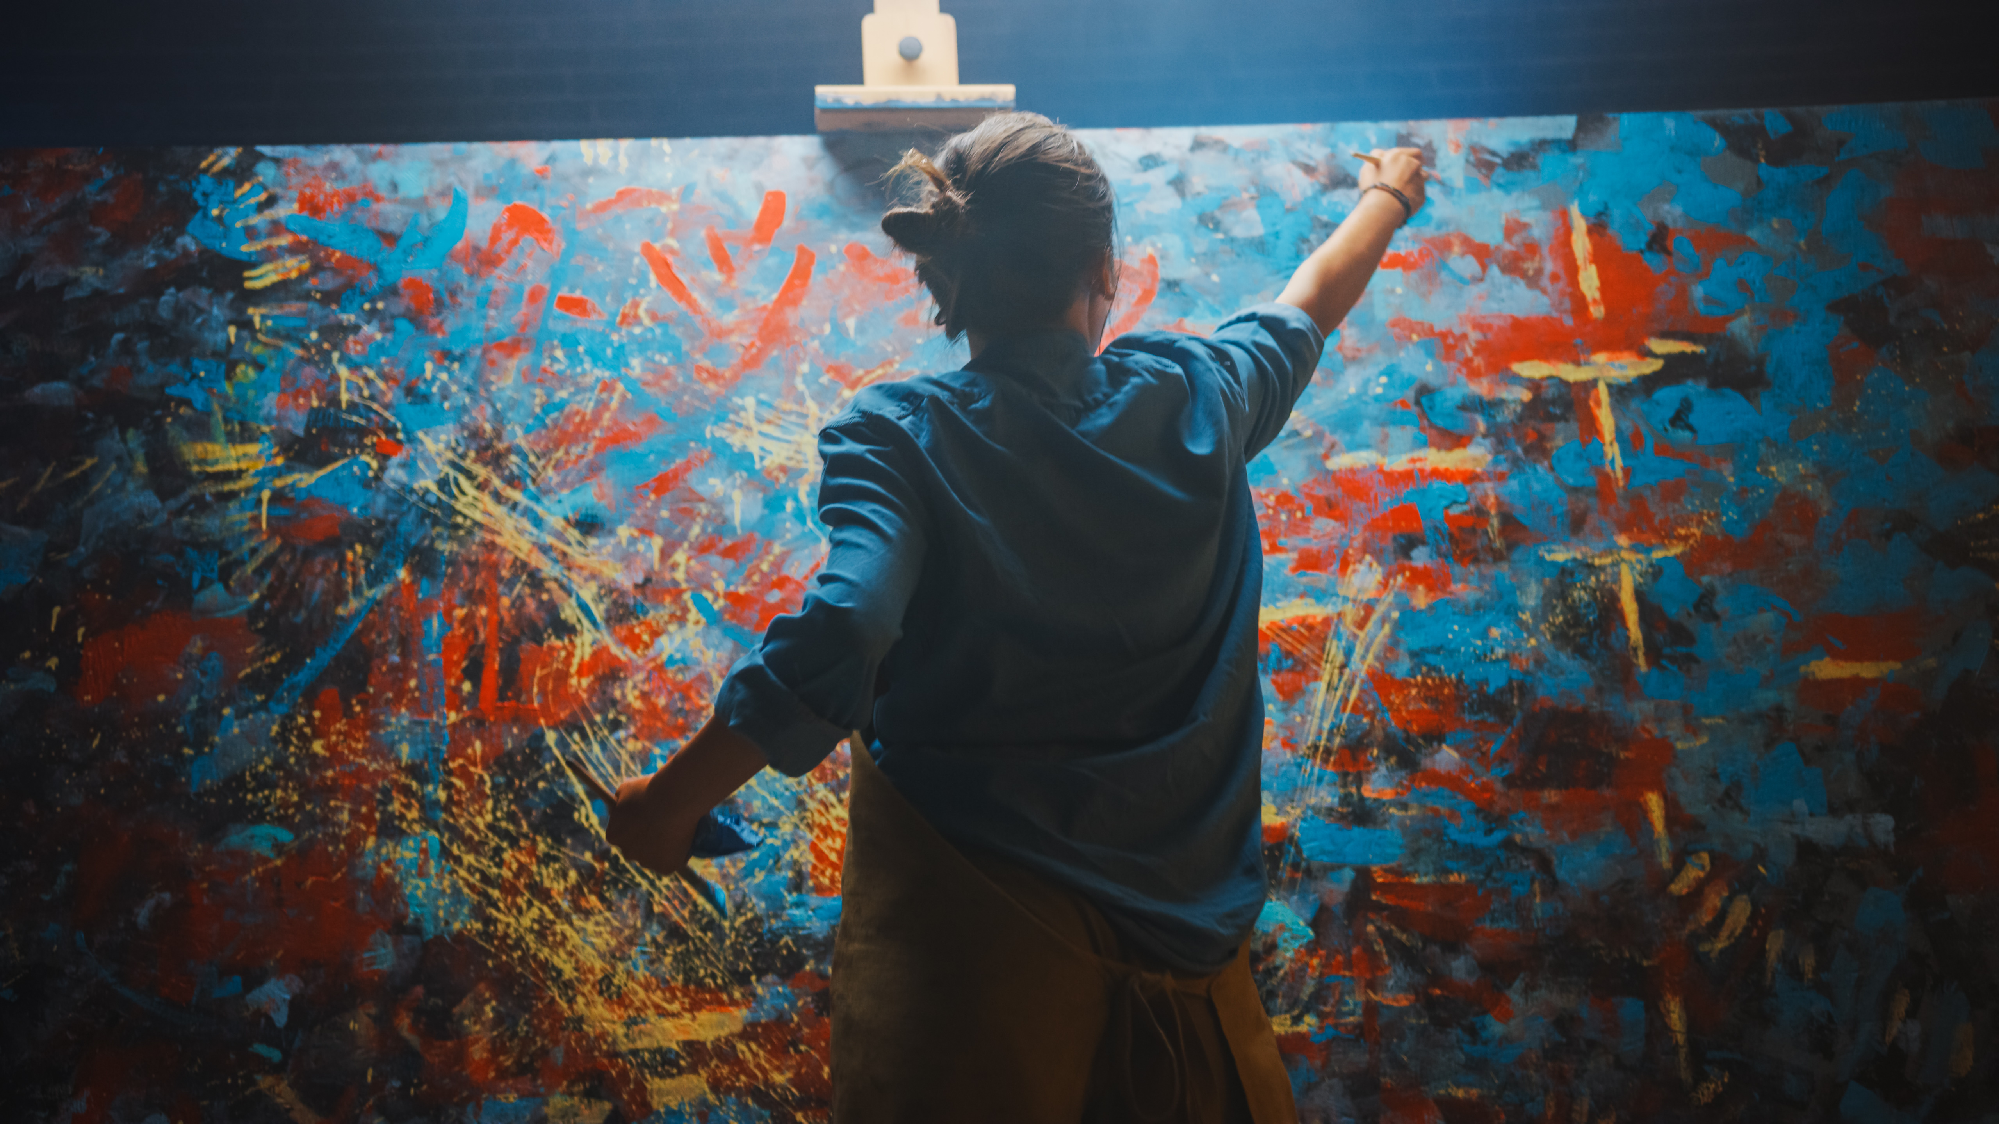
Wrap Up!
What Careers Did We Explore Today?
Toy makers regularly choose materials that stretch, squish, bounce, or change colors. They ask what a toy should feel like, how it should move, and what will
make it more fun to play with.
Clothes designers sometimes incorporate smart materials to make clothes more comfortable or more interesting
Artists sometimes use materials that change color, glow, or more and stretch to create more exciting art
Notes:
Toy makers regularly choose materials that stretch, squish, bounce, or change colors. They ask what a toy should feel like, how it should move, and what will make it more fun to play with.
Clothes designers sometimes incorporate smart materials to make clothes more comfortable or more interesting
Artists sometimes use materials that change color, glow, or more and stretch to create more exciting art

