Slide 1




Activity Overview

Slide 2

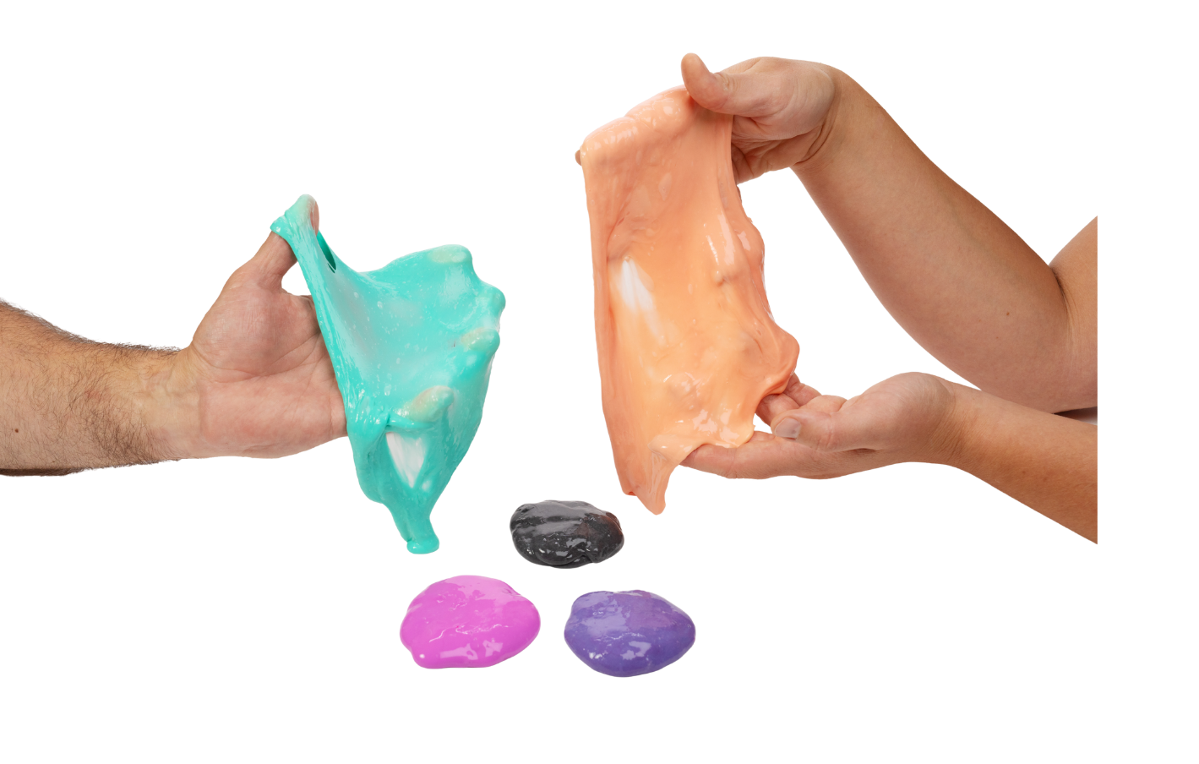

Color-Changing Slime

Slide 3

Key Words to Know
Material
- What something is made of
Energy
- Something that causes change, like heat or movement
Temperature
- A measure of how warm or cool something is
Response
- How something changes when something happens to it
Notes:
Here are some vocabulary words you might need to know:
Material: What something is made of
Energy: Something that causes change, like heat or movement
Temperature: A measure of how warm or cool something is
Response: How something changes when something happens to it

Slide 4
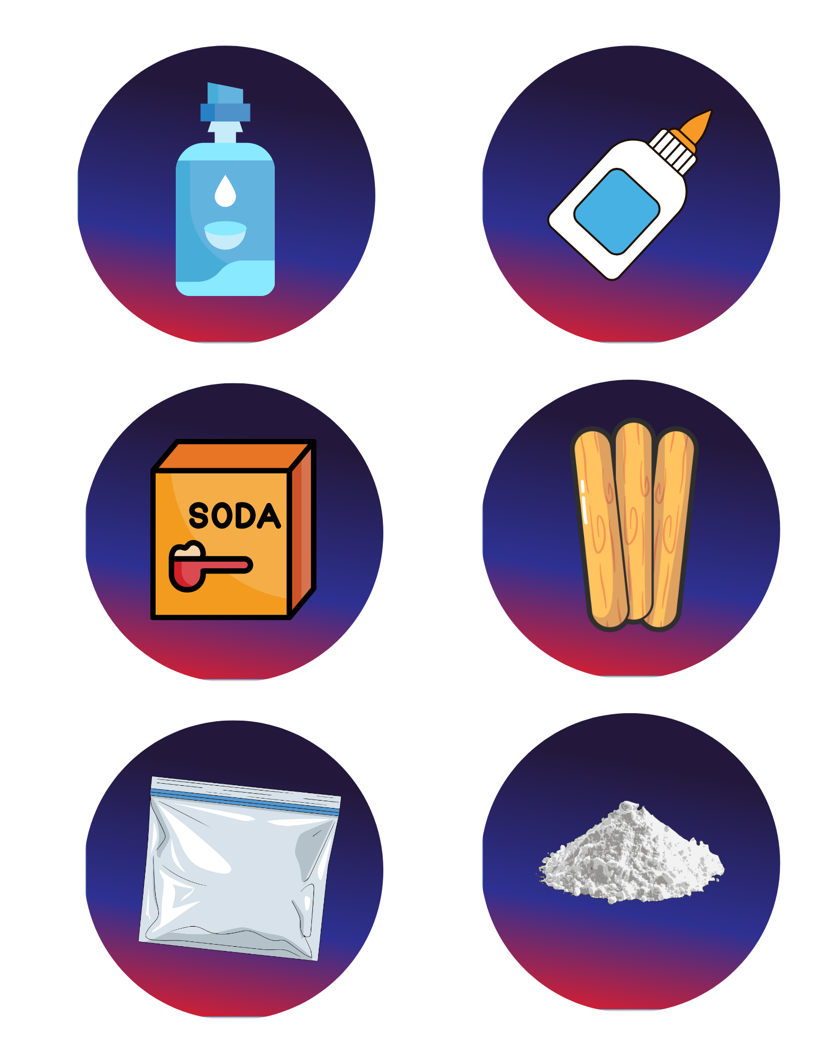
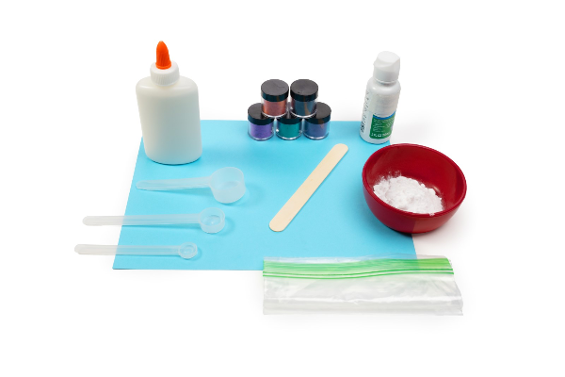

Today’s Materials
Elmer’s Glue
Contact Solution
Thermochromic Powder
Ziplock Bag
Baking Soda
Craft Stick
Measuring Scoops
Notes:
2 tablespoons of Elmer’s glue
1/8 teaspoon of thermochromic powder (scoop included with powder)
Three 1/8 teaspoons of baking soda
¾ teaspoon of contact solution
1 Ziploc bag
1 craft stick
Thermochromic powder
Baking soda
Eye contact solution
1 Tablespoon scoops
1 teaspoon scoops
1/8 teaspoon scoops

Slide 5
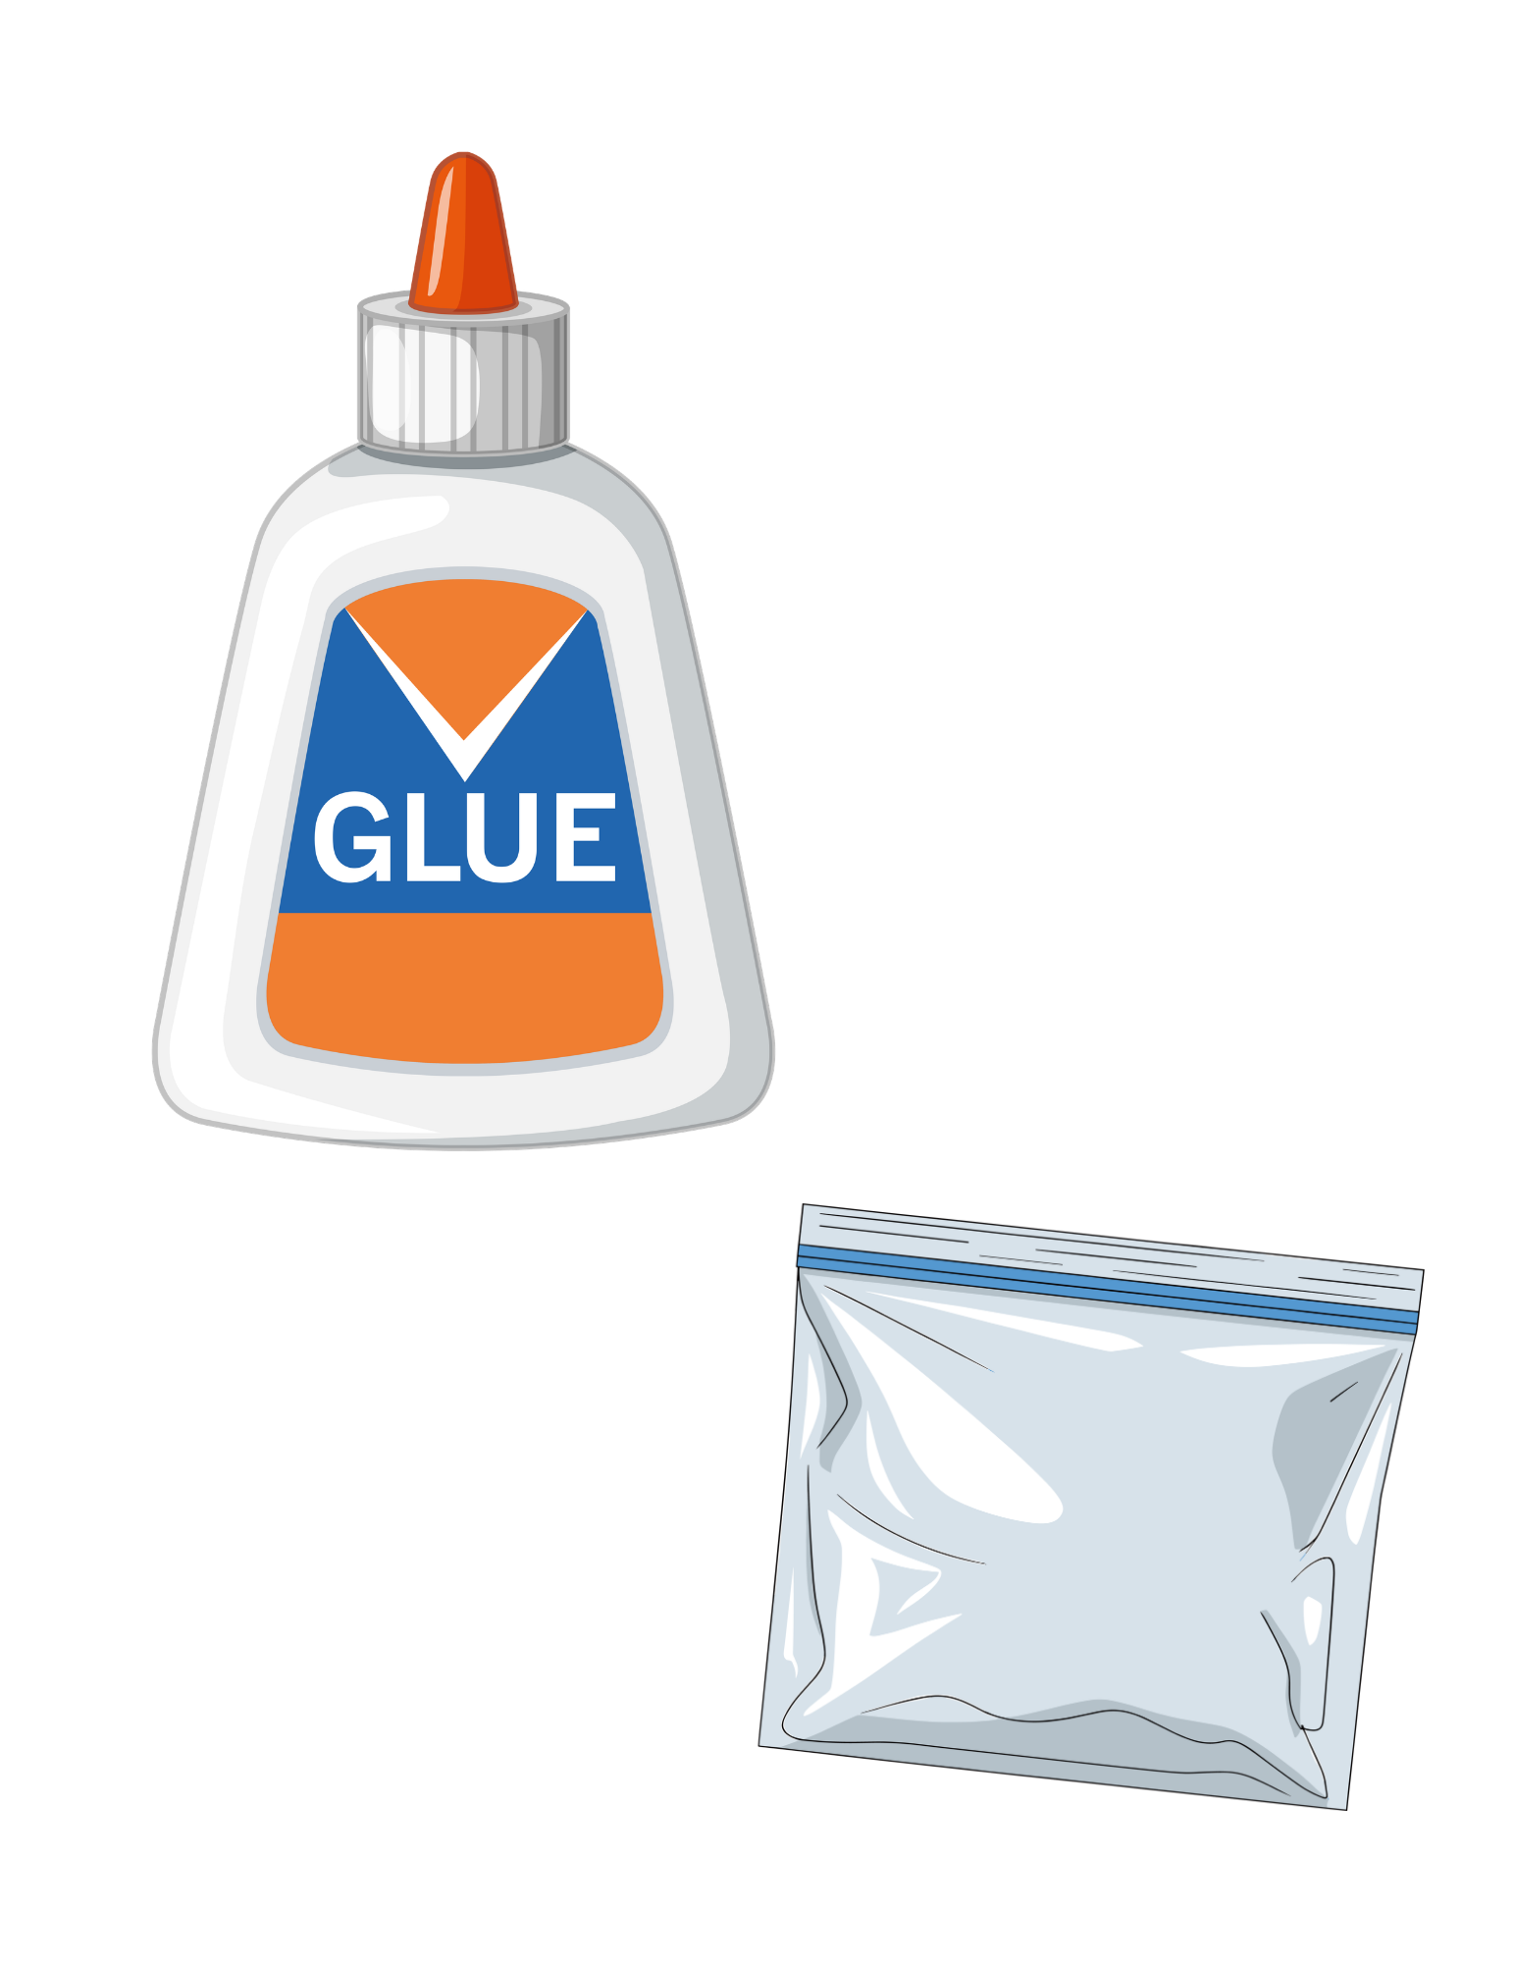
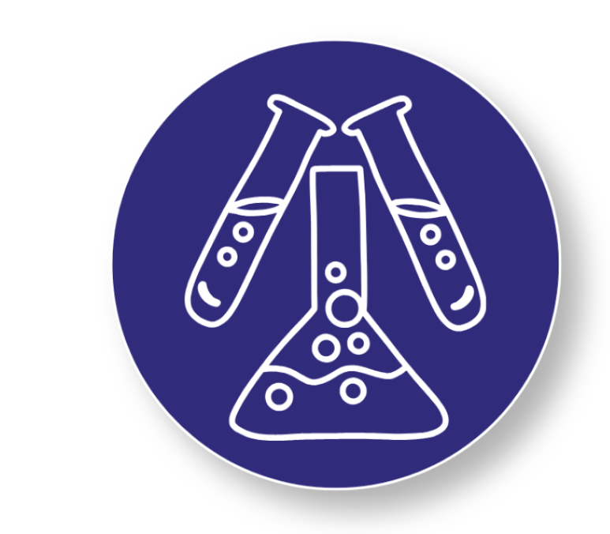
Step 1
Start With the Base
1
Place 2 tablespoons of glue into your plastic bag
Add 1 spoonful of color-changing powder to the bag
2
3
Seal the bag tightly
Use your hands to gently mush and squish the bag until the glue and powder are mixed together
4
It’s Time to Become a Materials Scientist!
Mix your ingredients carefully and get ready to create a slime with a superpower.
Notes:
Start with the Base
Place 2 tablespoons of glue into your plastic bag
Add 1 spoonful of color-changing powder to the bag
Seal the bag tightly
Use your hands to gently mush and squish the bag until the glue and powder are mixed together

Slide 6
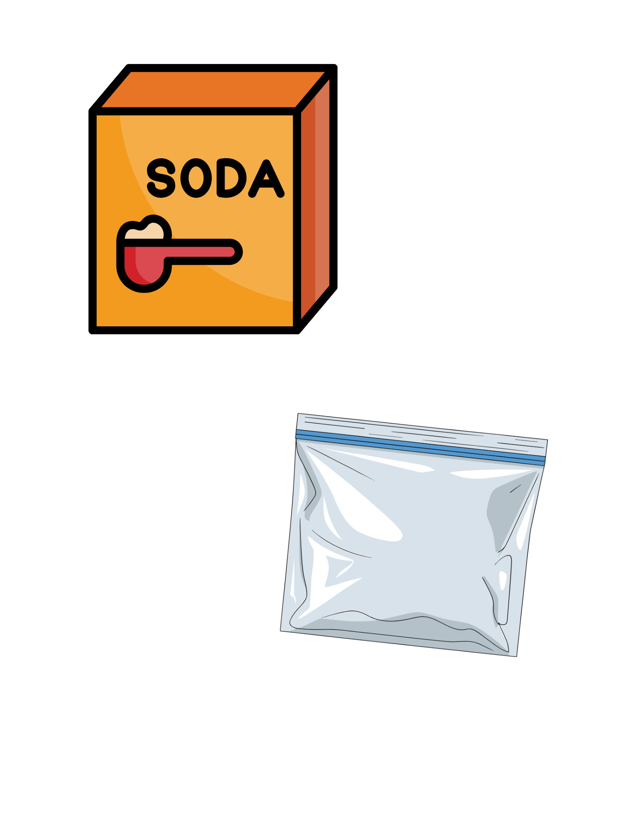

Step 2
Add the Activator
Open the bag and add three 1/8 teaspoons of baking soda
5
6
Seal the bag again
Use your hands to mush and mix the ingredients through the bag until everything is combined
7
You’re Almost There!
You're one step closer to creating a super material! Mix everything well and get ready to see your slime come to life.
Notes:
Add the Activator
Open the bag and add three 1/8 teaspoons of baking soda
Seal the bag again
Use your hands to mush and mix the ingredients through the bag until everything is combined

Slide 7
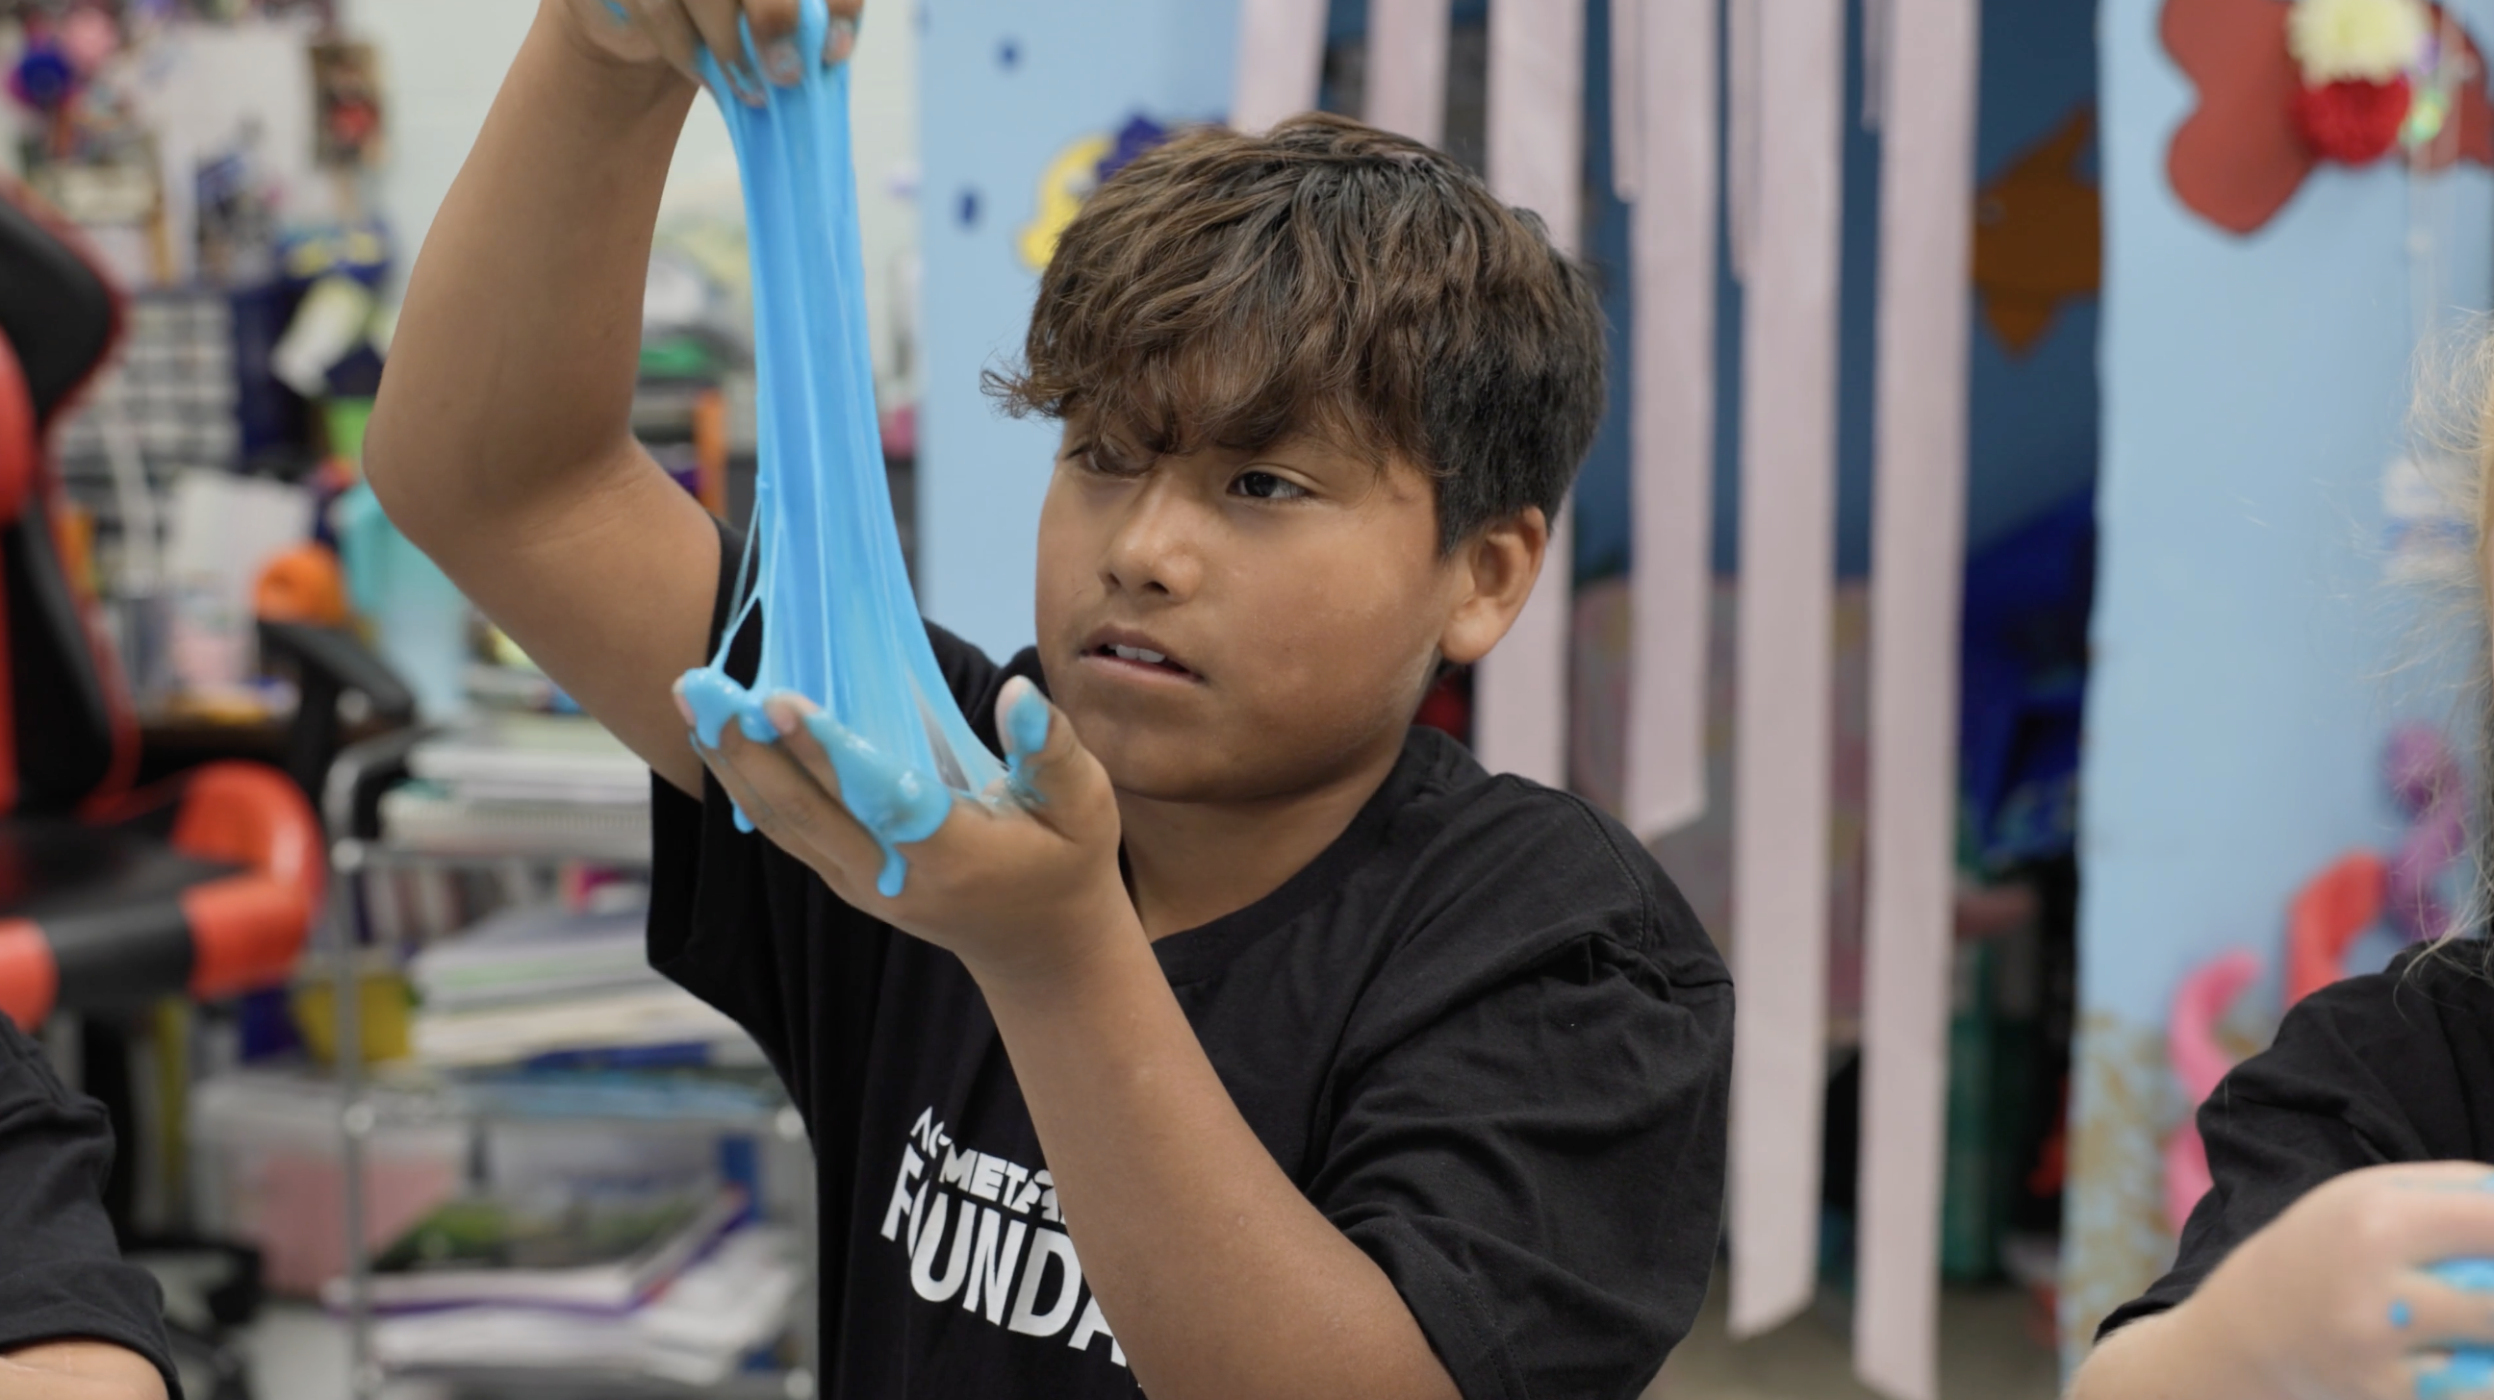

Step 3
Watch the Slime Form
Open the bag and carefully add ¾ teaspoon of contact solution
8
9
Seal the bag one last time
Mush, squeeze, and press the bag with your hands
10
Keep mixing until the slime starts to pull together and looks stretchy instead of runny
11
Scientist Tip:
Watch your material transform! The contact solution helps the ingredients link together, turning the mixture into a stretchy slime with amazing new properties.
Notes:
Watch the Slime Form
Open the bag and carefully add ¾ teaspoon of contact solution
Seal the bag one last time
Mush, squeeze, and press the bag with your hands
Keep mixing until the slime starts to pull together and looks stretchy instead of runny

Slide 8
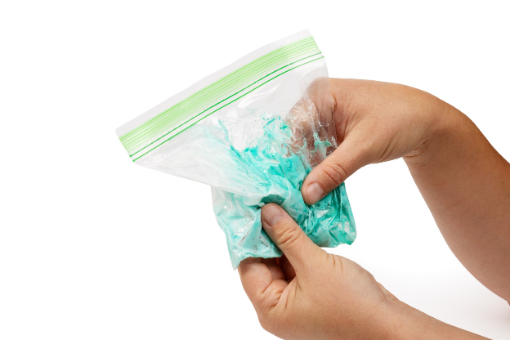

Step 4
Watch the Color Change!
12
Hold the bag in your hands
Stretch and squish the slime through the bag
13
14
Watch closely and note the color change as your hands warm up the slime
You Made a Super Material!
Heat from your hands is triggering tiny color-changing particles inside the slime, creating a reversible color change.
Notes:
Hold the bag in your hands
Stretch and squish the slime through the bag
Watch closely and note the color change as your hands warm up the slime

Slide 9

Why would a scientist want to create a material that changes colors?
Are there things that occur in the natural world that change colors?
You Just Created Color-Changing Slime!

Slide 10

Turn and Talk Time!
Where do you think the energy will come from in this activity?
How can you be sure that energy from your hands is moving into the material?
What evidence do you see that heat is affecting the slime?
What characteristics of the slime remain the same, even though the color changes?
Notes:
Where do you think the energy will come from in this activity?
How can you be sure that energy from your hands is moving into the material?
What evidence do you see that heat is affecting the slime?
What characteristics of the slime remain the same, even though the color changes?

Slide 11
Wrap Up!
What Careers Did We Explore Today?
Materials Scientists study how materials respond to heat, light, and other forms of energy. They test materials to see how they change and help design new materials with specific responses.
Packaging Engineers design containers that protect products and sometimes include materials that respond to temperature changes to warn is food or medicine gets too hot or too cold.
Medical Device Designers create medical tools that use materials that change color to show temperature changes or signal when something needs attention. These materials help doctors and nurses notice important changes quickly.
Notes:
Materials Scientists study how materials respond to heat, light, and other forms of energy. They test materials to see how they change and help design new materials with specific responses.
Packaging Engineers design containers that protect products and sometimes include materials that respond to temperature changes to warn is food or medicine gets too hot or too cold.
Medical Device Designers create medical tools that use materials that change color to show temperature changes or signal when something needs attention. These materials help doctors and nurses notice important changes quickly.

