Slide 1




Activity Overview
Controlled Descent

Slide 2

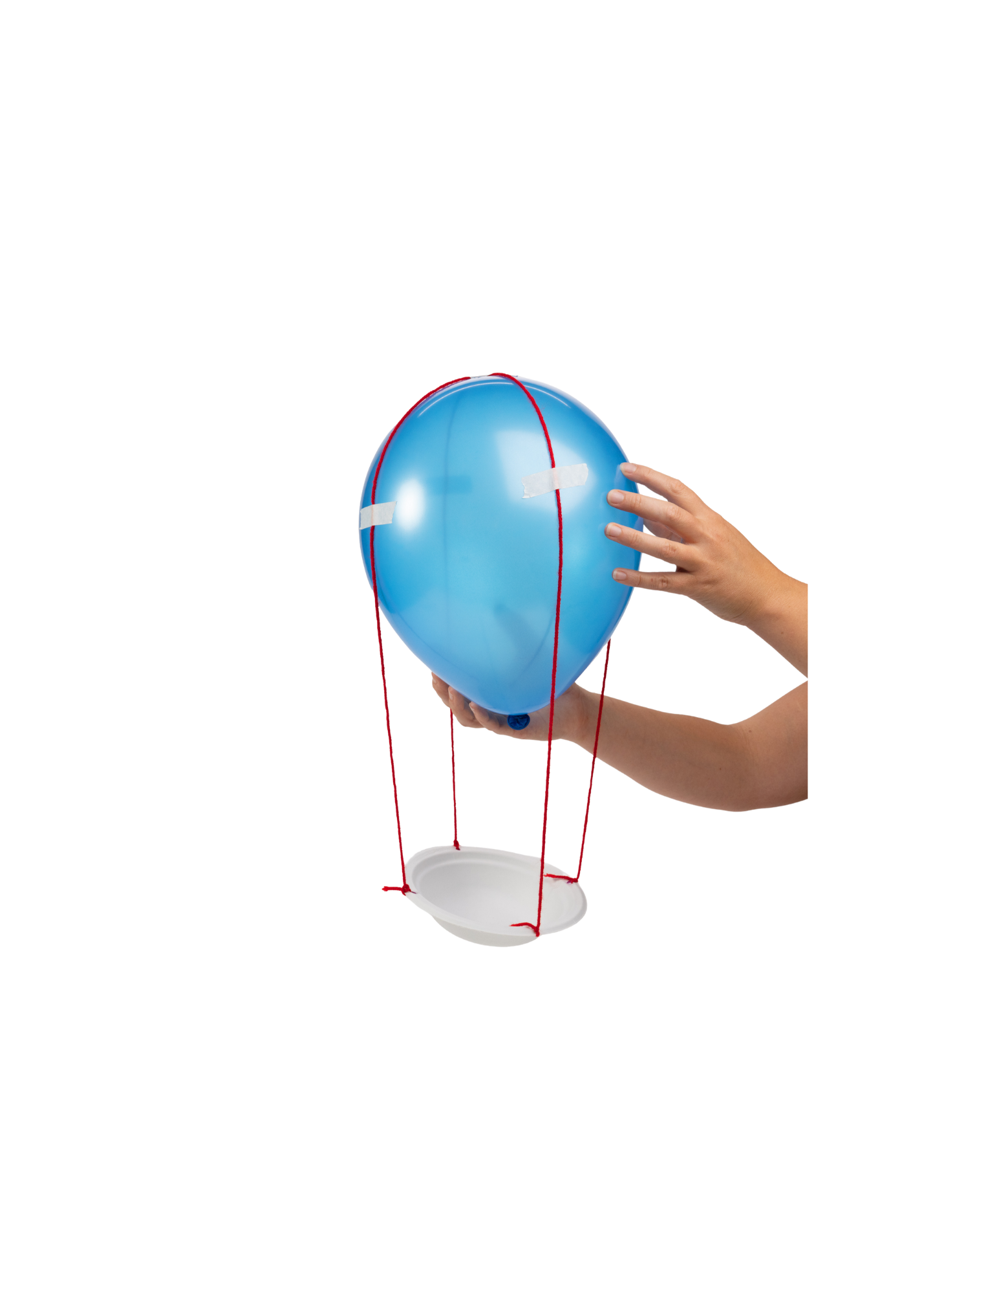


Controlled Descent

Slide 3
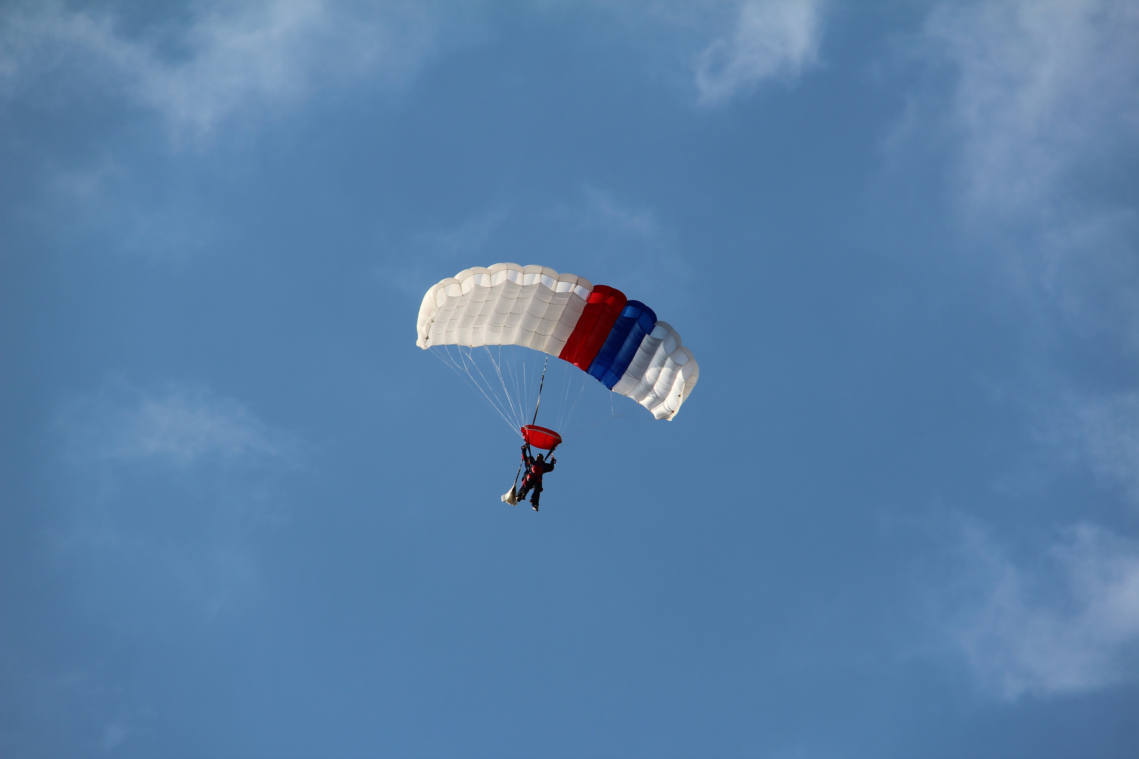

The Foundations of Designing for Gravity
Have you ever wondered why things always seem to fall to the ground?
Things fall because of gravity, but engineers design ways to control how they fall.
Everything on Earth is pulled toward the ground by gravity. When an object is dropped, gravity pulls it downward. Engineers cannot turn gravity off—but they can design systems that help control how fast something falls and what happens when it lands.
In this lesson, you will explore how designs can slow down a falling object and help protect it from impact.
Notes:
Have you ever wondered why things always seem to fall to the ground?
Things fall because of gravity, but engineers design ways to control how they fall.
Everything on Earth is pulled toward the ground by gravity. When an object is dropped, gravity pulls it downward. Engineers cannot turn gravity off—but they can design systems that help control how fast something falls and what happens when it lands.
In this lesson, you will explore how designs can slow down a falling object and help protect it from impact.

Slide 4

How Air Can Slow Things Down
As an object moves through the air, the air pushes back on it; this is called air resistance. This push can help slow the object down.
Size – bigger surfaces push against more air
Shape – wide, flat shapes slow down more than small ones
Materials – some materials catch more air than others
Notes:
How Air can Slow Things Down
As an object moves through the air, the air pushes back on it, this is called air resistance. This push can help slow the object down.
Whether air slows something a little or a lot depends on:
Size – bigger surfaces push against more air
Shape – wide, flat shapes slow down more than small ones
Materials – some materials catch more air than others
A parachute is a design that uses air to slow down a falling object. Instead of falling straight down quickly, the parachute spreads out and lets air push against it, helping the object fall more slowly.
I.
When an object moves through the air, the air pushes back on it and can help slow it down. Engineers use this idea when designing packaging, safety systems, and equipment that protects products while they are moving.

Slide 5
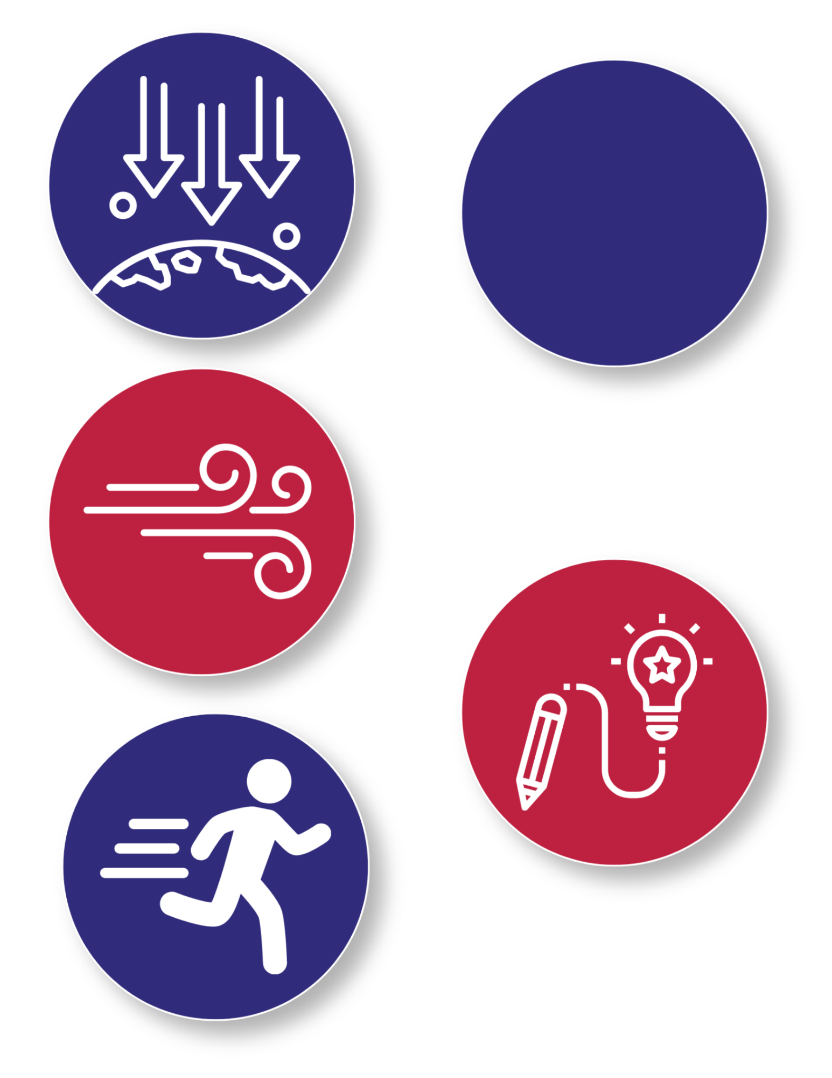
Key Words to Know
- The force that pulls objects down toward Earth
Gravity
Air Resistance
- The push from the air that slows an object down as it moves or falls
Controlled Motion
- Moving something in a careful way so it doesn’t go too fast or hit too hard
Design
- A plan for how something will be built or made to solve a problem
Notes:
Gravity: The force that pulls objects down towards Earth
Air Resistance: The push from the air that slows an object down as it moves or falls
Controlled Motion: Moving something in a careful way so it doesn’t go too fast or hit too hard
Design: A plan for how something will be built or made to solve a problem

Slide 6
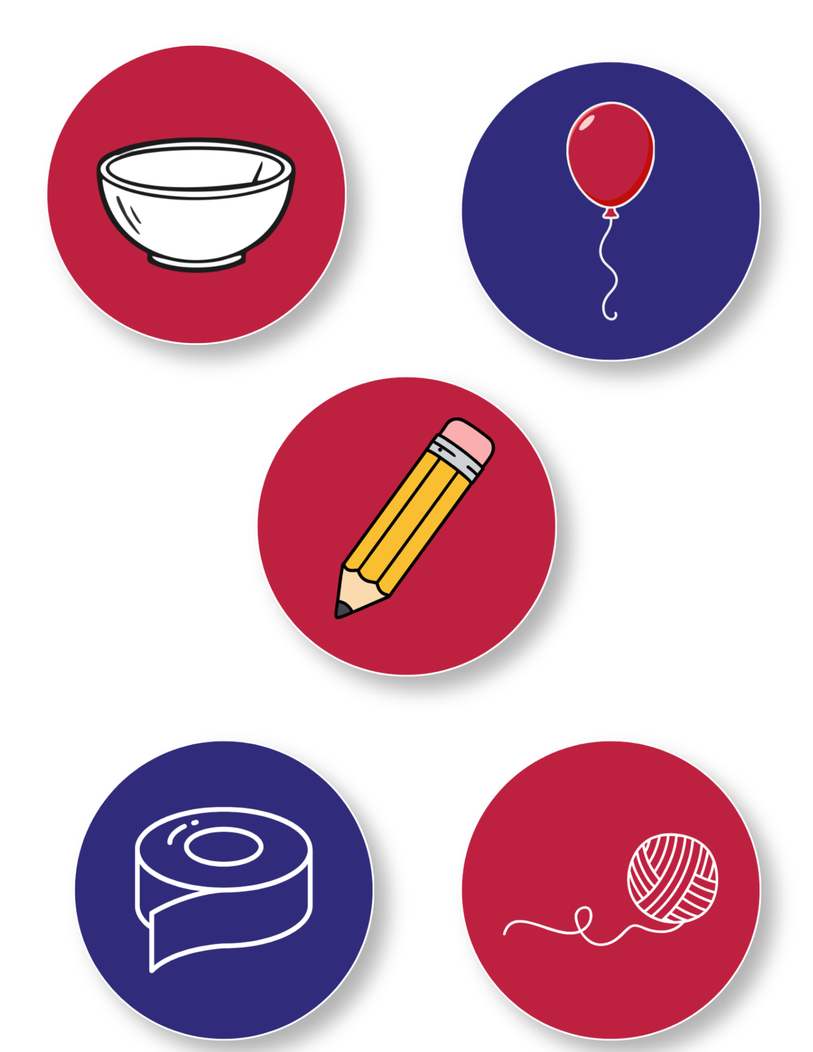
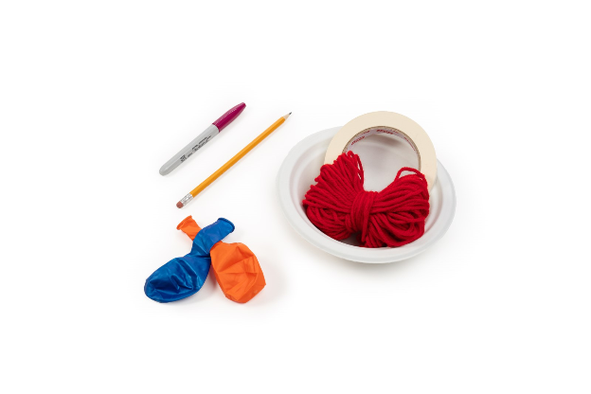
Today’s Materials
Balloon
Tape
Bowl
4 Strips of Yarn
1 Pencil Per Student
Notes:
1 balloon
1 bowl
4 strips of yarn of equal length
Tape
1 pencil per student (to punch holes through the edge of paper bowls)

Slide 7
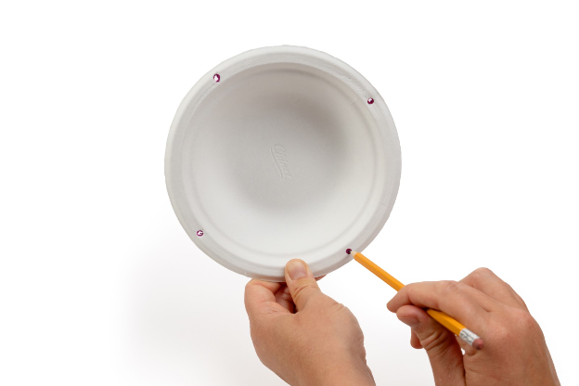
Step 1 Prep Your Bowl
Look at the edge of your bowl like it is the face of a clock
Check that the holes are spaced evenly around the bowl
1
3
Punch four holes
around the edge of the bowl using a pencil:
One hole at 12 o’clock
One hole at 3 o’clock
One hole at 6 o’clock
One hole at 9 o’clock
Make sure the holes are big enough for the string or yarn to fit through
2
4
Notes:
Look at the edge of your bowl like it is the face of a clock
Punch four holes around the edge of the bowl using a pencil:
One hole at 12 o’clock
One hole at 3 o’clock
One hole at 6 o’clock
One hole at 9 o’clock
Check that the holes are spaced evenly around the bowl
Make sure the holes are big enough for the string or yarn to fit through

Slide 8
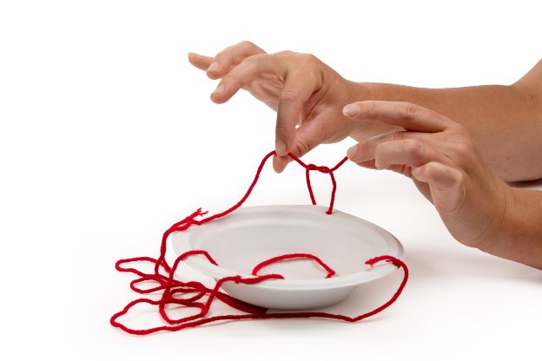
Step 2 Attach the Strings
Cut or gather 4 pieces of yarn of equal length
5
Hold the bowl up by all 4 strings to ensure that it hangs flat, and level. If not, adjust the strings until it does.
8
Put one string through each hole in the bowl
6
Tie each string tightly so it stays attached
7
Notes:
Cut or gather 4 pieces of yarn of equal length
Put one string through each hole in the bowl
Tie each string tightly so it stays
attached
Hold the bowl up by all 4 strings to ensure that it hangs flat, and level. If not, adjust the strings until it does.

Slide 9

Step 3 Inflate Your Balloon
9
Inflate our balloon
Inflate your balloon and tie it. This will serve as your parachute.
10
Notes:
Inflate your balloon
Inflate your balloon and tie it. This will serve as your parachute.

Slide 10
Step 4 Attach the Parachute to the Strings
Gather the loose ends of all four strings
Gently lift the balloon to check that all 4 strings are securely attached
11
13
Use the tape provided to secure one string at:
12 o’clock
3 o’clock
6 o’clock position
9 o’clock position
12
Notes:
Attach the Parachute to the Strings
Gather the loose ends of all four strings
Use the tape provided to secure one string at the 12 o’clock position, another at the 3 o’clock position, another at the 6 o’clock position, and the last at the 9 o’clock position
Gently lift the balloon to check that all 4 strings are securely attached

Slide 11
Step 5
Add the Object/Payload
Place an item into the bowl and hold the parachute system up by the balloon to ensure that the bowl still hangs relatively level.
14
Notes:
Add the Object/Payload
Place an item into the bowl and hold the parachute system up by the balloon to ensure that the bowl still hangs relatively level

Slide 12
Step 6
Test the Parachute
Grab your parachute system by the balloon and take it to the drop location
15
16
Release the parachute system and watch it fall
Observe what happens as it moves through the air
Notes:
Test the Parachute
Grab your parachute system by the balloon and take it to the drop location
Release the parachute system and watch it fall
Observe what happens as it moves through the air

Slide 13
Step 7
Observe and Hypothesize
After testing your parachute, look closely at what happened
17
18
Compare your parachute with others in class:
Some balloons may be larger or smaller
Some objects may be heavier or lighter
Some parachutes may fall slower or faster
Use your observations to form a “hypothesis,” an educated guess or explanation. You can explain your thinking by finishing this sentence:
“I think this parachute worked better because...”
Notes:
Observe and Hypothesize
After testing your parachute, look closely at what happened
Compare your parachute with others in class:
Some balloons may be larger or smaller
Some objects may be heavier or lighter
Some parachutes may fall slower or faster
Use your observations to form a “hypothesis,” an educated guess or explanation. You can explain your thinking by finishing this sentence: “I think this parachute worked better because...”

Slide 14
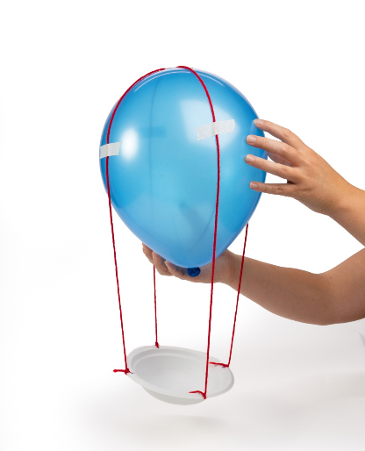
Controlled Descent

Slide 15

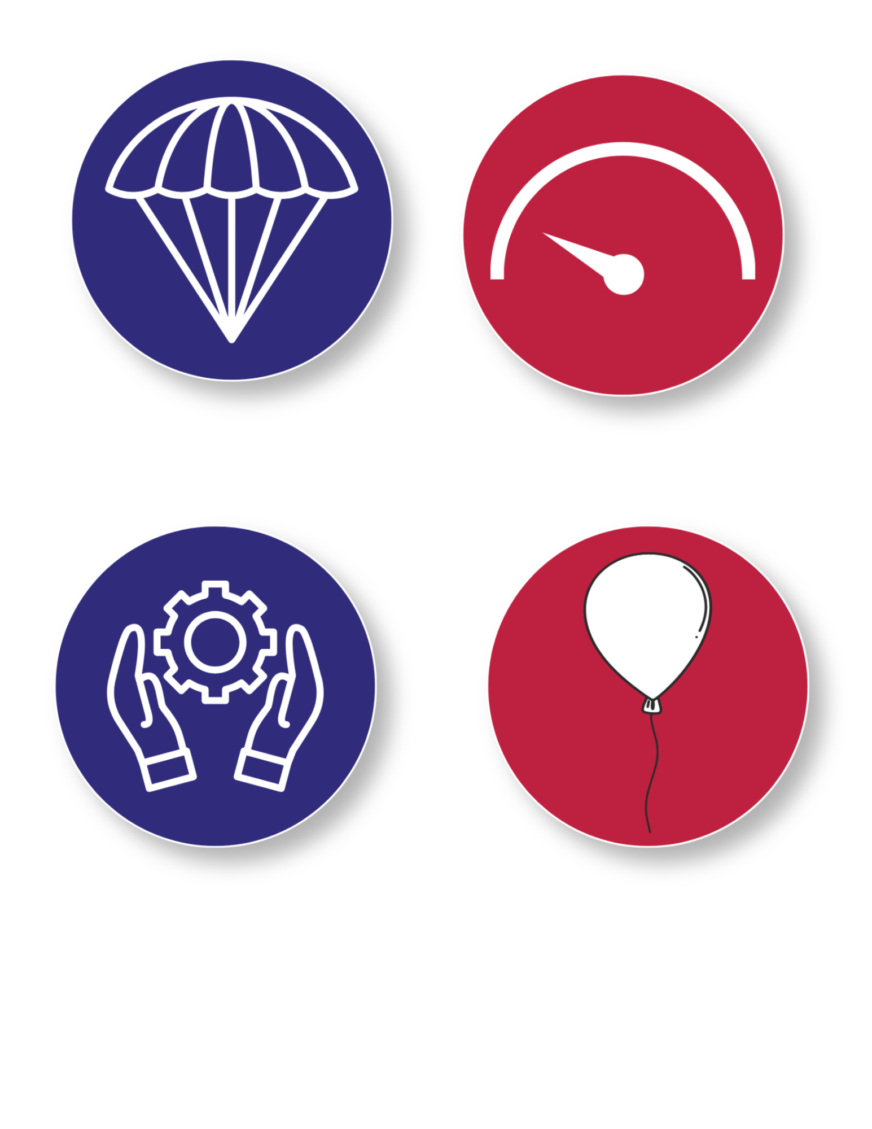
Turn and
TALK TIME
How was your
parachute similar to or
different from others’ parachutes?
Which design features helped control the fall
of the parachute
the best, and why?
Which parachutes seemed to fall the slowest?
What do they have in common?
Did larger or smaller balloons seem better at creating air resistance?

Slide 16


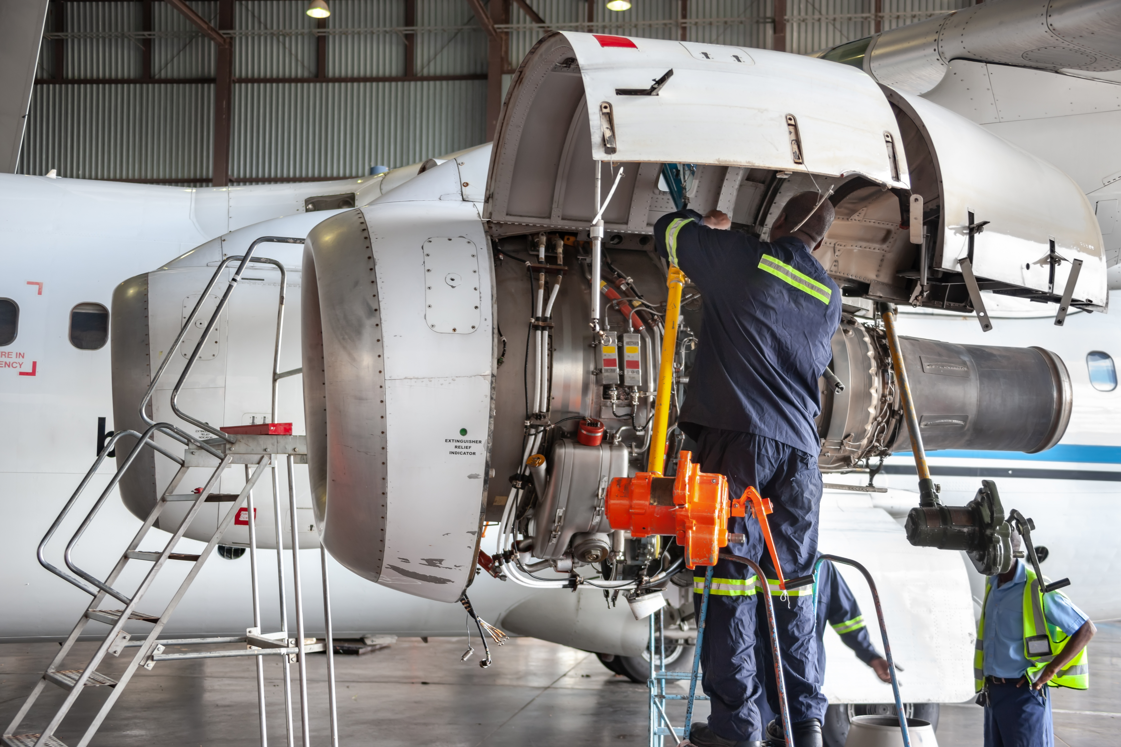
Career Exploration
Packing engineers design boxes and containers that protect products during shipping. They must think about gravity when boxes are stacked or dropped, and design packaging that absorbs impact,
Safety Engineers design systems that slow things down to keep people and equipment safe. They consider how fast objects move, how they stop, and what happens when something falls
Aerospace or Flight Engineers design parachutes, aircraft, and landing systems. These individuals must carefully study how air pushes on objects.
Notes:
Packaging Engineers design boxes and containers that protect products during shipping. They must think about gravity when boxes are stacked or dropped, and design packaging that absorbs impact, just like your parachute protects the object inside the bowl
Safety Engineers design systems that slow things down to keep people and equipment safe. They consider how fast objects move, how they stop, and what happens when something fails
Aerospace or Flight Engineers design parachutes, aircraft, and landing systems. These individuals must carefully study how air pushes on objects.

Slide 17


Wrap Up!
What Careers Did We Explore Today?
Packaging Engineers design boxes and containers that protect products during shipping. They must think about gravity when boxes are stacked or dropped, and design packaging that absorbs impact, just like your parachute protects the object inside the bowl
Safety Engineers design systems that slow things down to keep people and equipment safe. They consider how fast objects move, how they stop, and what happens when something fails
Aerospace or Flight Engineers design parachutes, aircraft, and landing systems. These individuals must carefully study how air pushes on objects.
Notes:
​
Packaging Engineers design boxes and containers that protect products during shipping. They must think about gravity when boxes are stacked or dropped, and design packaging that absorbs impact, just like your parachute protects the object inside the bowl
Safety Engineers design systems that slow things down to keep people and equipment safe. They consider how fast objects move, how they stop, and what happens when something fails
Aerospace or Flight Engineers design parachutes, aircraft, and landing systems. These individuals must carefully study how air pushes on objects.

