Slide 1




Activity Overview
Craft Stick Flyers

Slide 2


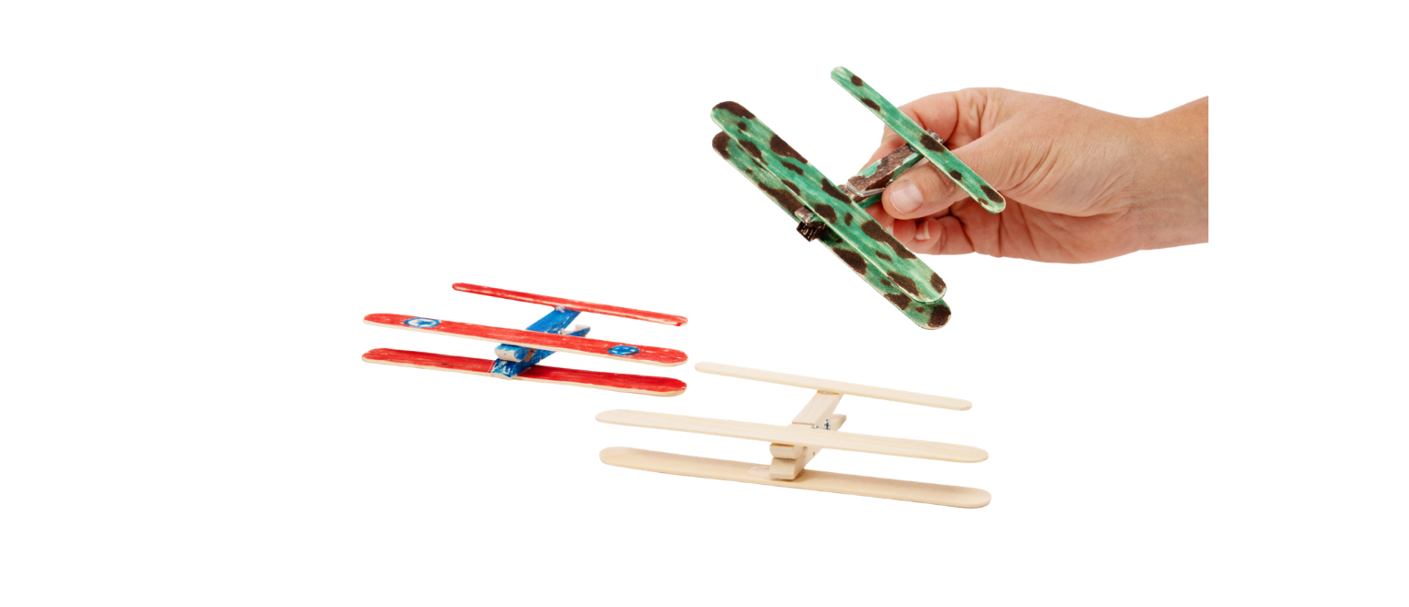


Craft Stick Flyers

Slide 3
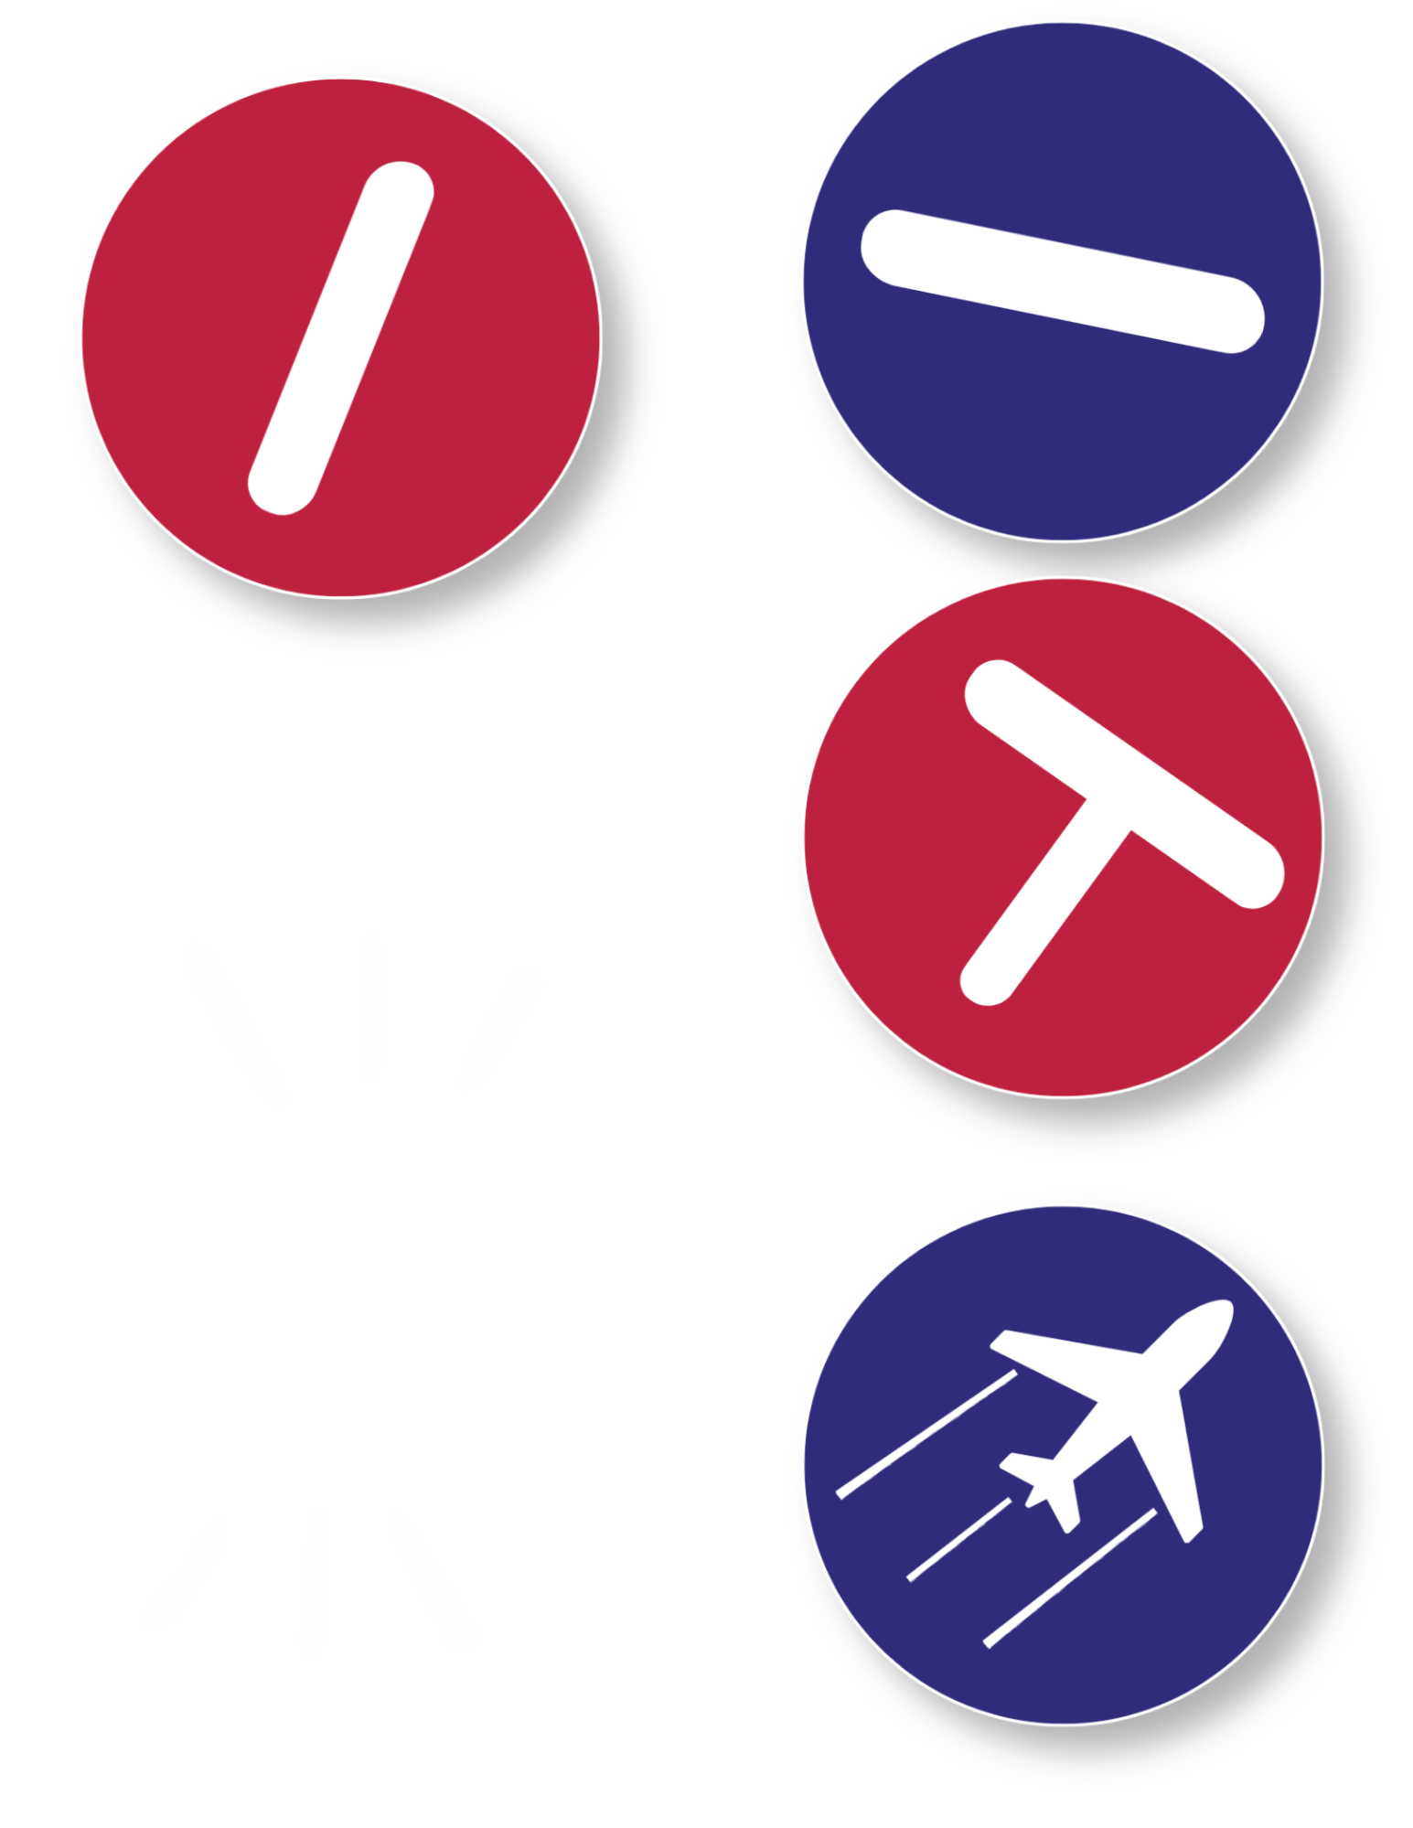

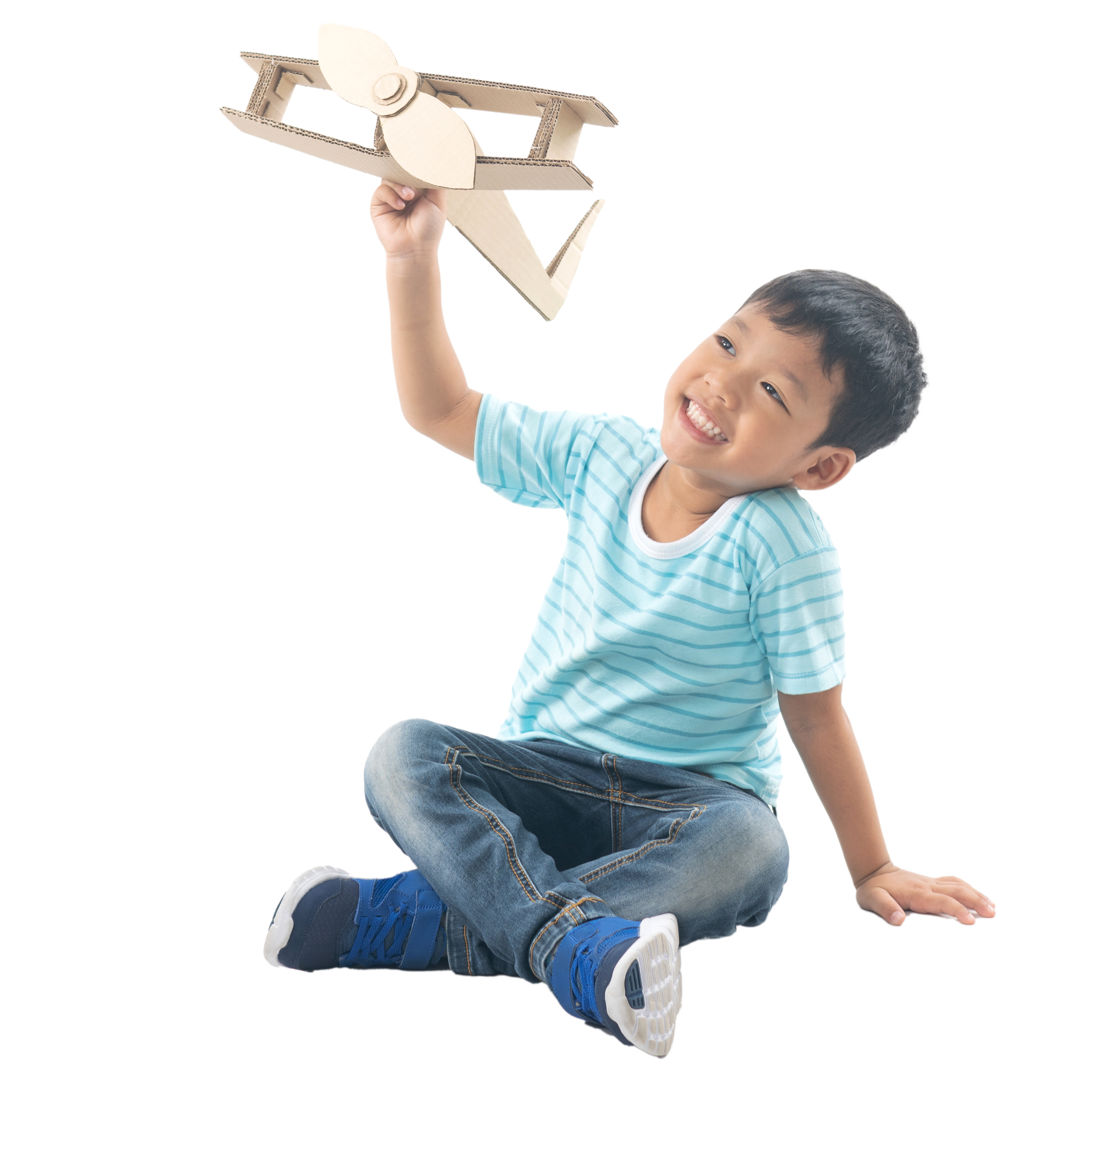
Today You’ll Become a Builder!
In today’s activity, we will be making our own Craft Stick Flyer.
Just like real builders, you’ll use a few different parts for the plane:
Builders assemble products one piece at a time, making sure every part fits correctly before the final product is complete.
Body
Wings
Tail
When pieces come together to make something new, we call that :
Assembly
Notes:
In today’s activity, we will be making out own Craft Stick Flyer. Just like real builders, you’ll use a few different parts for the plane’s body, wings, and tail, and you’ll put them together in order. When pieces come together to make something new, we call that assembly.
Builders in factories do this every day. They follow steps, check their work, and make sure the parts they use fit just right. If something looks loose, or crooked, they fix it so that the final product is strong and ready to use.

Slide 4
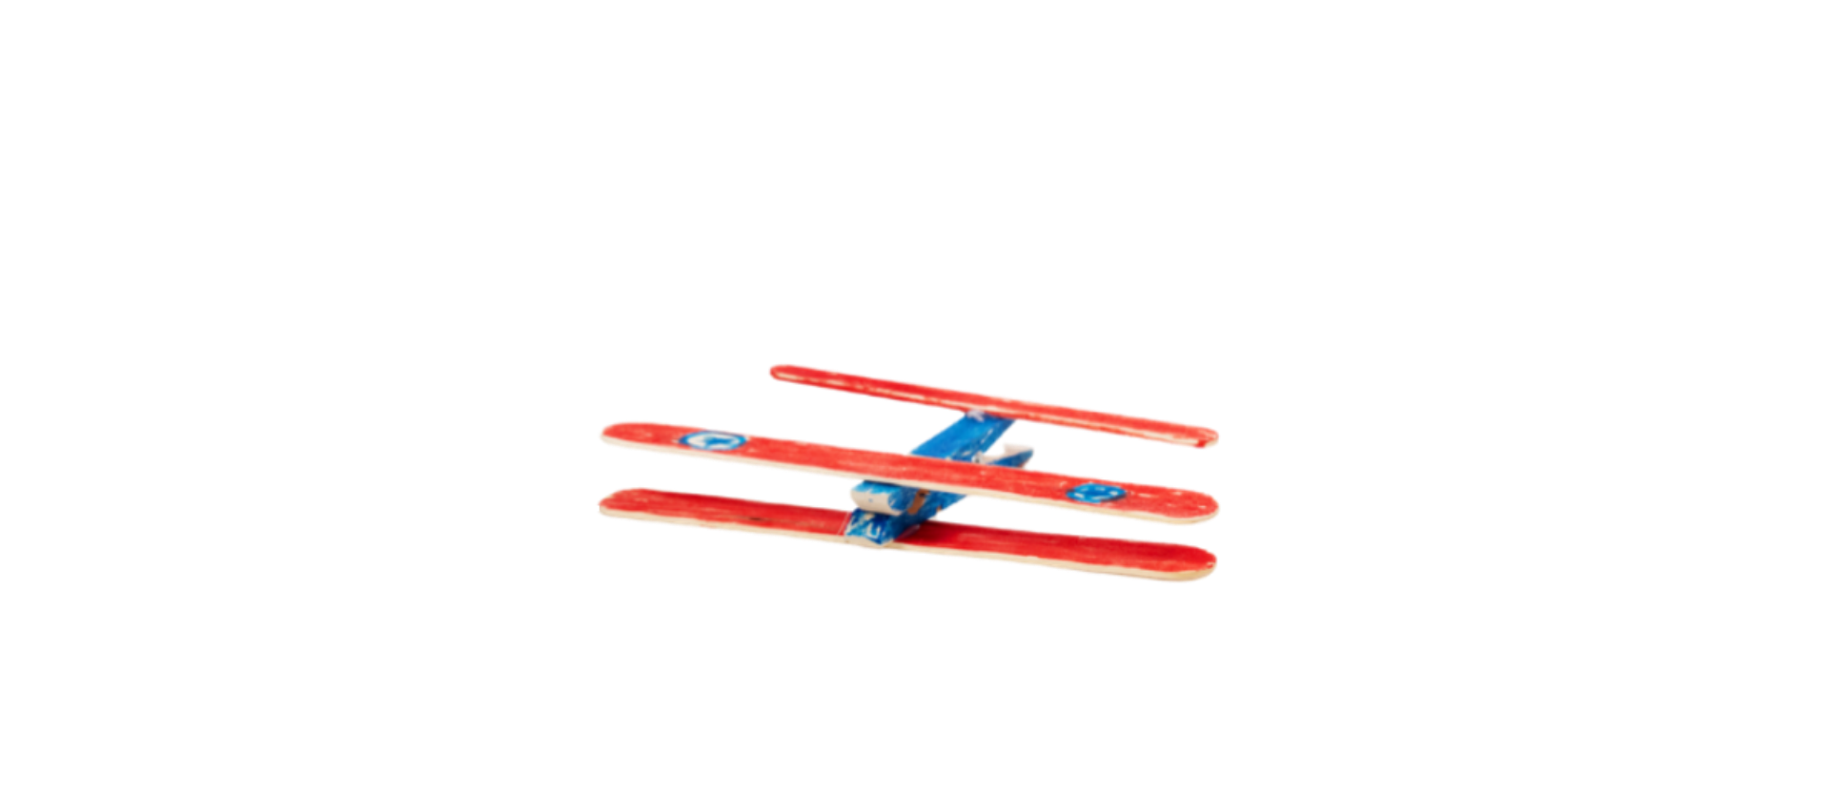
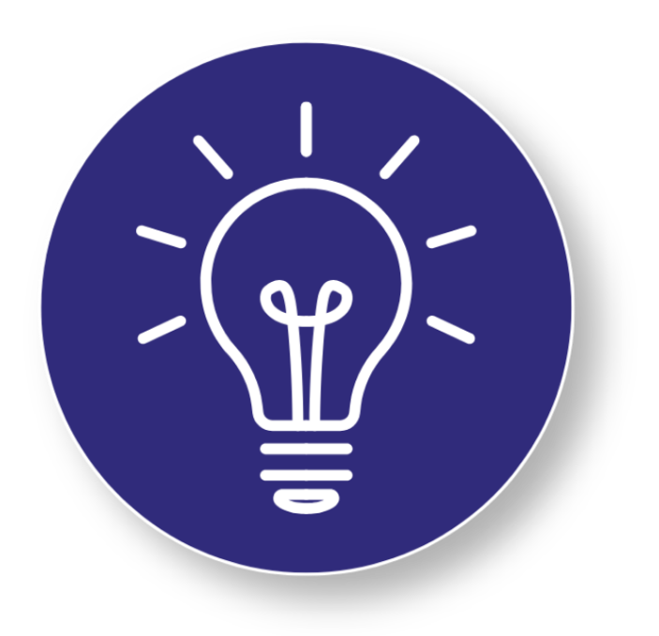
Key Words to Know
Think Like a Builder!
Builders carefully assemble many different parts to create products that are safe, strong, and work the way they are designed to.
Notes:
Body: The main part of the airplane that everything else attaches to
Wings: The flat parts on the side of an airplane that help it glide through the air
Tail: The small flat piece at the back of a plane that helps keep it steady
Assembly: Putting parts together in the right order to make something new

Slide 5
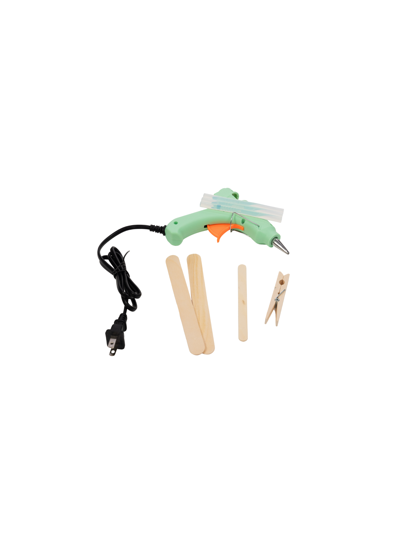
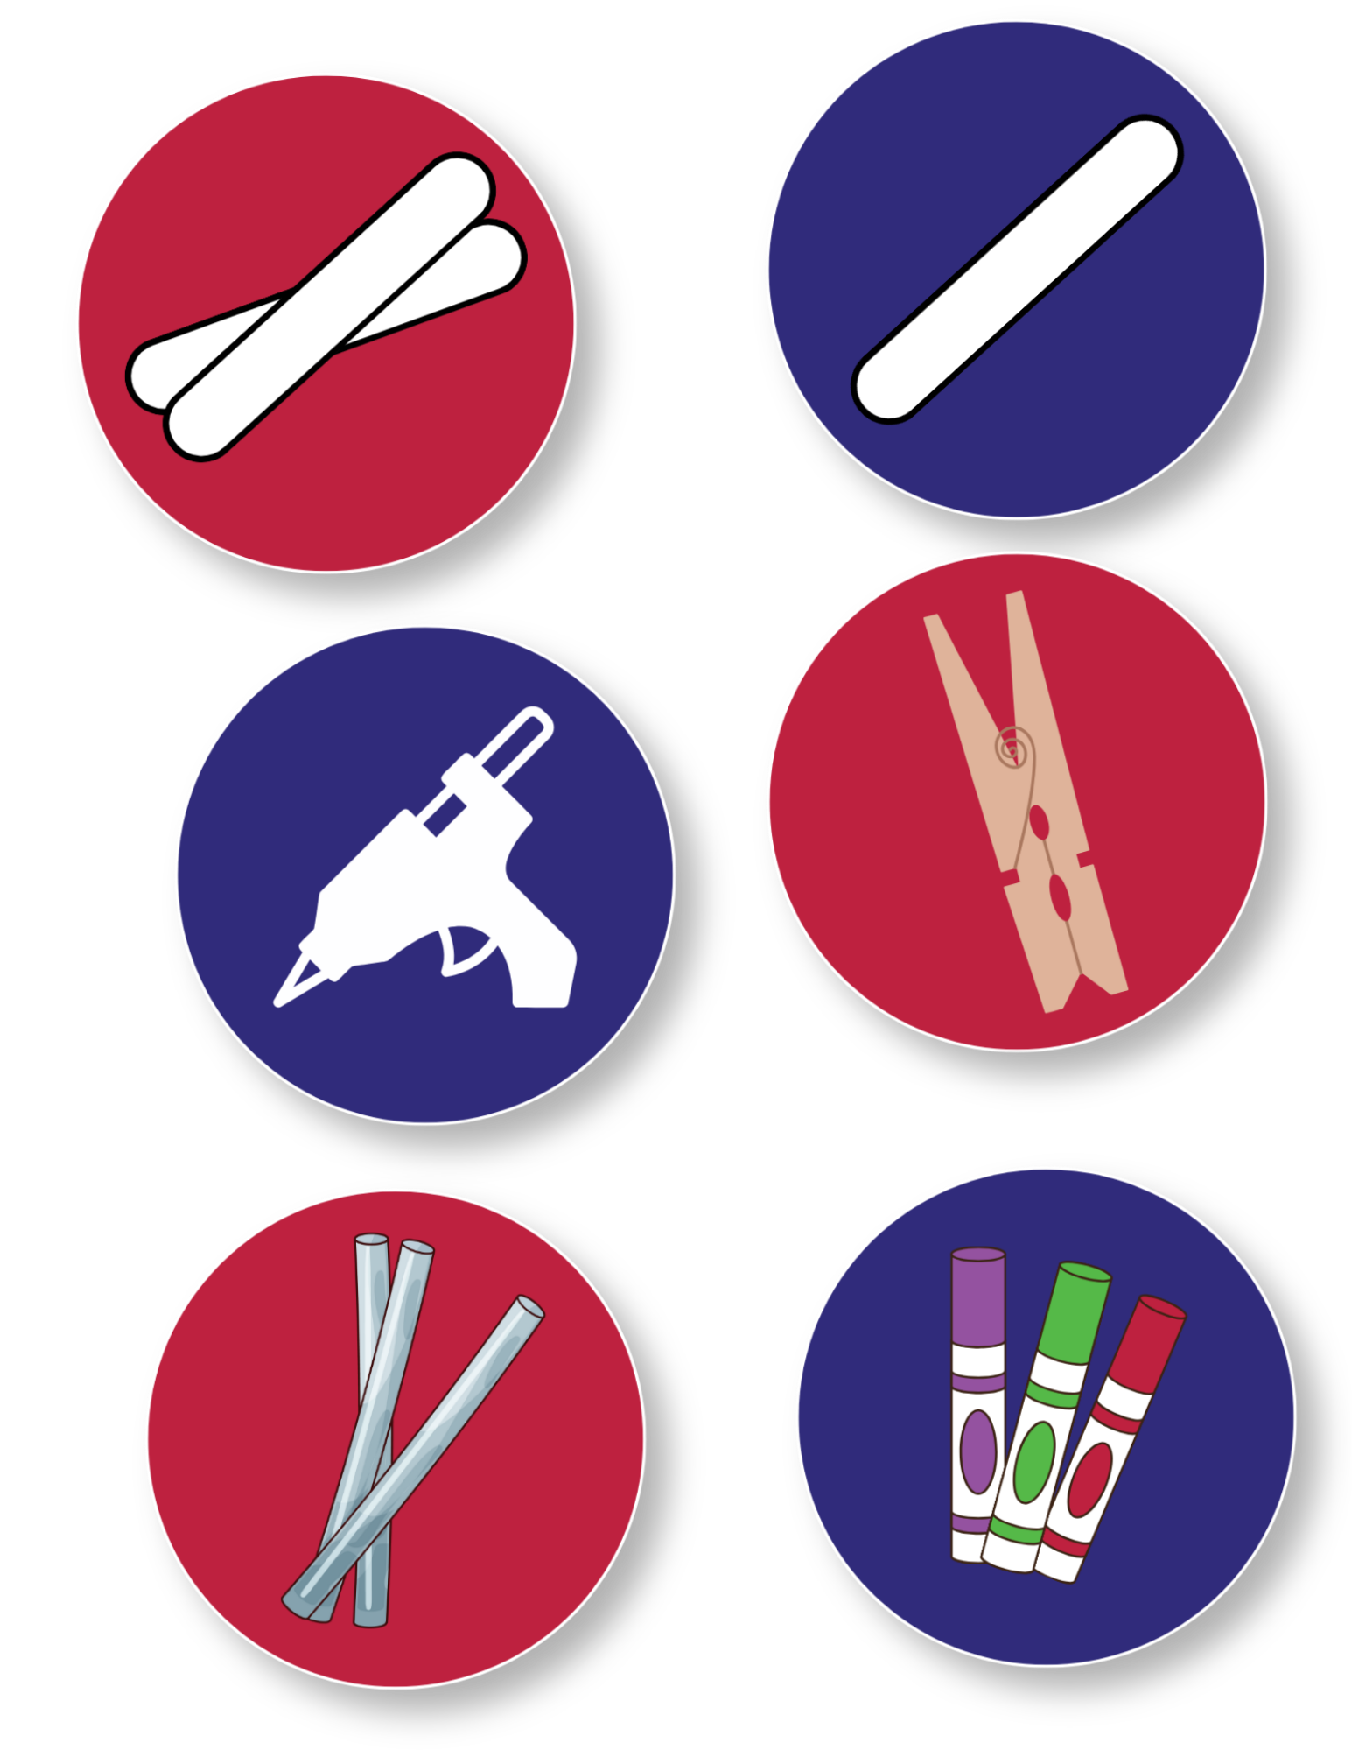
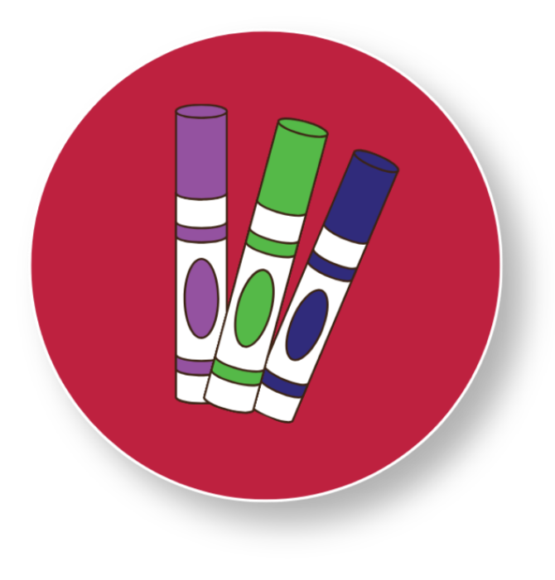
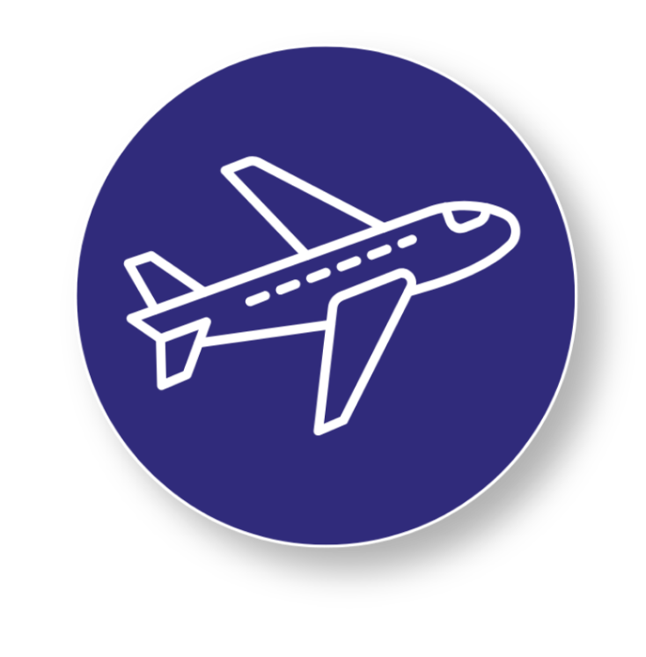
Today’s Materials
2 Jumbo Craft Sticks
1 Wooden Clothes Pin
1 Standard Craft Stick
1 Hot Glue Gun
Markers
10 Hot Glue Sticks
Get Ready to Build!
Gather your materials and get ready to assemble your plane like a builder.
Notes:
2 jumbo craft sticks
1 standard craft stick
1 wooden clothespin
1 hot glue gun (for teacher use)
10 hot glue sticks (for teacher use)
markers

Slide 6
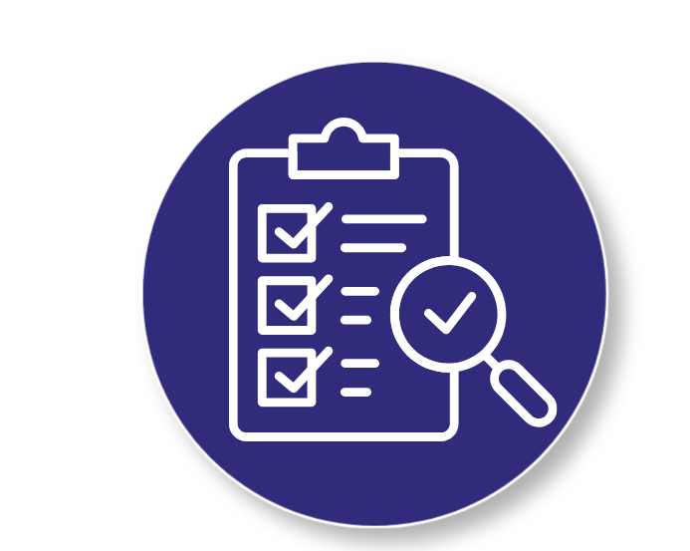
Step 1
Material Preparation
Pre-heat hot glue gun at a “teacher station” away from students.
1
Distribute markers or your preferred coloring medium.
3
Distribute 2 jumbo craft sticks, 1 standard craft stick, and 1 wooden clothespin to each student.
2
Builder Tip:
Every successful build starts with preparation. Having the right parts ready makes it easier to follow directions and create a strong, finished flyer
Notes:
Material Preparation
Pre-heat hot glue gun at a “teacher station” away from students.
Distribute 2 jumbo craft sticks, 1 standard craft stick, and 1 wooden clothespin to each student.
Distribute markers or your preferred coloring medium.

Slide 7
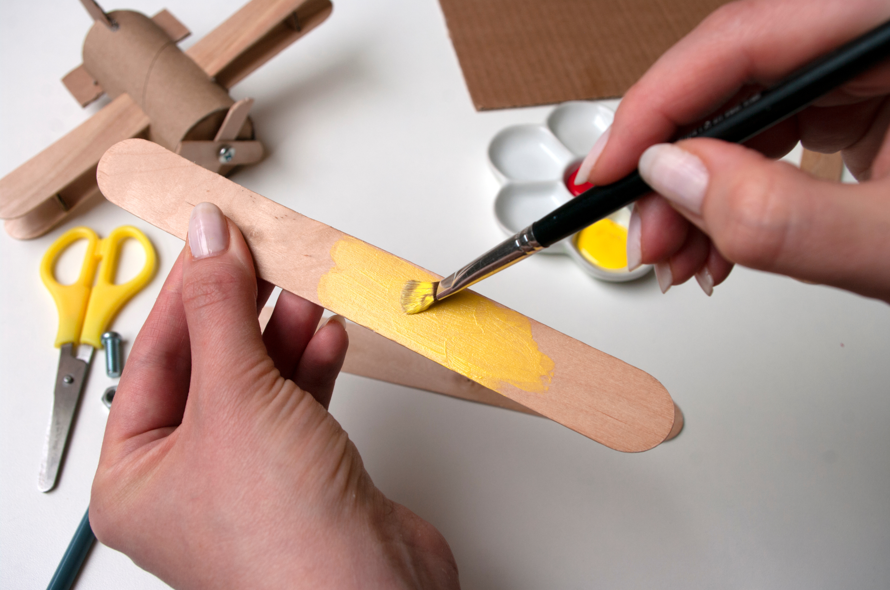
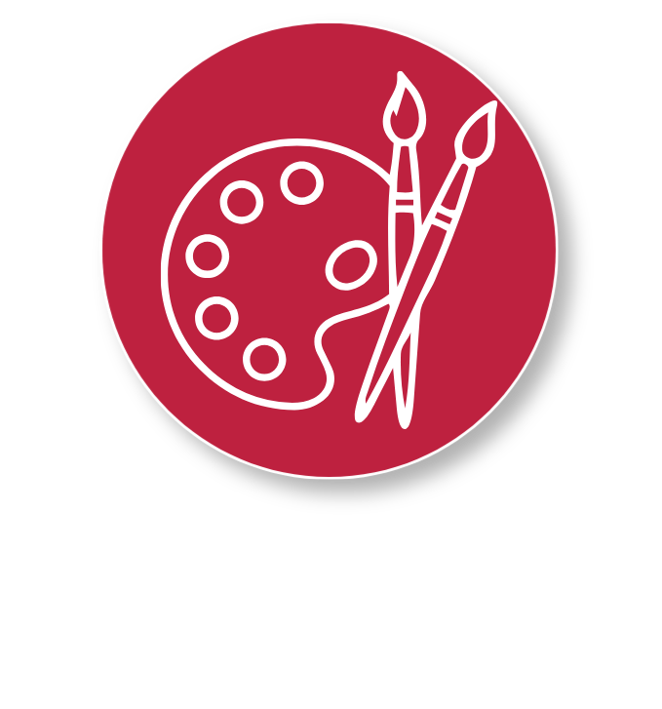
Step 2
Material Preparation
4
Decorate each plane part
Encourage the students to decorate their craft sticks and clothespins. Students will want to color in both sides of their craft sticks, and all sides of their clothespin for the best effect.
5
Remind students to write their name on the bottom side of their clothespin to avoid future mix-ups.
6
Get Creative!
This is your chance to be creative! Personalizing your flyer makes it unique while helping you recognize your own project during the activity.
Notes:
Decorate each plane part
Encourage the students to decorate their craft sticks and clothespin. Students will want to color in both sides of their craft sticks, and all sides of their clothespin for the best effect.
Remind students to write their name on the bottom side of their clothespin to avoid future mix-ups.

Slide 8
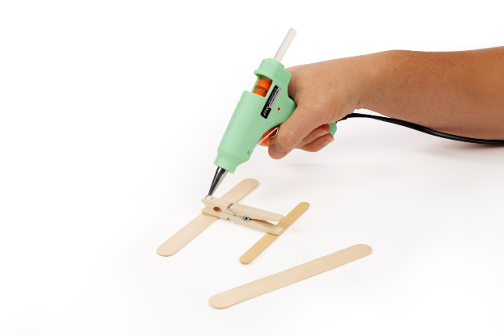
Step 3
Assembly
Call a small group of students to line up at the hot glue station
Take the student’s clothespin
(this will be the body of the plane).
7
Add two tiny dots of hot glue on the top:
One near the clamp end (front)
One about halfway down the clothespin (toward the back)
8
Have the student place:
A jumbo craft stick across the glue dot at the front (main wings)
A regular craft stick across the back dot (tail)
9
Flip the plane over and add one small dot of glue under the front wings.
Attach the second jumbo craft stick directly under the first to complete the wing pair.
10
Notes:
Assembly
Call a small group of students to line up at the hot glue station
Take the student’s clothespin (this will be the body of the plane).
Add two tiny dots of hot glue on the top:
One near the clamp end (front)
One about halfway down the clothespin (toward the back)
Have the student place:
A jumbo craft stick across the glue dot at the front (main wings)
A regular craft stick across the back dot (tail)
Flip the plane over and add one small dot of glue under the front wings.
Attach the second jumbo craft stick directly under the first to complete the wing pair.

Slide 9
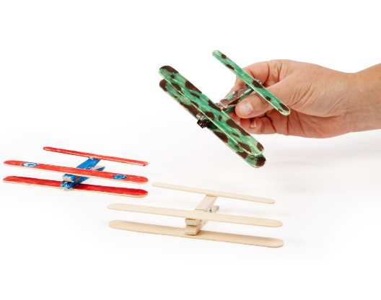
You Made a Craft Stick Flyer!

Slide 10

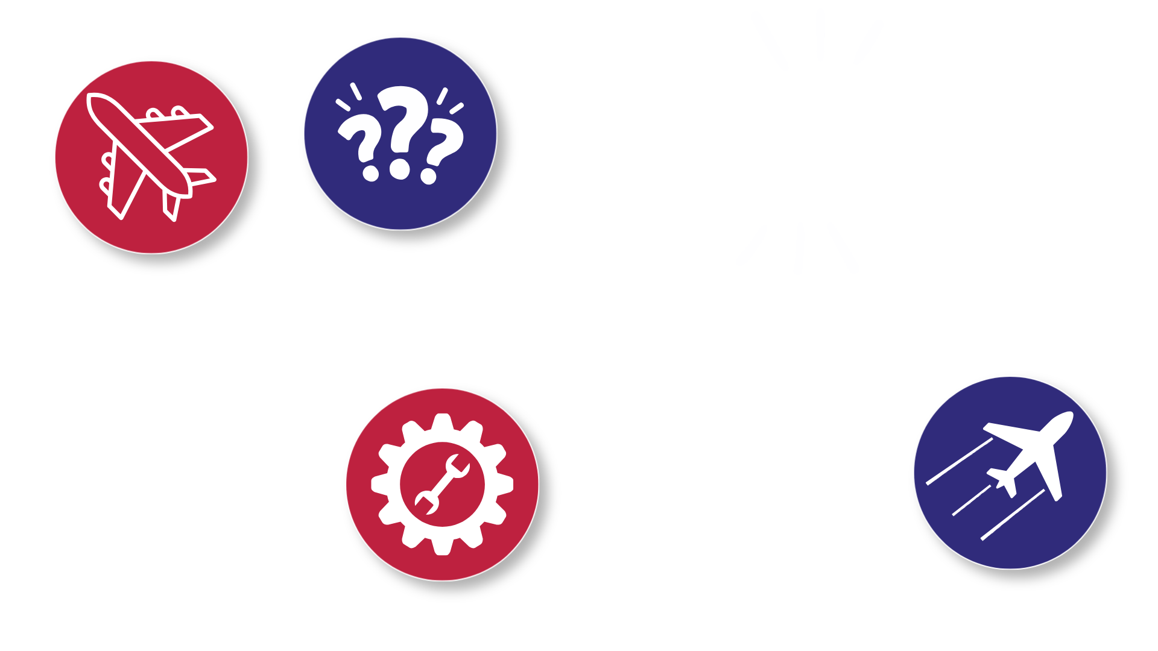
Turn and
TALK TIME
Can you show me the body of your plane?
What do you think would happen if your plane's wings were uneven?
What job/function do you think this piece does? (point to any part of the plane)
What was the trickiest part
of building your flyer?
Notes:
Can you show me the body of your plane?
What job/function do you think this piece does? (point to any part of the plane)
What do you think would happen if your plane's wings were uneven?
What was the trickiest part of building your flyer?

Slide 11

Career Exploration
Toy makers use the design and assembly process to build toys from lots of small pieces. They make sure everything fits together safely before the product is ready for market.
Manufacturing technicians help make things people use every day, like bikes, tools, backpacks, and even school supplies. They follow steps in a sequential order to ensure that each product is put together correctly.

