Slide 1




Activity Overview
Getting the Point

Slide 2

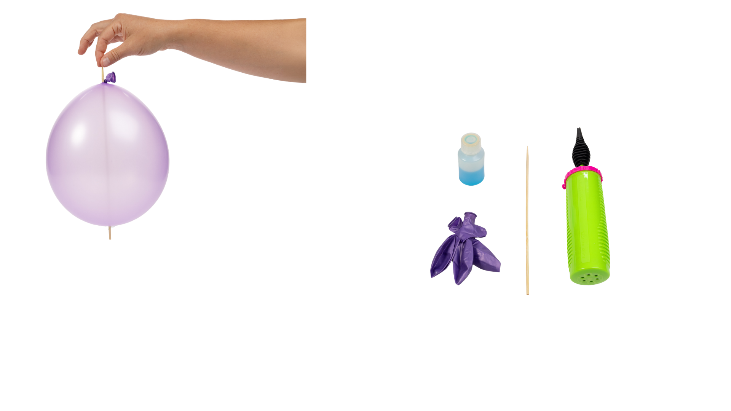


Getting the Point

Slide 3
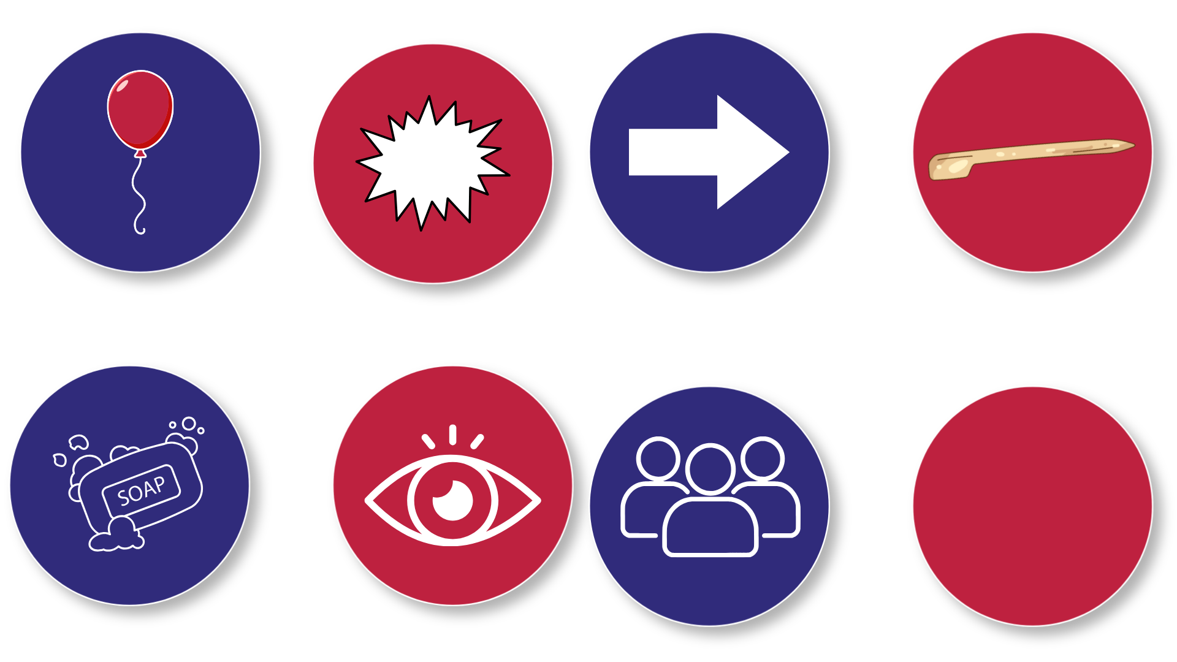
Getting the Point
Some materials can stretch, and some materials cannot. A balloon is a stretchy material. When air goes inside a balloon, the balloon stretches to make room.
When we poke a balloon with something sharp, it usually pops. That’s because the balloon is pulled very tight, and the material can tear easily when it is tight.
But today, we are going to test what happens when we help the balloon stretch instead of tear.
We will use a wooden skewer to gently poke the balloon in places where it can stretch the most.
We will also use soap. Soap makes things slippery. When something is slippery, it can slide instead of grabbing and tearing. The soap helps the skewer slide through the balloon while the balloon stretches around it.
Notes:
Some materials can stretch, and some materials cannot. A balloon is a stretchy material. When air goes inside a balloon, the balloon stretches to make room.
When we poke a balloon with something sharp, it usually pops. That’s because the balloon is pulled very tight, and the material can tear easily when it is tight.
But today, we are going to test what happens when we help the balloon stretch instead of tear.
The balloon you are using has thicker and thinner parts. Some places stretch more easily than others.
We will use a wooden skewer to gently poke the balloon in places where it can stretch the most.
We will also use soap. Soap makes things slippery. When something is slippery, it can slide instead of grabbing and tearing. The soap helps the skewer slide through the balloon while the balloon stretches around it.
Today, you will test how stretchy material behaves when you push slowly, carefully, and in the right place. You will watch what happens when the material stretches instead of breaking.
People who build and design things test materials like this to learn how strong they are and how they behave. By stretching, poking, and watching closely, you are learning how materials respond to what you do.

Slide 4
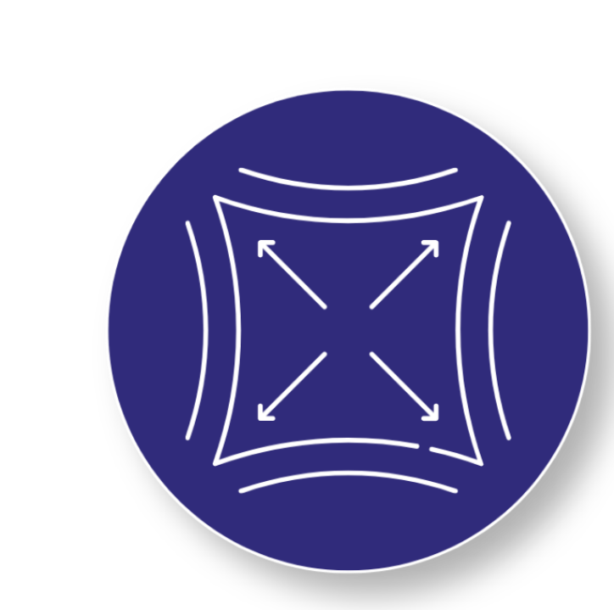
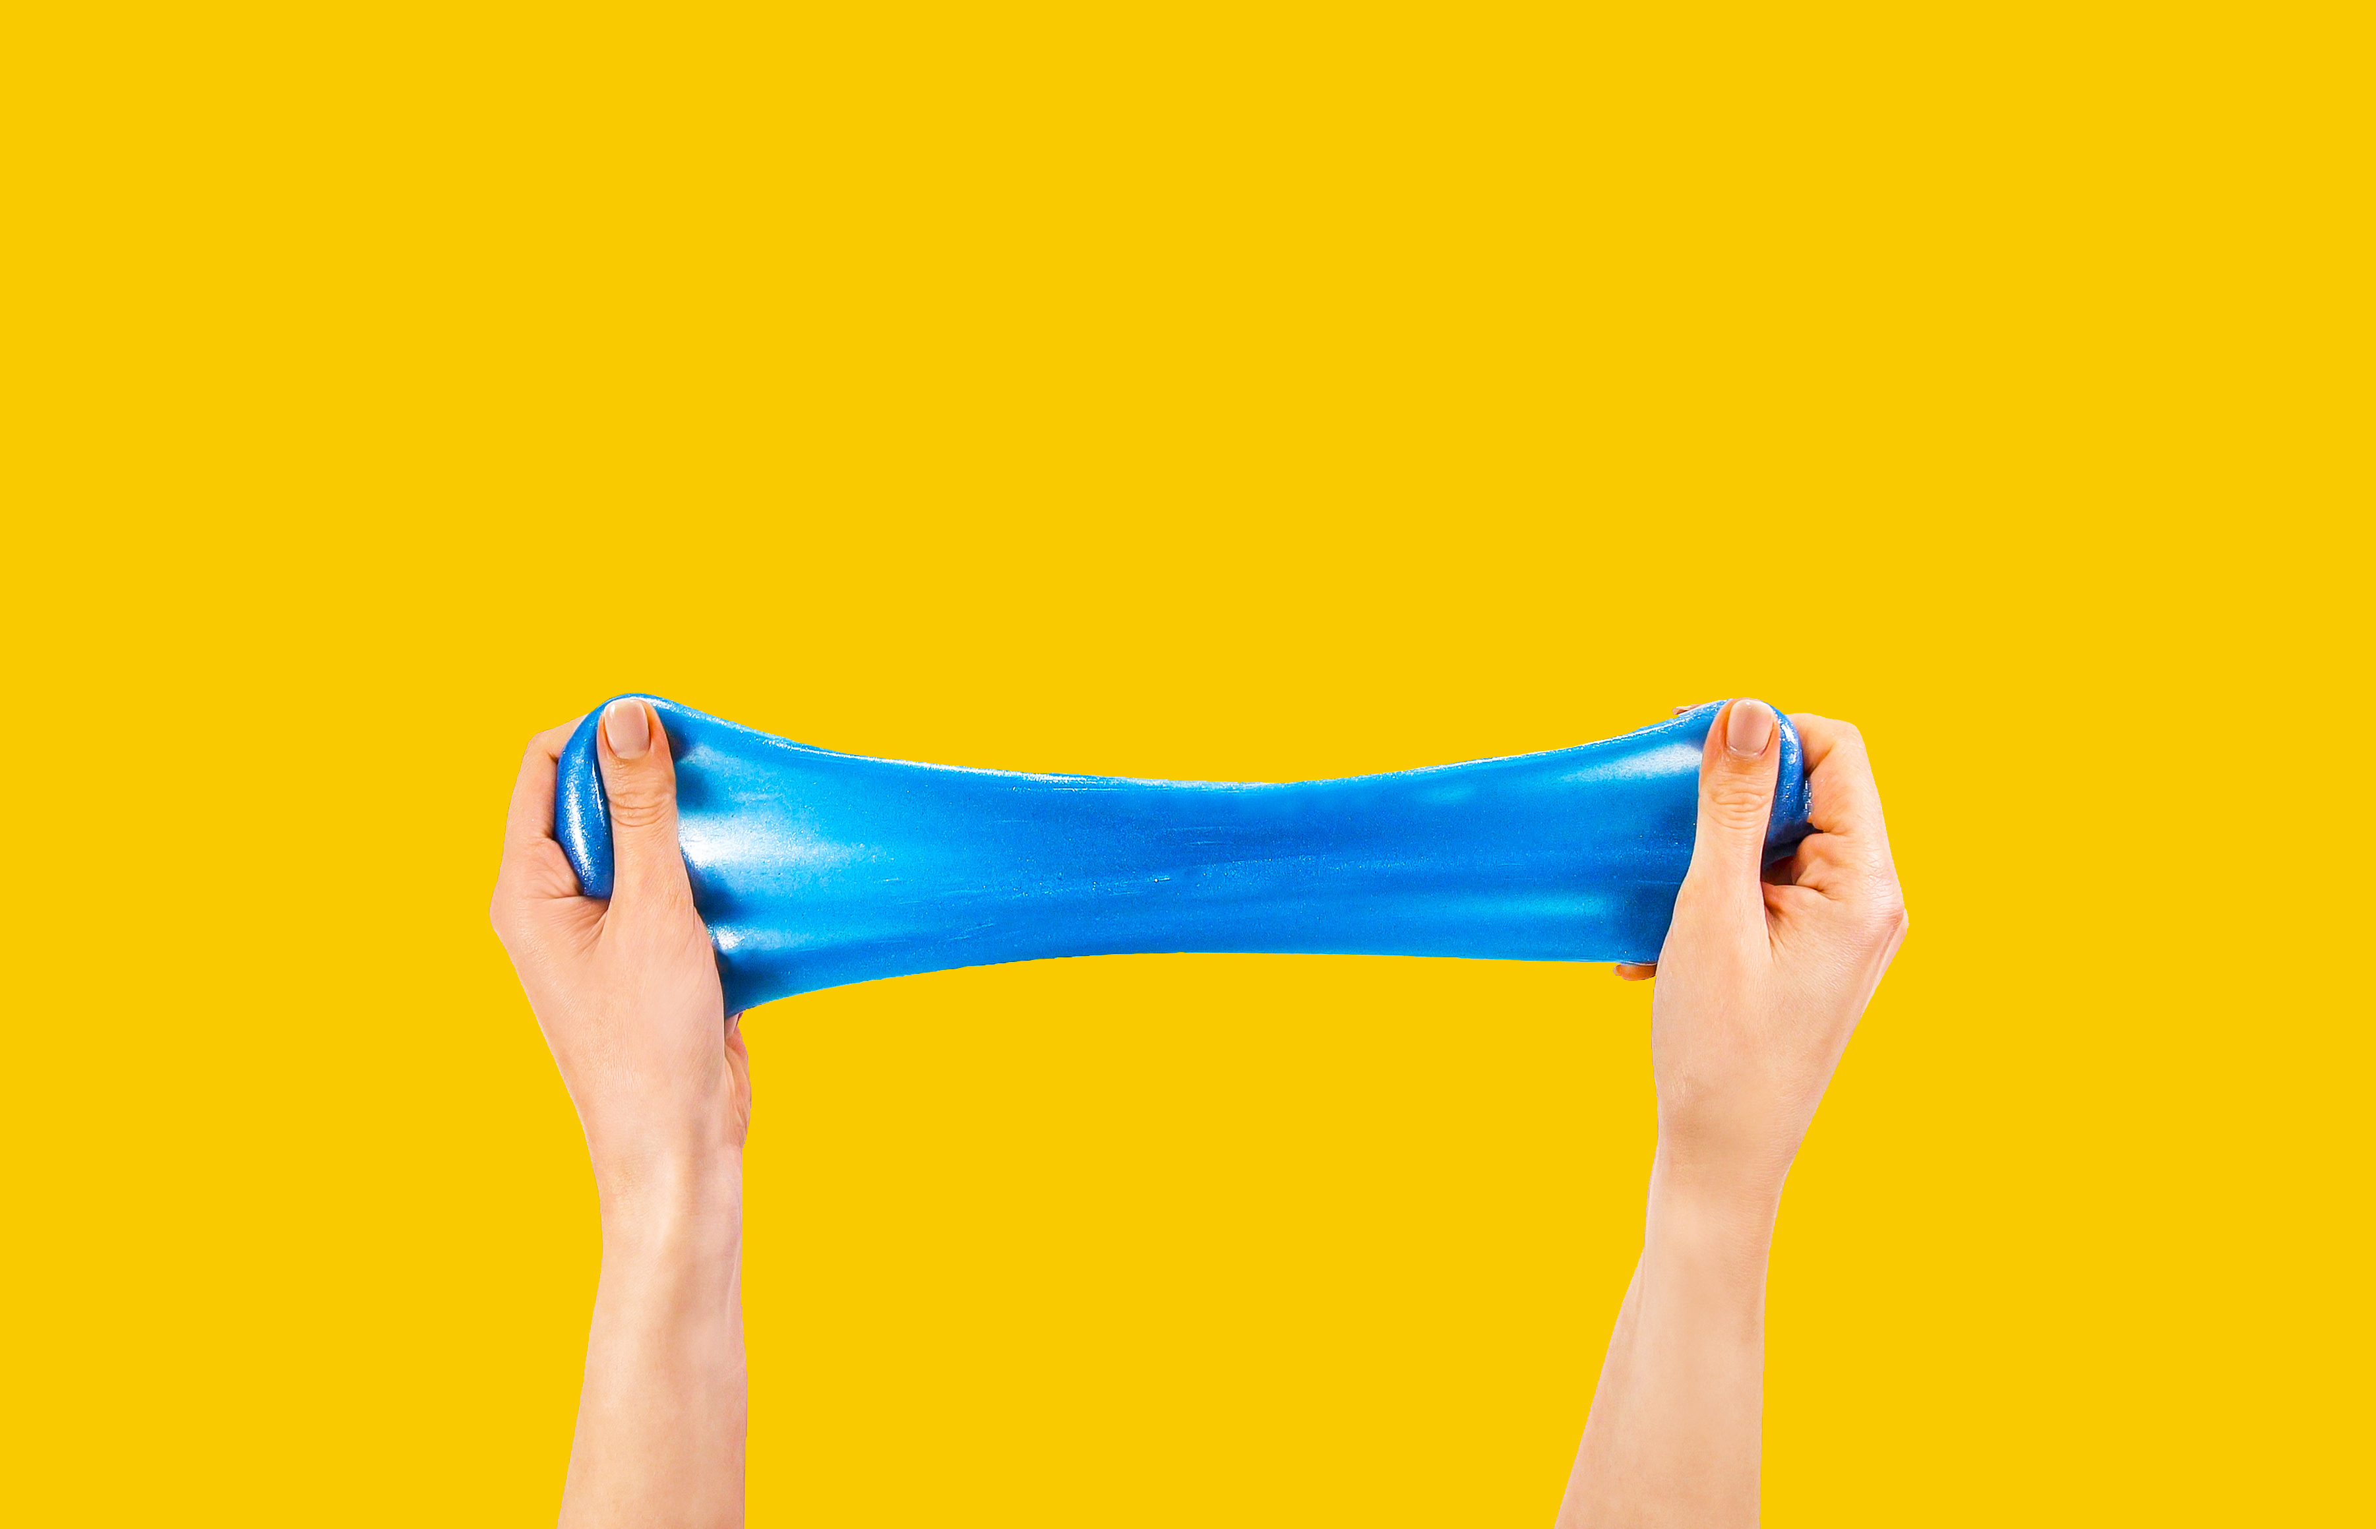
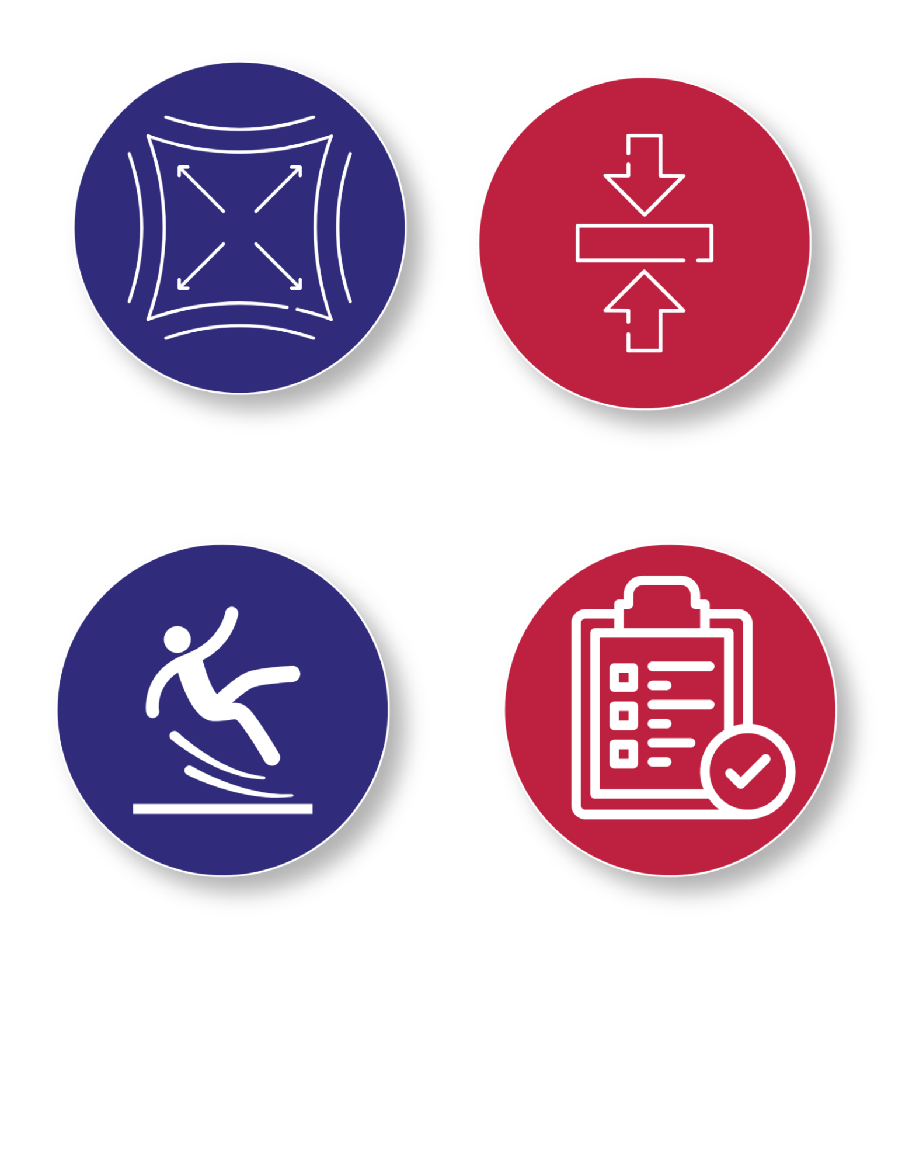
Key Words to Know
STRETCH
To pull something longer without breaking it
FORCE
A push or a pull
SLIPPERY
Easy to slide across without sticking
TEST
To try something out to see how it works
Notes:
Stretch: To pull something longer without breaking it
Force: A push or a pull
Slippery: Easy to slide across without sticking
Test: To try something and see what happens

Slide 5
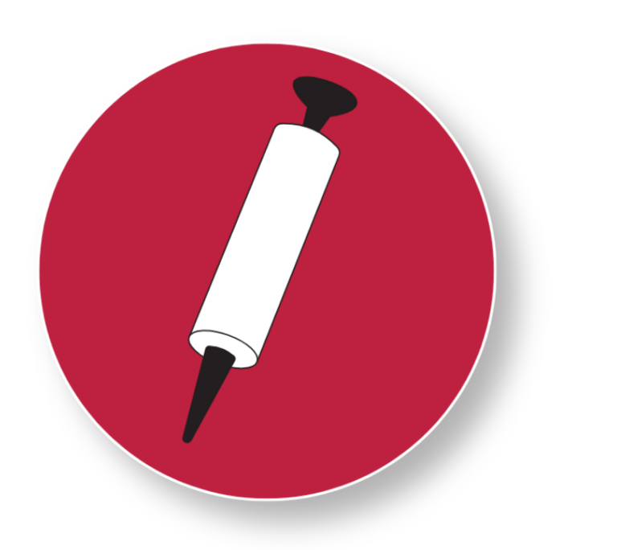
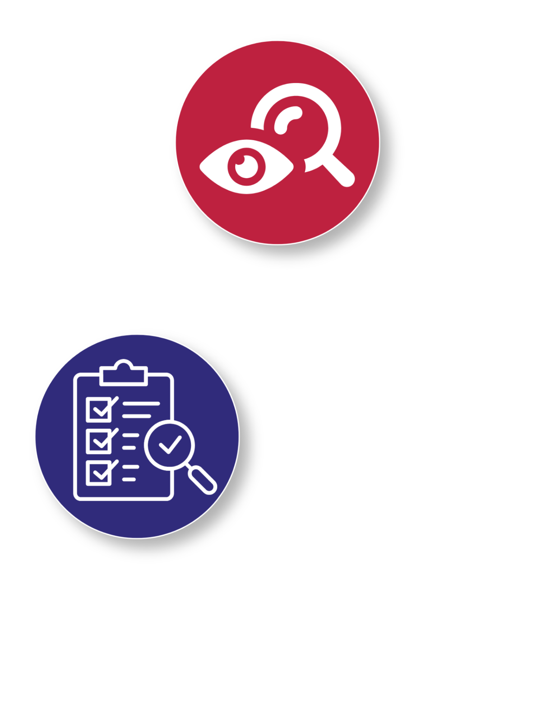
Today’s Materials
Wooden Skewer
Balloon Pump
Balloon
Dish Soap
Get Ready to Test the Limits!
Materials scientists prepare their tools before every test. Organize your supplies now so you can focus on making careful observations during the experiment.
Notes:
1 wooden skewer
1 balloon
Dish soap
(Optional) Balloon pump

Slide 6
Step 1- Prepare the Balloon
1
Choose one balloon.
Carefully inflate the balloon. Do not overfill it.
2
A good check: you should still see a small dark spot at the top of the balloon when inflated.
3
Tie the balloon closed.
Pay Attention!
An over-inflated balloon will pop more easily, as it is stretched too tightly. Stretch has limits, so be conscious of how inflated your balloon gets.
Notes:
Prepare the Balloon
Choose one balloon
Carefully inflate the balloon. Do not overfill it.
A good check: you should still see a small dark spot at the top of the balloon when inflated.
Teacher note: An over-inflated balloon will pop more easily, as it is stretched too tightly. This is a good moment to reinforce that stretch has limits
Tie the balloon closed

Slide 7
Step 2- Inspect the Balloon
Find the thicker parts of the balloon
4
Hold the balloon in your hands
5
Feel the balloon near the tied end, and the opposite end
6
Take Note: These areas are “thicker” and can stretch more easily than the sides of the balloon.
Notes:
Find the thicker parts of the balloon
Hold the balloon in your hands
Feel the balloon near the tied end, and the opposite end. These areas are “thicker” and can stretch more easily than the sides of the balloon

Slide 8
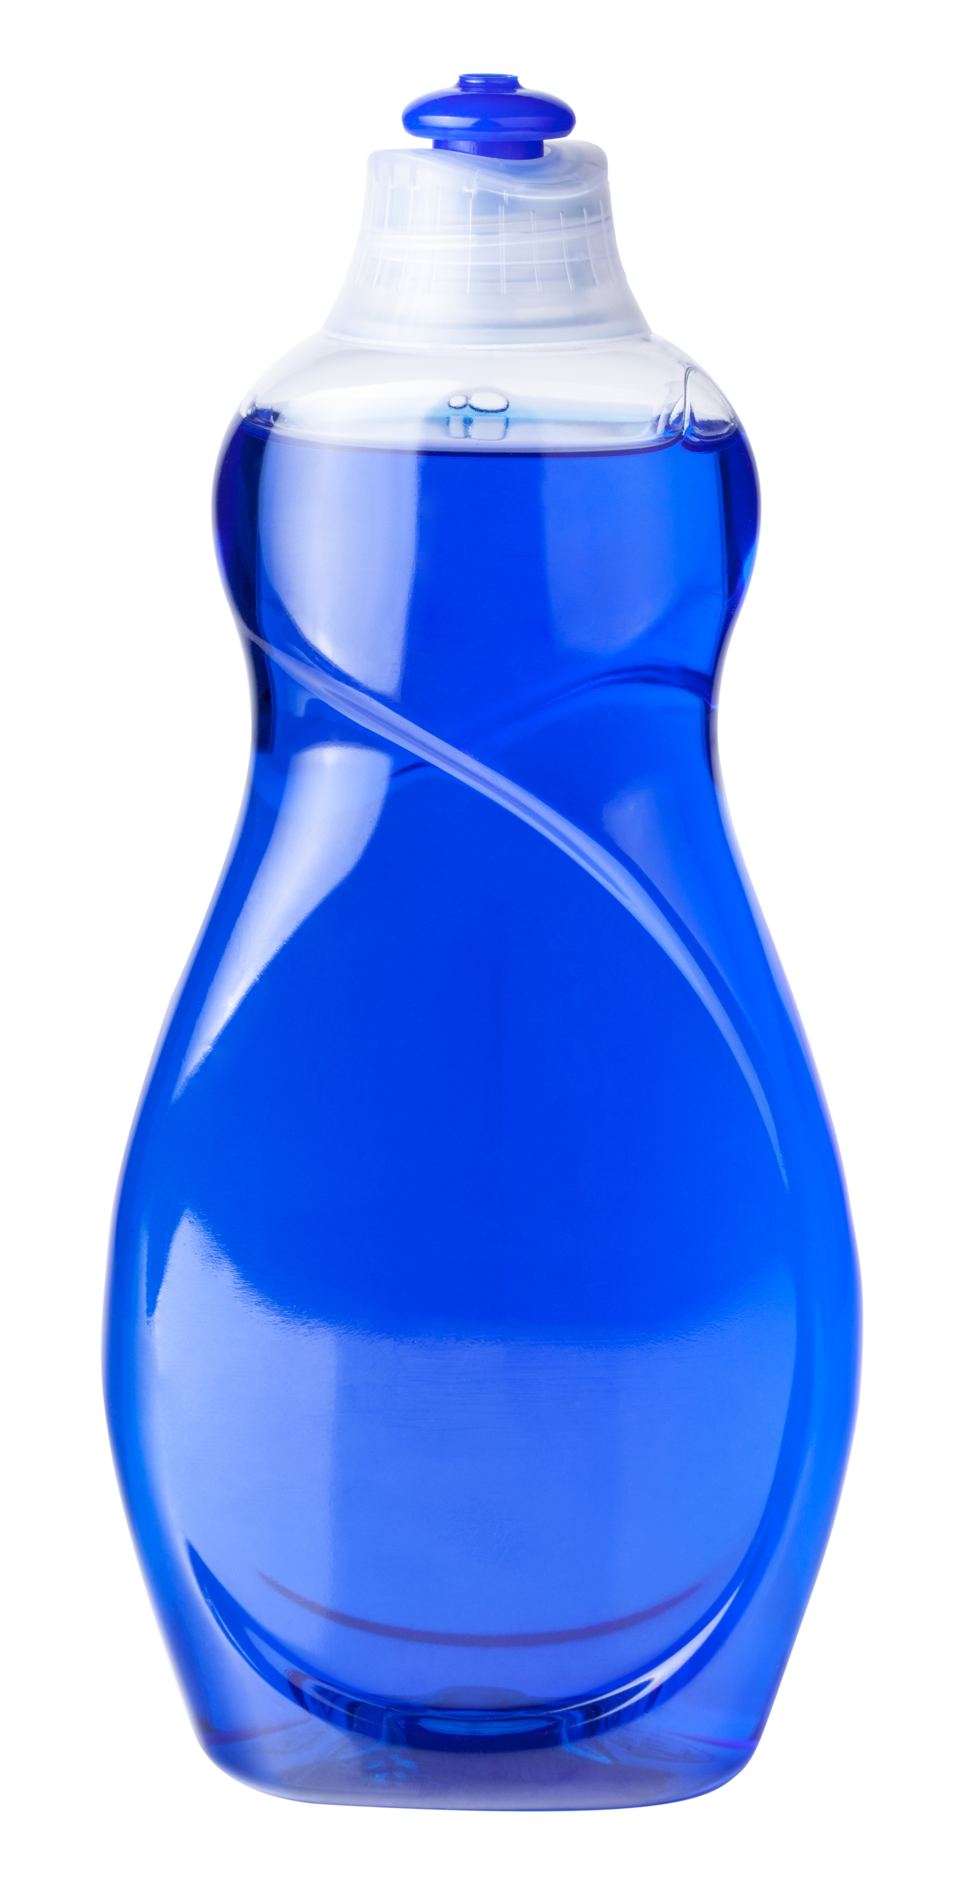
Step 3- Prep the Skewer
7
Make the skewer slippery
Either dip the tip of the skewer in a dollop of dish soap, or apply a small bead of dish soap directly onto the thick portion of the balloon from the previous step
8
It’s a Slippery Situation!
The soap makes the skewer slippery (or reduces friction), which helps it slide through the balloon, instead of grab
Notes:
Make the Skewer Slippery
Either dip the tip of the skewer in a dollop of dish soap, or apply a small bead of dish soap directly onto the thick portion of the balloon from the previous step
Teacher prompt: “The soap makes the skewer slippery (or reduces friction), which helps it slide through the balloon, instead of grab

Slide 9
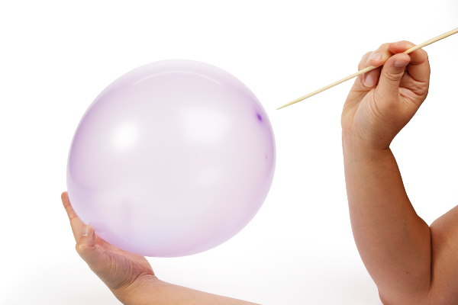
Step 4- Time to Test
9
Test the balloon carefully
10
Place the skewer on the thicker end of the balloon (opposite the knot)
11
Slowly press and gently twist the skewer
Take your time! Go slow.
Slow pressure helps the balloon to stretch instead of tear
Patience Pays Off!
Testing materials isn't about rushing- it's about making careful observations.
Slow, gentle movements help us discover how stretchy materials behave.
Notes:
Test the balloon carefully
Place the skewer on the thicker end of the balloon (opposite the knot)
Slowly press and gently twist the skewer
Take your time. Go slow. Slow pressure helps the balloon to stretch instead of tear

Slide 10
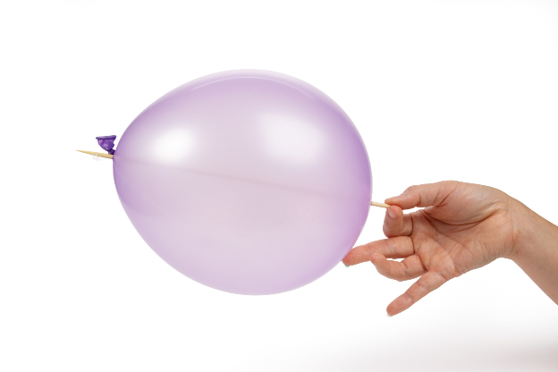
Step 4- Time to Test
12
Slide the skewer through
Keep twisting slowly until the skewer goes into the balloon
13
Continue gently twisting and sliding the skewer through the balloon
14
Wow! Watch how the balloon stretches around the skewer instead of popping
Did it Work?
Pay attention as the balloon stretches around the skewer instead of popping. Great scientists observe every detail!
Notes:
Slide the skewer through
Keep twisting slowly until the skewer goes into the balloon
Continue gentle twisting and sliding the skewer through the balloon
Watch how the balloon stretches around the skewer instead of popping

Slide 11
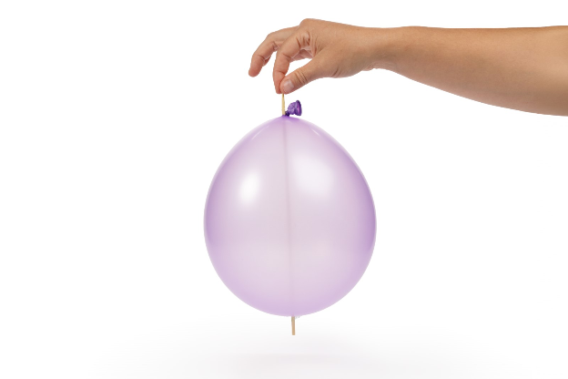
Getting to the Point

Slide 12
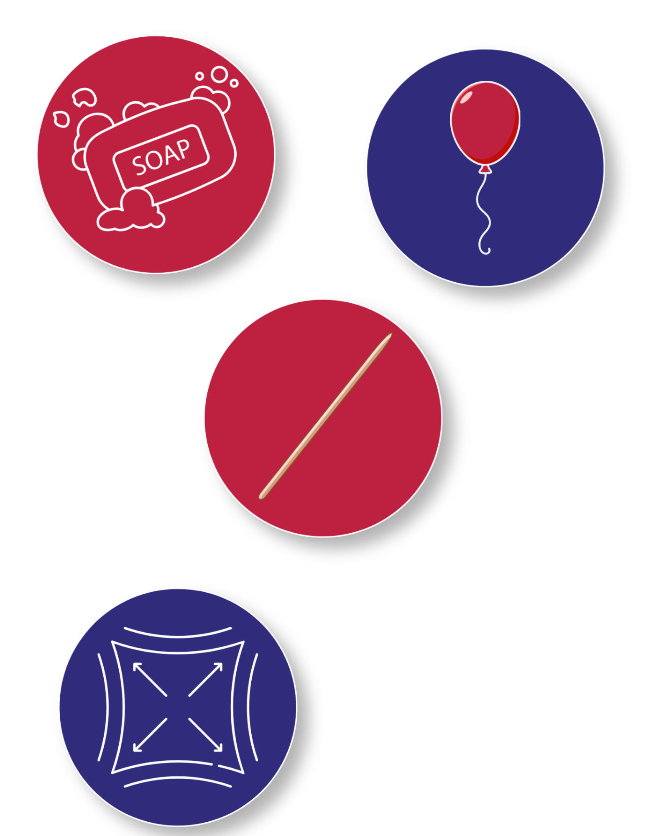
Turn and Talk Time!
What did you think would happen to a balloon if you poked it with something sharp?
How might soap help the skewer go through the balloon?
What have you learned about stretchy materials?
Why do you think it’s important to push the skewer into the thicker parts of the balloon, instead of the thinner parts?
Notes:
What did you think would happen to a balloon if you poked it with something sharp?
How might soap help the skewer go through the balloon?
What have you learned about stretchy materials?
Why do you think it’s important to push the skewer into the thicker parts of the balloon, instead of the thinner parts?

Slide 13

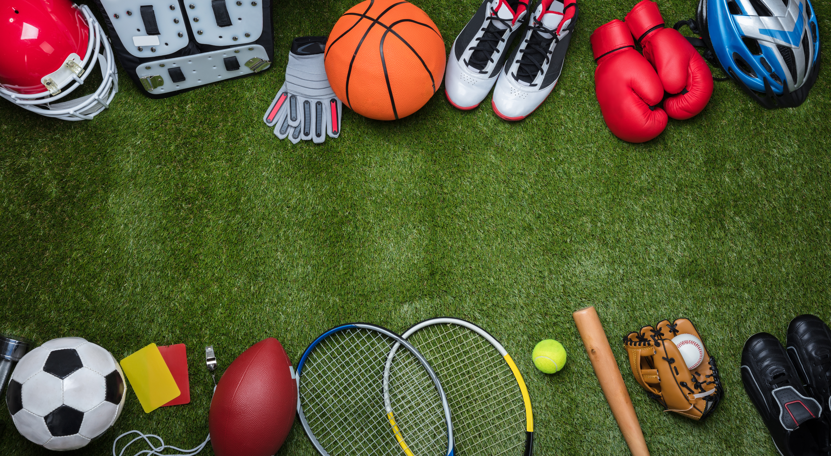

Wrap Up!
What Careers Did We Explore Today?
Builders use materials like rubber, foam, and flexible coatings that must stretch without breaking. If materials stretch too much or not enough, buildings and structures may not work the right way
Toy and Sports Equipment Makers use stretchy materials so they can bounce, bend, and move safely
Repair Workers and Installers use rubber seals, hoses, and streps that need to stretch to fit and tighten back into place
Notes:
Builders use materials like rubber, foam, and seals that must stretch without breaking. If materials stretch too much or not enough, buildings and structures may not work the right way
Toy and Sports Equipment Makers use stretchy materials so they can bounce, bend, and move safely
Repair Workers and Installers use rubber seals, hoses, and streps that need to stretch to fit and tighten back into place

