Slide 1


Activity Overview
It’s Rocket Science

Slide 2

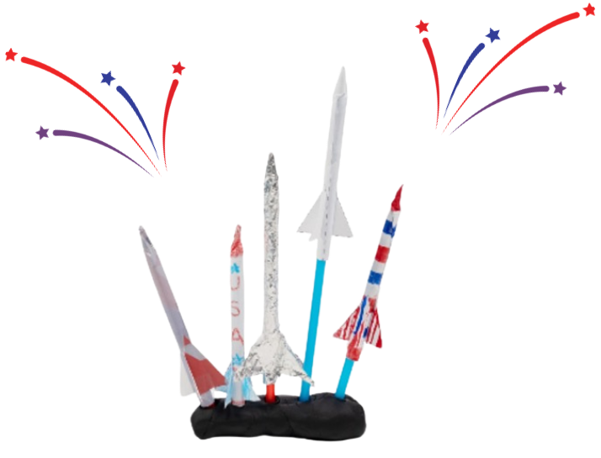
It’s Rocket Science!

Slide 3


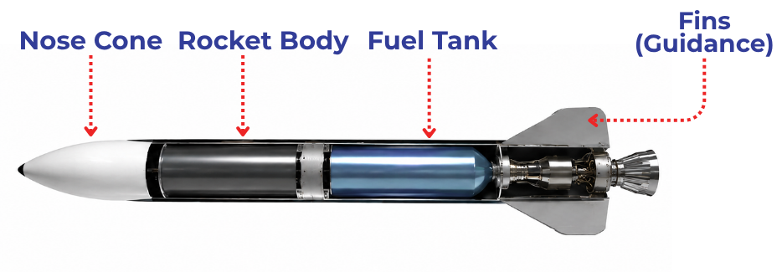


Rockets are more complex than they look! Strong materials and smart design help them do their job for a long time.
Why Do Materials Matter?
EVERY MATERIAL HAS A JOB
Rockets must stay strong, keep their shape, and fly safely.
ENGINEERS CHOOSE MATERIALS CAREFULLY
Engineers test for the strongest material and those that can be used again
YOUR CHALLENGE
Build two straw rockets using different material
Notes:
People build things to do specific jobs. A rocket needs to stay together, keep its shape, and work more than once. The material it is made from helps it do that job.
A rocket may look simple from the outside, but launching one takes careful design, strong materials, and parts that all work together.
Real rockets have to survive a lot. They need a strong body to hold their shape, a sealed fuel system so gases don’t escape where they shouldn’t, and fins or guidance systems to help them move in the right direction. During launch, rockets also face heat, shaking, pressure, and powerful forces as they lift off the ground.
That means every material has a job to do. Your straw rocket is much simpler than a real rocket, but it has some of the same design challenges. It needs to hold its shape, stay sealed, move through the air, and maybe even work more than once.
And one of the most important choices in any design is the material.
Different materials have different characteristics. Some materials are easy to shape and stay strong. Other materials may look shiny or exciting, but they can bend, wrinkle, or break more easily.
When engineers design and build things, they do not choose materials just because of how they look. They test materials to see how well they work. If something bends or breaks, that helps engineers learn what material is better for the job.
In this activity, you will build two rockets the same way but use different materials. By building, launching, and comparing your rockets, you will learn that choosing the right material helps a design work better.

Slide 4
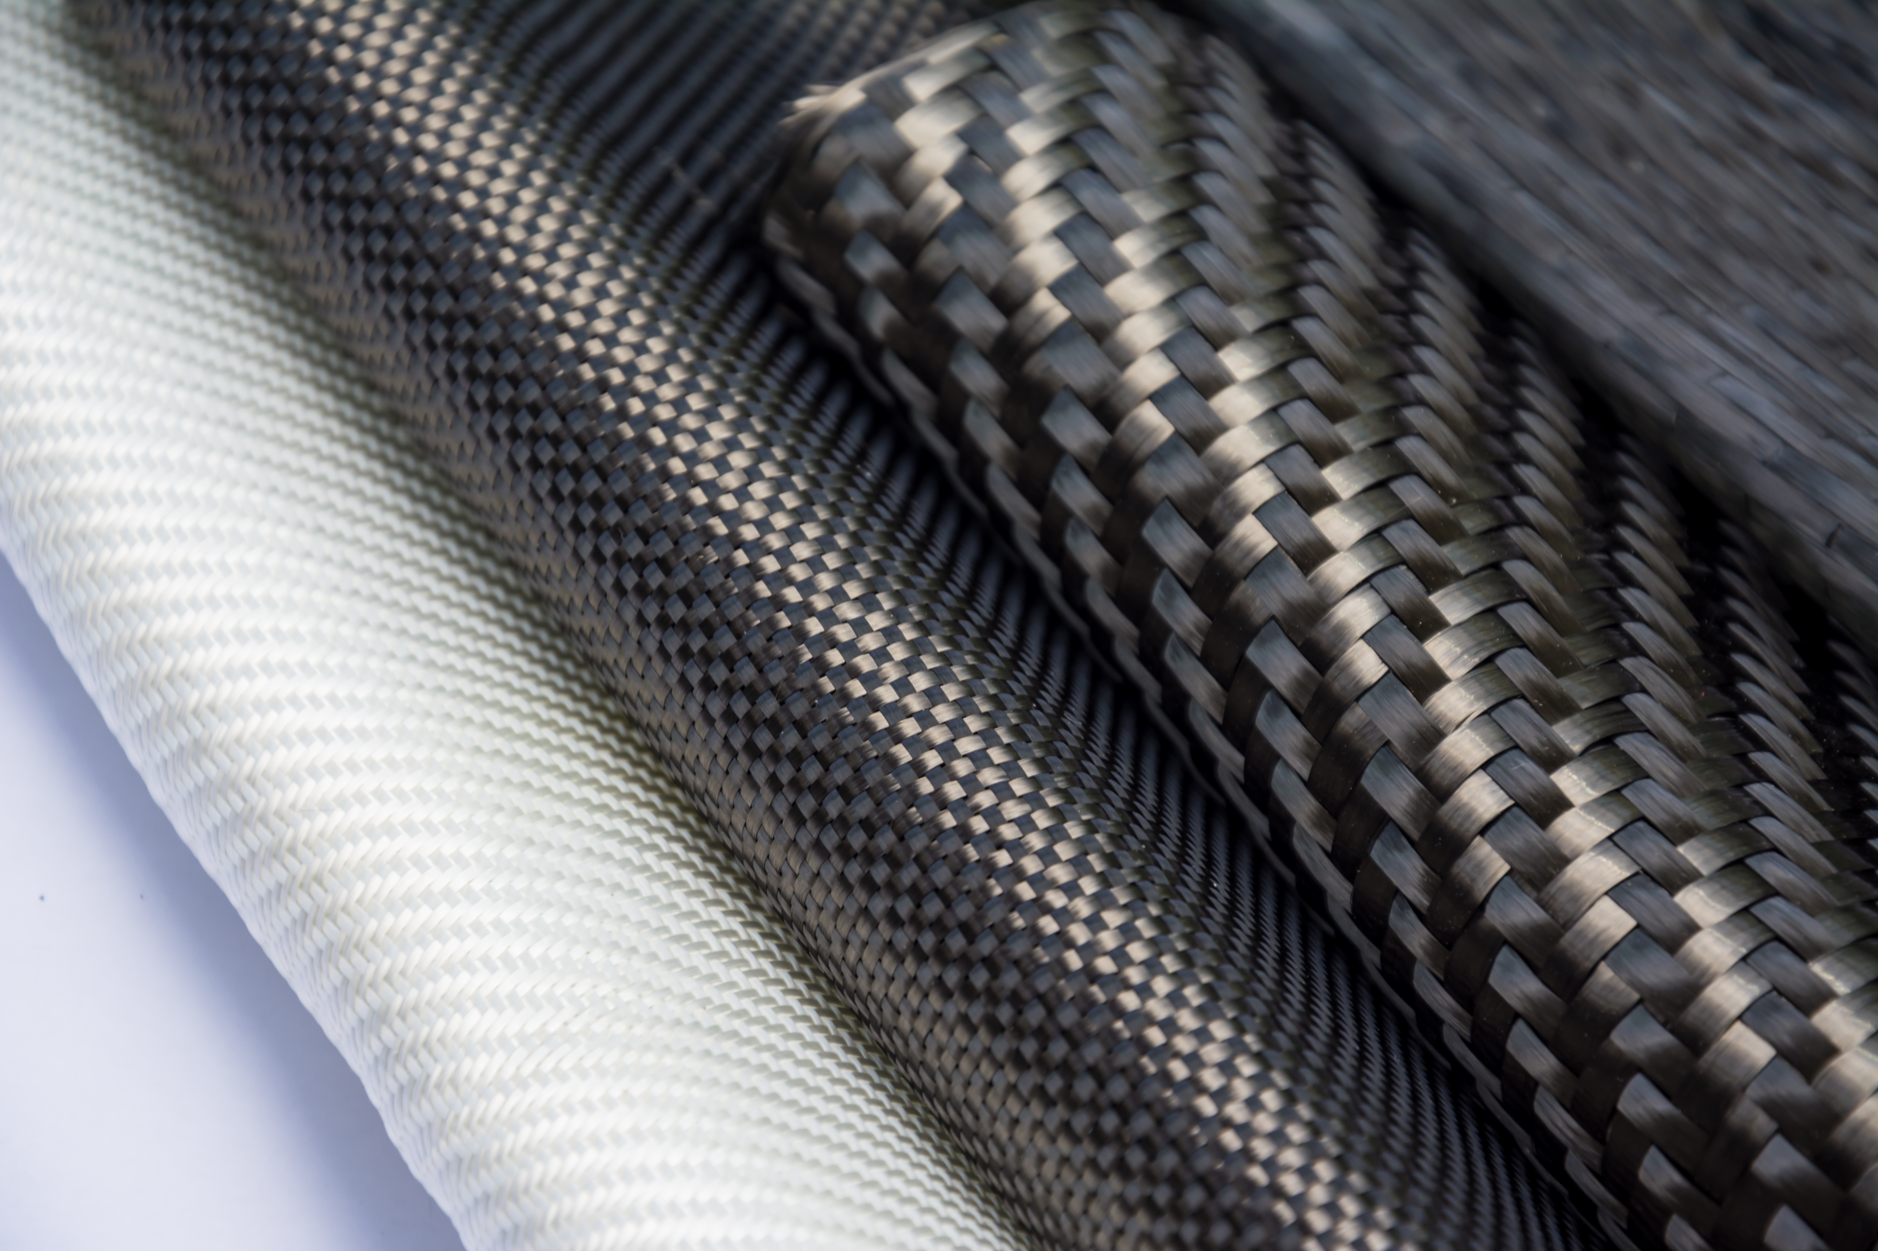


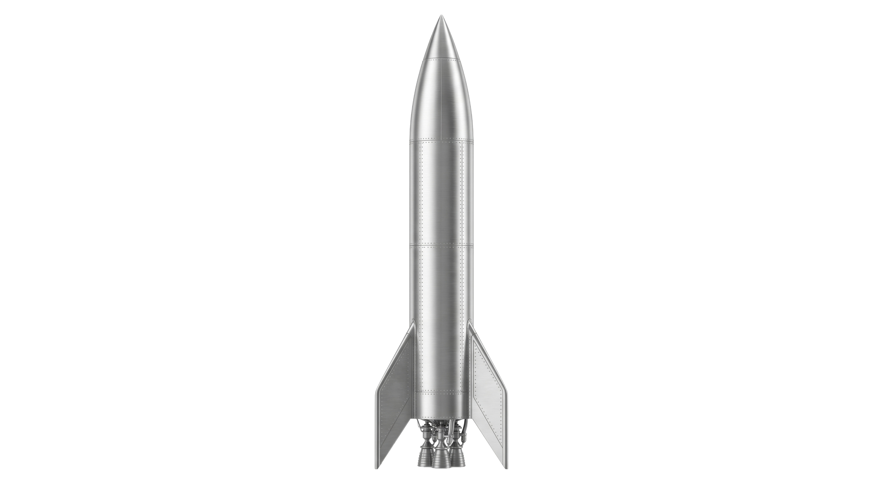
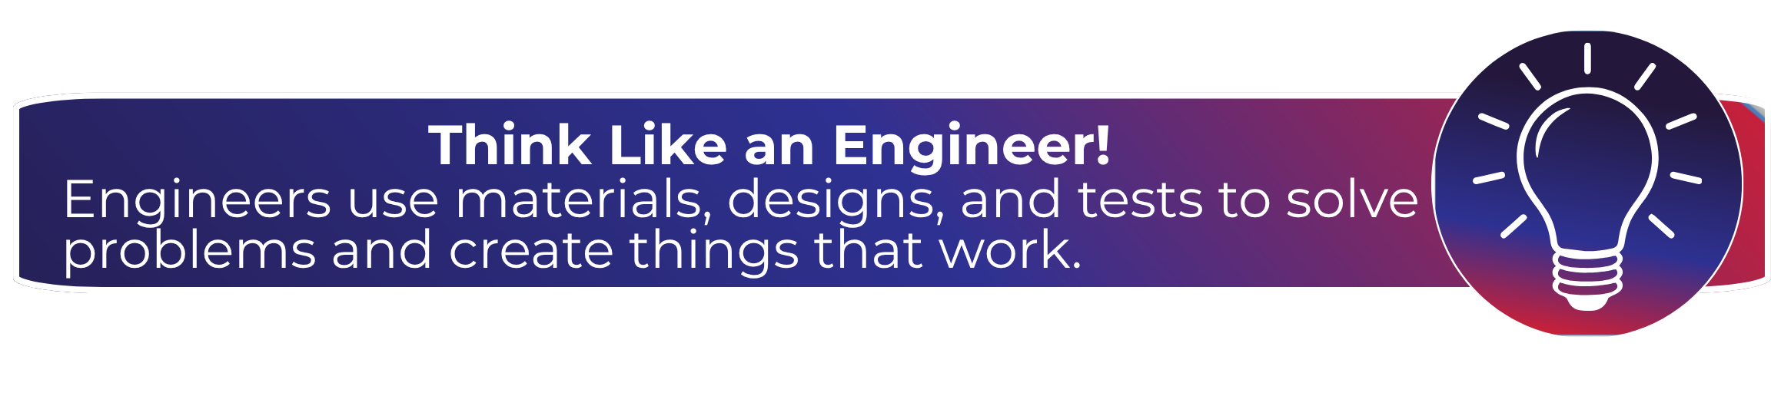
Key Words to Know
Material
Design
MATERIAL
What something is made of
DESIGN
A plan for how something is built
FIN
A flat surface that helps guide motion and keep an object moving in a straight direction
TEST
To try something out to see how it works
Test
Fin
Notes:
Material - What something is made of
Design - A plan for how something is built
Fin - A flat surface that helps guide motion and keep an object moving in a straight direction
Test – To try something out to see how it works

Slide 5

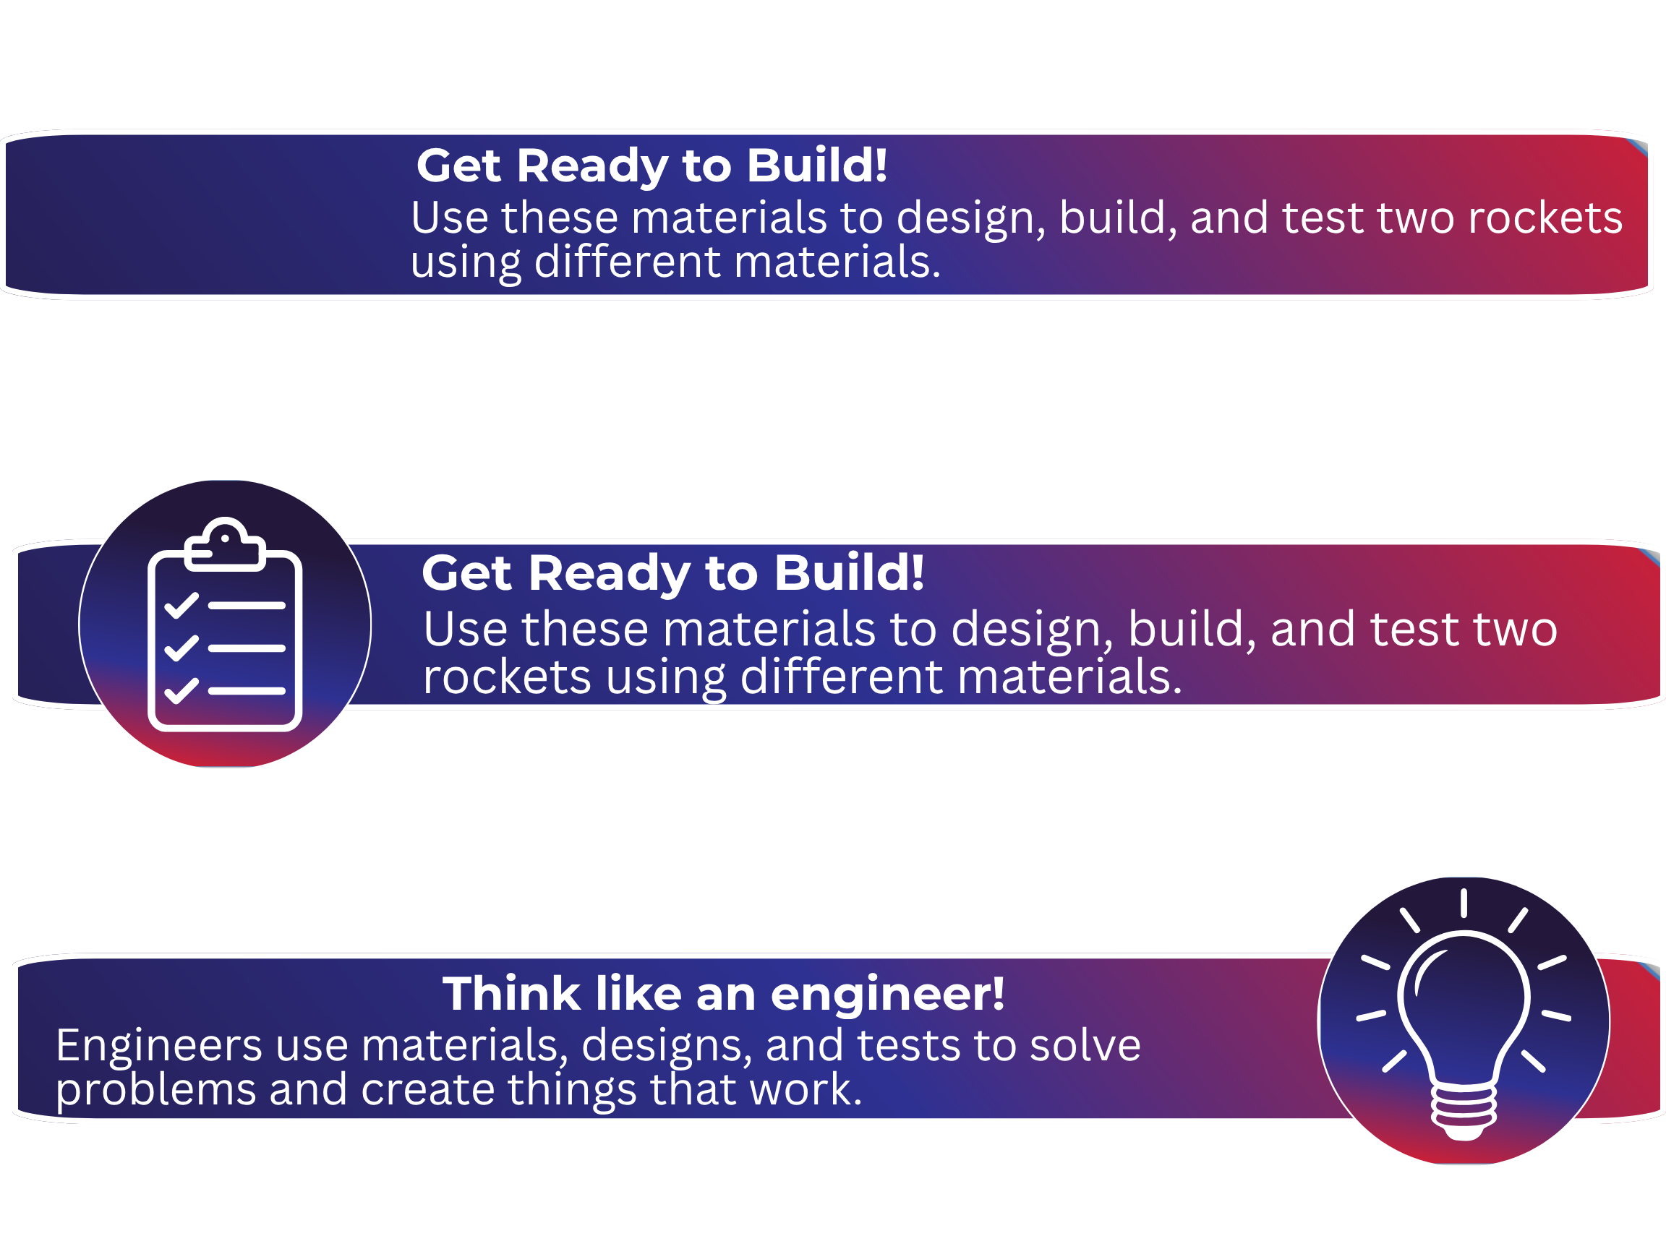
Today’s Materials
Straw
Tape Roll
Scissors
Aluminum Foil
Pencil
Rocket Template Printout

Slide 6
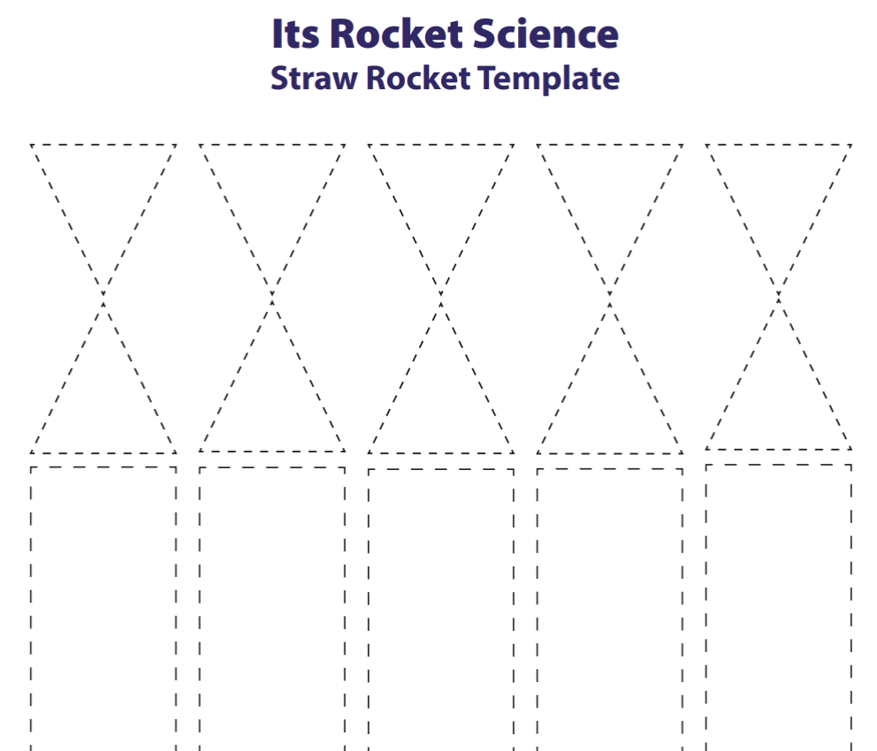
Step 1- Build the Paper Rocket Body
Wrap the rectangular portion of the rocket template around a pencil to form a tube.
1
Cut out the rocket template
2
Use tape to keep the tube’s shape
3
Twist the top of the paper tube into a point and tape it so that air cannot escape
4
Notes:
Build the paper rocket body
Cut out the rocket template
Wrap the rectangular portion of the rocket template around a pencil to form a tube.
Use tape to keep the tube’s shape
Twist the top of the paper tube into a point and tape it so that air cannot escape

Slide 7
Step 2- Form the Paper Rocket Fins
Cut the rocket fins from template.
Tape one fin to each side of the rocket body near the bottom. Then, carefully slide the paper rocket off the pencil.
1
2
Notes:
Form the paper rocket fins
Cut out the rocket fins from the template
Tape one fin to each side of the rocket body near the bottom
Carefully slide the paper rocket off the pencil

Slide 8

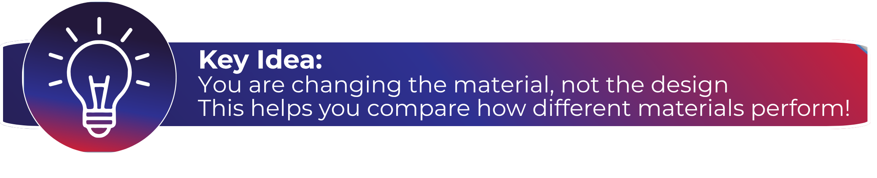
Step 3- Build the Aluminum Foil Rocket
Using the same steps as before, create a second rocket made of aluminum foil instead of paper.
Keep the design the same so only the material is different.
Notes:
Build the aluminum foil rocket ​
Using the same steps as before, create a second rocket made of aluminum foil instead of paper ​
Keep the design the same so only the material is different

Slide 9
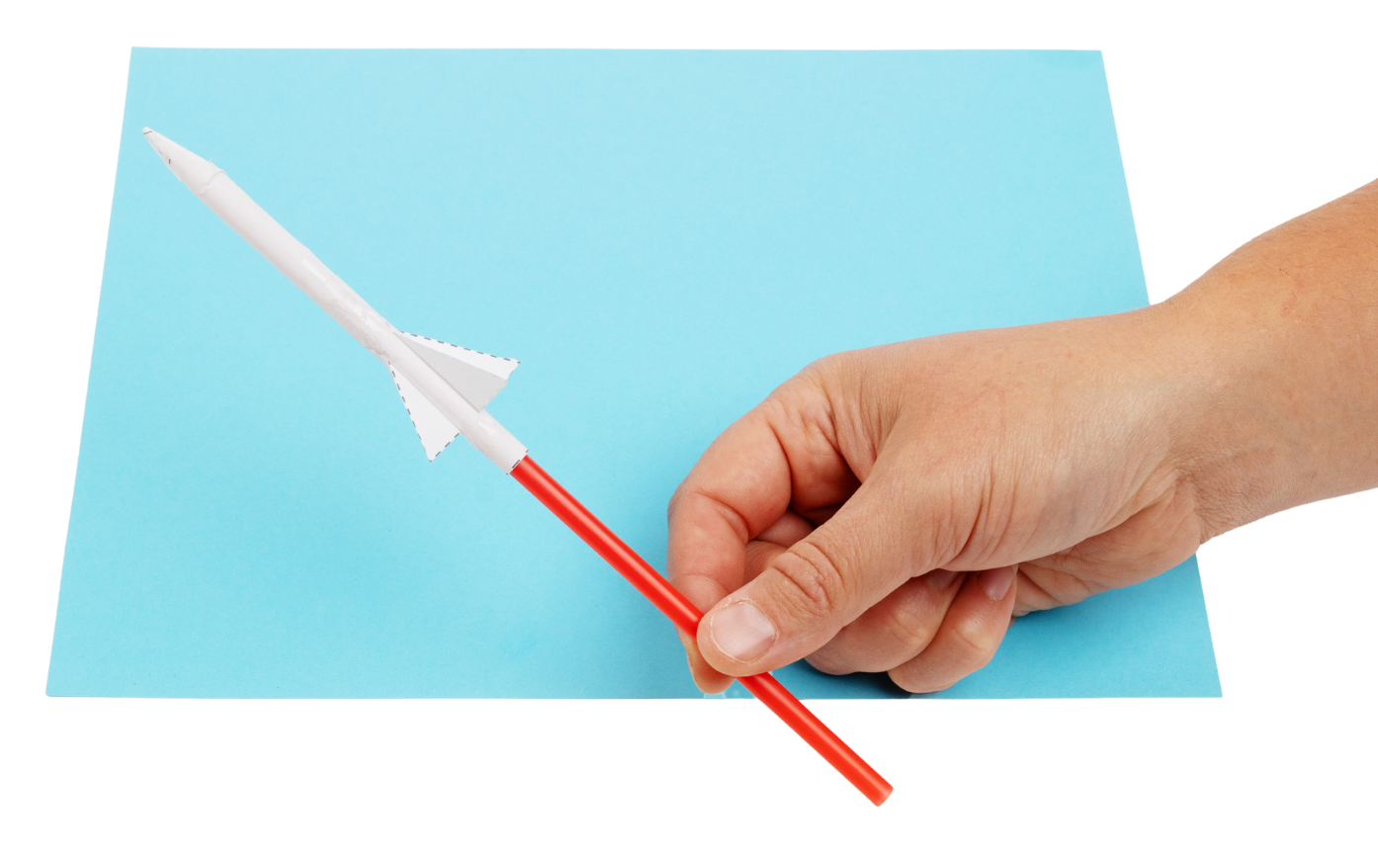

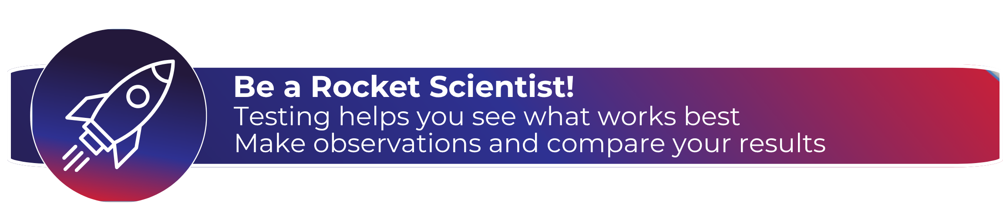
Step 4- Test the Rocket!
Observe how each rocket launches, holds its shape, and works after being used.
Slide the paper rocket onto straw.
Blow through the straw to launch the rocket.
Repeat the test with the aluminum foil rocket.
1
2
3
4
How it launches
How it holds shape
How it works after being used
Notes:
Test the rocket ​
​
Slide the paper rocket onto a straw ​
Blow through the straw to launch the rocket ​
Repeat the test with the aluminum foil rocket ​
Observe how each rocket launches, holds its shape, and works after being used ​
​

Slide 10

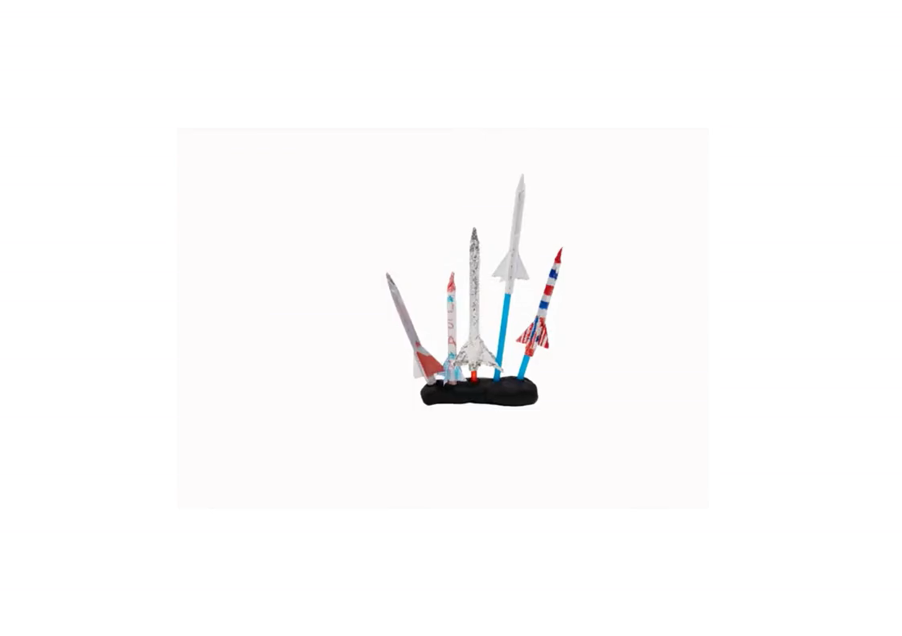
You just made a straw rocket!

Slide 11

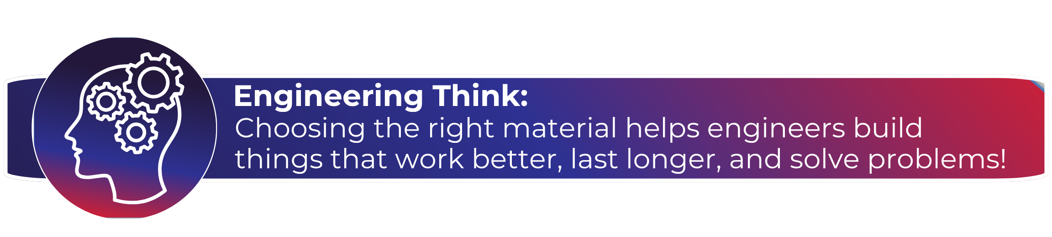
Which Rocket Was Easier to Build?
Think About:
Did one rocket keep its shape better than the other rocket after launch?
Which material helped the rocket do its job better?
Why does picking the right material matter?
Notes:
Which rocket was easier to build?
Did one rocket keep its shape better than the other rocket after launch?
Which material helped the rocket do its job better?
Why does picking the right material matter?

Slide 12

Wrap Up!
What Careers Did We Explore Today?
Builders choose materials like wood, bricks, and metal to make sure buildings stay strong and safe ​
Car makers who design and build cars work to test materials to make sure that cars are strong and safe to use ​
Toy designers think about the materials they will use to design toys that are fun to use and do not break easily ​
People who design rockets test different materials to help rockets stay strong and work safely ​
Notes:
Builders choose materials like wood, bricks, and metal to make sure buildings stay strong and safe ​
Car makers design and build cars work to test materials to make sure that cars are strong and safe to use ​
Toy designers think about the materials they will use to design toys that are fun to use, and do not break easily ​
People who design rockets test different materials to help rockets stay strong and work safely ​

