Slide 1




Activity Overview
Kinetic Critters

Slide 2

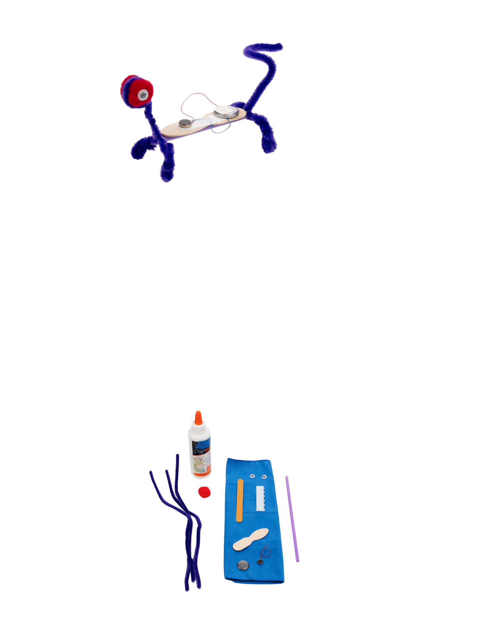

Kinetic Creatures

Slide 3
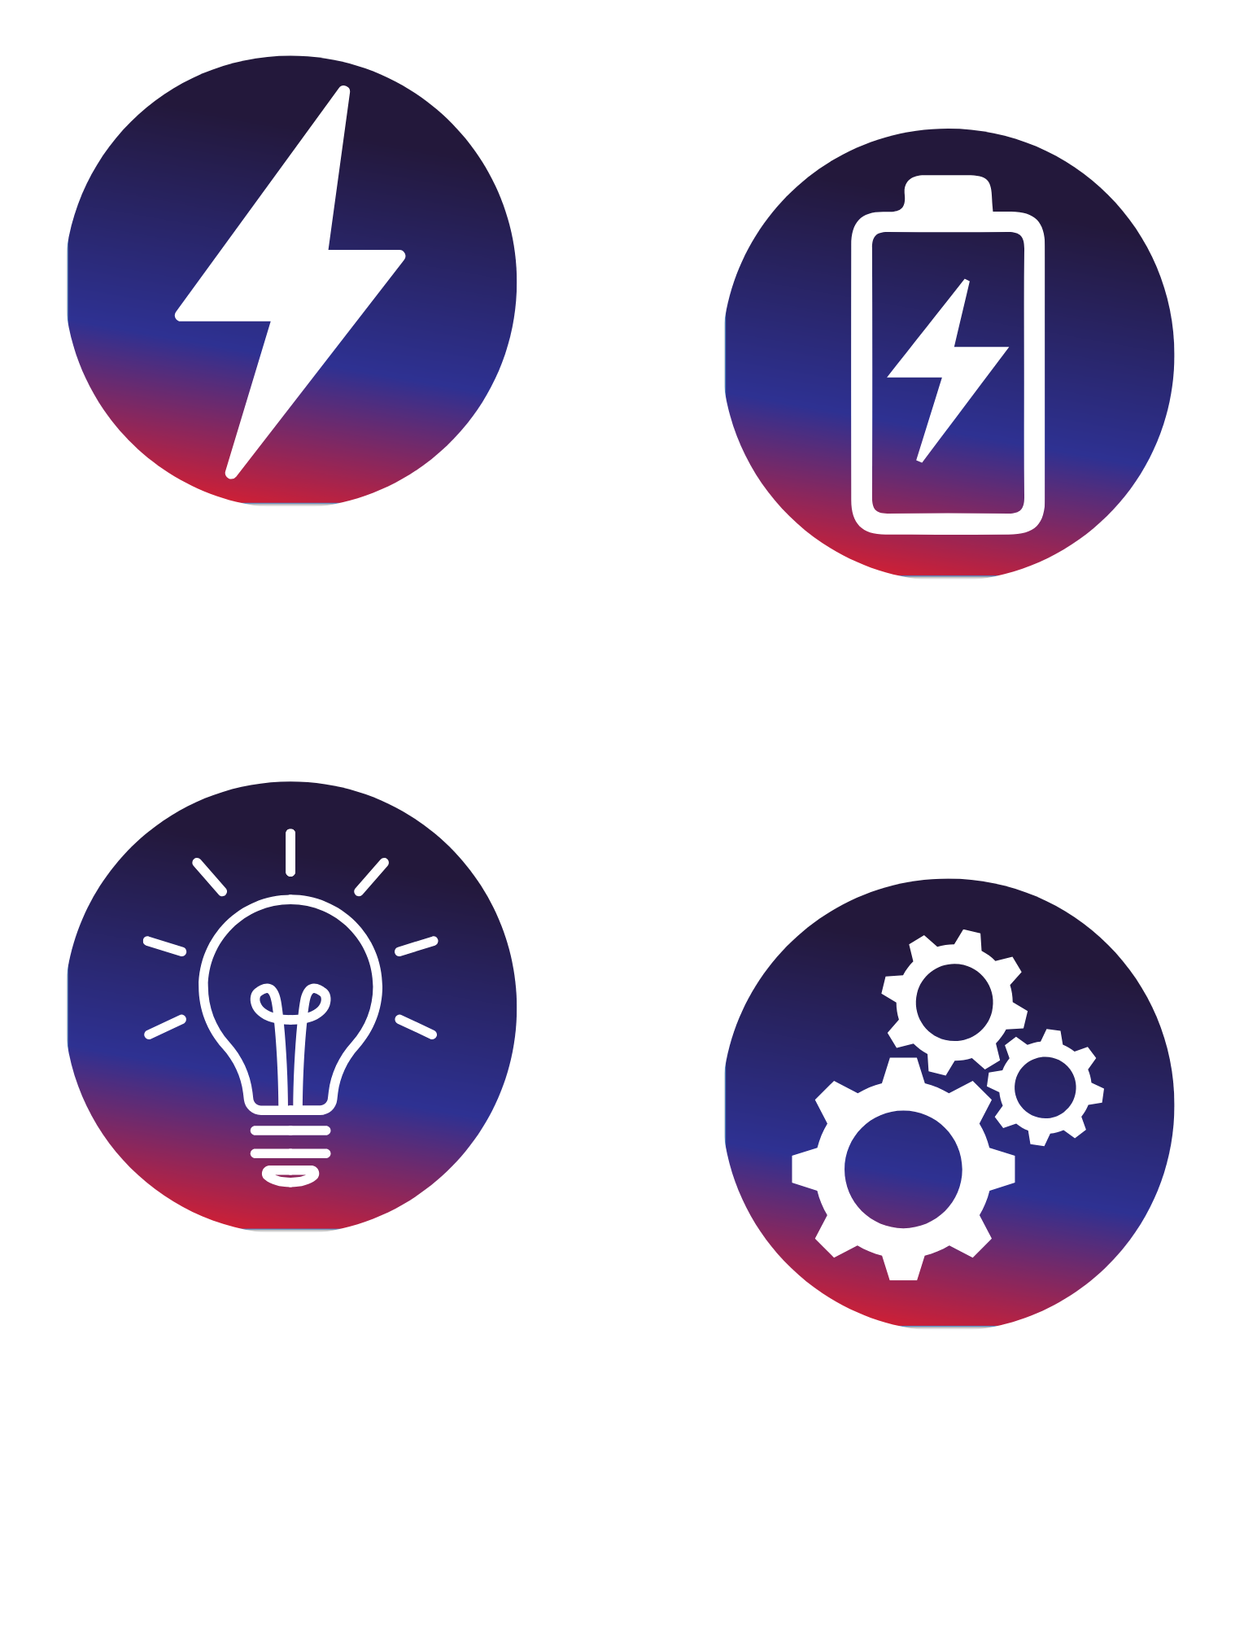
Foundations of Energy
Many things we use everyday move because they use energy. Some toys light up, some make sounds, and some move across the floor because they use electrical energy from a battery.
A battery stores energy that can be used to make something happen. When a battery is connected to a motor, that energy can be used to make the motor move. When the connection is made, the motor turns on. When the connection is broken, it turns off.
In today’s activity, you will use electrical energy in a simple way - to make a creature move. As you build, you’ll discover that how parts are connected matters. If the motor doesn’t move, the energy isn’t reaching it yet.
You will test your creature, notice how it moves, and make changes to improve it. Engineers and builders do this every day: they try something, see what happens, and make adjustments to make it work better.
Notes:
Many things we use everyday move because they use energy. Some toys light up, some make sounds, and some move across the floor because they use electrical energy from a battery.
A battery stores energy that can be used to make something happen. When a battery is connected to a motor, that energy can be used to make the motor move. When the connection is made, the motor turns on. When the connection is broken, it turns off.
In today’s activity, you will use electrical energy in a simple way - to make a creature move. As you build, you’ll discover that how parts are connected matters. If the motor doesn’t move, the energy isn’t reaching it yet.
You will test your creature, notice how it moves, and make changes to improve it. Engineers and builders do this every day: they try something, see what happens, and make adjustments to make it work better.

Slide 4
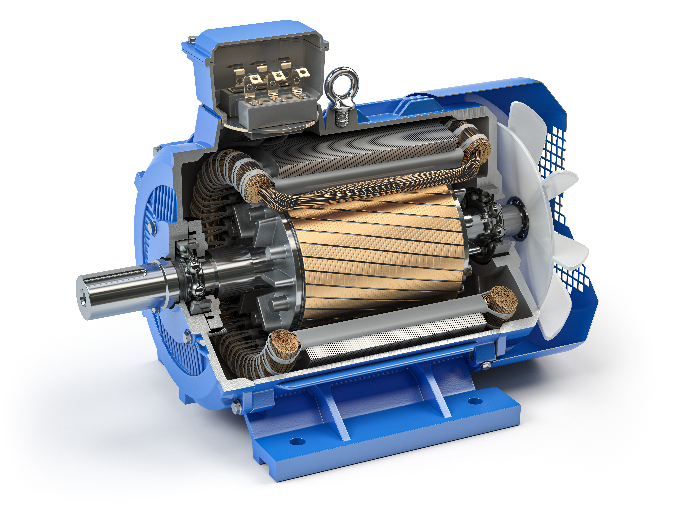
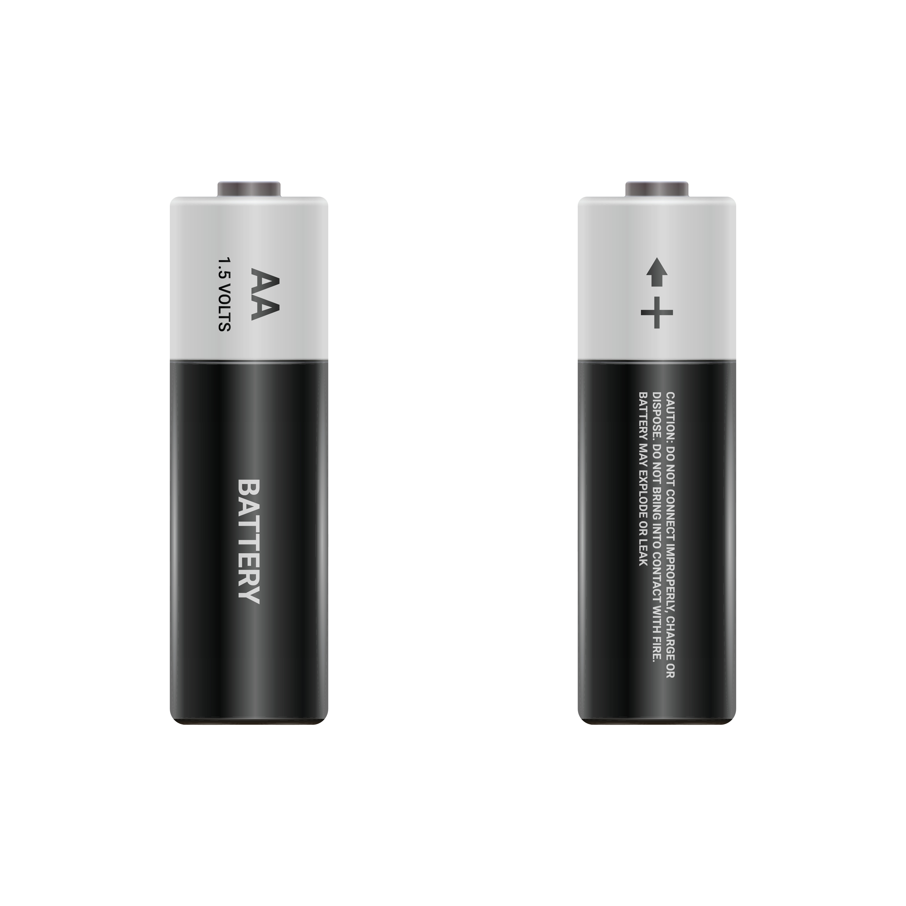
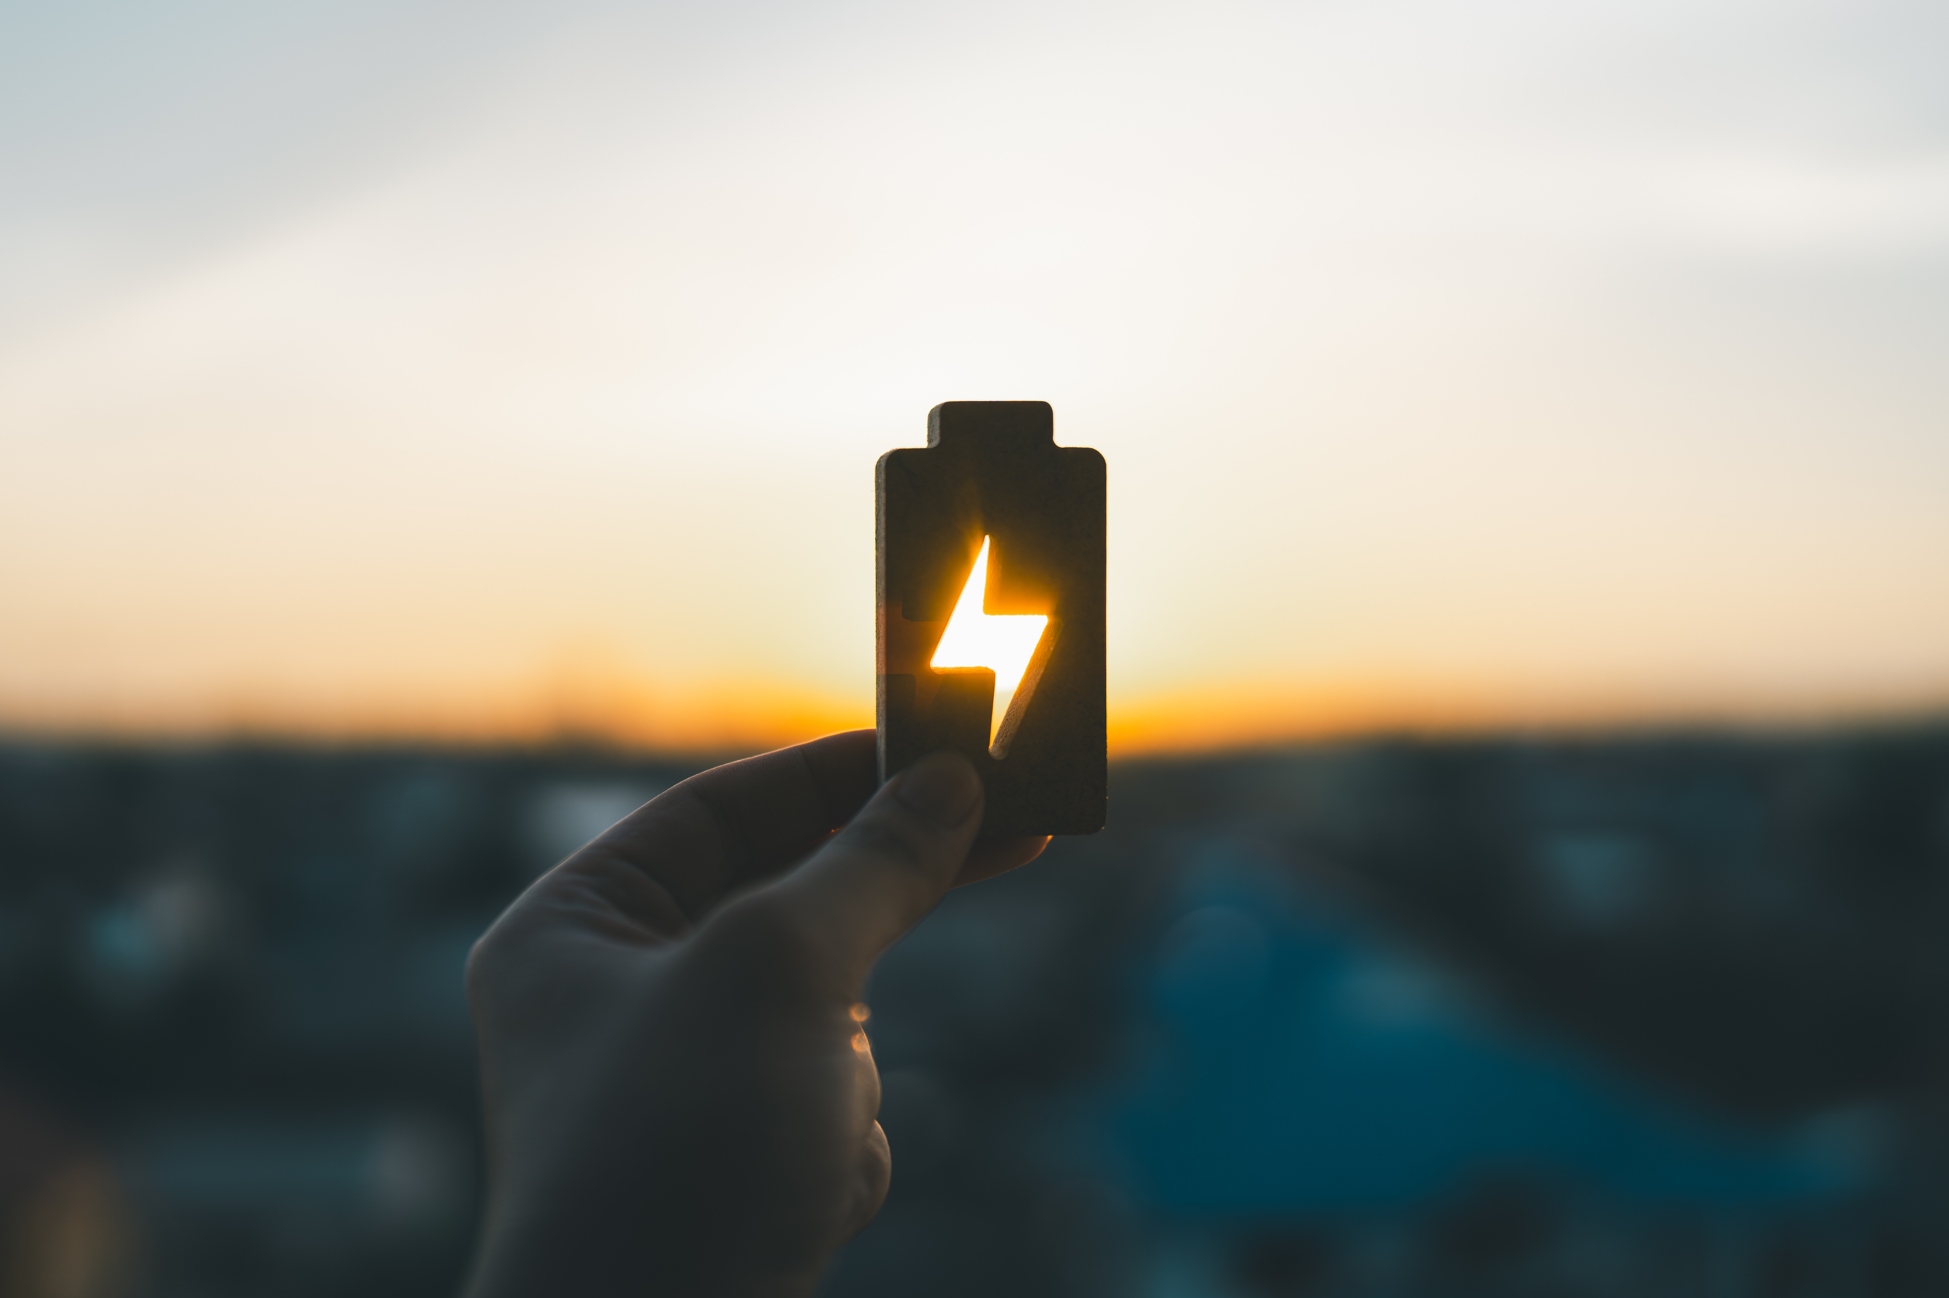
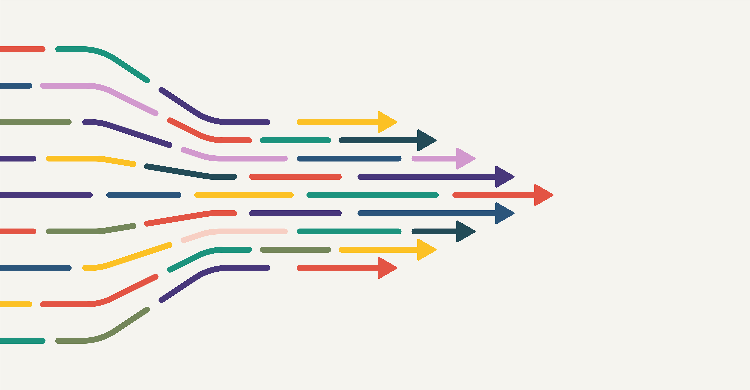
Key Words to Know
Motor
Battery
BATTERY
A small power source that provides energy
MOTOR
A device that moves when it gets power from a battery
ENERGY
Something that makes things move, light up, or make sound
MOVEMENT
When something changes position or location
Energy
Movement
Notes:
Material - What something is made of
Design - A plan for how something is built
Fin - A flat surface that helps guide motion and keep an object moving in a straight direction
Test – To try something out to see how it works

Slide 5
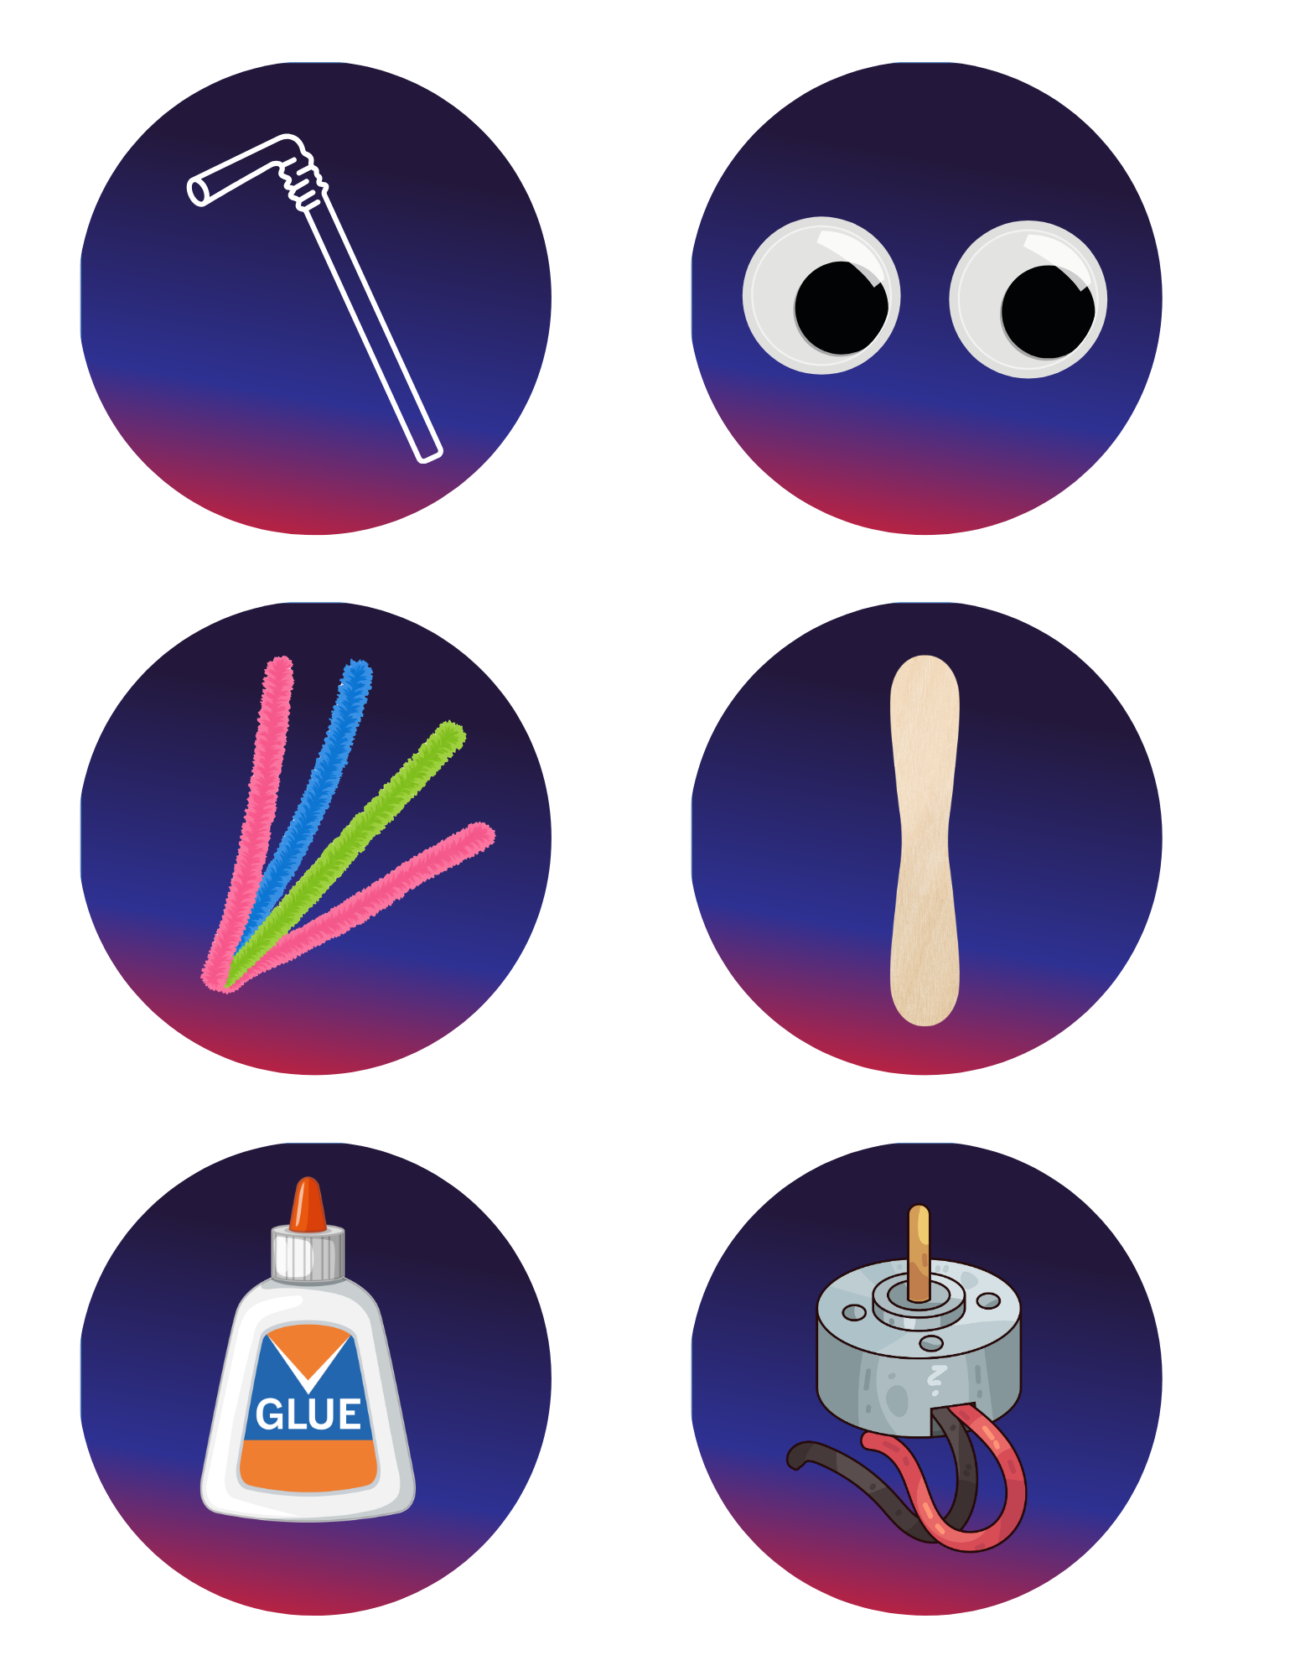
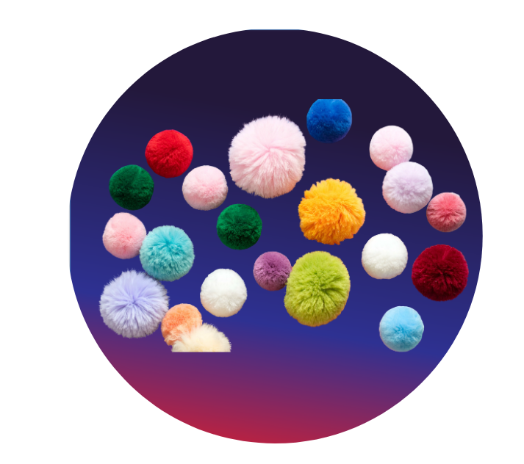
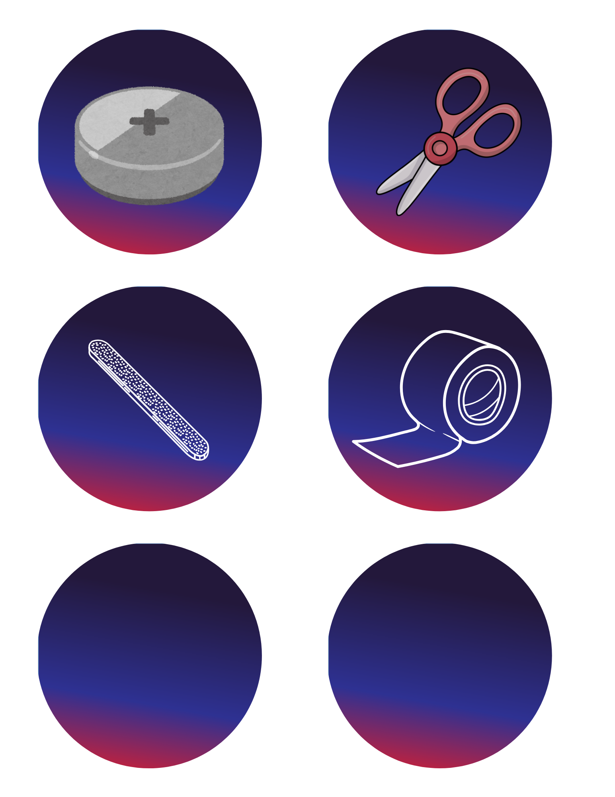
Today’s Materials
Pipe Cleaners
Straw
Pom-Pom
Googly Eyes
Wooden Ice Cream Spoon
Craft Glue
Small Vibrating Motor with Wires
Coin-Cell Battery
Scissors
Emery Board
Adhesive Tabs or Pieces of Double-Sided Tape
Notes:
1 drinking straw (cut to approximately 2 inches)
3 pipe cleaners
1 pom-pom
2 googly eyes
1 wooden ice cream spoon
1 small vibrating motor with wires
1 coin-cell battery
2 adhesive tabs or pieces of double-sided tape
Craft glue
1 emery board (teacher use)
Scissors

Slide 6
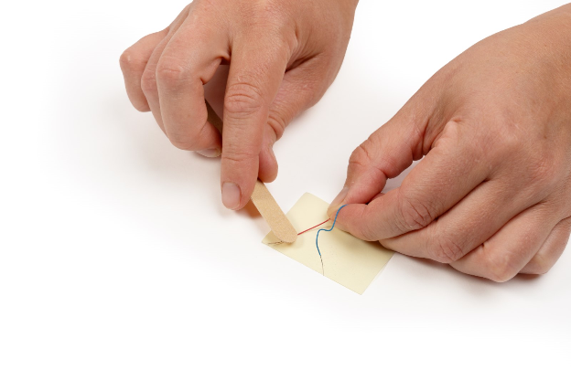
Teacher Tips
The vibrating motors included in this activity have very thin wires that are partially stripped, but often not enough to make reliable contact with the battery
Use the provided emery board to gently rub off about a half-inch of the wire coating near the tip of each wire
To reduce frustration during the activity, it is recommended that teachers prepare the motor wires in advance by gently removing a bit more of the wire coating to expose additional metal
Pre-stripping the wires helps ensure that students can successfully complete the circuit by simply touching the bare wire to the battery during the activity
Notes:
The vibrating motors included in this activity have very thin wires that are partially stripped, but often not enough to make reliable contact with the battery
To reduce frustration during the activity, it is recommended that teachers prepare the motor wires in advance by gently removing a bit more of the wire coating to expose additional metal
Use the provided emery board to gently rub off about a half-inch of the wire coating near the tip of each wire
Pre-stripping the wires helps ensure that students can successfully complete the circuit by simply touching the bare wire to the battery during the activity

Slide 7
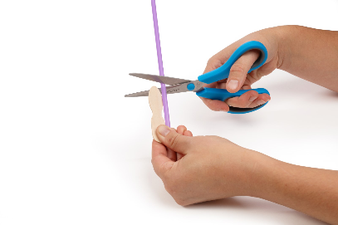
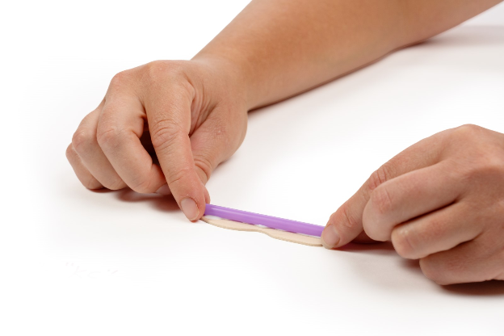
Step 1- Build the Body
Cut a piece of straw that is the length of the wooden spoon
1
Glue it to the center of the spoon lengthwise with a few dabs of craft glue
2
Notes:
Build the body:
Cut a piece of straw that is the length of the wooden spoon, and glue it to the center of the spoon lengthwise with a few dabs of craft glue

Slide 8
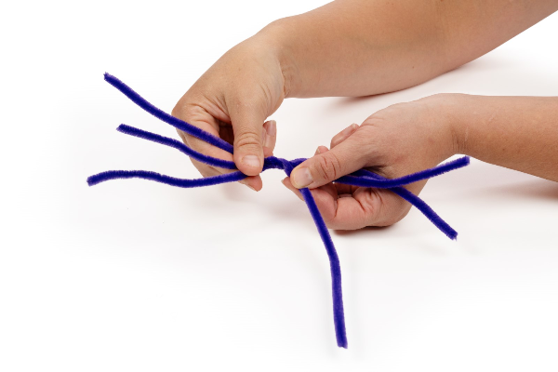
Step 2- Time to Twist
Line up three pipe cleaners side-by-side
3
Twist them together in the center several times
4
Notes:
Line up three pipe cleaners side-by-side and twist them together in the center several times

Slide 9
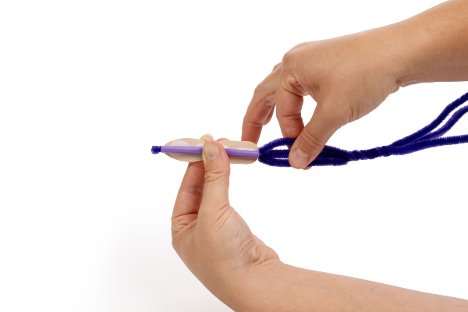
Step 3- Slide into the Straw
Slide the pipe cleaners through the straw, leaving equal lengths of pipe cleaner on either side
5
Notes:
Slide the pipe cleaners through the straw, leaving equal lengths of pipe cleaner on either side

Slide 10
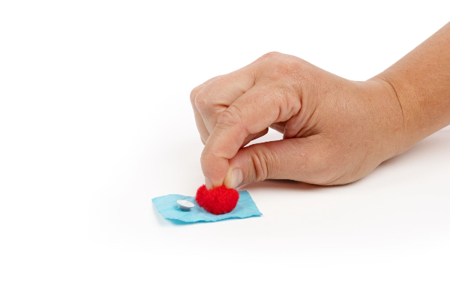
Step 4- Prepare the Creature’s Head
Gather one pom-pom and two googly eyes
6
Add a small dab of craft glue to opposite sides of the pom-pom and attach the googly eyes
7
Notes:
Prepare the creature’s head:
Gather one pom-pom and two googly eyes
Add a small dab of craft glue to opposite sides of the pom-pom and attach the googly eyes

Slide 11
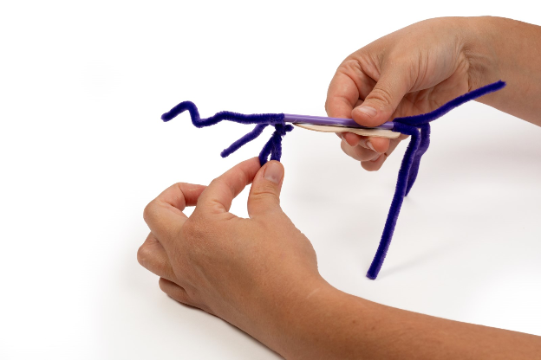
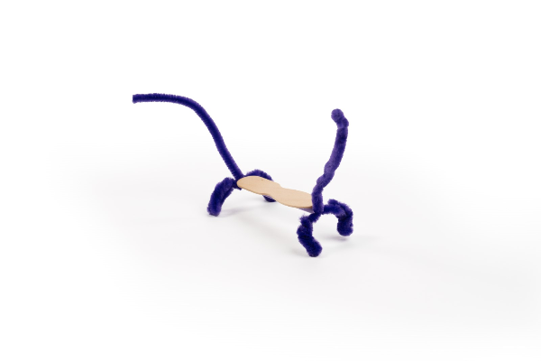
Step 5- Add the Legs and Head
On each end of the creature, bend two pipe cleaners downwards to form four legs
8
Bend the third pipe cleaner upward to form a tail
9
Adjust the legs so that the creature can stand
10
Wrap one of the front pipe cleaner ends around the pom-pom between the eyes to secure the head.
11
Notes:
On each end of the creature, bend two pipe cleaners downwards to form four legs
Bend the third pipe cleaner upward to form a tail
Adjust the legs so that the creature can stand
Wrap one of the front pipe cleaner ends around the pom-pom between the eyes to secure the head.

Slide 12
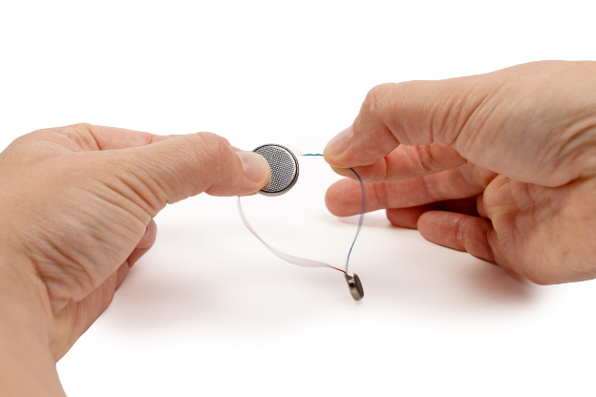
Step 6- Test the Circuit
Touch one exposed motor wire to the top face of the battery, and the other to the bottom face of the battery. This should activate the motor as a test.
12
Make sure the motor vibrates. If not, adjust the wires so they make contact with the battery surfaces.
13
Notes:
Test the Circuit
Touch one exposed motor wire to the top face of the battery, and the other to the bottom face of the battery. This should activate the motor as a test.
Make sure the motor vibrates. If not, adjust the wires so they make contact with the battery surfaces.

Slide 13
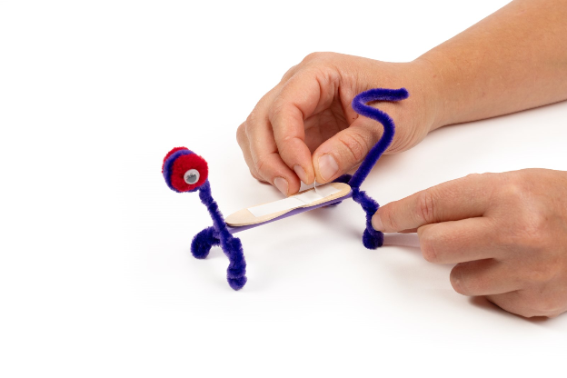
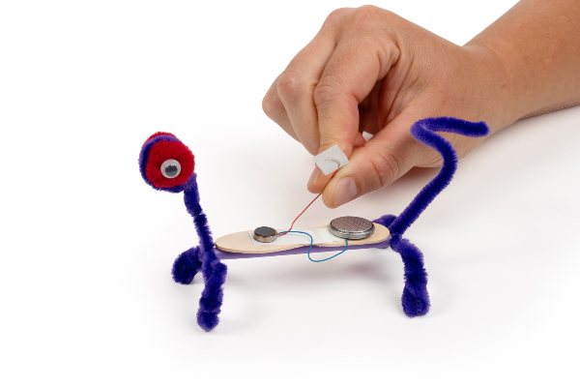
Step 7- Connect the Circuit
Attach the motor and battery to the body using adhesive tabs near the back of the straw body. ​
14
Press the negative side of the battery onto the tab and secure one motor wire beneath it so it maintains contact. ​
15
Tape the second motor wire so it can be lifted on and off the positive side of the battery. When the wire touches the battery, the circuit closes and the motor activates.
16
Notes:
Connect the Circuit
​
Attach the motor and battery to the body using adhesive tabs near the back of the straw body. ​
Press the negative side of the battery onto the tab and secure one motor wire beneath it so it maintains contact. ​
​
Tape the second motor wire so it can be lifted on and off the positive side of the battery. When the wire touches the battery, the circuit closes and the motor activates.

Slide 14
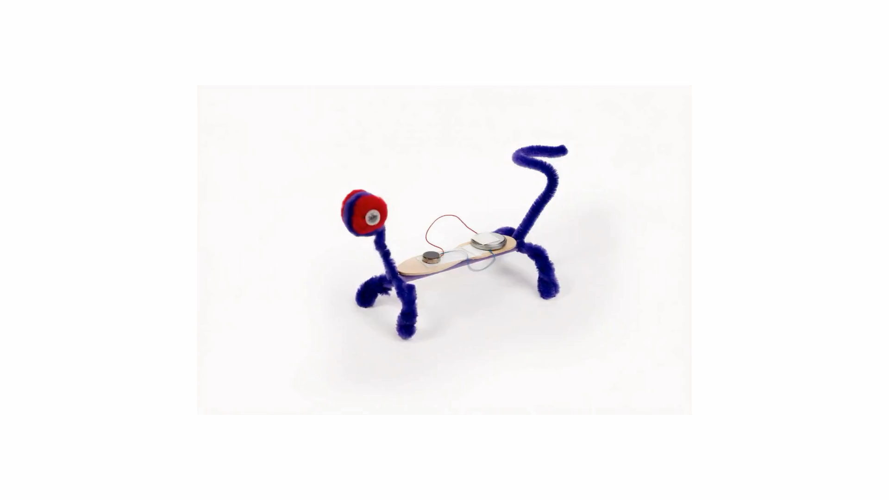
Step 8- Test
Place the creature on a flat surface and activate the motor.
Observe how it moves.
17
Notes:
Test
Place the creature on a flat surface and activate the motor.
Observe how it moves.

Slide 15
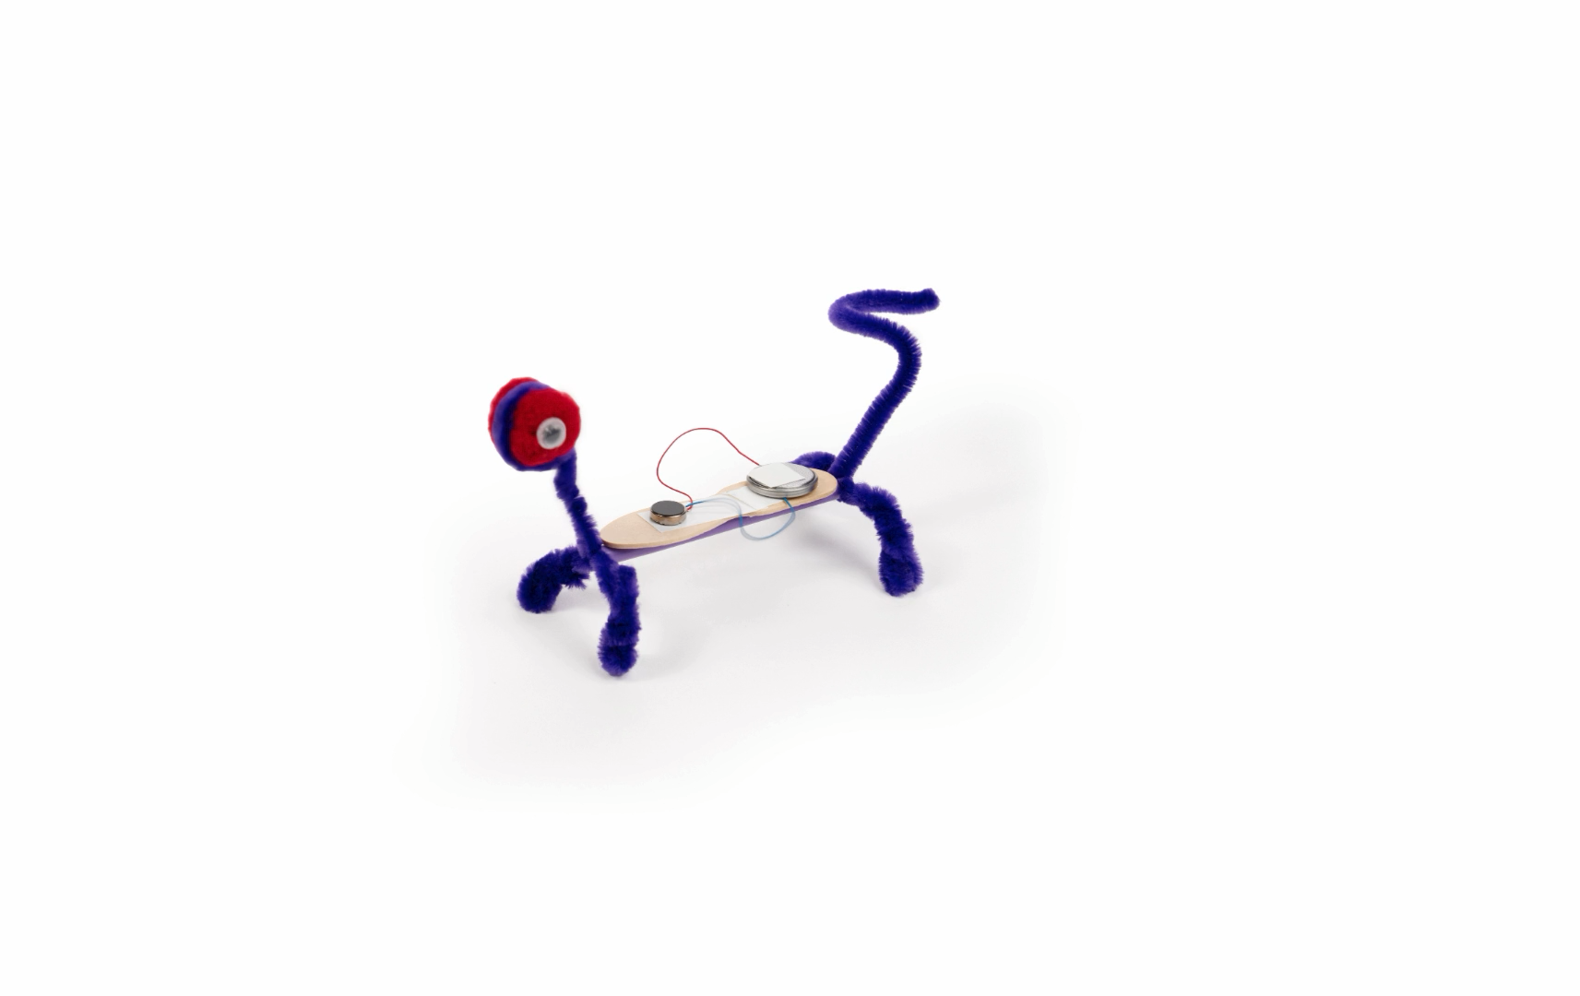
Step 8- Test
Place the creature on a flat surface and activate the motor.
Observe how it moves.
18
Notes:
Test
Place the creature on a flat surface and activate the motor.
Observe how it moves.

Slide 16
Step 8- Readjust
Adjust the legs, balance, or position of the motor. Test again and compare
how the movement changes.
19
Notes:
Improve
Adjust the legs, balance, or position of the motor.
Test again and compare how the movement changes.

Slide 17
You Just made a Kinetic Creature!

Slide 18

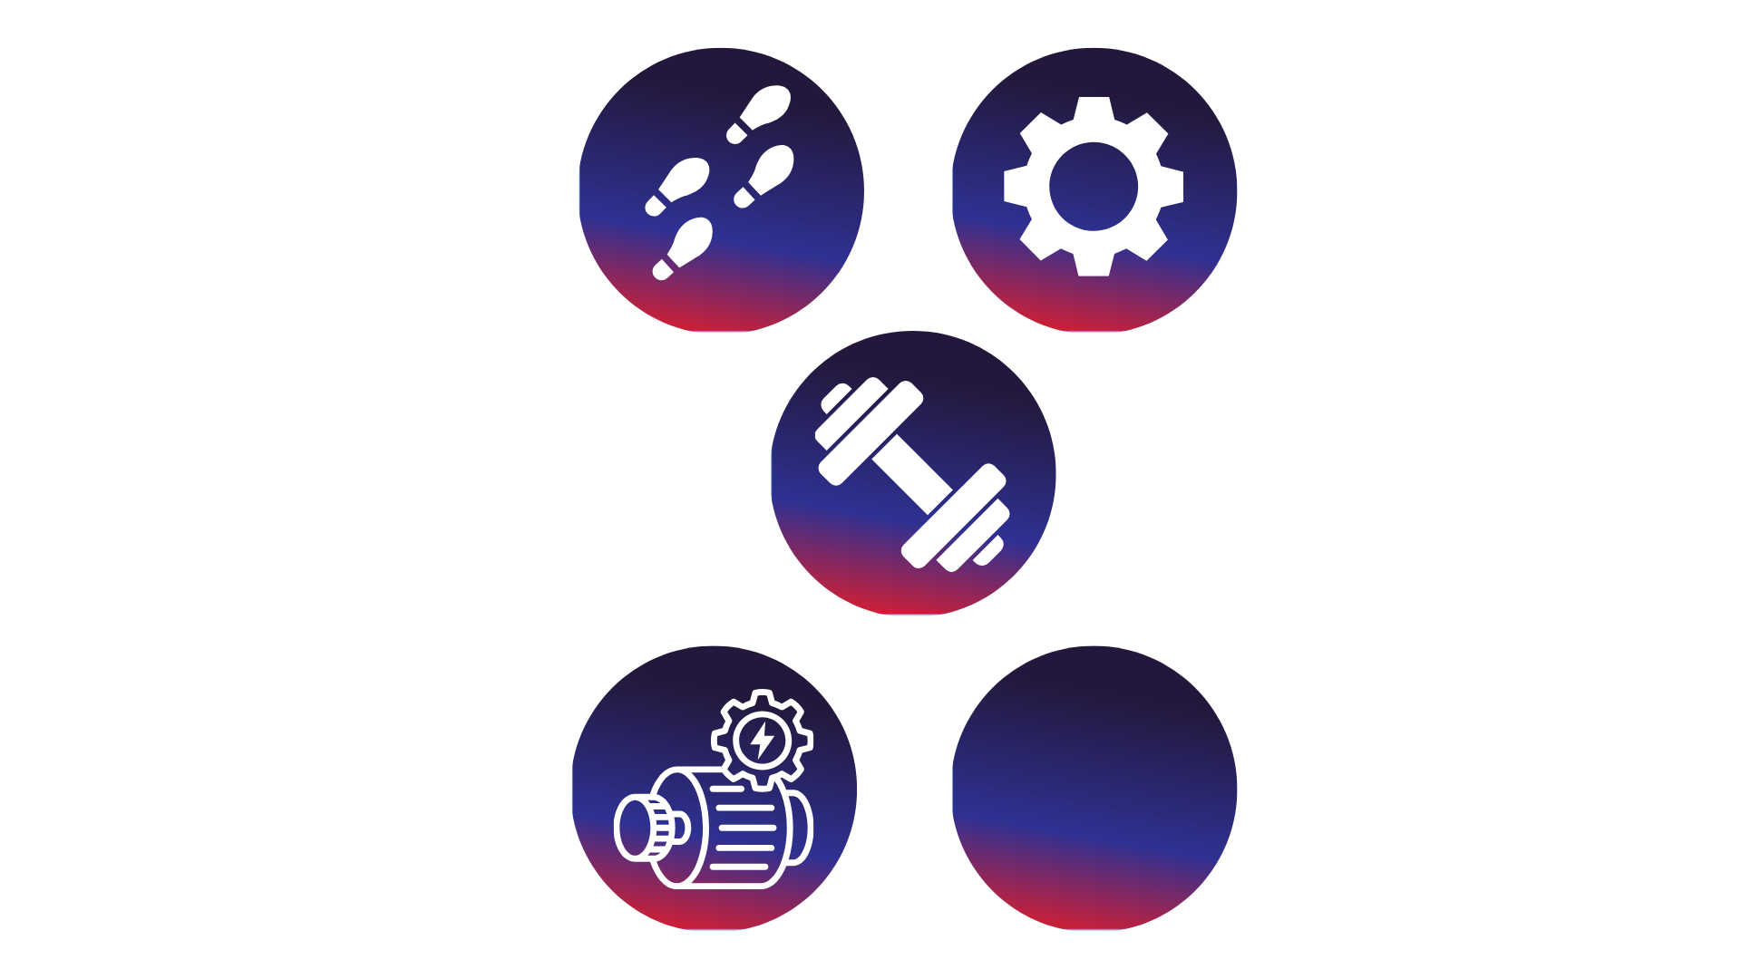
Turn and Talk Time!
What made your creature start moving?
What changes did you make to your creature,
and how did those changes affect how it moved?
What happened when the weight shifted forward or backward?
What did you notice about the battery and motor working together?
Notes:
What made your creature start moving?
What changes did you make to your creature, and how did those changes affect how it moved?
What happened when the weight shifted forward or backward?
What did you notice about the battery and motor working together?

Slide 19


Wrap Up!
What Careers Did We Explore Today?
Electrical engineers work with batteries and wires to help power toys, tools, and machines
Mechanical engineers design parts that move and help things work together
Manufacturing technicians put parts together, test products, and make sure everything works properly
Toy and product designers create fun products that move, vibrate, or light up using simple electrical parts
Notes:
Electrical engineers work with batteries and wires to help power toys, tools, and machines
Mechanical engineers design parts that move and help things work together
Manufacturing technicians put parts together, test products, and make sure everything work properly
Toy and product designers create fun products that move, vibrate, or light up using simple electrical parts

