Slide 1




Activity Overview
Kinetic Sand

Slide 2

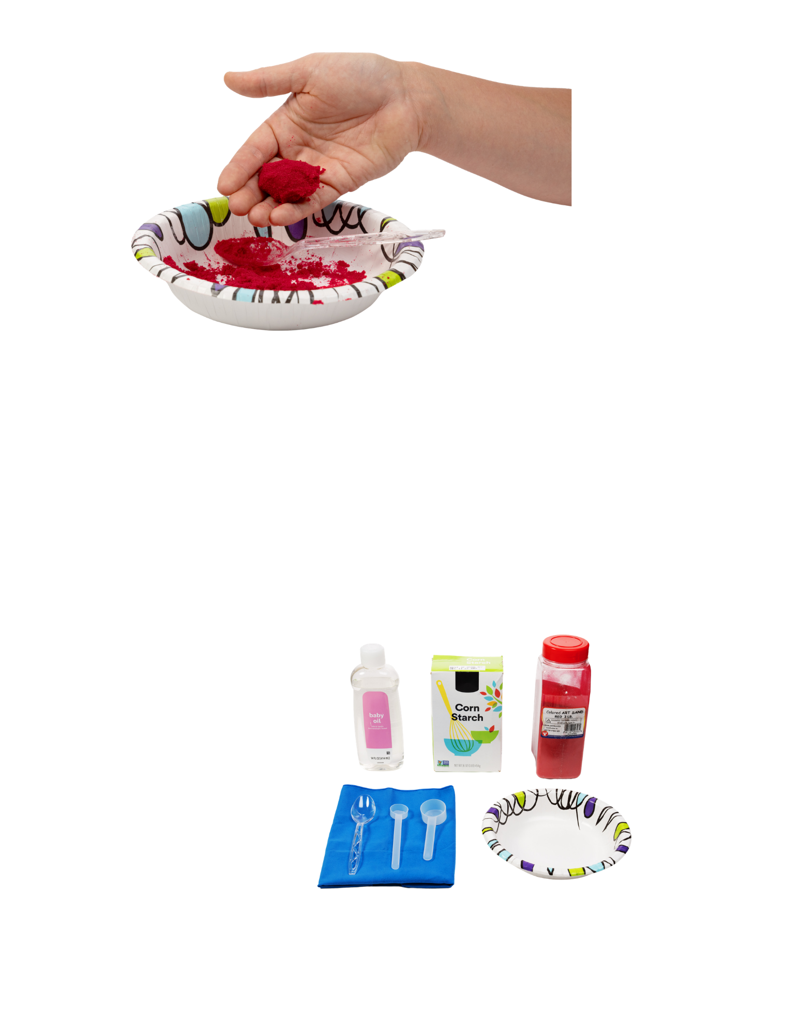

Kinetic Sand

Slide 3
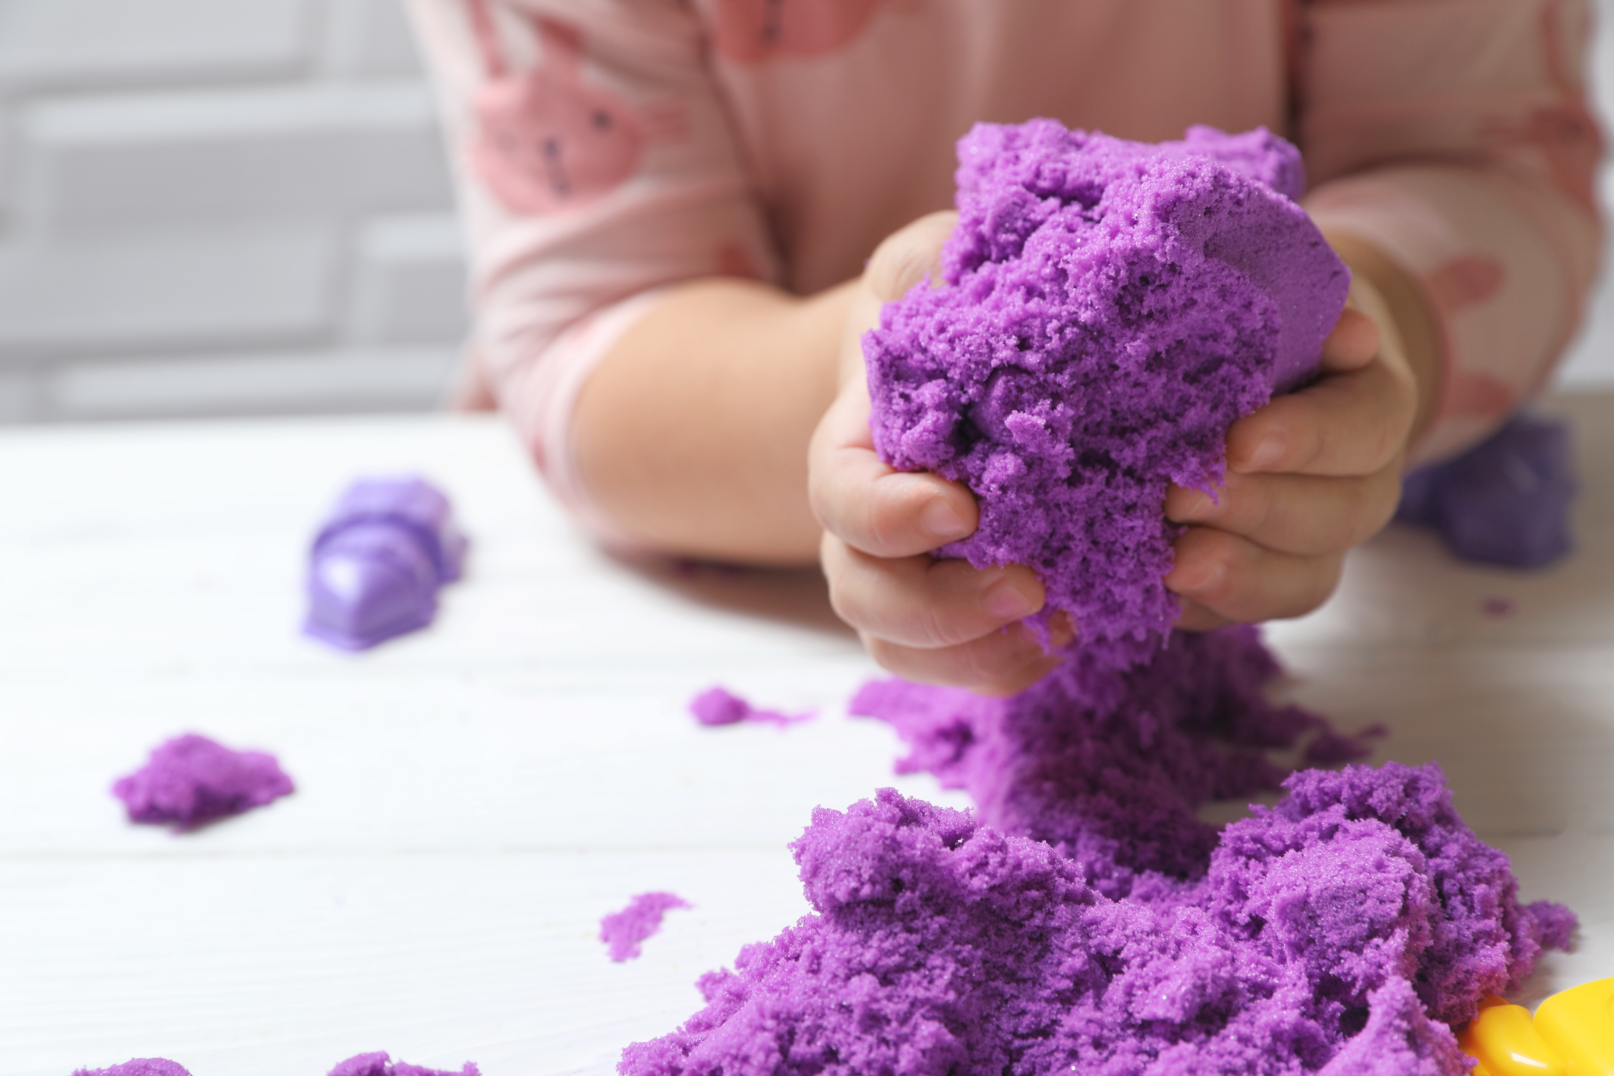
Kinetic Sand- Explore. Mix. Discover.
Material science is when we learn about stuff; how it feels, what it does, and what happens when we mix it with other things. Today we are going to be material scientists while making kinetic sand. ​
What is kinetic sand? ​
Kinetic sand is a type of sand that can: ​
Hold its shape when you squeeze it ​
Fall apart slowly when you let it go ​
When you hold it or press it, it stays together like a solid. But when you let it fall or move, it flows like a liquid.
To make kinetic sand, we will be using three materials:
Sand
Cornstarch
Oil
Notes:
Material science is when we learn about stuff; how it feels, what it does, and what happens when we mix it with other things. Today we are going to be material scientists while making kinetic sand. ​
What is kinetic sand? ​
Kinetic sand is a type of sand that can: ​
Hold its shape when you squeeze it ​
Fall apart slowly when you let it go ​
Act like both a solid and a liquid. When you hold it or press it, it stays together like a solid. But when you let it fall or move, it flows like a liquid. ​
To make kinetic sand, we will be using three materials: ​
Sand – Sand is made of tiny pieces called grains. By itself, sand falls apart and feels dry. ​
Cornstarch – Cornstarch helps things stick together just a little. It helps the sand grains “hold hands.” ​
Oil – Oil coats the sand so the grains can slide. This makes the sand smooth and keeps it from sticking to our hands. ​
When sand, cornstarch, and oil work together, they become a composite — a material made by combining different materials to create something more useful than each one would be on its own. ​
When we mix these ingredients, something new happens. The sand becomes soft, can be shaped, and does not feel dry. By combining our ingredients and mixing them together, we can create a new material that behaves in a new way.

Slide 4
Key Words to Know
What something is made of (example:
sand, water, wood, and dirt are all materials).
MATERIAL
MIX
To put things together and stir them so they become one.
A material made by combining two or more different materials, so they work better together.
COMPOSITE
MEASURE
To use tools to make sure we have the right amount of something.
SHAPE
The way something looks or is formed.
Notes:
Material – What something is made of (example: sand, water, wood, and dirt are all materials)
Mix – To put things together and stir them so they become one
Measure – To use tools to make sure we have the right amount of something
Shape – The way something looks or is formed
Composite - A material made by combining two or more different materials so they work better together.

Slide 5
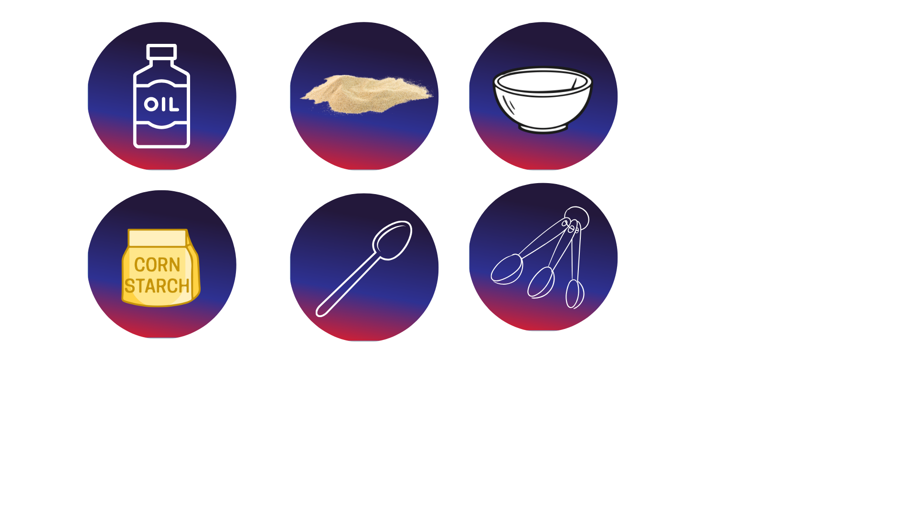
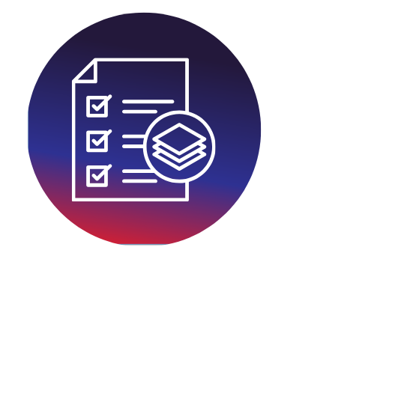
Today’s Materials
Craft Sand
Cornstarch
Oil
Spoon
1 Tablespoon Scoop
1 Teaspoon Scoop
Paper Bowl
Get Ready to Experiment!
Gather your materials and get ready to use them to create a new material!
Notes:
Craft sand (4 tablespoons)
Cornstarch (2 teaspoons)
Oil (1 teaspoon)
1 spoon
1 paper bowl
Materials Supplied (for sharing)
[5] 1 Tablespoon scoops
[5] 1 teaspoon scoops

Slide 6
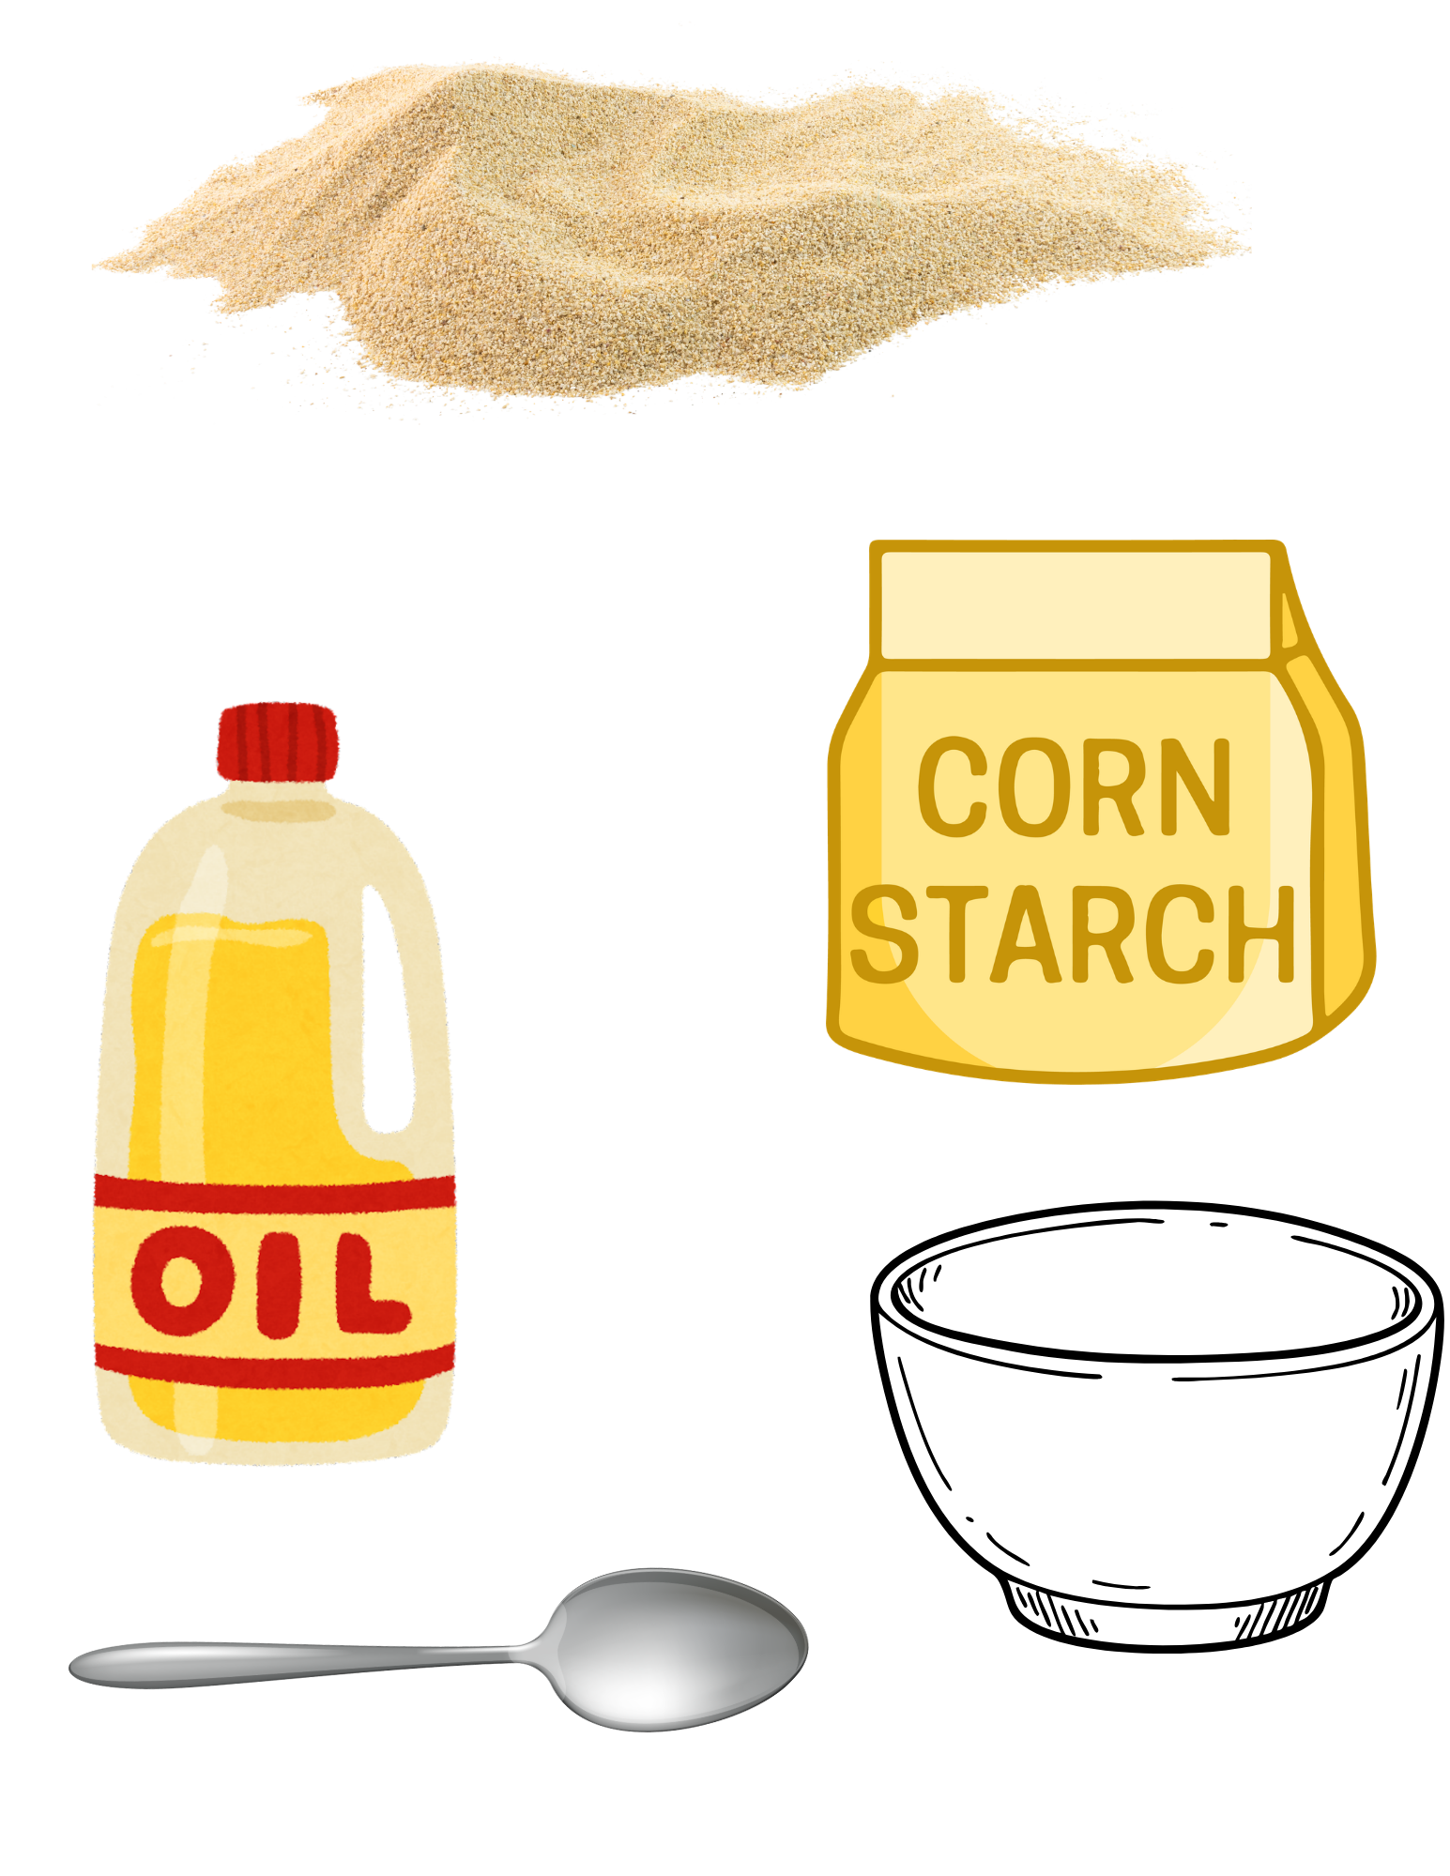
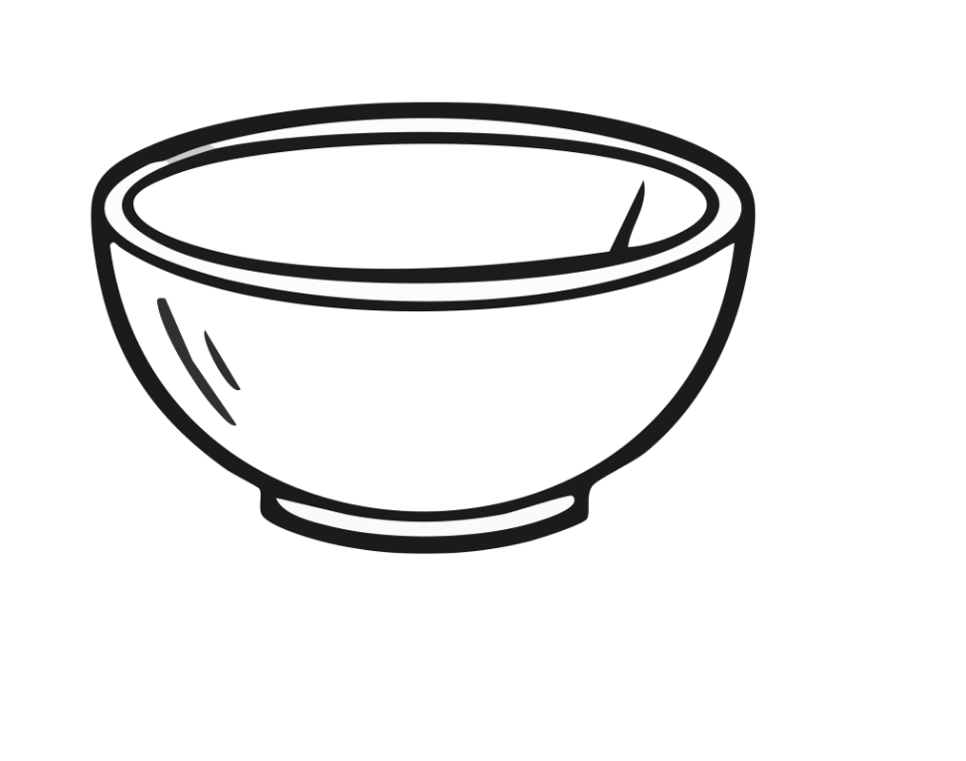
Step 1
Get Ready!
Each Student Will Need:
A bowl
Sand
Cornstarch
Oil
A spoon
Notes:
Step 1: Get Ready
Each student will need:
A bowl
Sand, cornstarch, and oil
A spoon

Slide 7
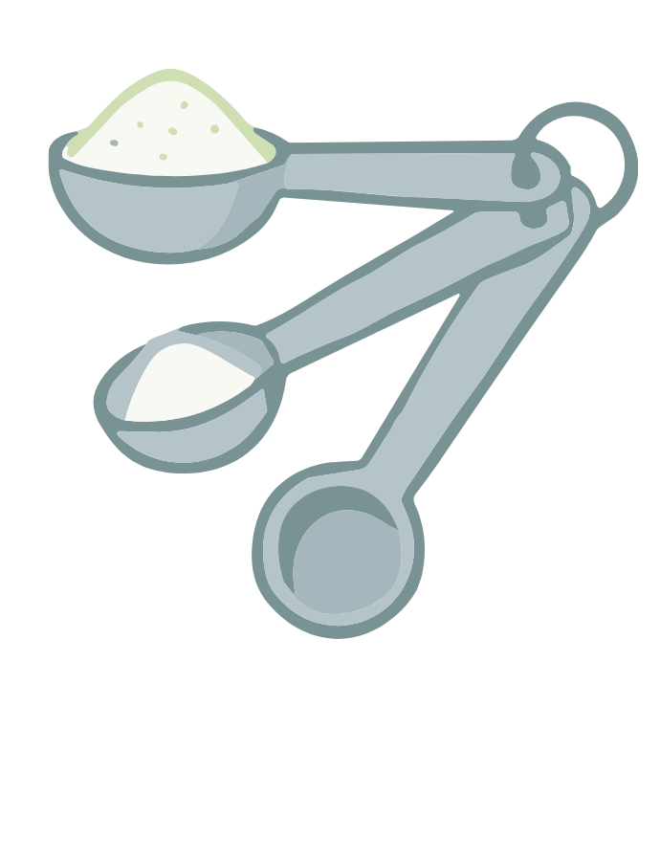
Step 2
Measure the Sand
Scoop 4 tablespoons of sand into your bowl
Measuring Tip: Level each scoop before adding it to your bowl
Scientist Tip:
Measuring carefully helps the reaction work the way scientists expect.
Notes:
Measure the Sand
Scoop 4 tablespoons of sand (the big scoop)
Level each scoop before adding it to your bowl

Slide 8
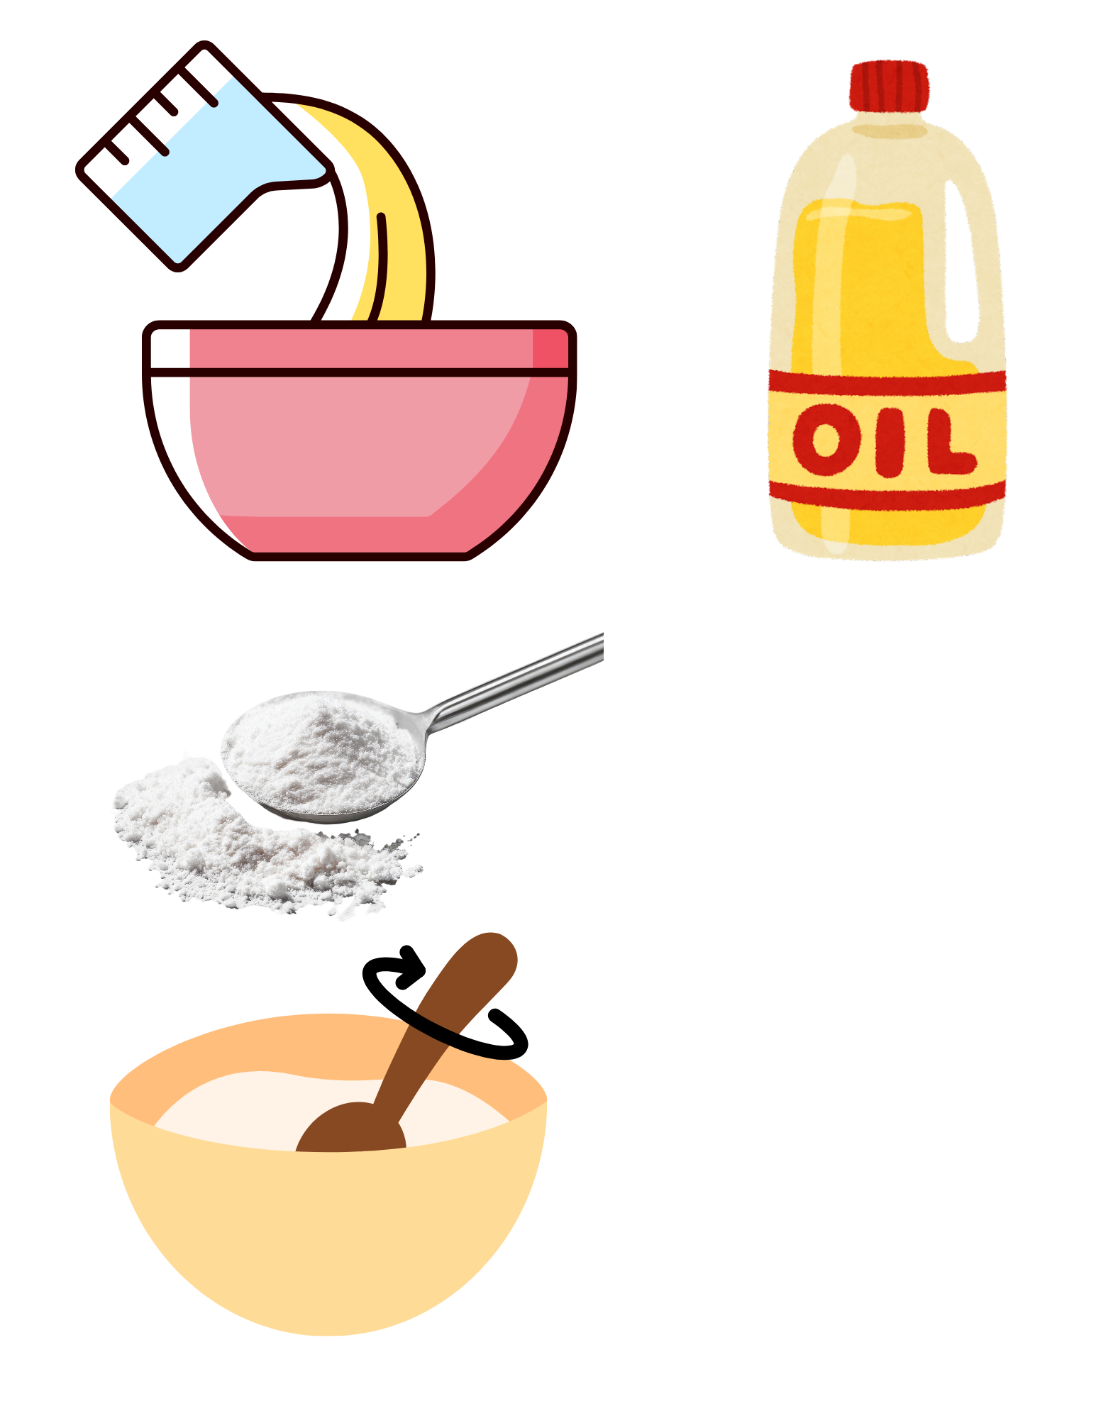
Step 3
Add the Cornstarch
Scoop 2 teaspoons of cornstarch into the bowl with your sand.
Notes:
Add the Cornstarch
Scoop 2 teaspoons (the smaller scoop) of cornstarch
Add it to the sand in your bowl

Slide 9
Step 4
Mix the Solids
Use your spoon to mix the sand and the cornstarch together
Notes:
Mix the solids
Use your spoon to mix the sand and the cornstarch together.

Slide 10
Step 5
Add the Oil
Measure 1 teaspoon of oil and carefully pour it into your bowl
Notes:
Add the oil
Measure 1 teaspoon of oil.
Carefully pour it into your bowl.

Slide 11
Step 6
Mix!
Use your spoon to mix everything together again
Notes:
Mix
Use your spoon to mix everything together again.
Stir until the oil spreads throughout the sand

Slide 12
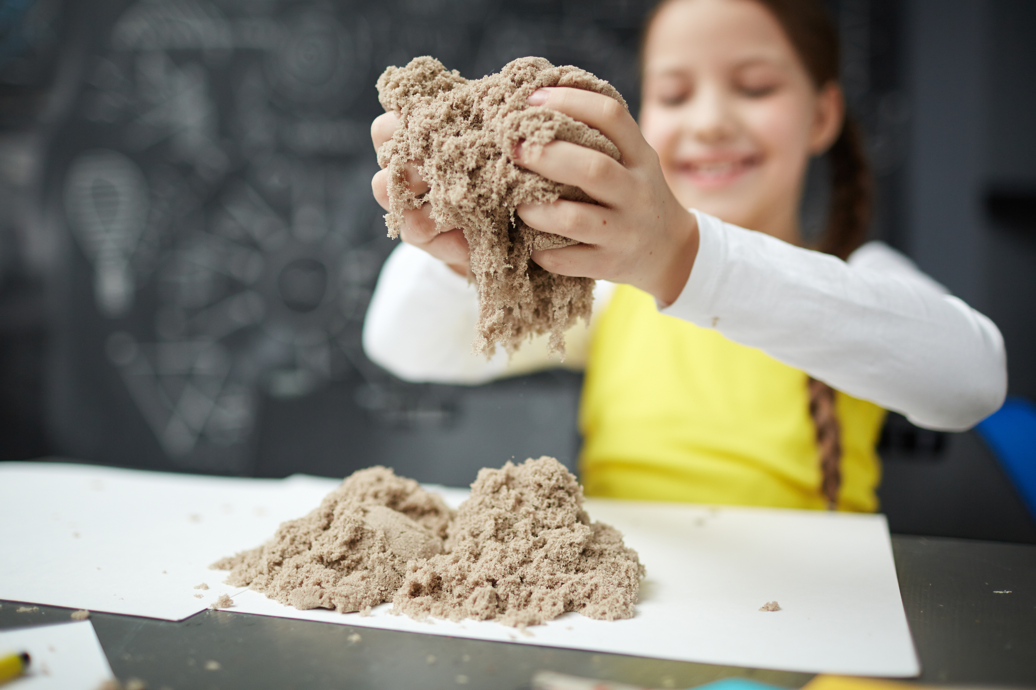
Step 7
Observe and Play!
Once the mixture gets thick, use your hands to play with it. Squeeze and knead the sand until it is soft and moldable.
Notes:
Use your hands, observe, play
When the mixture gets thick, use your hands.
Squeeze and knead the sand until it is soft and moldable.

Slide 13

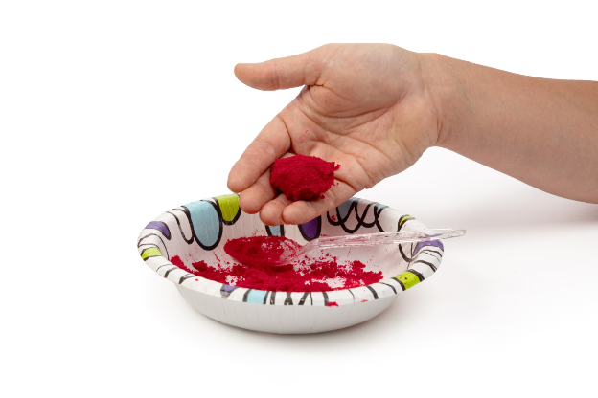
You just made kinetic sand!

Slide 14
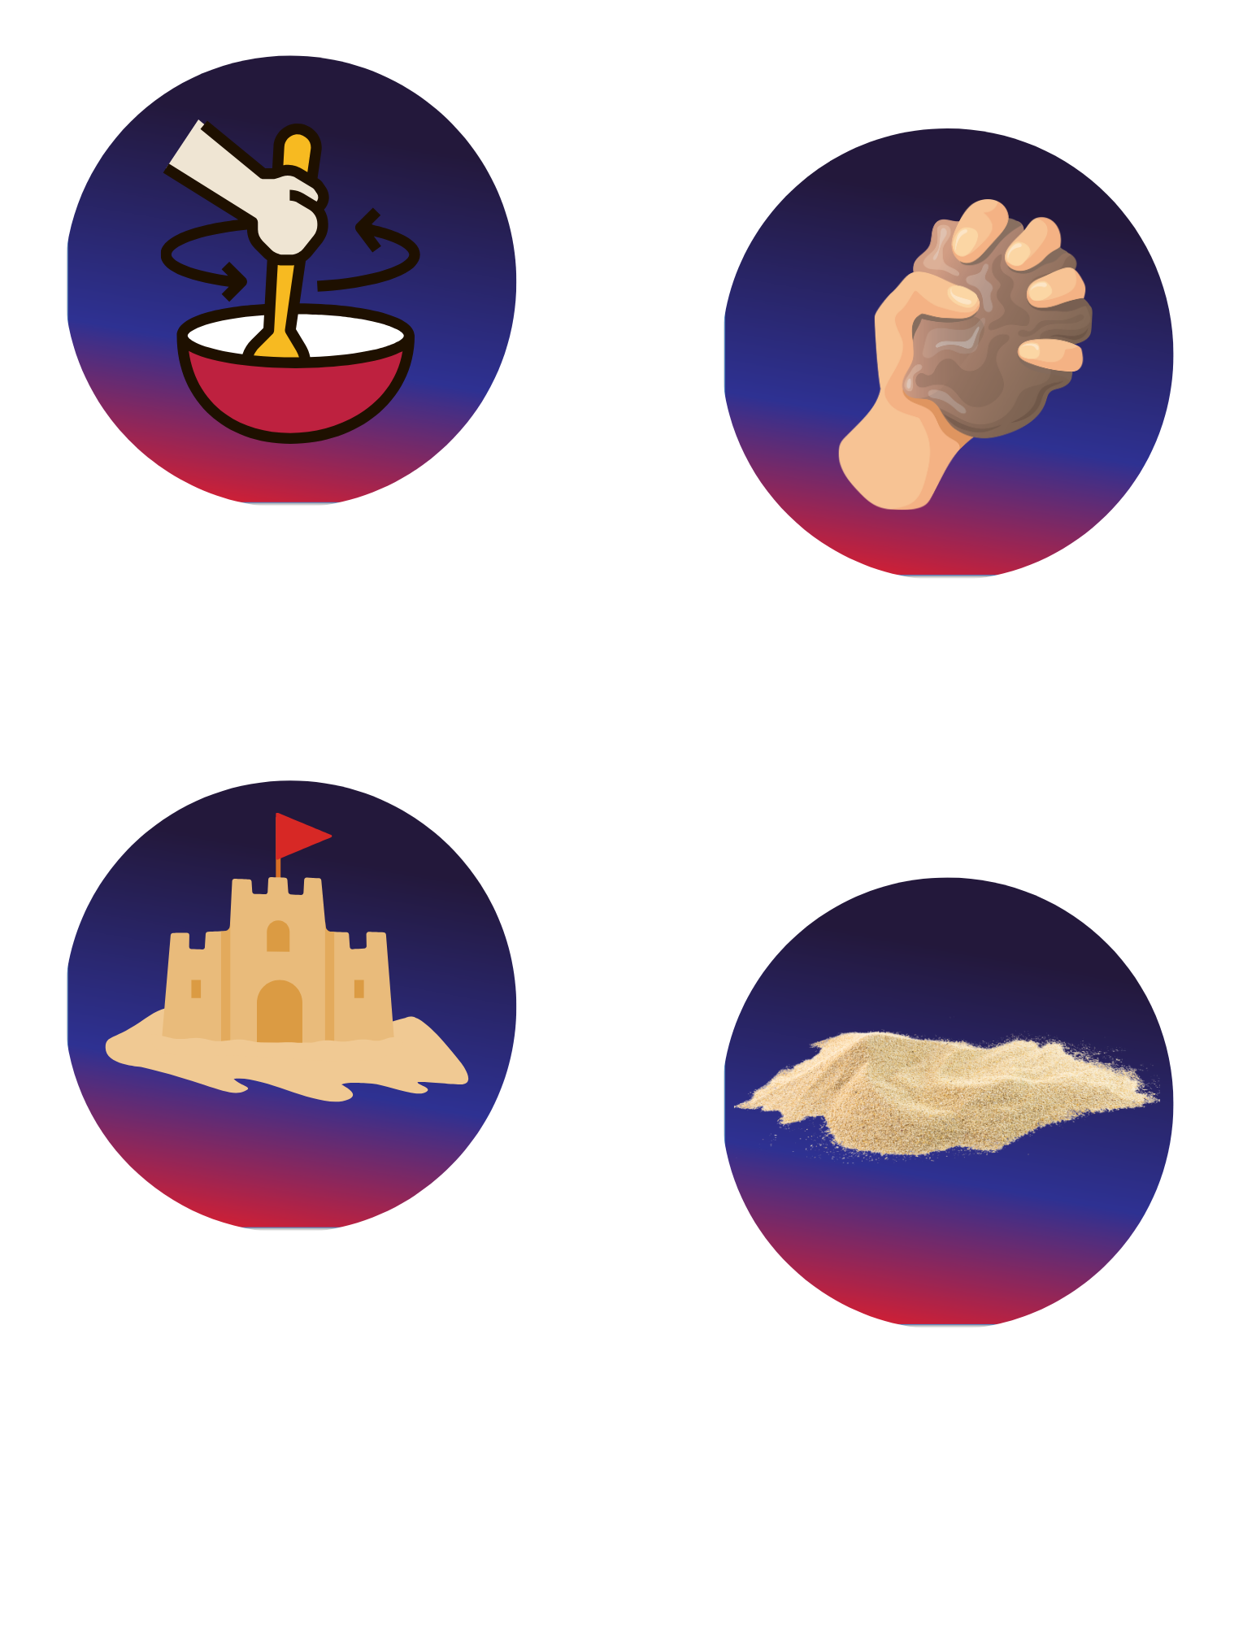
Turn and Talk Time!
Does the sand feel different before and after we mix it?
What happens when you squeeze the sand?
What helped the sand stick together?
What do you think would happen if we added more oil or more sand?
Notes:
Does the sand feel different before and after we mix it?
What happens when you squeeze the sand?
What helped the sand stick together?
What do you think would happen if we added more oil or more sand?

Slide 15


Career Exploration
Builders use their knowledge of different materials, including concrete, sand, and water, to build stronger buildings and roads.
Chefs use their knowledge of ingredients and their properties to mix ingredients to make
food that is soft, sticky, fluffy, or crunchy.
Toy designers choose materials so that toys are safe, soft, stretchy, or squishy.
Artists use clay, paint, sand, and other materials to create art with different textures.
Scientists study how materials change when they are mixed together, heated, or cooled.
Notes:
Builders use their knowledge of different materials, including concrete, sand, and water, to build stronger buildings and roads.
Chefs use their knowledge of ingredients and their properties to mix ingredients to make food that is soft, sticky, fluffy, or crunchy.
Toy designers choose materials so that toys are safe, soft, stretchy, or squishy.
Artists use clay, paint, sand, and other materials to create art with different textures.
Materials engineers study how different materials behave when they are mixed, shaped, or changed. They help create new materials with special properties.
Construction workers mix and use materials like sand, cement, and water to build sidewalks, bridges, and buildings.
Product designers choose the right materials to make everyday items like shoes, furniture, and tools work well and feel right.
Manufacturing workers combine materials and follow steps to make products used every day.
Scientists study how materials change when they are mixed together, heated, or cooled.
Composite technicians work with materials that are combined to make stronger, lighter, or more useful products. They help make parts for things like cars, airplanes, boats, sporting goods, and even wind turbine blades.

