Slide 1




Activity Overview
Modern Materials,
Ancient Technology

Slide 2

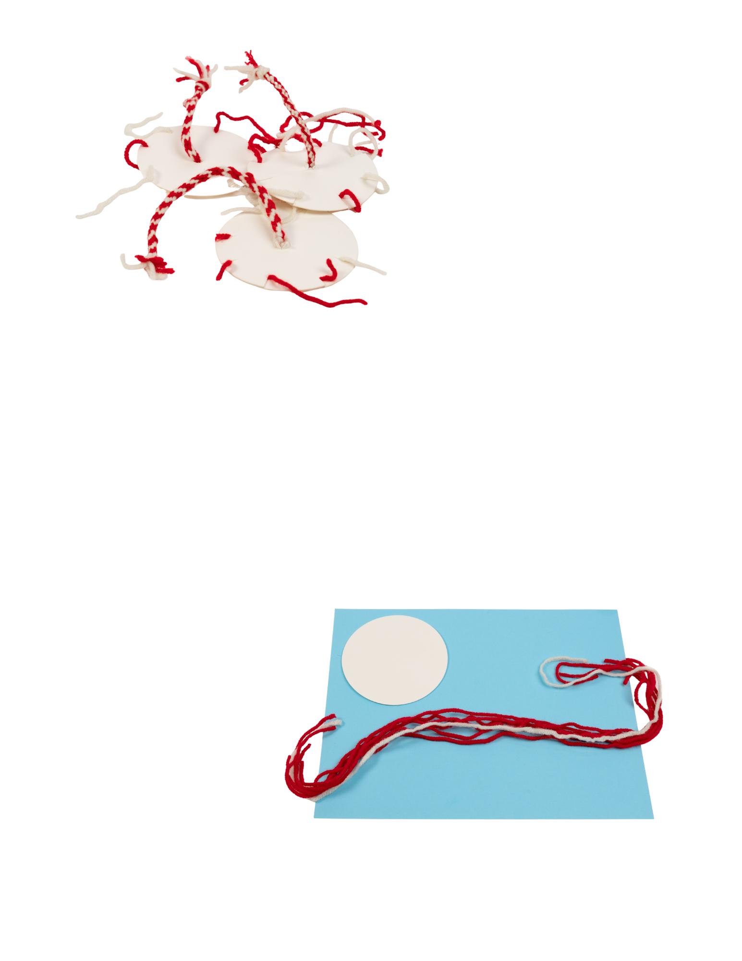

Modern Material: Ancient Technology
Kumihimo

Slide 3


Modern Material
Material science is when we learn about materials- how they feel, how they behave, and how they change when we combine them.
Today, we are going to be material scientists by building a braided cord.
What happens when we combine fibers?
This happens because of how the
strands are arranged.
This arrangement is called structure.
For thousands of years, people have used braiding to make rope, clothing, and tools. Today, engineers still use this same idea to create strong materials used in everyday life.
A single piece of string can be pulled apart easily. But when multiple strands are combined, something new happens. The strands work together to become:
Stronger
More Stable
Less Likely to Break
Engineers combine fibers to create cables, composite materials, medical sutures, climbing ropes, and advanced braided materials used in aerospace and manufacturing.
Notes:
Material science is when we learn about materials—how they feel, how they behave, and how they change when we combine them.
Today, we are going to be material scientists by building a braided cord.
What happens when we combine fibers? A single piece of string can be pulled apart easily. But when multiple strands are combined, something new happens. The strands work together to become:
Stronger
More stable
Less likely to break
This happens because of how the strands are arranged. This arrangement is called structure. For thousands of years, people have used braiding to make rope, clothing, and tools. Today, engineers still use this same idea to create strong materials used in everyday life.
Engineers combine fibers to create cables, composite materials, medical sutures, climbing ropes, and advanced braided materials used in aerospace and manufacturing.
This activity introduces a braiding method that demonstrates how structure can increase strength.

Slide 4
Key Words to Know
A thin strand of material such as thread, yarn, or plant fiber.
FIBER
A method of crossing strands over one another to create a stronger cord or material.
BRAIDING
STRUCTURE
The way parts are arranged or combined to form a stronger system.
TENSILE STRENGTH
A material’s ability to resist pulling forces.
Notes:
Fiber: A thin strand of material such as thread, yarn, or plant fiber.
Braiding: A method of crossing strands over one another to create a stronger cord or material.
Structure: The way parts are arranged or combined to form a stronger system.
Tensile Strength: A material’s ability to resist pulling forces.

Slide 5
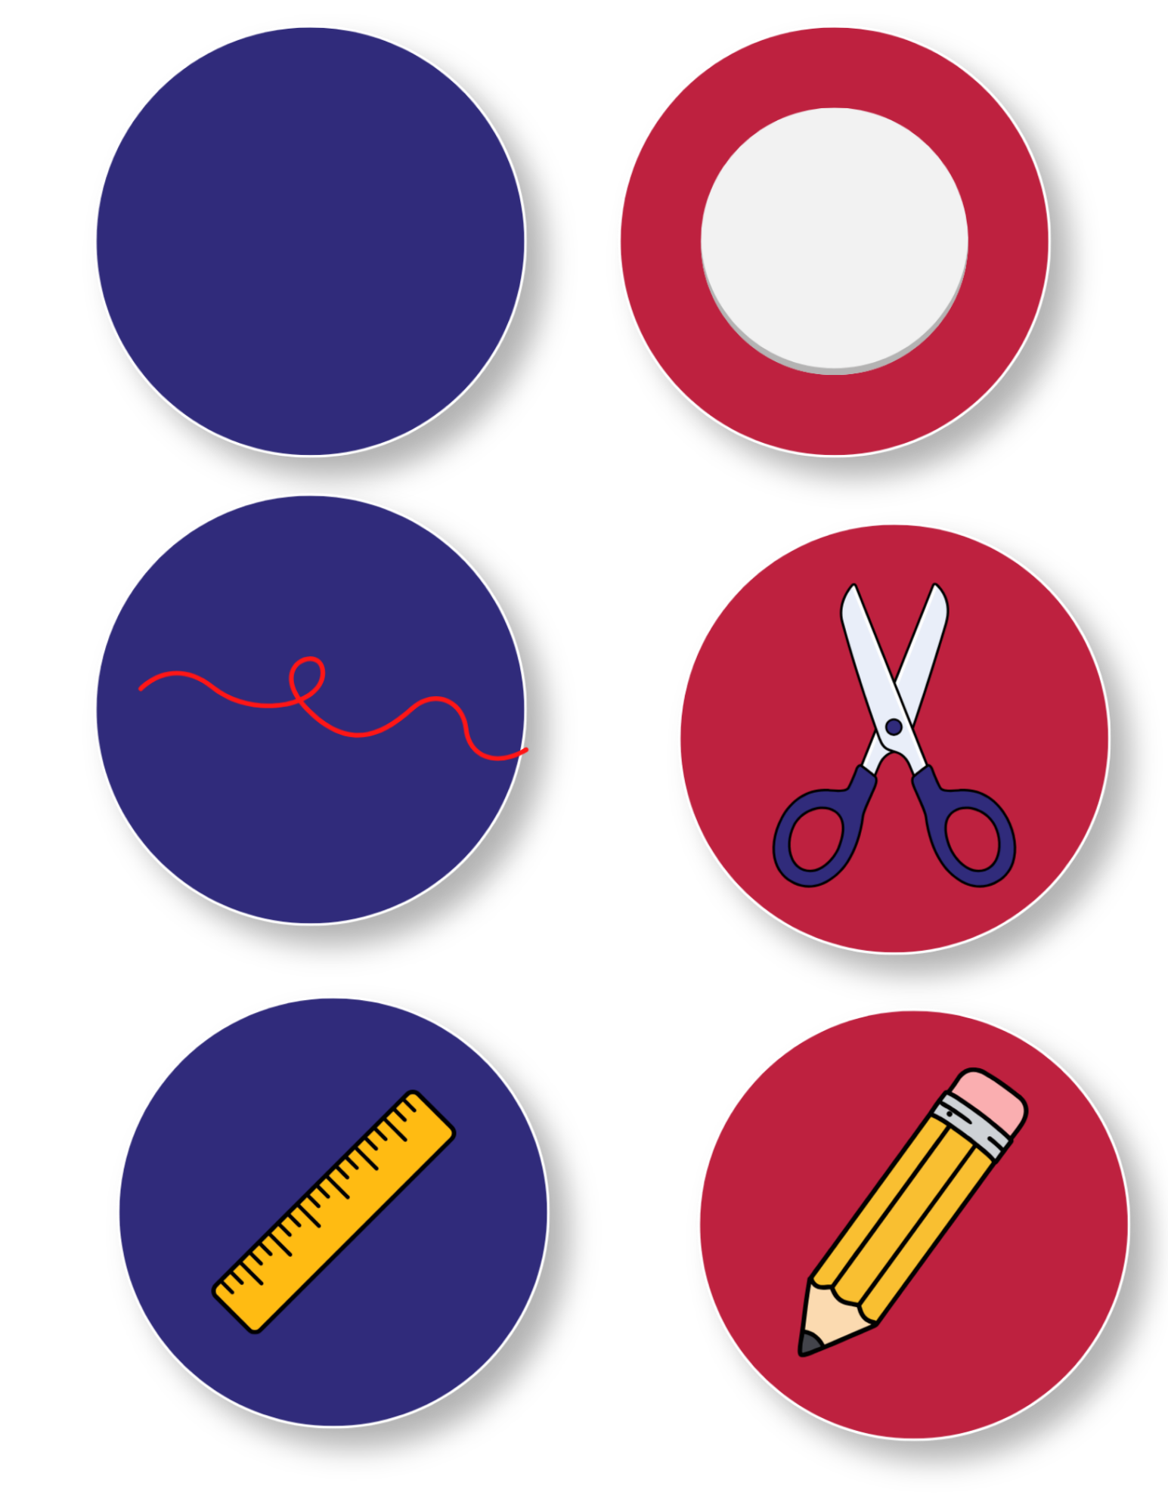
Today’s Materials
Cardboard Coaster
Pencil
Ruler
7 Lengths of String
Optional:
Key Ring or lanyard clip
Magnifier
Tape measure or
digital calipers
Scissors
Notes:
4-inch cardboard coaster (kumihimo disk)
7 lengths of string (approximately 12 inches each)
Teacher-supplied materials
Scissors
Ruler
Pencil
Optional: key ring or lanyard clip
Optional: magnifier
Optional: tape measure or digital calipers

Slide 6
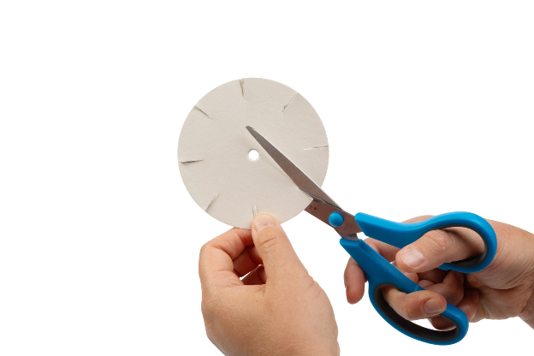
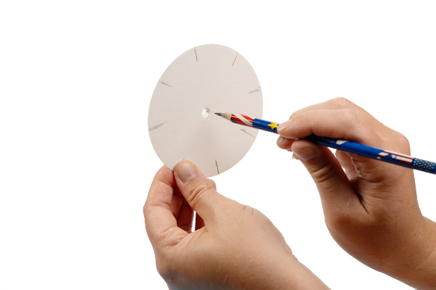
Step 1
Prepare Your Disk
Cut eight evenly spaced slits around the edge of your disk
1
Using the tip of a pencil, punch one small hole in the center of the disk
2
Notes:
Prepare your disk
Cut eight evenly spaced slits around the edge of your disk
Using the tip of a pencil, punch one small hole in the center of the disk

Slide 7
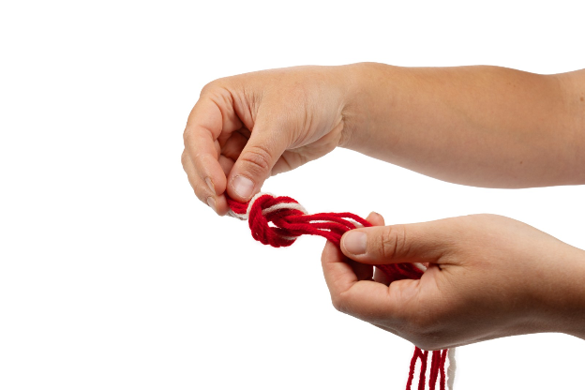
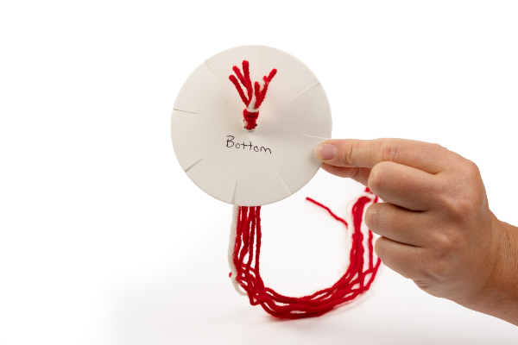
Step 2
Prepare Your Strings
Cut seven strings, each the length of your arm from your elbow to your hand
3
Take your strings and tie them together in a knot at one end
4
Push the knot through the hole in the center so it hangs underneath
5
Notes:
Prepare your strings
Cut seven strings, each the length of your arm from your elbow to your hand
Take your strings and tie them together in a knot at one end
Push the knot through the hole in the center so it hangs underneath

Slide 8
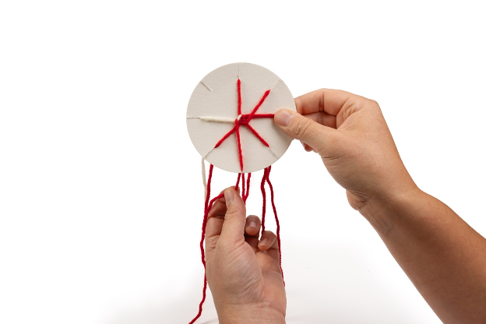
Step 3
Place Your Strings Cont.
Put one string in each slit.
6
Note:
One slit will be empty.
Notes:
Put one string in each slit.
One slit will be empty.

Slide 9
Step 4
Time to Position
Find the empty slit.
6
Turn the disk so that the empty slit is pointing towards you
7
Notes:
Find the empty slit
Turn the disk so that the empty slit is pointing towards you

Slide 10
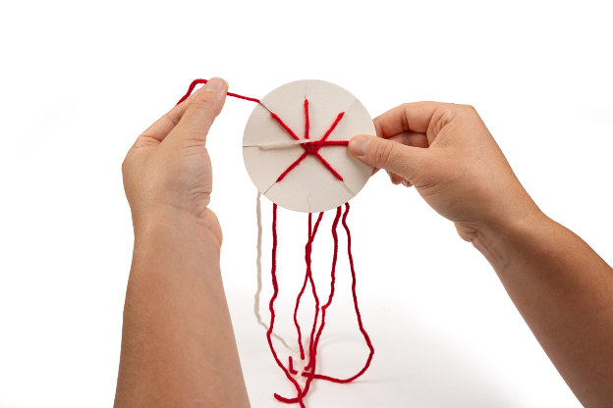
Step 5
Time to Position
Move one string
8
Starting at the empty slit, count three slits to the left
9
Take the string out of that slit, and move it to the empty slit
10
Notes:
Move one string
Starting at the empty slit, count three slits to the left.
.
Take the string out of that slit, and move it to the empty slit

Slide 11
Step 6
Time to Position Cont.
Turn and Repeat
11
Turn the disk so that the new empty slit is pointing towards you
12
Repeat Step 5
13
Notes:
Turn and repeat
Turn the disk so that the new empty slit is pointing towards you
Repeat step 5

Slide 12
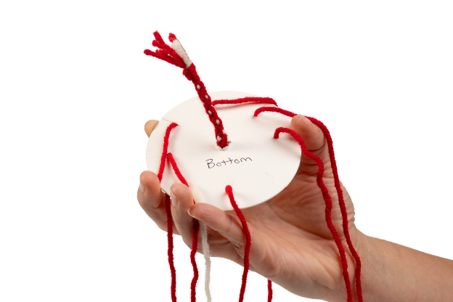
Step 7
Repeat!
Repeat steps 4-6 many times. As you work, a braided cord will grow underneath the disk
14
Notes:
Keep going
Repeat steps 4-6 many times. As you work, a braided cord will grow underneath the disk

Slide 13

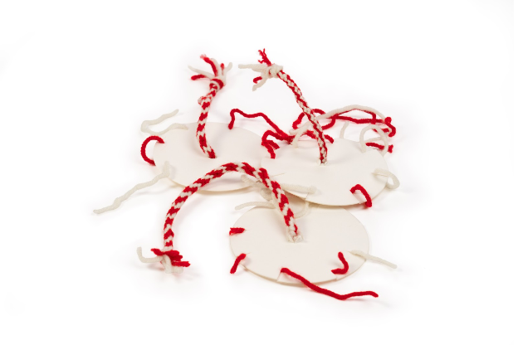
Modern Material: Ancient Technology (Kumihimo)

Slide 14

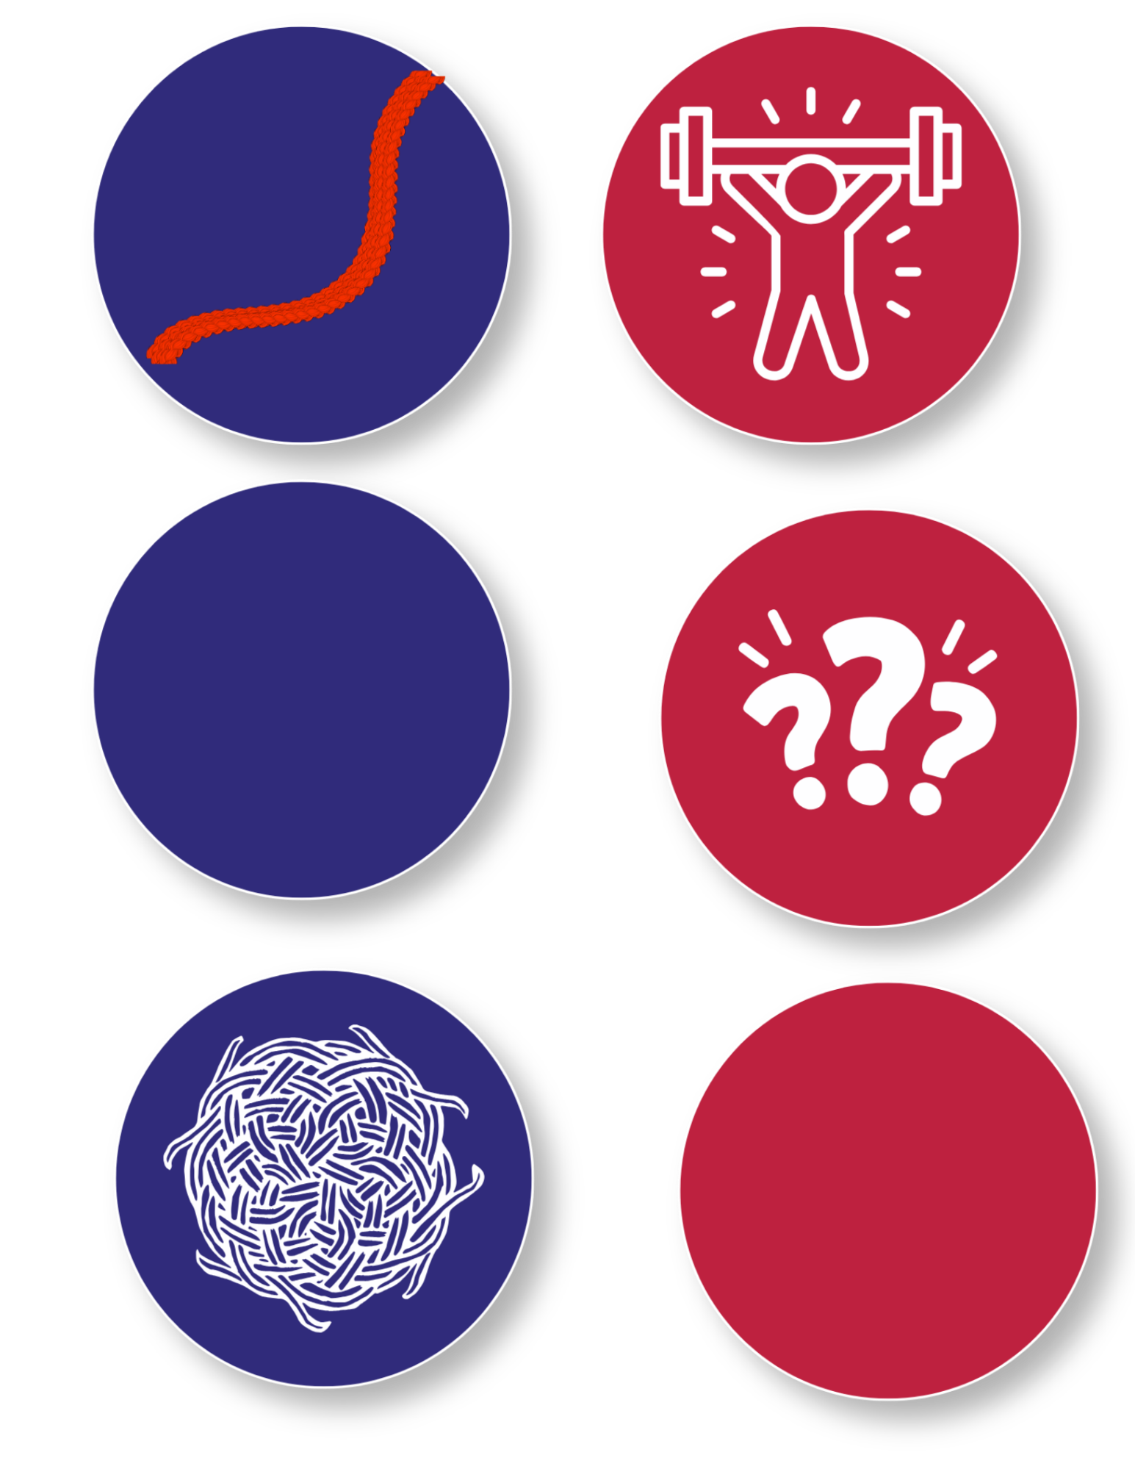
Turn and
TALK TIME
How does the strength of a single
strand compare to the braided cord?
How does the braided structure affect strength?
What happens when multiple strands combine?
Why might engineers combine fibers instead of using a single strand?
Notes:
How does the strength of a single strand compare to the braided cord?
What happens when multiple strands combine?
How does the braided structure affect strength?
Why might engineers combine fibers instead of using a single strand?

Slide 15

Career Exploration
Materials engineers study how fibers and materials behave when they are combined into structures such as cables, fabrics, and composites.
Engineers also design braided materials used in climbing ropes, parachute lines, medical sutures, reinforced composites, and protective textiles.
Aerospace engineers use advanced braided materials to build lightweight parts for airplanes, rockets, and spacecraft.
Medical engineers design materials like sutures and implants that must be strong, flexible, and safe for the human body.
Construction workers and rigging specialists use ropes and cables made from braided fibers to lift, secure, and move heavy objects safely.
Outdoor and safety equipment designers create products like harnesses, ropes, and protective gear that rely on strong braided materials.
Notes:
Materials engineers study how fibers and materials behave when they are combined into structures such as cables, fabrics, and composites.
Manufacturing engineers design processes that braid or weave fibers into strong industrial materials used in equipment, vehicles, and aerospace systems.
Engineers also design braided materials used in climbing ropes, parachute lines, medical sutures, reinforced composites, and protective textiles.
Aerospace engineers use advanced braided materials to build lightweight parts for airplanes, rockets, and spacecraft.
Medical engineers design materials like sutures and implants that must be strong, flexible, and safe for the human body.
Construction workers and rigging specialists use ropes and cables made from braided fibers to lift, secure, and move heavy objects safely.
Outdoor and safety equipment designers create products like harnesses, ropes, and protective gear that rely on strong braided materials.

