Slide 1




Activity Overview
Molding and Casting

Slide 2

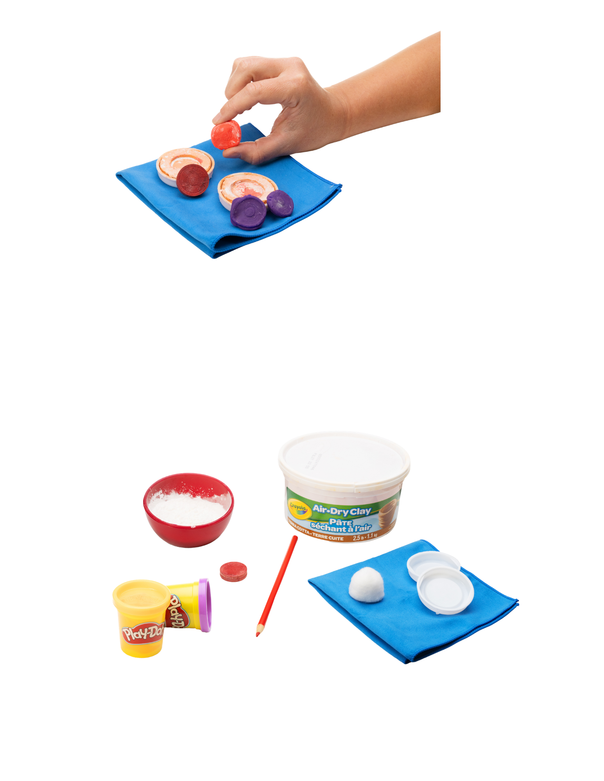


Molding and Casting

Slide 3
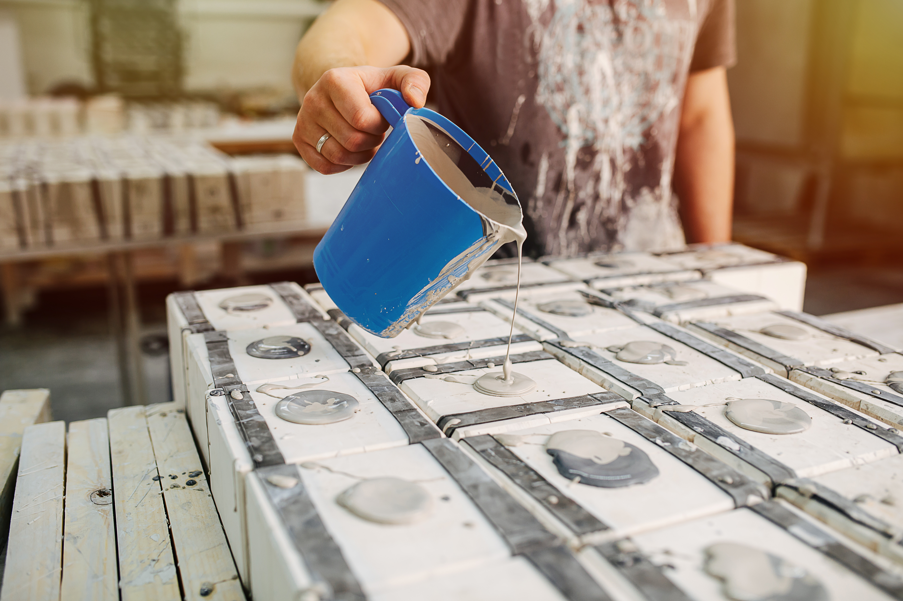
Modern Material
Sometimes, people need to make the same object over and over again, like parts for cars, toys, or tools. One way they do this is by using something called a mold. ​
A mold is a special shape that you can fill to make a copy of something. First, an object is pressed into a soft material to create the mold. This captures its shape. ​
Then, a new material is pressed or poured into that mold. When it sets or dries, it becomes a copy of the original object. ​
In this activity, you will make your own mold and use it to create several copies of the same object. ​
Notes:
Sometimes, people need to make the same object over and over again, like parts for cars, toys, or tools. One way they do this is by using something called a mold. ​
A mold is a special shape that you can fill to make a copy of something. First, an object is pressed into a soft material to create the mold. This captures its shape. ​
Then, a new material is pressed or poured into that mold. When it sets or dries, it becomes a copy of the original object. ​
Many molds are made in two pieces so you can open them up and take the finished object out. ​
Using molds helps people make lots of objects that all look the same. After making them, engineers check to make sure each one is the right shape and size. ​
In this activity, you will make your own mold and use it to create several copies of the same object. ​

Slide 4
Key Words to Know
MOLD
A shape that helps you make another object.
CASTING
Making a new object by filling a mold.
The shape left behind when you press something into a soft material.
IMPRESSION
QUALITY CONTROL
Checking to see if something was made the right way.
Notes:
Mold: A shape that helps you make another object.
Casting: Making a new object by filling a mold.
Impression: The shape left behind when you press something into a soft material.
Quality Control: Checking to see if something was made the right way.

Slide 5
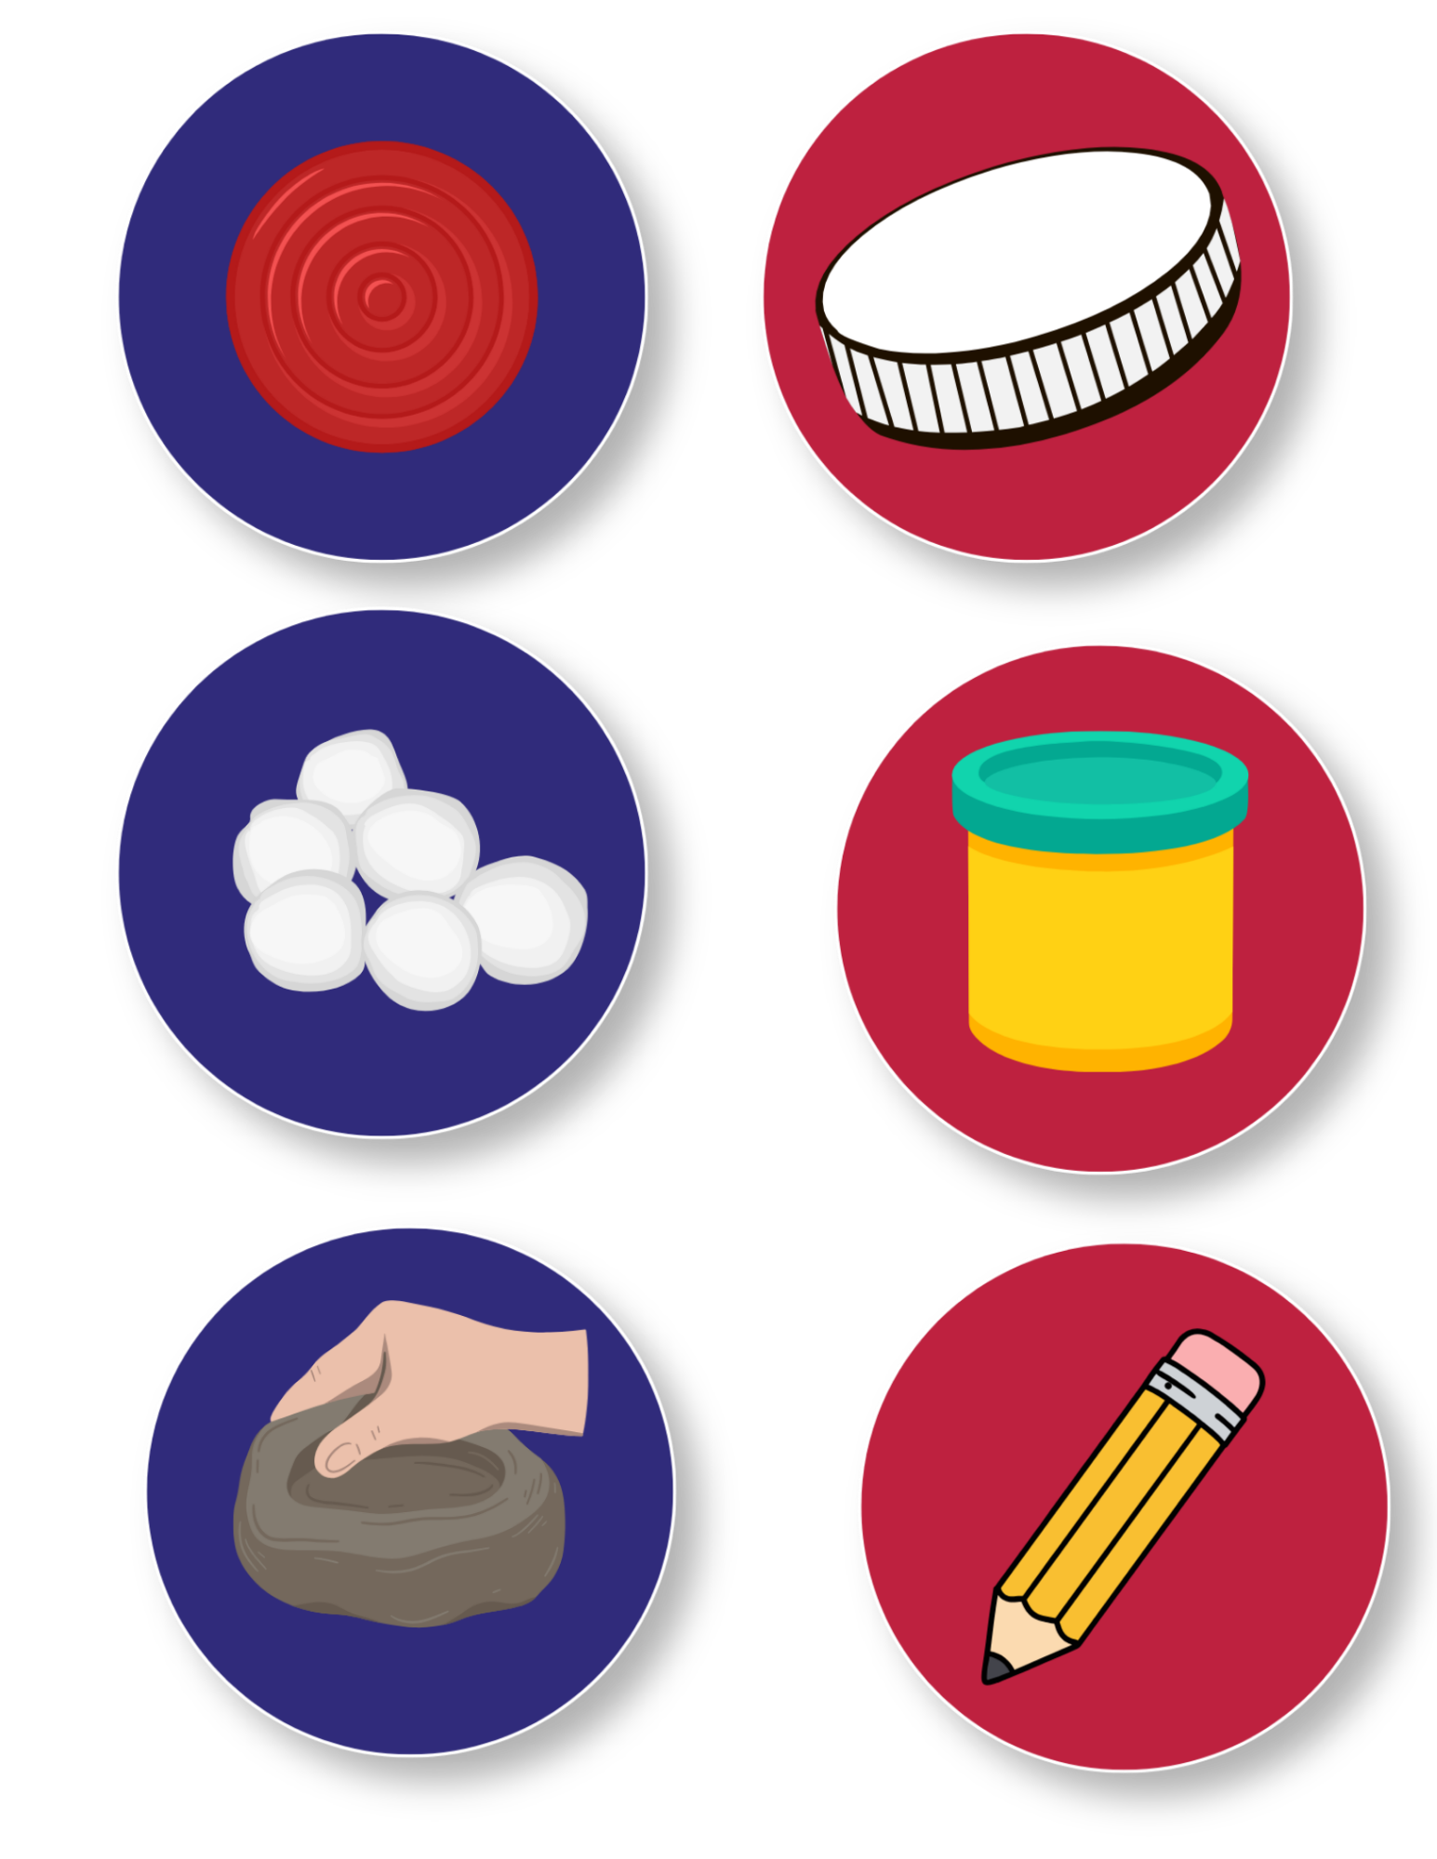
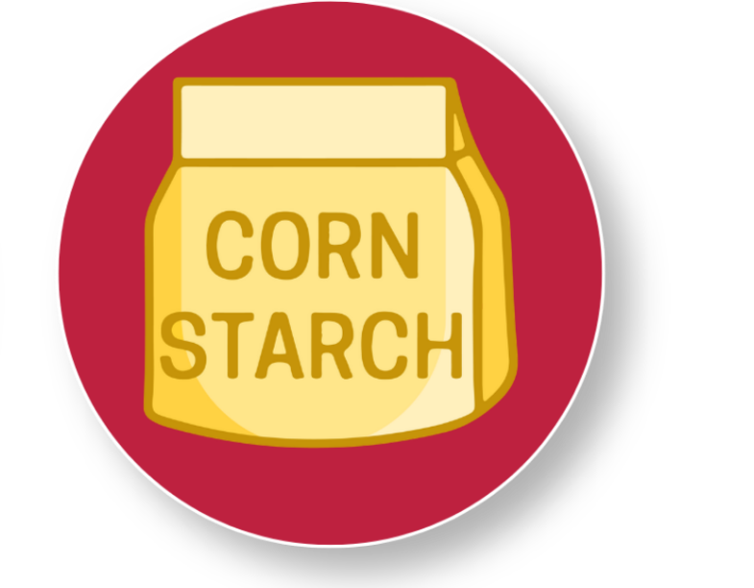
Today’s Materials
Mailing Tube Lids
Air-Dry Clay
Cotton Ball
Playdough
Checker Piece
Cornstarch
Pencil
Notes:
2 mailing tube lids
1 cotton ball
1 checker piece
air-dry clay
play dough
cornstarch
1 pencil

Slide 6
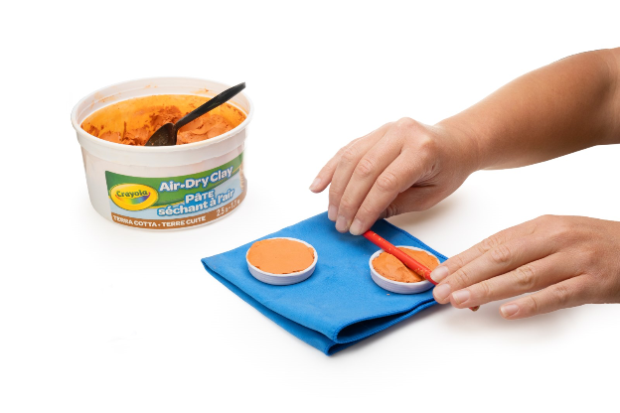
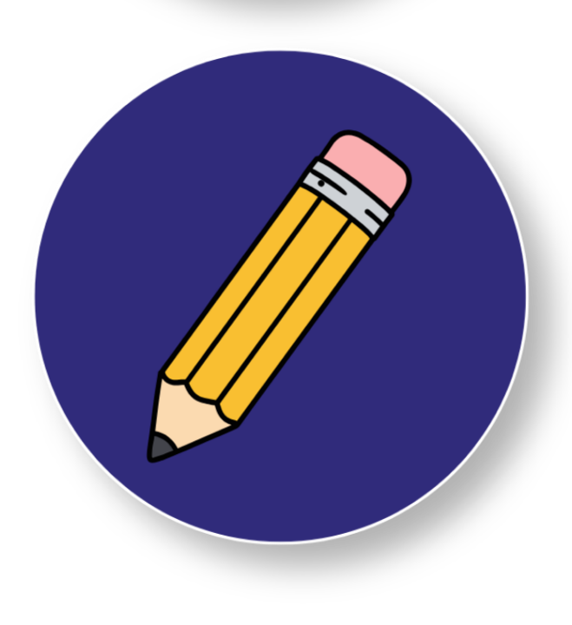
Step 1
Prepare a Mold
Have students write their names on the backs of each of their mailing tube lids.
1
Pack each (2) mailing tube lid to its top with air-dry clay.
2
Tip:
Use a pencil to roll over the lip of each lid to smooth down any excess air-dry clay
Notes:
Step 1: Prepare a mold
Students should write their name on the backs of each of their mailing tube lids since this is a multi-day activity
Pack each (2) mailing tube lid to its top with air dry clay
Use a pencil to roll over the lip of each lid to smooth down any excess air-dry clay

Slide 7
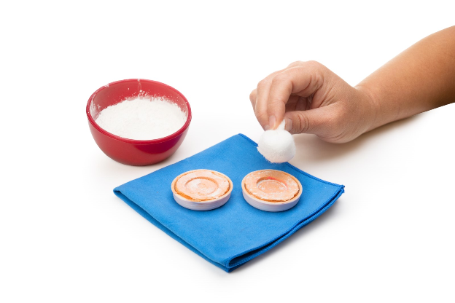
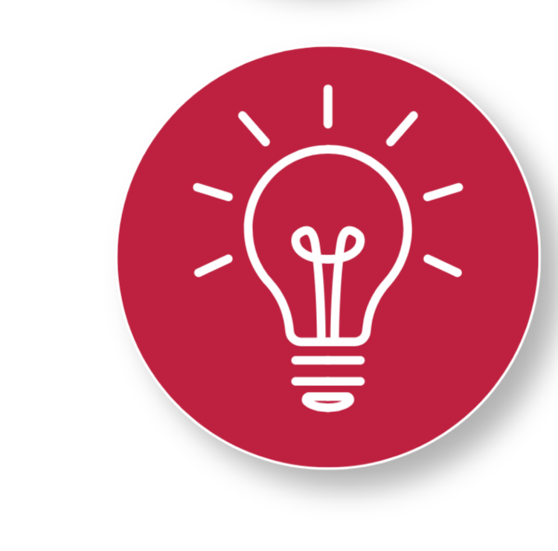
Step 2
Prepare the Mold for Impression
Dab a cotton ball in the cornstarch
3
Dab the corn starched cotton ball lightly over the surface of the air-dry clay in each mailing tube lid. This will prevent the checker piece from sticking to the clay mold.
4
Tip:
Just a light coating will do the job!
Notes:
Prepare the mold for an impression
Dab a cotton ball in the cornstarch
Dab the corn starched cotton ball lightly over the surface of the air-dry clay in each mailing tube lid. This will prevent the checker piece from sticking to the clay mold. A light coating will do the job.

Slide 8
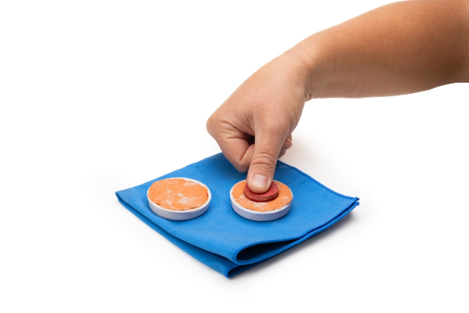
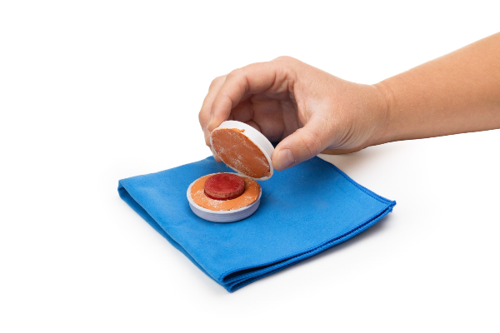
Step 3
Finish the Mold
Firmly press a checker piece roughly halfway into the clay in one mailing tube lid
5
Notes:
Finish the mold
Firmly press a checker piece roughly halfway into the clay in one mailing tube lid

Slide 9
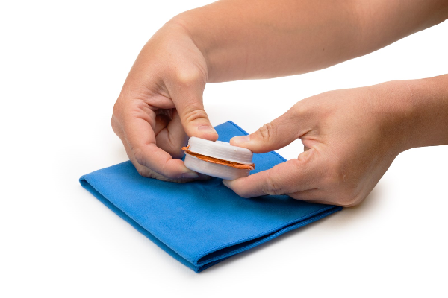
Step 4
Press the Mold
Carefully place the second lid on top of the first lid, as if it were a sandwich. Press straight down so both lids meet evenly
6
Leave the mold undisturbed for a few minutes before carefully pulling the lids apart
7
Notes:
Carefully place the second lid on top of the first lid, as if it were a sandwich. Press straight down so both lids meet evenly
Leave the mold undisturbed for a few minutes before carefully pulling the lids apart

Slide 10
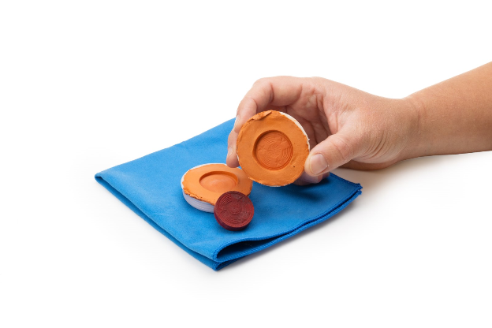
Step 5
Dry the Mold
Carefully remove the checker piece without disturbing the clay
8
Allow the mold to dry over the course of the remainder of the school day
9
Notes:
Carefully remove the checker piece without disturbing the clay
Allow the mold to dry over the course of the remainder of the school day

Slide 11
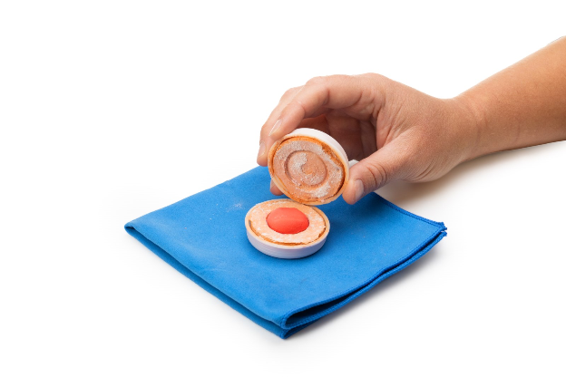
Day 2 Step 1
Prepare the Casting
Roll a small amount of playdough into a ball.
1
Place a small piece of playdough into one half of the mold, slightly overfilling it. ​
2
Tip:
Only use enough foam clay to fill the mold without overflowing.
The industry calls this overflow ‘flash’ ​
Notes:
Prepare the casting ​
Roll a small amount of play dough into a ball. Only enough foam clay should be used to fill the mold without overflowing (industry calls this overflow ‘flash’) ​
Place a small piece of play dough into one half of the mold, slightly overfilling it. ​

Slide 12
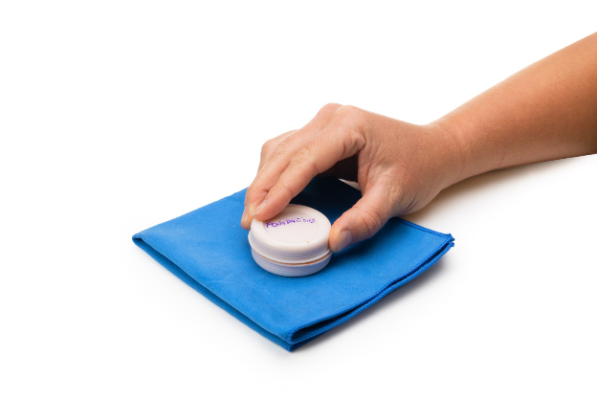
Day 2 Step 2
Cast the Foam Clay
Press the mold halves gently, but firmly together for several seconds
3
Open up the mold halves and gently remove the foam clay casting
4
Notes:
Cast the foam clay
Press the mold halves gently, but firmly together for several seconds
Open up the mold halves and gently remove the foam clay casting

Slide 13
Day 2 Step 3
Quality Check
Examine the cast and compare it to the original checker
5
Notes:
Quality Check
Examine the cast and compare it to the original checker

Slide 14
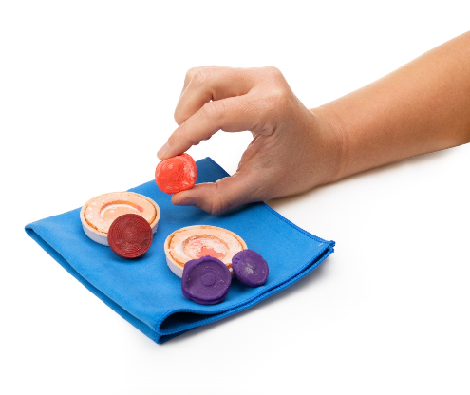
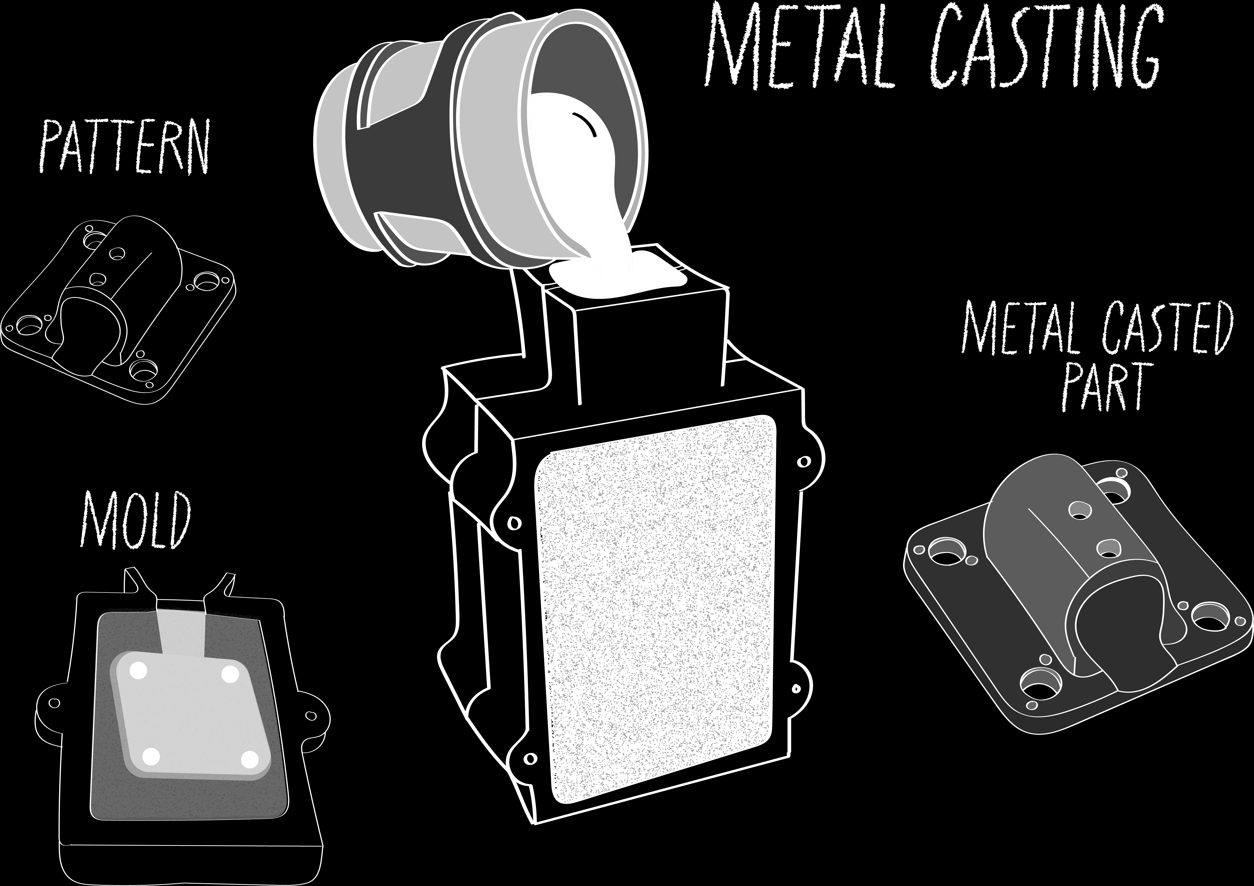
You made a casting of a checker!

Slide 15

Turn and
TALK TIME
How does the cast compare to the original checker?
Do all casts look the same?
What happened when the mold halves did not line up perfectly?
How did pressure or filling affect the final shape?
Why might manufacturers check parts during production?
Notes:
How does the cast compare to the original checker?
Do all casts look the same?
What happened when the mold halves did not line up perfectly?
How did pressure or filling affect the final shape?
Why might manufacturers check parts during production?

Slide 16

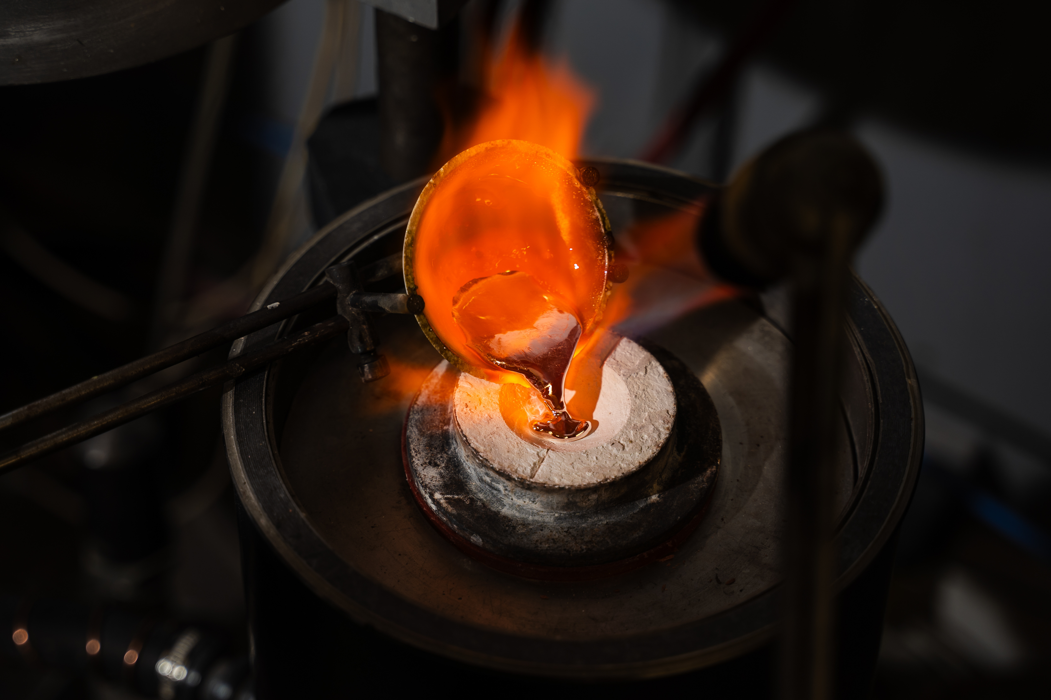
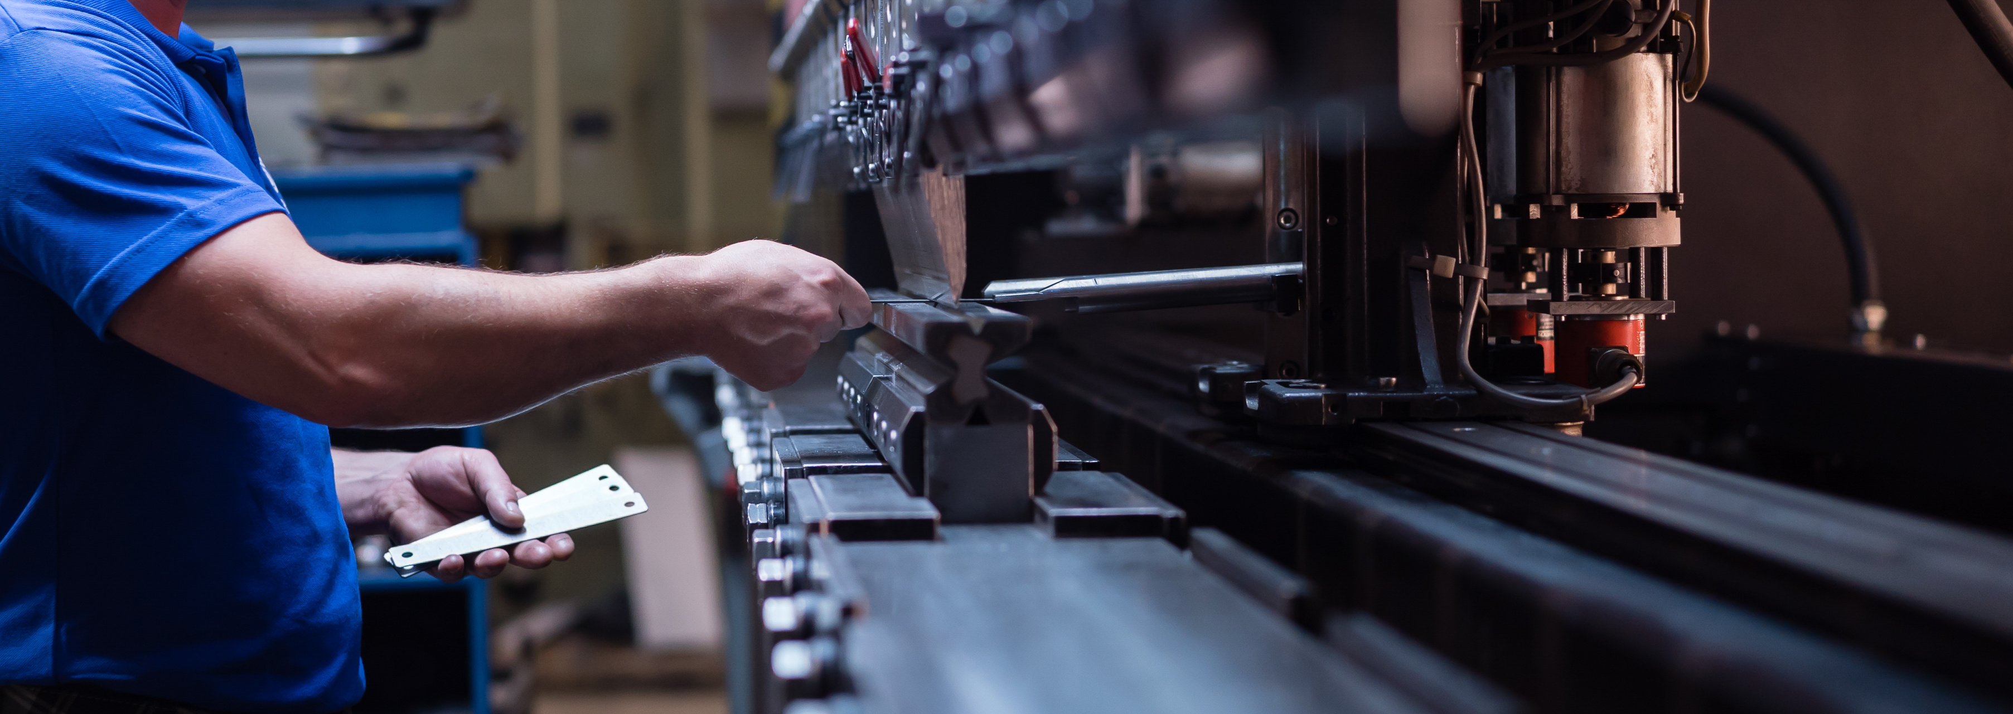
Career Exploration
Quality Control Inspectors look for missing details, uneven edges, or differences between parts and help fix problems
Metal Casting Workers use molds to shape melted metal into parts for cars, tools, and machines. They use the same mold many times to make parts that match in shape and size
Composite Manufacturing Technicians use molds to form strong materials made from plastics and fibers. These molded parts are used in things like sports equipment, airplanes, and wind turbine blades
Notes:
Metal casting workers use molds to shape melted metal into parts for cars, tools, and machines. They use the same mold many times to make parts that match in shape and size
Composite Manufacturing Technicians use molds to form strong materials made from plastics and fibers. These molded parts are used in things like sports equipment, airplanes, and wind turbine blades
Manufacturing Engineers design molds and processes that help factories make thousands of identical parts. They think about alignment, pressure, and materials to make parts turn out correctly
Quality Control Inspectors check finished parts to see if they match the original design. They look for missing details, uneven edges, or differences between parts and help fix problems

