Slide 1




Activity Overview
Rubber Band-Powered Car

Slide 2

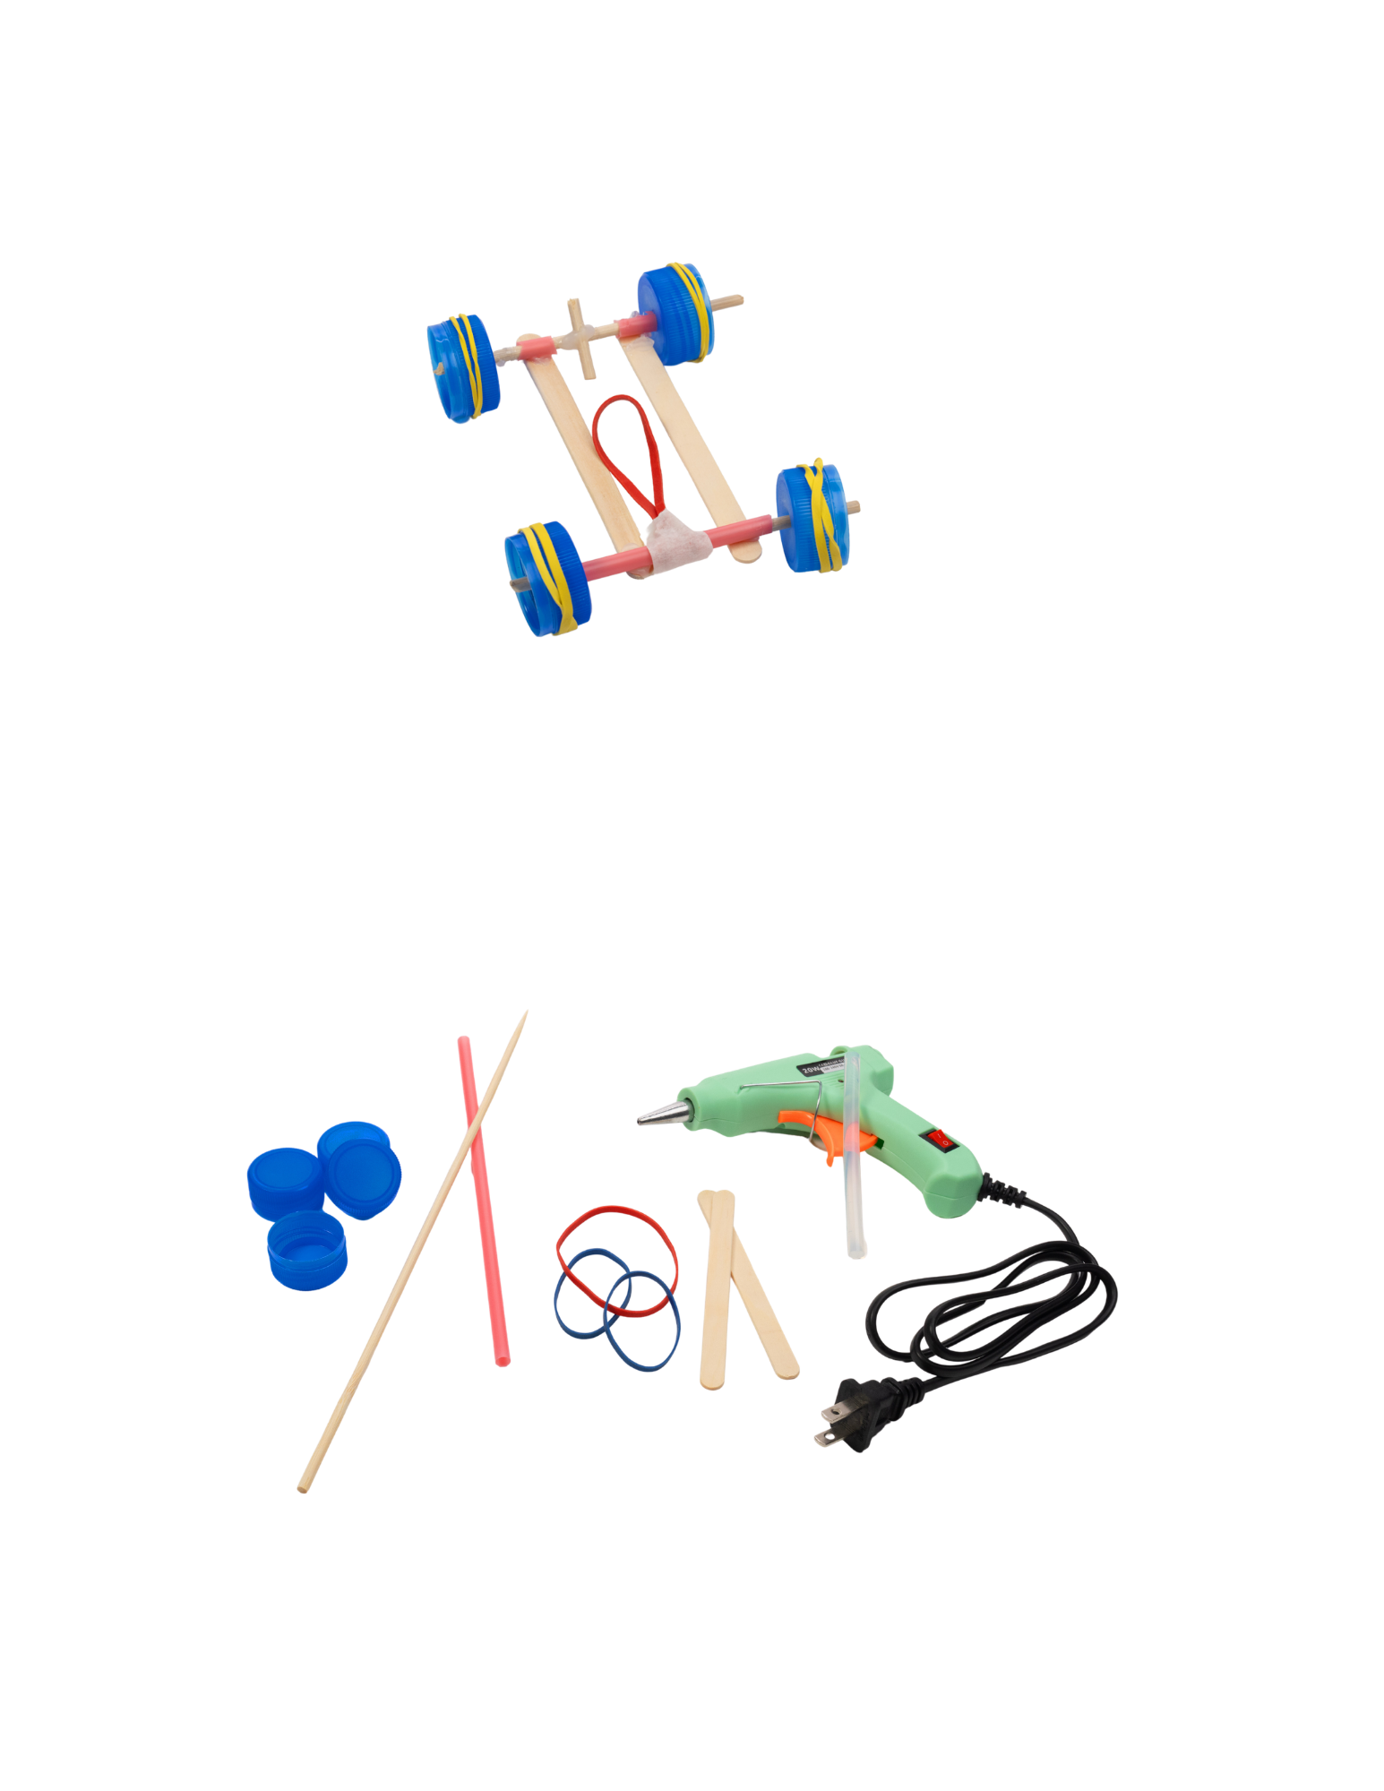


Rubber Band-Powered Cars

Slide 3
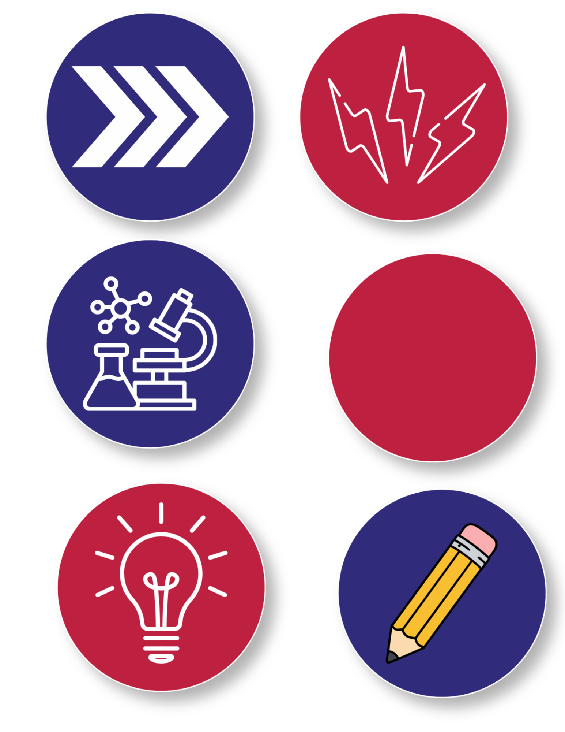
Foundations of Motion
Motion is how things move. Objects only move when a force-like a push, a pull, or stored energy-acts on them.
In this activity, you will twist a rubber band to store energy. When you let it go, the rubber band unwinds and turns the car's wheels. The stored energy changes into motion (kinetic energy).
Motion doesn't always happen smoothly. When parts rub together, friction slows or stop movement. Engineers study friction to make designs work better.
Scientists and engineers build, test, and improve designs. As you build your rubber band-powered car, you'll explore how energy, forces, and motion work together.
Notes:
Motion is how and why things move. Objects do not move on their own, they only move when something makes them move, such as a push, a pull, or a force stored in a solid material.
In this activity, motion comes from a rubber band that has been twisted. This causes energy in the rubber band to accumulate as stored energy. When the rubber band is released, it unwinds and causes the wheels and axles of the car to turn. These parts work together as a system to change stored energy into kinetic energy, the energy of motion.
Not all motion happens smoothly. When parts rub against each other, motion can slow down or stop. This slowing force is called friction. Understanding motion means paying attention to how parts are connected, how freely they can move, and how forces travel through a system.
Scientists and engineers study motion to understand how things move, why they sometimes don’t, and how designs can be adjusted to work better. By building and testing a rubber band-powered car, you will be able to explore the foundations of motion by observing cause and effect in a real, working system.

Slide 4
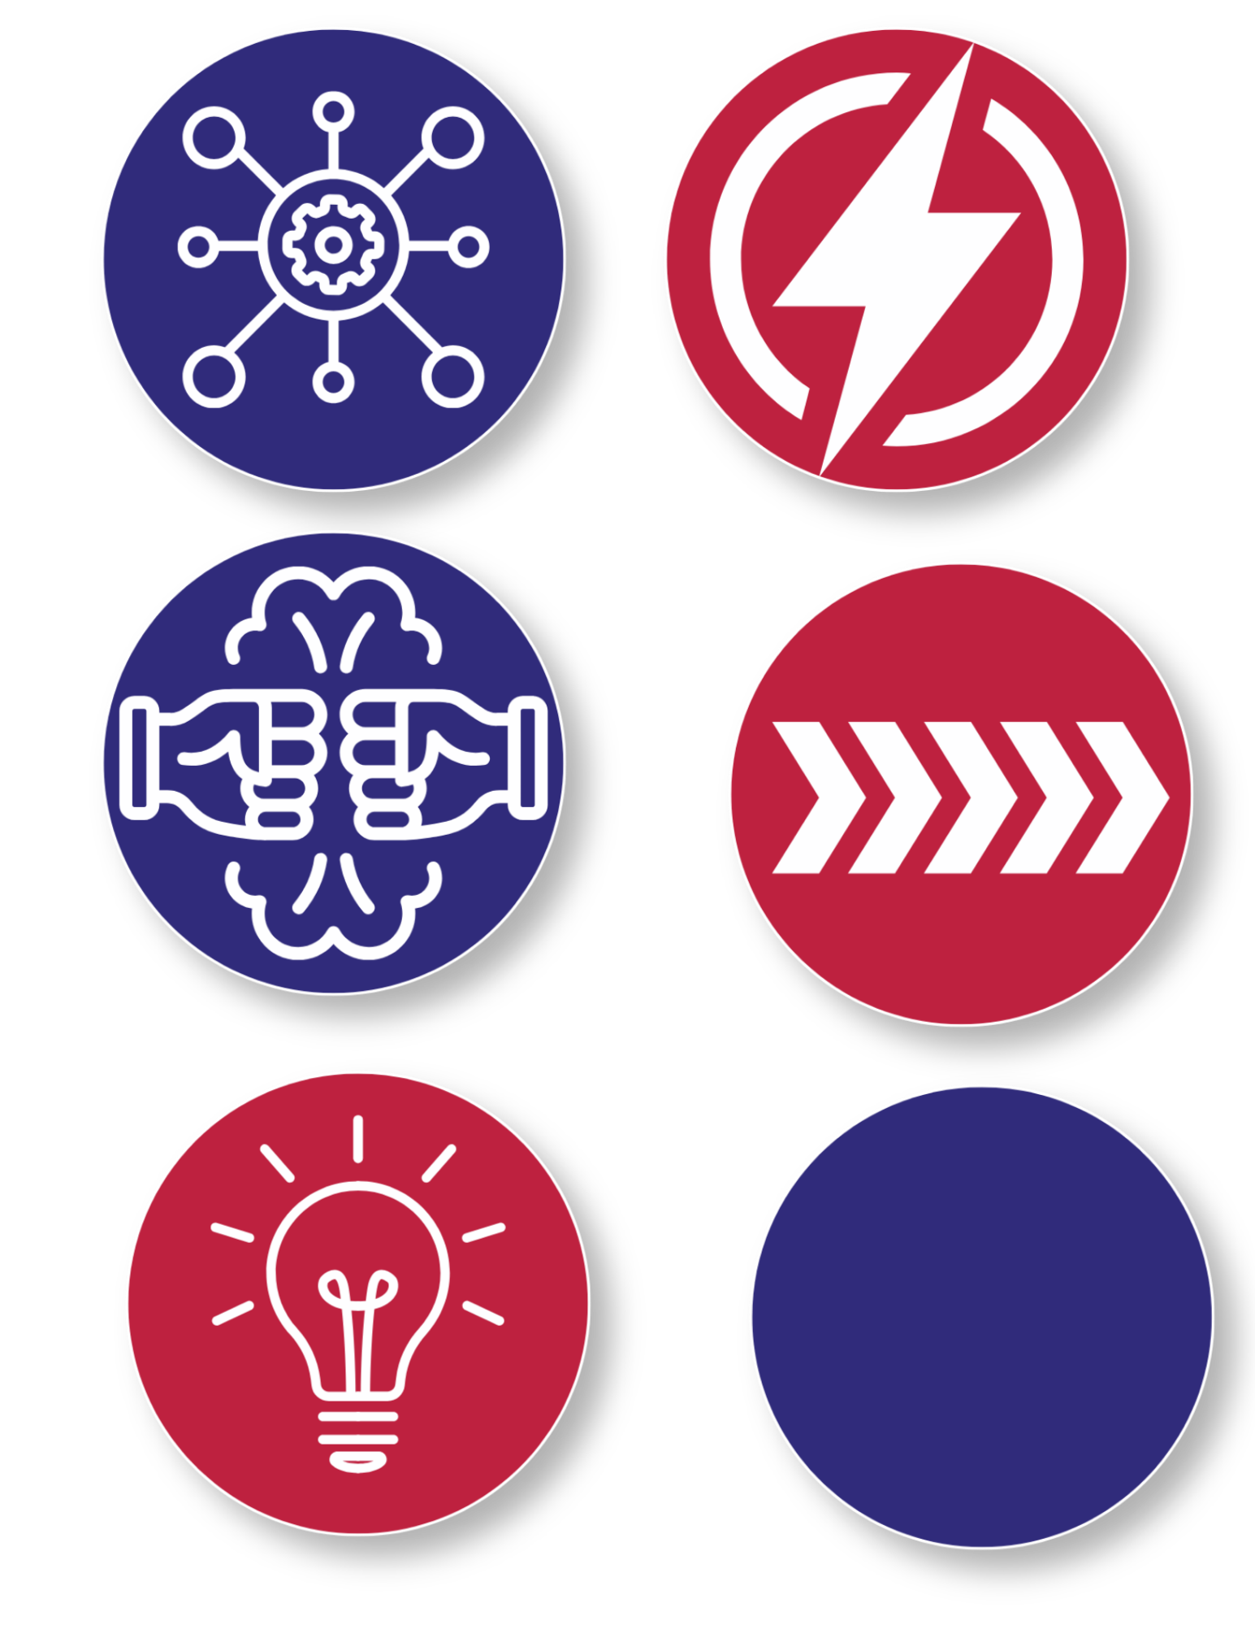
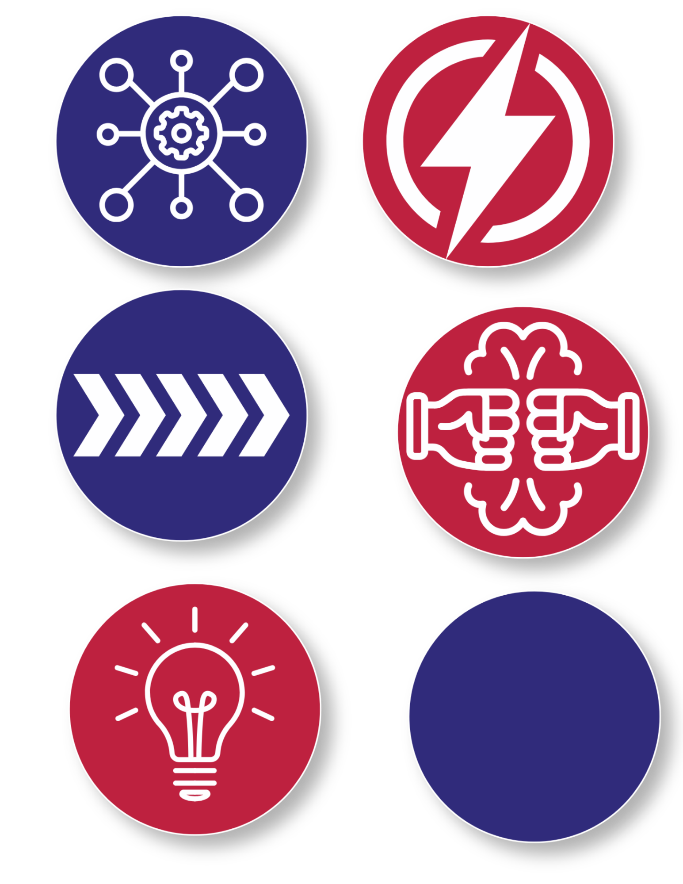
Key Words to Know
System
- A group of parts that work together to do a job
Stored Energy
- Energy that is saved up and ready to use. Also known as “potential energy”
Motion
- When something moves
Friction
- A force that slows things down when surfaces rub together
Notes:
System: A group of parts that work together to do a job
Stored Energy: Energy that is saved up and ready to use. Also known as “potential energy”
Motion: When something moves
Friction: A force that slows things down when surfaces rub together

Slide 5
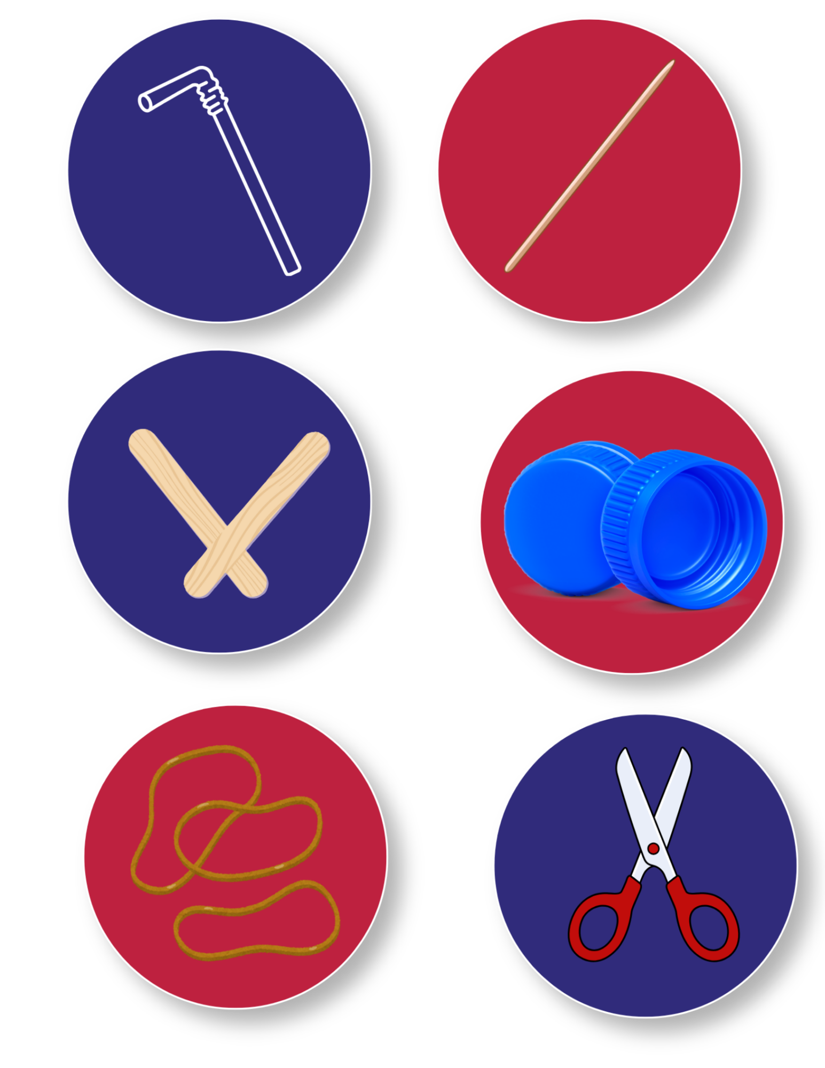
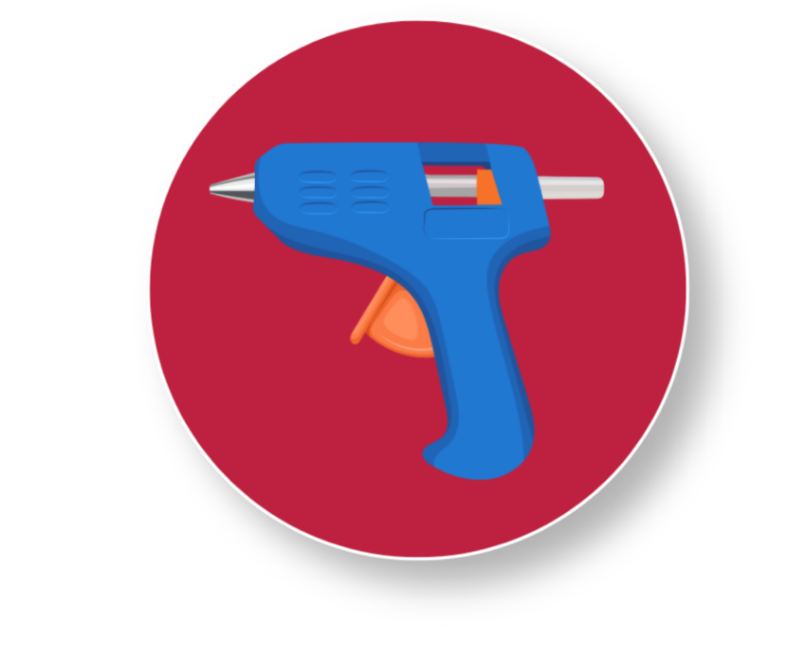
Today’s Materials
Bottle Caps
Wooden Skewer
Craft Sticks
Straw
Rubber Bands
Scissors
Hot Glue Gun
Notes:
1 straw
1 wooden skewer
2 craft sticks
4 bottle caps
3 rubber bands
1 hot glue gun
Scissors

Slide 6
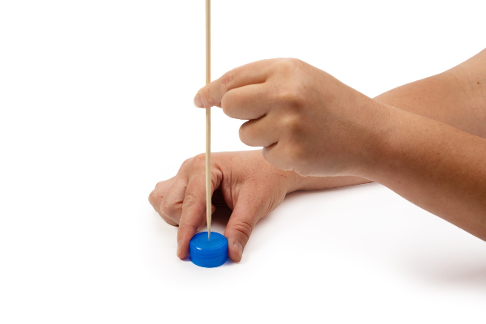
Step 1 Prepare the Wheels
Using the pointed edge of the skewer, poke a hole in the middle of each of the four bottle caps. Press the bottle cap against the table while you do this, as pictured.
1
Tip:
Make the hole large enough for the skewer to slide through the bottle cap.
Notes:
Preparing the wheels
Using the pointed edge of the skewer, poke a hole in the middle of each of the four bottle caps. Press the bottle cap against the table while you do this, as pictured.
Make the hole large enough for the skewer to slide through the bottle cap.

Slide 7
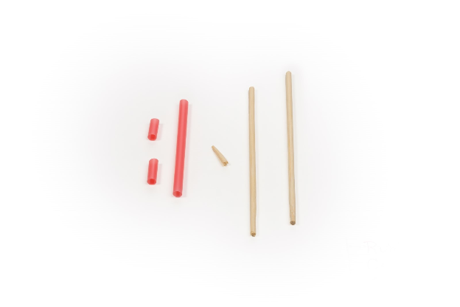
Step 2 Prepare the Axle Housings
Using scissors, cut the straw into three pieces.
2
Cut two short pieces that are about ½ inch long (or the width of a craft stick)
3
Cut one long piece that is about 2 ½ inches long (or about ½ the length of a craft stick)
4
Notes:
Prepare the axle housings
Using scissors, cut the straw into three pieces.
Cut two short pieces that are about ½ inch long (or the width of a craft stick)
Cut one long piece that is about 2 ½ inches long (or about ½ the length of a craft stick)

Slide 8
Step 3 Prepare the Axles
Using scissors (with help, if needed), cut the skewer into three pieces.
5
6
Cut one short piece that is about 1 inch long
7
Cut the rest of the skewer in half
Notes:
Prepare the axles
Using scissors (with help, if needed), cut the skewer into three pieces, making sure to hold onto the end of the skewer that isn’t being cut
Cut one short piece that is about 1 inch long (or slightly longer than the width of a craft stick)
Cut the rest of the skewer in half

Slide 9
Step 4 Prepare the Axles Cont.
Hot glue the axle housings to the craft sticks
8
Using the hot glue gun, glue the straws across the craft sticks so that they make a plus (+) shape
9
Notes:
Hot glue the axle housings to the craft sticks
Using the hot glue gun (caution: hot) glue the straws across the craft sticks so that they make a plus (+) shape, as pictured

Slide 10
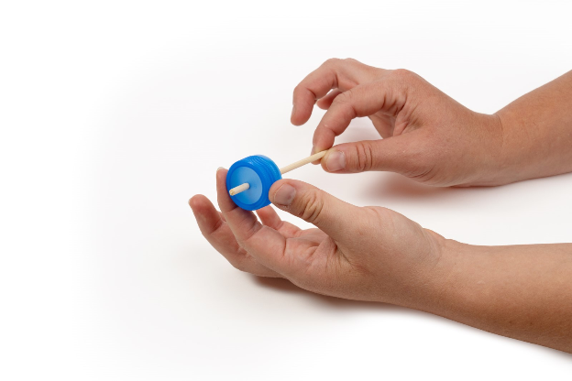
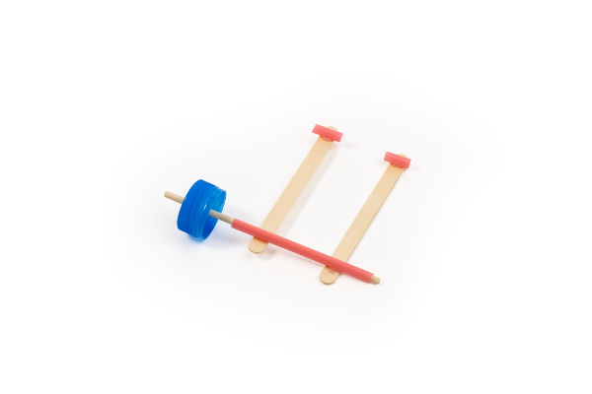
Step 5 Wheel and Axle Assembly
Push one long skewer into the bottle cap to make a wheel and axel assembly, then slide the skewer through the long straw
10
Notes:
Start your front wheel and axle assembly
Push one long skewer into the bottle cap to make a wheel and axel assembly, then slide the skewer through the long straw

Slide 11
Step 6 Wheel and Axle Assembly Cont.
Push the other long skewer into another bottle cap to make a second wheel and axle. Next, slide the skewer through the two short straw pieces
11
Notes:
Start your rear wheel and axle assembly
Push the other long skewer into another bottle cap to make a second wheel and axle. Next, slide the skewer through the two short straw pieces

Slide 12
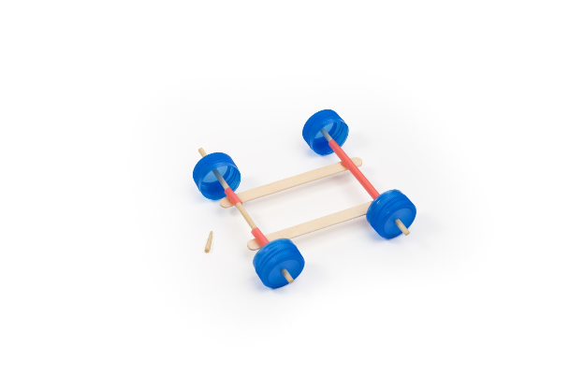
Step 7 Wheel and Axle Assembly Cont.
Place the last two bottle caps onto the open ends of each skewer. These are the wheels to your car.
12
Notes:
Finish your wheel and axle assemblies
Place the last two bottle caps onto the open ends of each skewer. These are the wheels to your car

Slide 13
Step 8 Prep Your Tires
Wrap one rubber band around each wheel that was connected to the skewer that was inserted into the short straws.
13
Think About:
Wrapping your tires preps them for traction.
Notes:
Wrap your tires for traction
Wrap one rubber band around each wheel that was connected to the skewer that was inserted into the short straws.

Slide 14
Step 9 Test Your Car
Test your car to make sure that it can roll smoothly. Place it on a flat surface and give the car a push.
14
If the wheels are crooked or the axle rubs too greatly against the axle housing, make small adjustments to help reduce the friction.
15
Tip:
If the car does not freely roll, friction may be slowing it down. Friction happens when parts
rub together and take energy away from motion.
Notes:
Test your car
Test your car to make sure that it can roll smoothly. Place it on a flat surface and give the car a push.
If the car does not freely roll, friction may be slowing it down.
Friction happens when parts rub together and take energy away from motion.If the wheels are crooked or the axle rubs too greatly against the axle housing, make small adjustments to help reduce the friction.

Slide 15
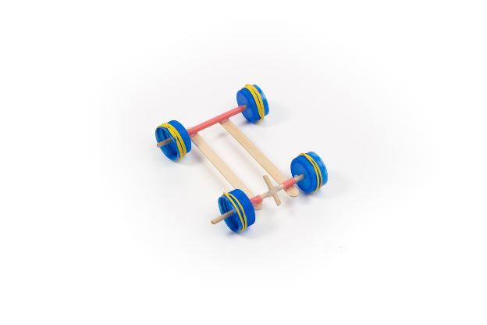
Step 10 Add Your Rubber Anchor
Using hot glue, glue the short skewer piece in the middle of the skewer that goes through the two short straws
16
Notes:
Add your rubber band anchor
Using hot glue, glue the short skewer piece in the middle of the skewer that goes through the two short straws

Slide 16
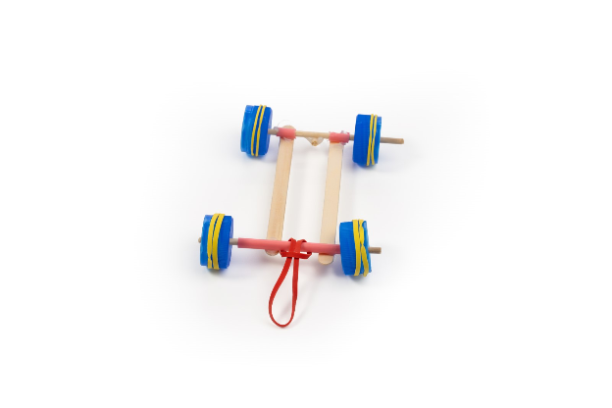
Step 11 Loop Your Rubber Band
Loop your last rubber band through itself around the middle of the long straw
17
Then tape the rubber band to the straw to hold it in place so that it does not slide off. As the skewer rotates, the rubber band should rotate with it
18
Notes:
Loop your rubber band
Loop your last rubber band through itself around the middle of the long straw
Then tape the rubber band to the straw to hold it in place so that it does not slide off. As the skewer rotates, the rubber band should rotate with it

Slide 17
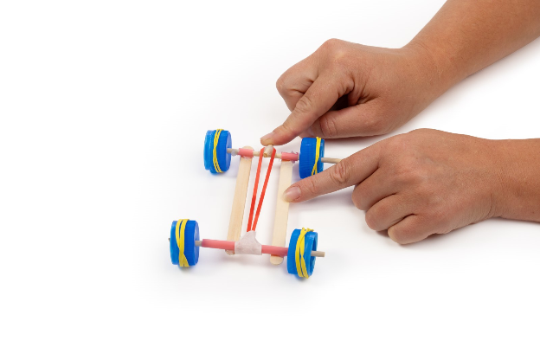
Hook Your Rubber Band Onto Your Anchor
Step 12
Hook the loose end of the rubber band onto the short skewer
19
Notes:
Hook your rubber band onto your anchor
Hook the loose end of the rubber band onto the short skewer

Slide 18
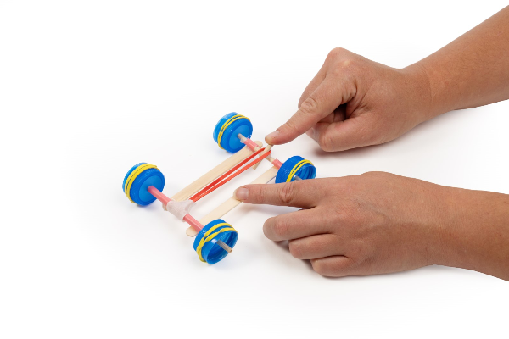
Step 13
Wind Up and Release
Wind up the axle that that has the anchor attached to is. Hold onto the rubber band if it begins to slip. By winding the axle, you will be building up stored energy. Place your car down on the floor and release to convert the stored energy into motion
20
Notes:
Wind up the axle that that has the anchor attached to is. Hold onto the rubber band if it begins to slip. By winding the axle, you will be building up stored energy. Place your car down on the floor and release to convert the stored energy into motion

Slide 19
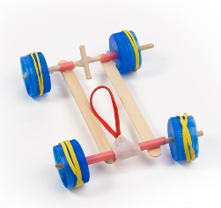

You made a rubber band-powered car!

Slide 20

Turn and
TALK TIME
What parts are working together in this car? In other words, which parts are working as a system?
What could happen if one part isn’t lined up correctly?
Which parts do you think are most important for helping the car roll?
Notes:
What parts of the car are working together in this car? In other words, which parts are working as a system?
What could happen if one part isn’t lined up correctly?
Which parts do you think are most important for helping the car roll?
What changes when the rubber band is twisted?

Slide 21



Wrap Up!
What Careers Did We Explore Today?
Mechanical Engineers design things that move, such as cars, bikes, elevators, and machines. It’s important that they understand how parts work together as a system and how to reduce friction so things move smoothly
Toy designers create moving toys like pull-back cars, wind-up toys, and launchers
Race Car Engineers focus on making cars move as fast and as smoothly as possible. They work to reduce friction, improve energy transfer, and make sure every part of a system is aligned and working together
Notes:
Mechanical engineers design things that move, such as cars, bikes, elevators, and machines. It’s important that they understand how energy is stored and released, how parts work together as a system, and how to reduce friction so things move smoothly
Toy designers crate moving toys like pull-back cars, wind-up toys, and launchers
Race car engineers focus on making cars move as fast and as smoothly as possible. They work to reduce friction, improve energy transfer, and make sure every part of a system is aligned and working together

