Slide 1




Activity Overview
Silly Putty

Slide 2



Silly Putty

Slide 3
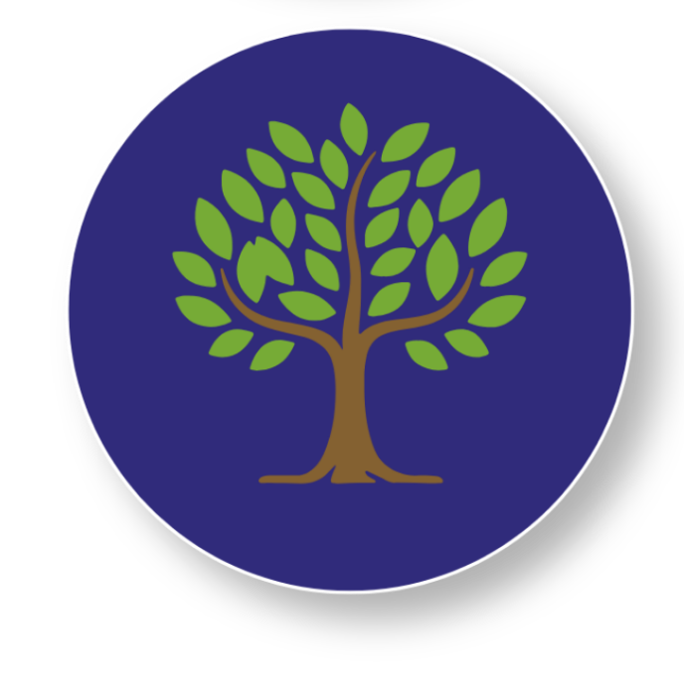
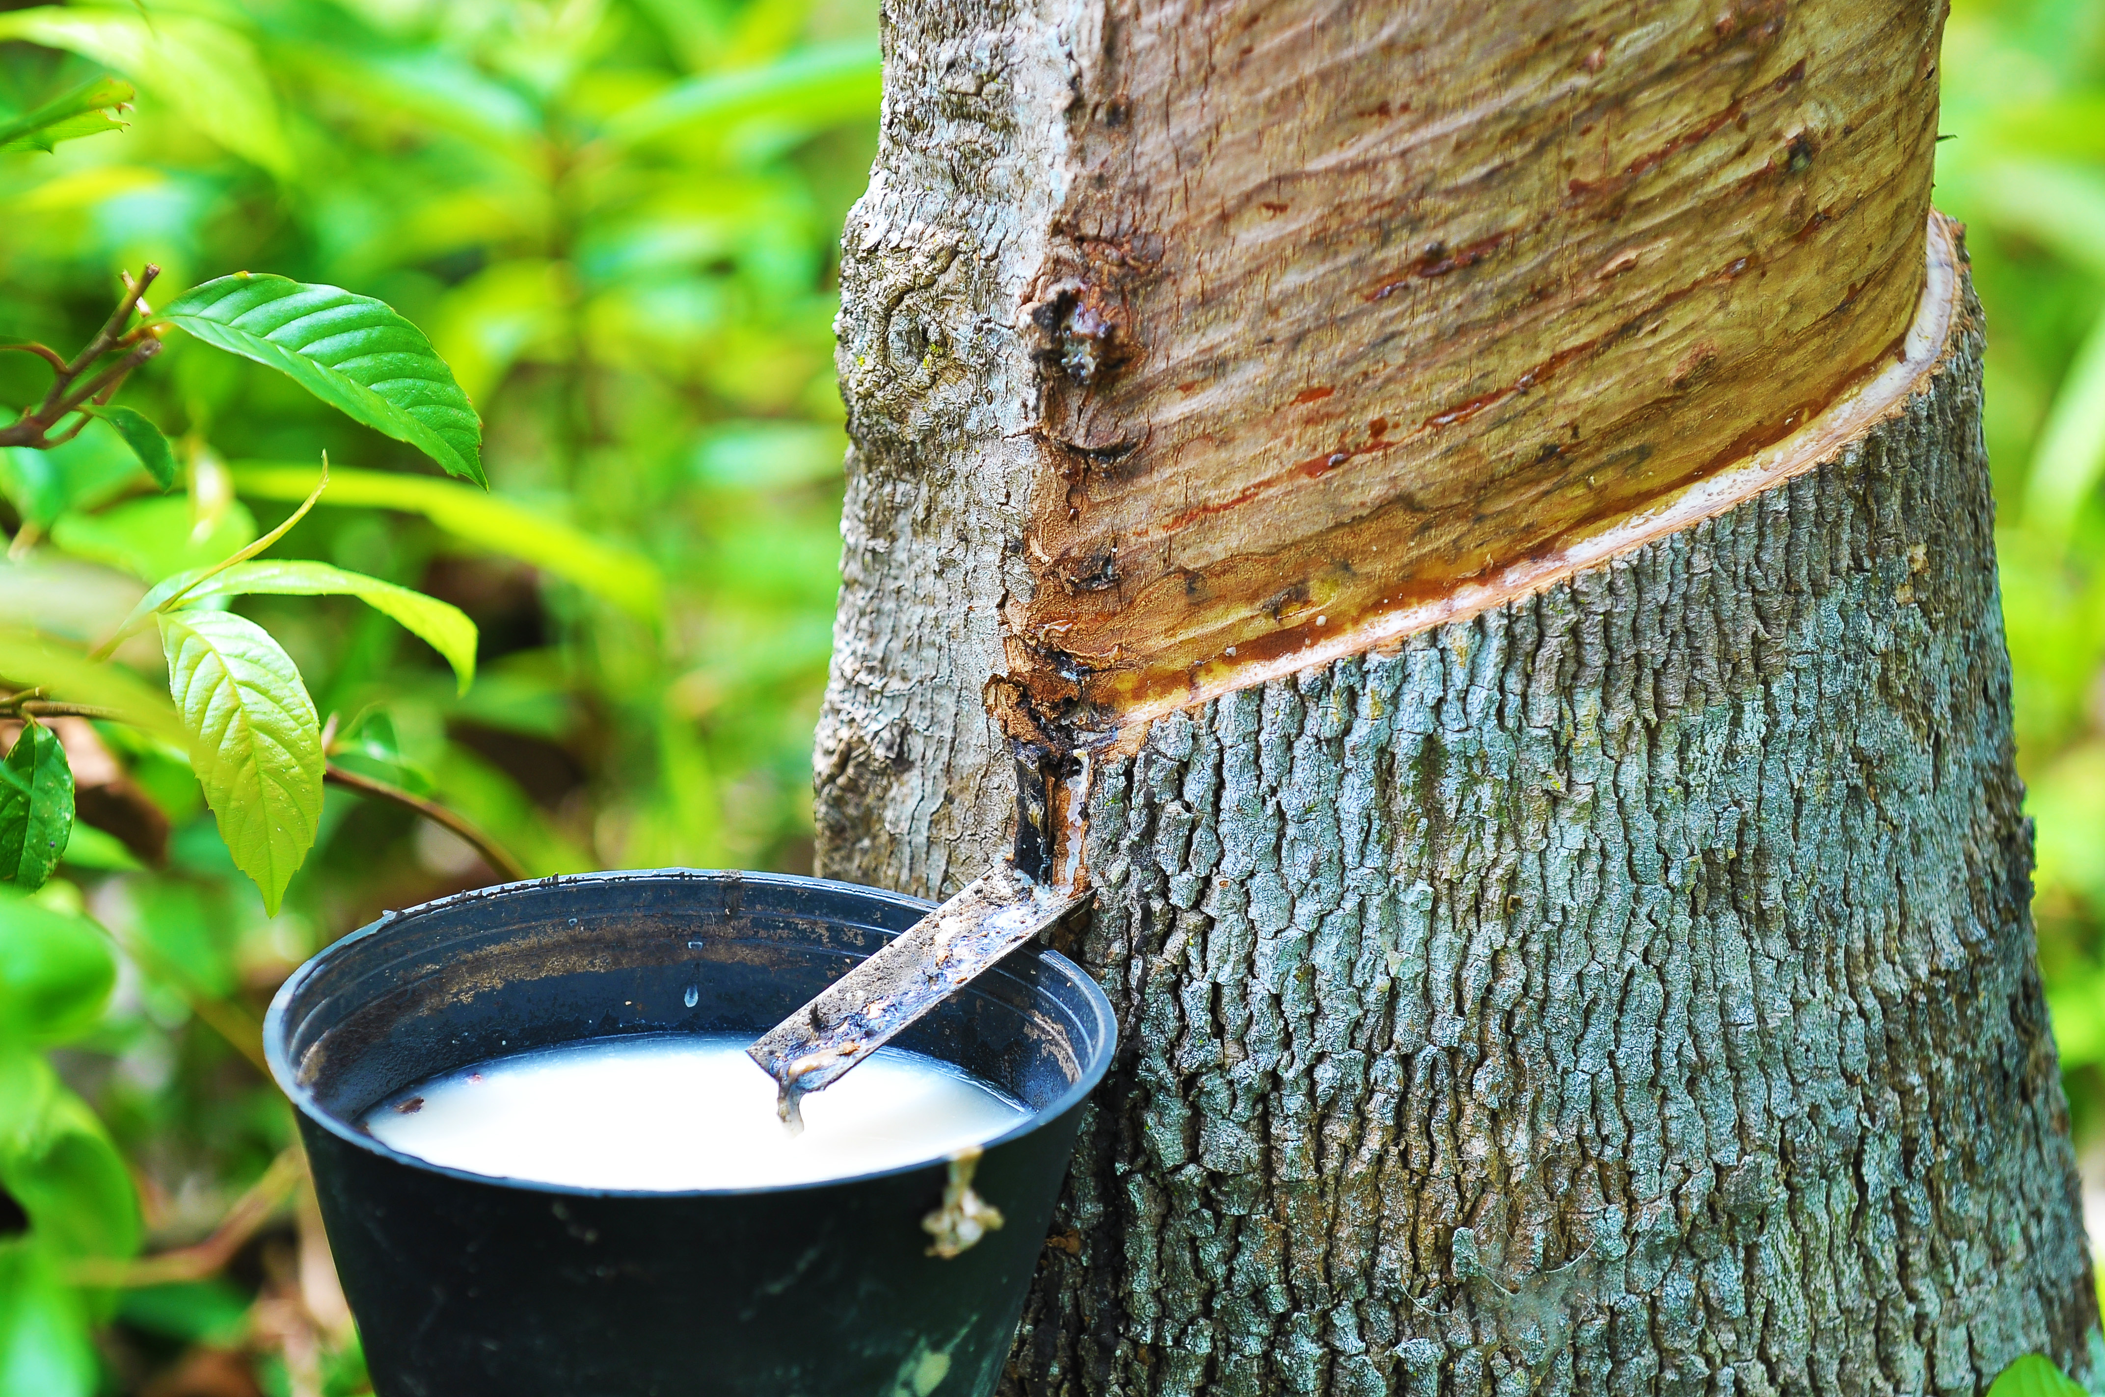
The Foundations of Controlling Materials
Have you ever wondered where materials come from?
Many materials, like plastic, foam, and rubber, don't start out the way we use them. They are made through a manufacturing process.
Some materials even begin in nature. Natural Rubber comes from rubber trees.
When the tree is tapped, it produces a milky liquid called latex. Workers collect the latex and process it to make natural rubber.
Rubber is stretchy, flexible, and bouncy, which makes it useful for products like tires, gloves, rubber bands, balls, and shoe soles.
Rubber doesn’t come off the tree ready to use. It still must be collected, mixed, shaped, and processed before it becomes the materials and products we use every day.
Notes:
Have you ever wondered where materials come from?
Things like plastic, and foam don’t start that way. They are made.
Some materials even begin in nature. Rubber, for example, can come from rubber trees. The tree makes a milky liquid called latex, and people collect that latex and process it to make natural rubber. Rubber can stretch, bend, and bounce, which is why it’s used in things like tires, gloves, rubber bands, balls, and shoe soles. But rubber doesn’t come off the tree ready to use. It still has to be collected, mixed, shaped, and processed before it becomes the materials and products we use every day.
Builders and makers don’t just put things together. Sometimes, they make the material first. They mix ingredients and work them in special ways to create something new.
Today, you get to be a maker, too!
In today’s activity, we will be making our own material. You will start with simple ingredients and follow steps to mix and work them together. As you do, you will see the material change right in your hands.
People who make materials in factories do this every day. They follow steps, use tools, and pay close attention to what happens as materials are mixed and worked. If a material doesn’t turn out the right way, they change what they do and try again.
As you make your material today, you’ll be practicing the same kinds of skills that makers and engineers use. By the end of the activity, you’ll have created a new material on your own—just like real builders and engineers do.

Slide 4
The Foundations of Controlling Materials
Today, you get to be a maker, too!
People who make materials in factories follow steps, use tools, and carefully watch what happens as materials are mixed and shaped. If something doesn't turn out the way they expected, they make changes and try again.
Today, you'll make your own material! You'll start with simple ingredients and follow the steps to mix and shape them. As you work, you'll see the material change right before your eyes.
As you make your material, you'll practice the same kinds of skills that makers, engineers, and manufacturers use every day. By the end of the activity, you'll have created a brand-new material of your own.
Notes:
Have you ever wondered where materials come from?
Things like plastic, and foam don’t start that way. They are made.
Some materials even begin in nature. Rubber, for example, can come from rubber trees. The tree makes a milky liquid called latex, and people collect that latex and process it to make natural rubber. Rubber can stretch, bend, and bounce, which is why it’s used in things like tires, gloves, rubber bands, balls, and shoe soles. But rubber doesn’t come off the tree ready to use. It still has to be collected, mixed, shaped, and processed before it becomes the materials and products we use every day.
Builders and makers don’t just put things together. Sometimes, they make the material first. They mix ingredients and work them in special ways to create something new.
Today, you get to be a maker, too!
In today’s activity, we will be making our own material. You will start with simple ingredients and follow steps to mix and work them together. As you do, you will see the material change right in your hands.
People who make materials in factories do this every day. They follow steps, use tools, and pay close attention to what happens as materials are mixed and worked. If a material doesn’t turn out the right way, they change what they do and try again.
As you make your material today, you’ll be practicing the same kinds of skills that makers and engineers use. By the end of the activity, you’ll have created a new material on your own—just like real builders and engineers do.

Slide 5
Key Words to Know
MATERIAL
What something is made of.
To put things together and stir them so they become one.
MIX
CHANGE
To become different
PROCESS
The steps you follow to make something
Notes:
Material - What something is made of
Mix - To put things together and move them around
Change - To become different
Process - The steps you follow to make something

Slide 6
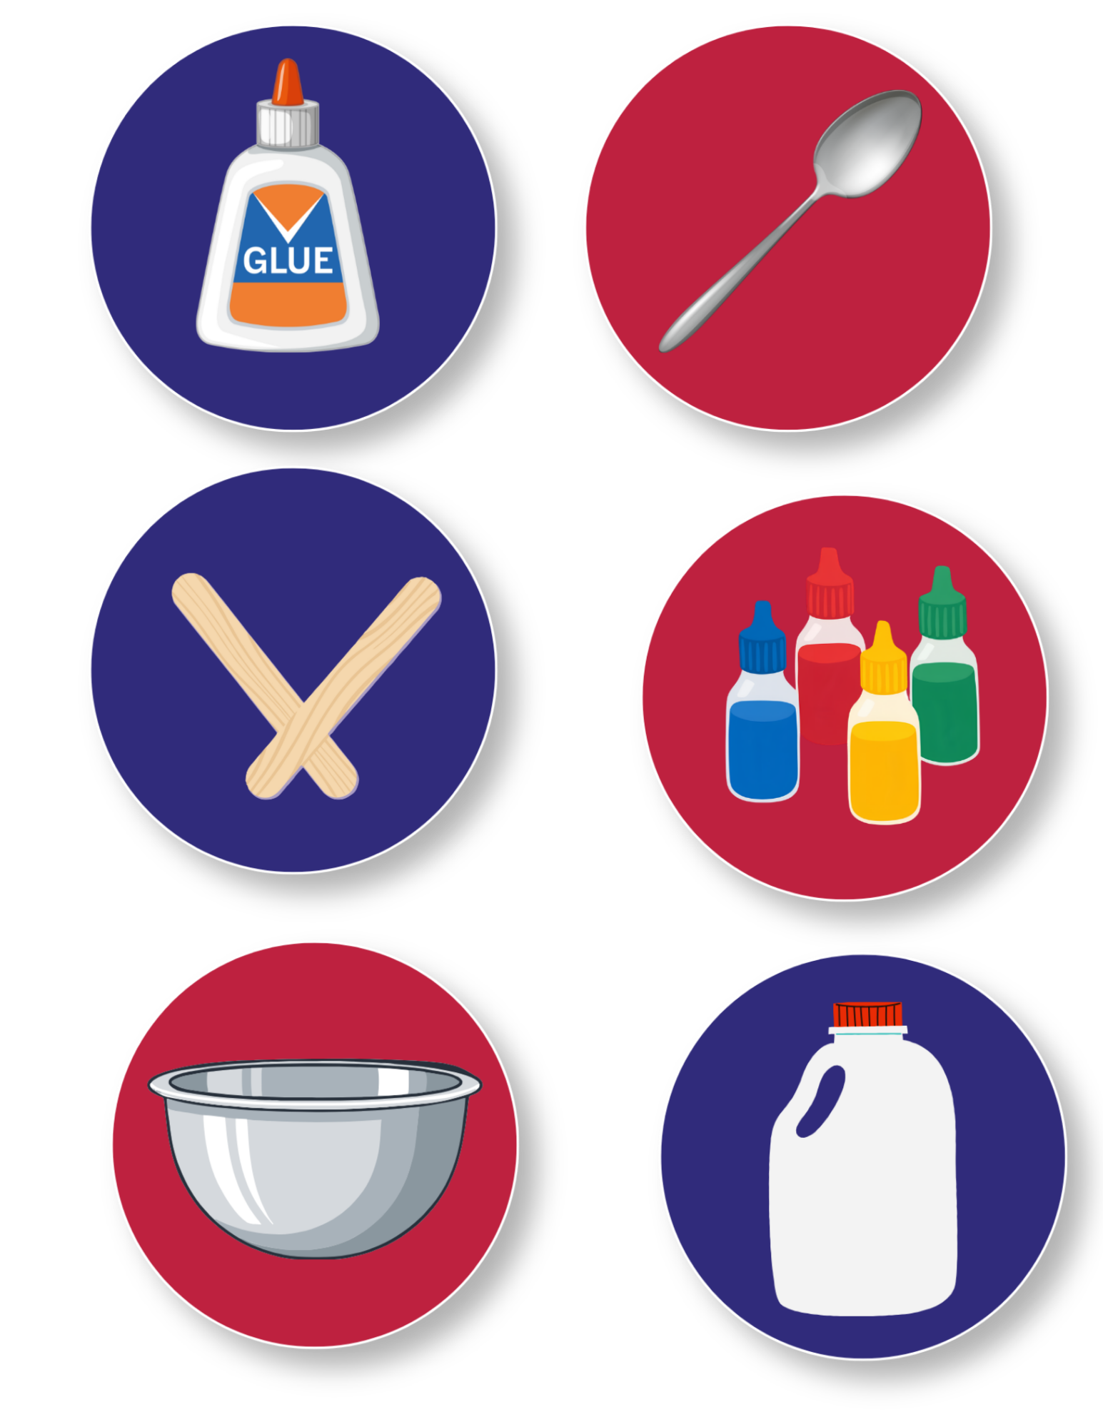
Today’s Materials
Glue
Craft Stick
Food Coloring
Spoon
Borax
½ Gallon Jug
Measuring Scoops
Mixing Bowl
Notes:
2 tablespoons of glue
4 drops of food coloring (optional)
2 tablespoons of Borax solution (see notes in Activity Directions for creating the solution)
1 mixing bowl
1 disposable spoon
1 craft stick (for facilitating glue removal from measuring spoon)
Materials Supplied (for sharing)
½ gallon jug (for creating Borax solution)
Borax container
[5] 1 tablespoon scoops
[5] 1 teaspoon scoops
[5] 1/8 teaspoon scoops

Slide 7
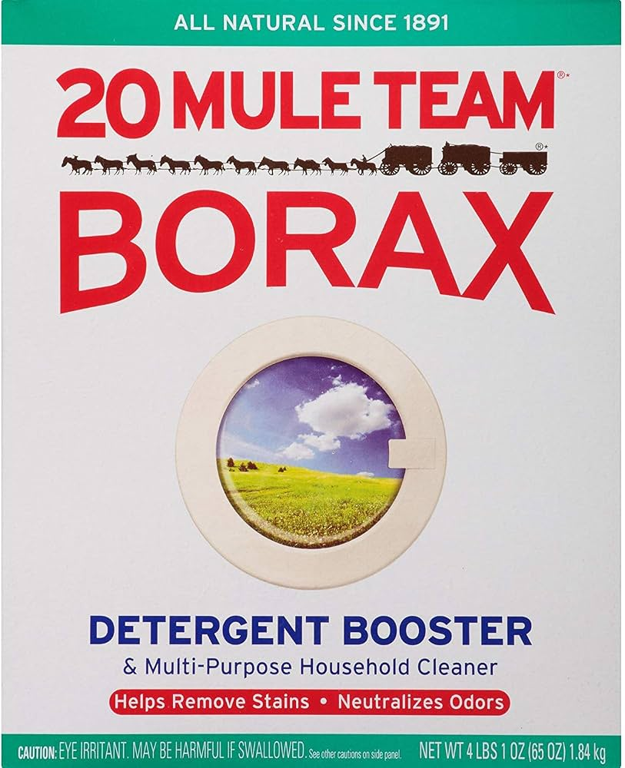
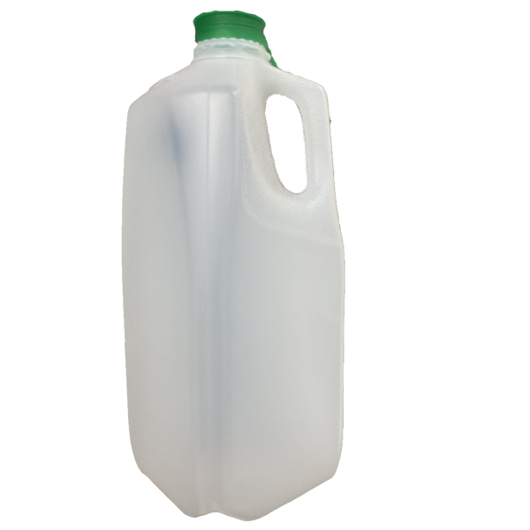

Step 1
Create the Borax Solution
Borax Solution
Mix 1.5 tablespoons of Borax powder in a ½ gallon of warm water to create the “Borax solution”
1
Tip:
You can use a rolled-up piece of paper or a folder to create a makeshift funnel to facilitate pouring Borax into the opening of the jug
Notes:
Teacher: Create the Borax solution
Mix 1.5 tablespoons of Borax powder in a ½ gallon of warm water to create the “Borax solution”
You can use a rolled up piece of paper or folder to create a makeshift funnel to facilitate pouring Borax into the opening of the jug

Slide 8
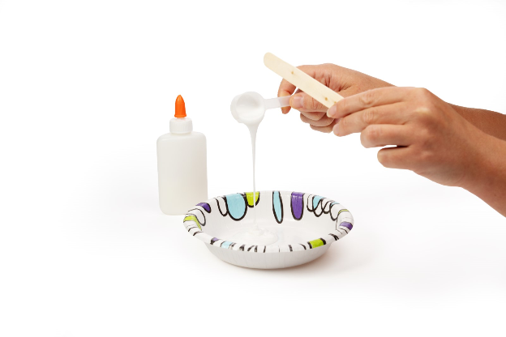
Step 2
Combine the Materials
Measure 2 tablespoons of glue and pour it into your bowl. Use your craft stick to help scrape remaining glue off the measuring spoon
2
Optional:
Mix ~four drops of food coloring into the glue, using your spoon
Notes:
Combine the Materials
Measure 2 tablespoons of glue and pour it into your bowl. Use your craft stick to help scrape remaining glue off of the measuring spoon
(Optional) Mix ~four drops of food coloring into the glue, using your spoon

Slide 9
Step 3
Add the Borax Solution
Add 2 tablespoons of the Borax solution slowly to the glue/food coloring mixture and stir with a spoon until the glue begins to separate from the bowl
3
Borax Solution
Notes:
Add the Borax solution
Add 2 tablespoons of the Borax solution slowly to the glue/food coloring mixture and stir with a spoon until the glue begins to separate from the bowl

Slide 10
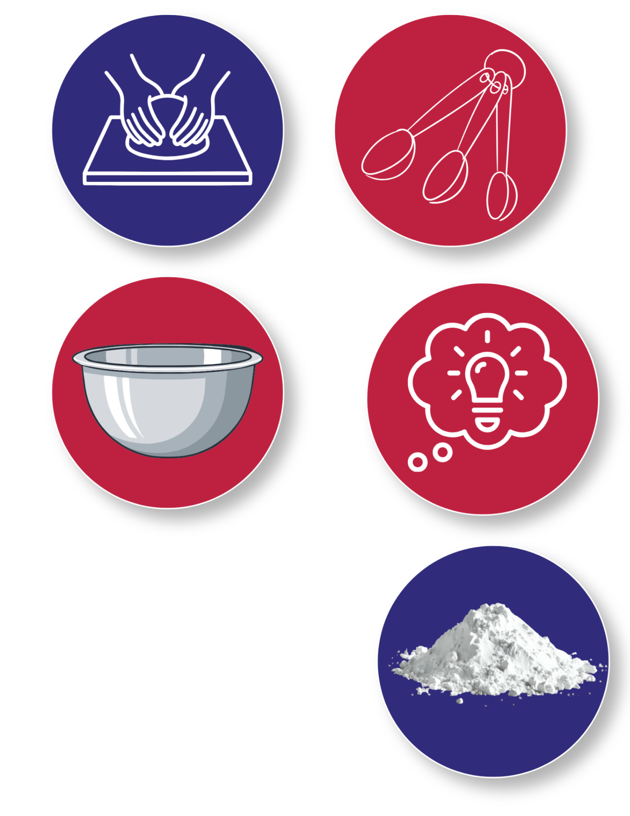
Step 4
Knead the Mixture
Once the glue has begun to separate from the bowl, knead the mixture in your hands until the putty begins to form
4
If your putty is too sticky, briefly dunk the putty back into the Borax solution and continue to knead with your hands until the desired consistency is achieved
5
Take Note:
allowing the putty to spend several minutes in the Borax solution will create a rubbery putty that no longer sticks to itself
Notes:
Knead the mixture
Once the glue has begun to separate from the bowl, knead the mixture in your hands until the putty begins to form
If your putty is too sticky, briefly dunk the putty back into the Borax solution and continue to knead with your hands until the desired consistency is achieved
Note: allowing the putty to spend several minutes in the Borax solution will create a rubbery putty that no longer sticks to itself

Slide 11
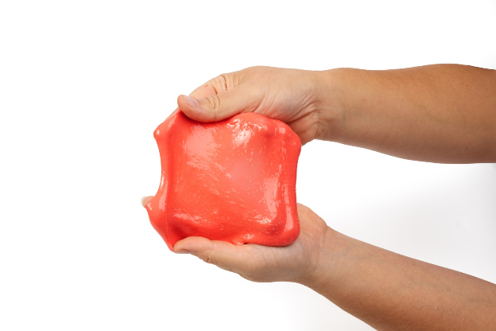
You made a mixture called Silly Putty!

Slide 12

Turn and
TALK TIME
What can you tell me about glue?
What did you think would happen to the glue when we mixed our materials together?
How did the glue change when we mixed our materials?
What can our new material do now that it couldn’t do before we mixed our materials?
Notes:
What can you tell me about glue?
What do you think will happen to the glue when we mix our materials together?
How did the glue change when we mixed our materials?
What can our new material do now that it couldn’t do before we mixed our materials?

Slide 13
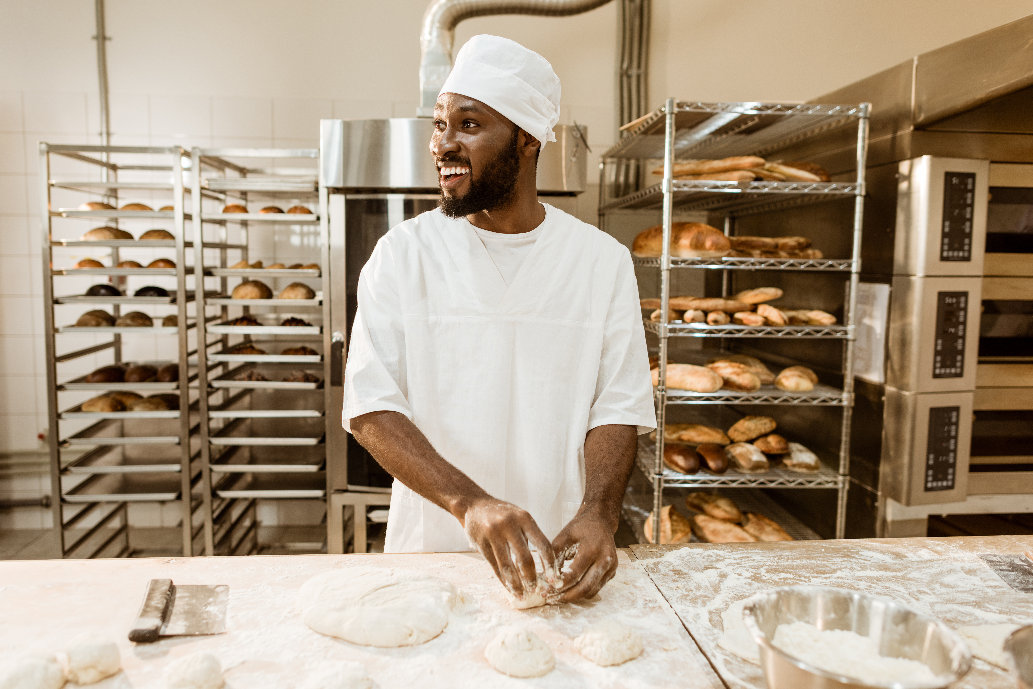
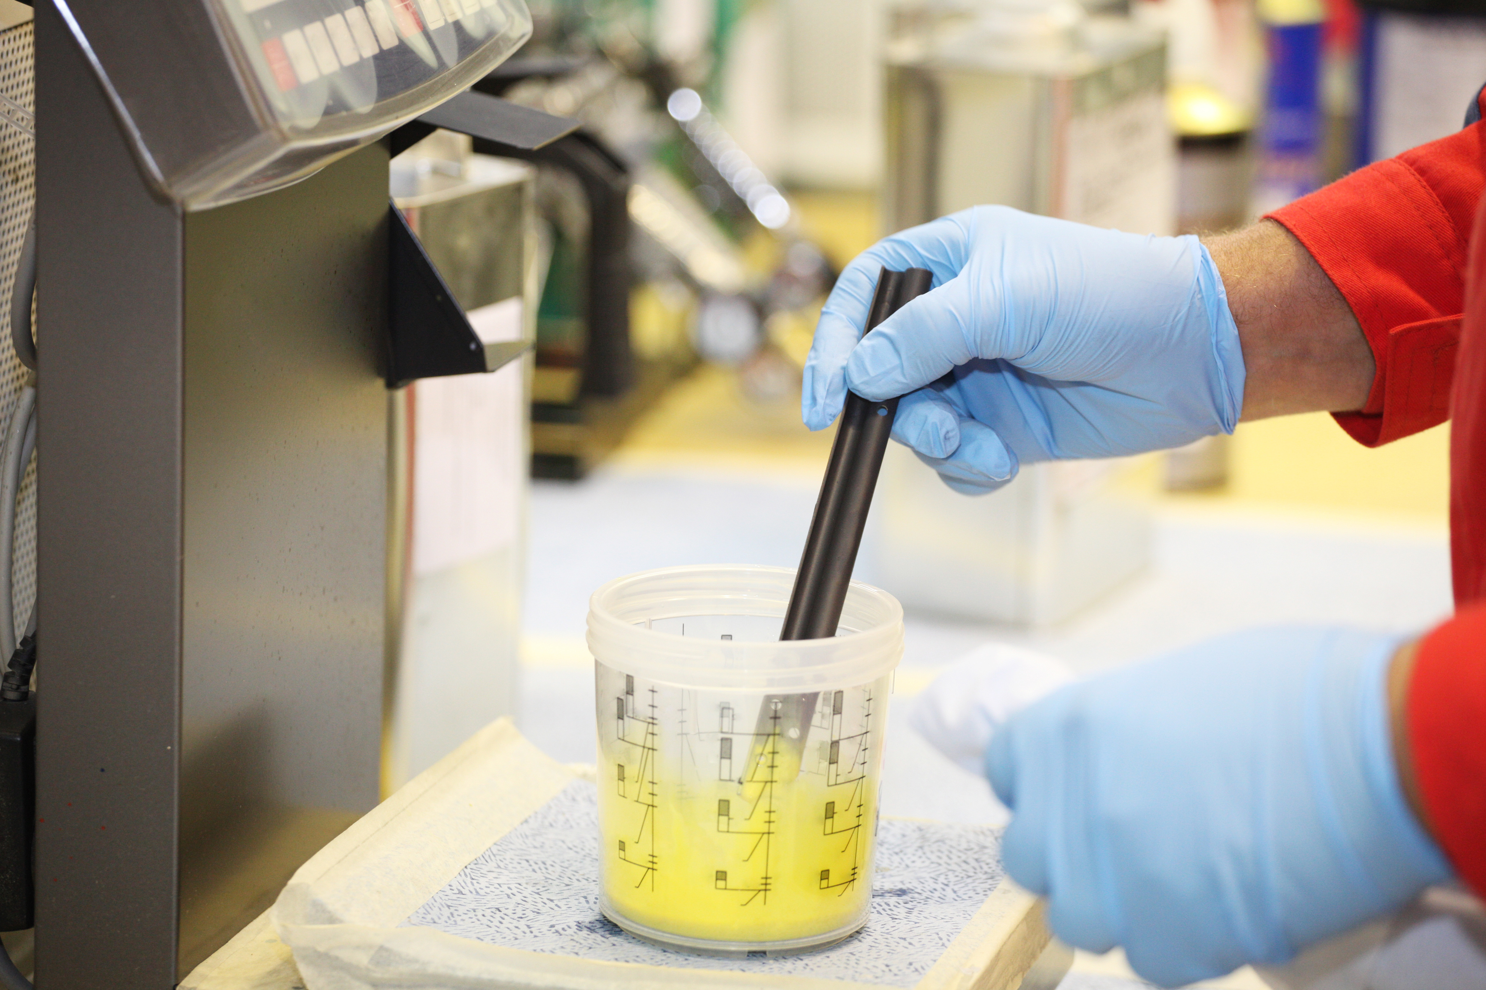

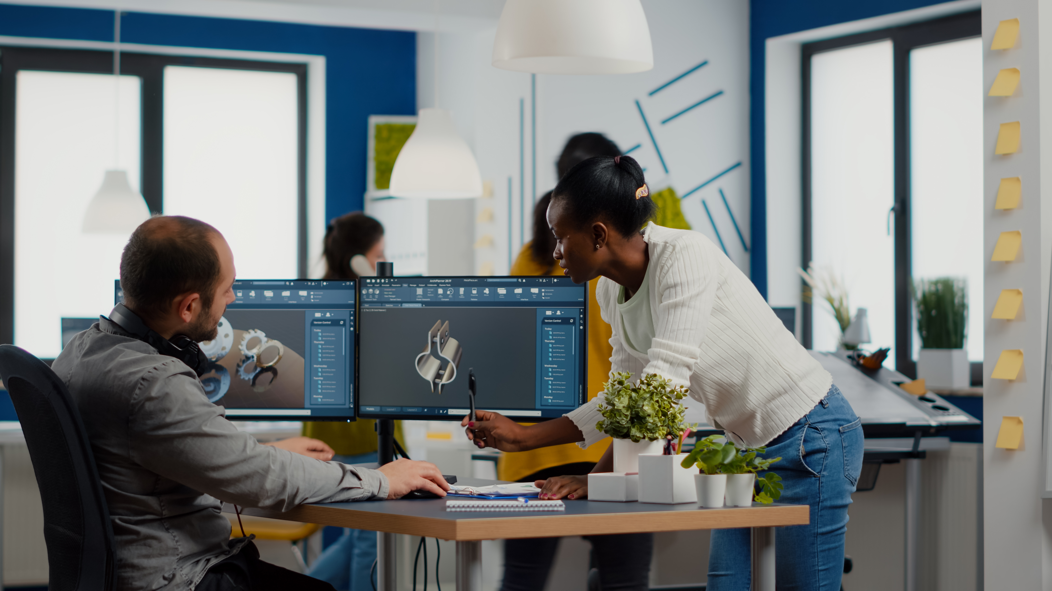
Career Exploration
Bakers mix ingredients like flour, water, and eggs to make new materials, like dough and batter
Paint Makers mix colors known as pigments, and various liquids and binding agents to create paints that are strong, durable, and vibrant
Factory Workers help make materials and products by following steps, and watching for changes
Engineers help decide how materials should be made so that they work the right way
Notes:
Bakers mix ingredients like flour, water, and eggs to make new materials, like dough and batter
Paint makers mix colors known as pigments, and various liquids and binding agents to create paints that are strong, durable, and vibrant
Factory workers help make materials and products by following steps, and watching for changes
Engineers help decide how materials should be made so that they work the right way

