Slide 1




Activity Overview
Silly Putty

Slide 2




Silly Putty

Slide 3
Materials Foundation
Have you ever noticed that two things made from the same material don’t always act the same way? One might stretch more, another might break more easily, even if they look alike. That’s because materials don’t just depend on what they’re made of. They also depend on how they are made.
When people make materials, they follow a process. A process is a set of steps, and each step matters. Mixing longer or shorter, using more or less of something, or working a material differently can change how it behaves.
Notes:
Have you ever noticed that two things made from the same material don’t always act the same way? One might stretch more, another might break more easily, even if they look alike. ​
That’s because materials don’t just depend on what they’re made of. ​
They also depend on how they are made. ​
When people make materials, they follow a process. A process is a set of steps, and each step matters. Mixing longer or shorter, using more or less of something, or working a material differently can change how it behaves. ​
Today, everyone will use the same ingredients to make a material. As you work, you may notice that not every material turns out exactly the same.That isn’t a mistake; it’s an important clue. Differences help us learn which steps matter the most. ​
​
Engineers and factory workers think this way every day. They compare materials, notice small differences, and adjust their processes so materials work the way they need them to. If a material is too stiff, too sticky, or too weak, they don’t give up, they change how it’s made and try again. ​
As you make and test your material today, you will practice the foundations of controlling materials: paying attention to steps, noticing changes, and thinking about how your actions affect the final outcome. These are the same skills engineers use when they design and improve materials for the real world. ​

Slide 4
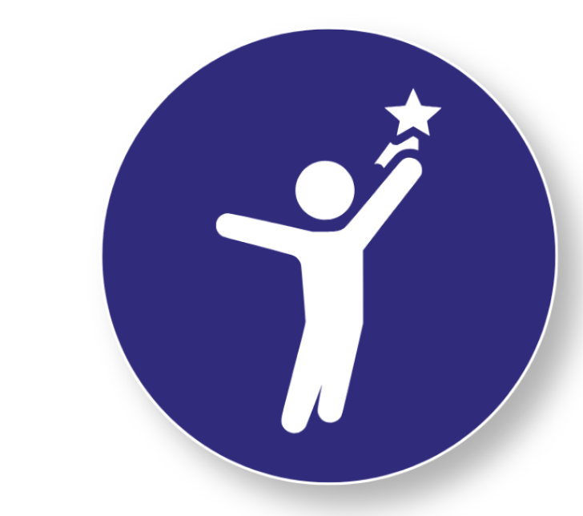

Materials Foundation
​
Engineers and factory workers think this way every day. They compare materials, notice small differences, and adjust their processes so materials work the way they need them to. If a material is too stiff, too sticky, or too weak, they don’t give up, they change how it’s made and try again. ​
As you make and test your material today, you will practice the foundations of controlling materials: paying attention to steps, noticing changes, and thinking about how your actions affect the final outcome.
Today, you will be the tester!
Today, everyone will use the same ingredients to make a material. As you work, you may notice that not every material turns out exactly the same. That isn’t a mistake; it’s an important clue. Differences help us learn which steps matter the most. ​
Think Like an Engineer!
These are the same skills engineers use when they design and improve materials for the real world. ​
Notes:
Have you ever noticed that two things made from the same material don’t always act the same way? One might stretch more, another might break more easily, even if they look alike. ​
That’s because materials don’t just depend on what they’re made of. ​
They also depend on how they are made. ​
When people make materials, they follow a process. A process is a set of steps, and each step matters. Mixing longer or shorter, using more or less of something, or working a material differently can change how it behaves. ​
Today, everyone will use the same ingredients to make a material. As you work, you may notice that not every material turns out exactly the same.That isn’t a mistake; it’s an important clue. Differences help us learn which steps matter the most. ​
​
Engineers and factory workers think this way every day. They compare materials, notice small differences, and adjust their processes so materials work the way they need them to. If a material is too stiff, too sticky, or too weak, they don’t give up, they change how it’s made and try again. ​
As you make and test your material today, you will practice the foundations of controlling materials: paying attention to steps, noticing changes, and thinking about how your actions affect the final outcome. These are the same skills engineers use when they design and improve materials for the real world. ​

Slide 5
Key Words to Know
MATERIAL
What something is made of.
A group or quantity of material made at the same time
BATCH
Keeping a step in a process the same, on purpose
CONTROL
OUTCOME
How something turns out
Notes:
Material - The matter from which a thing is or can be made
Batch - A group or quantity of material made at the same time
Control - Keeping a step in a process the same, on purpose
Outcome - How something turns out

Slide 6
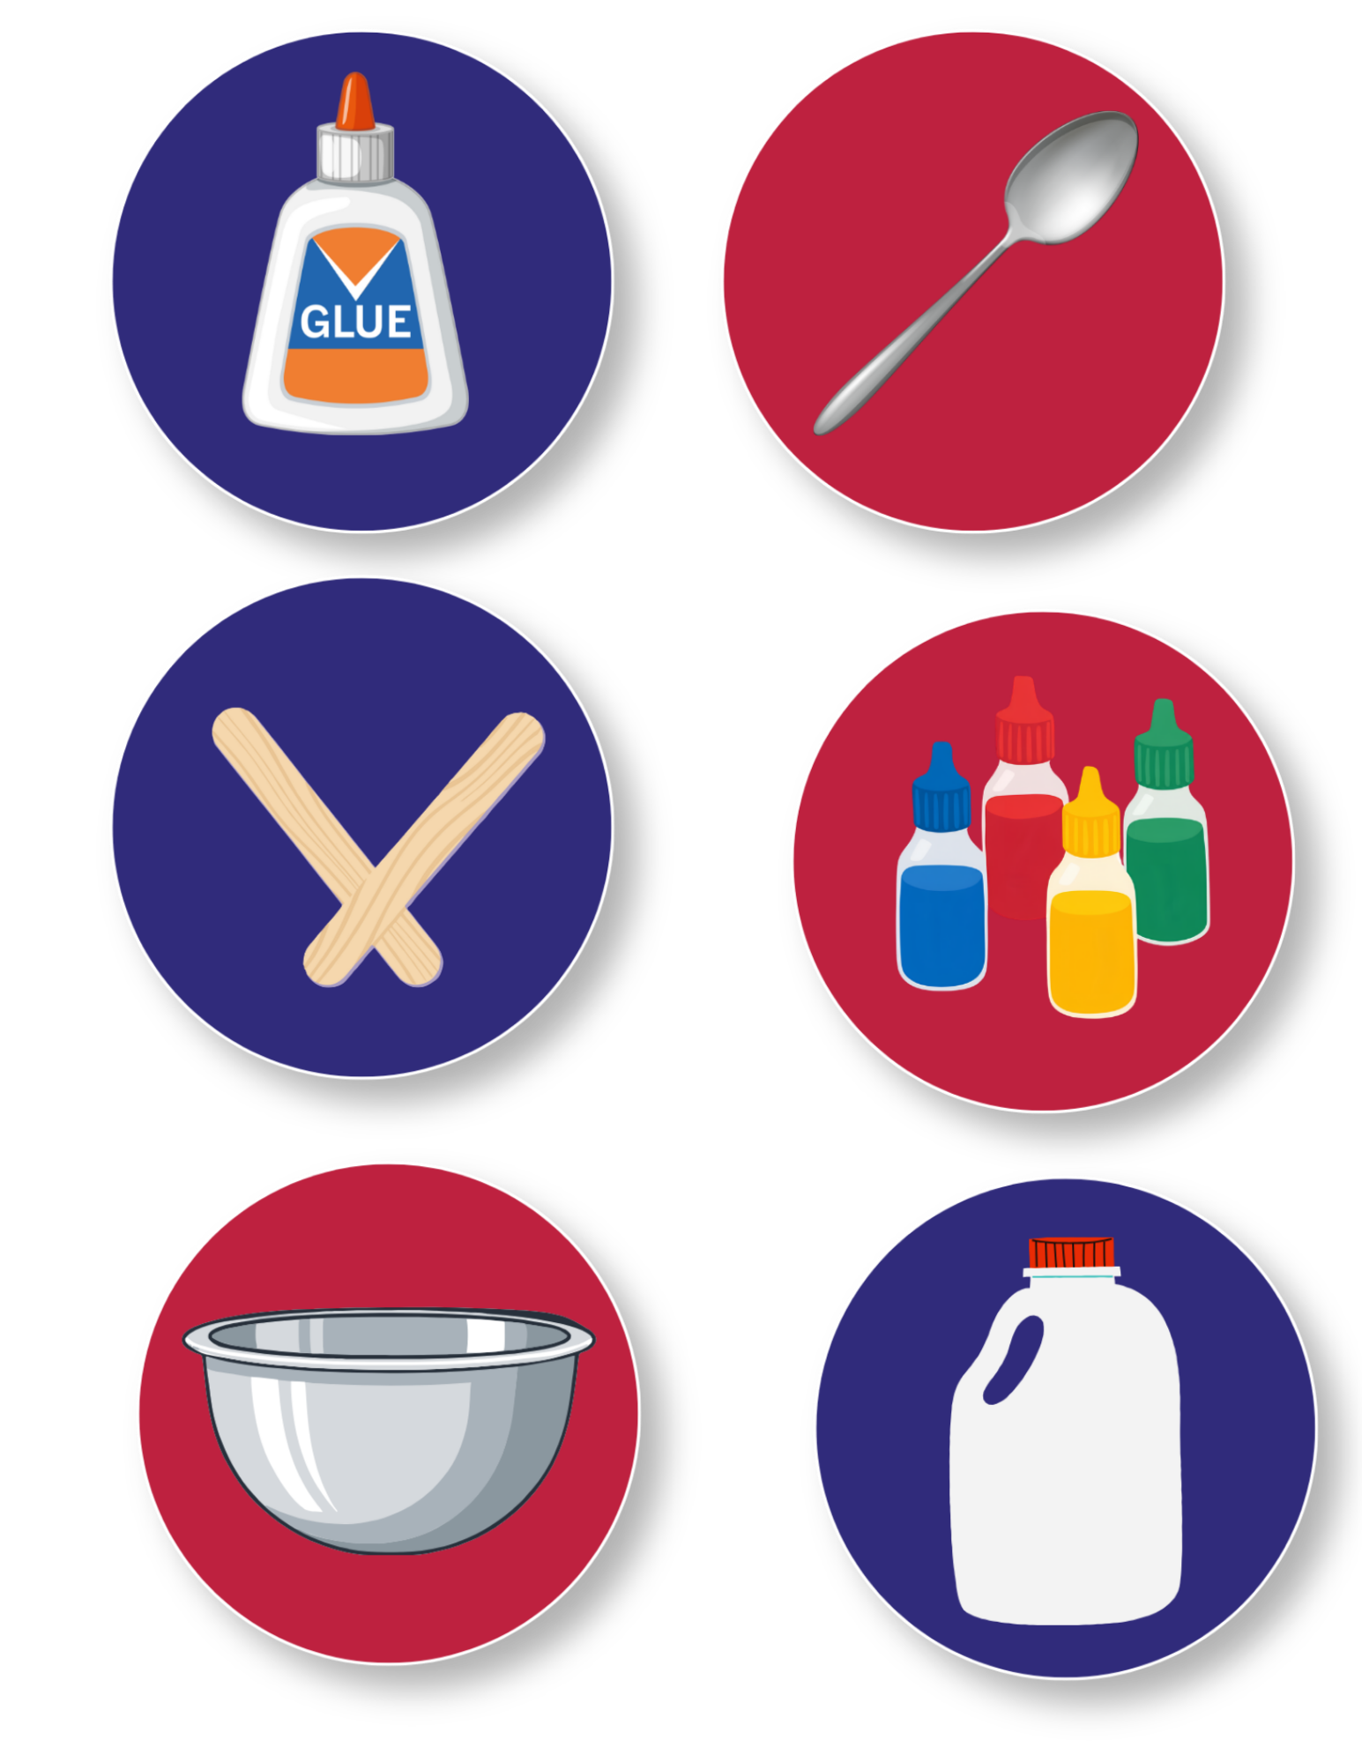
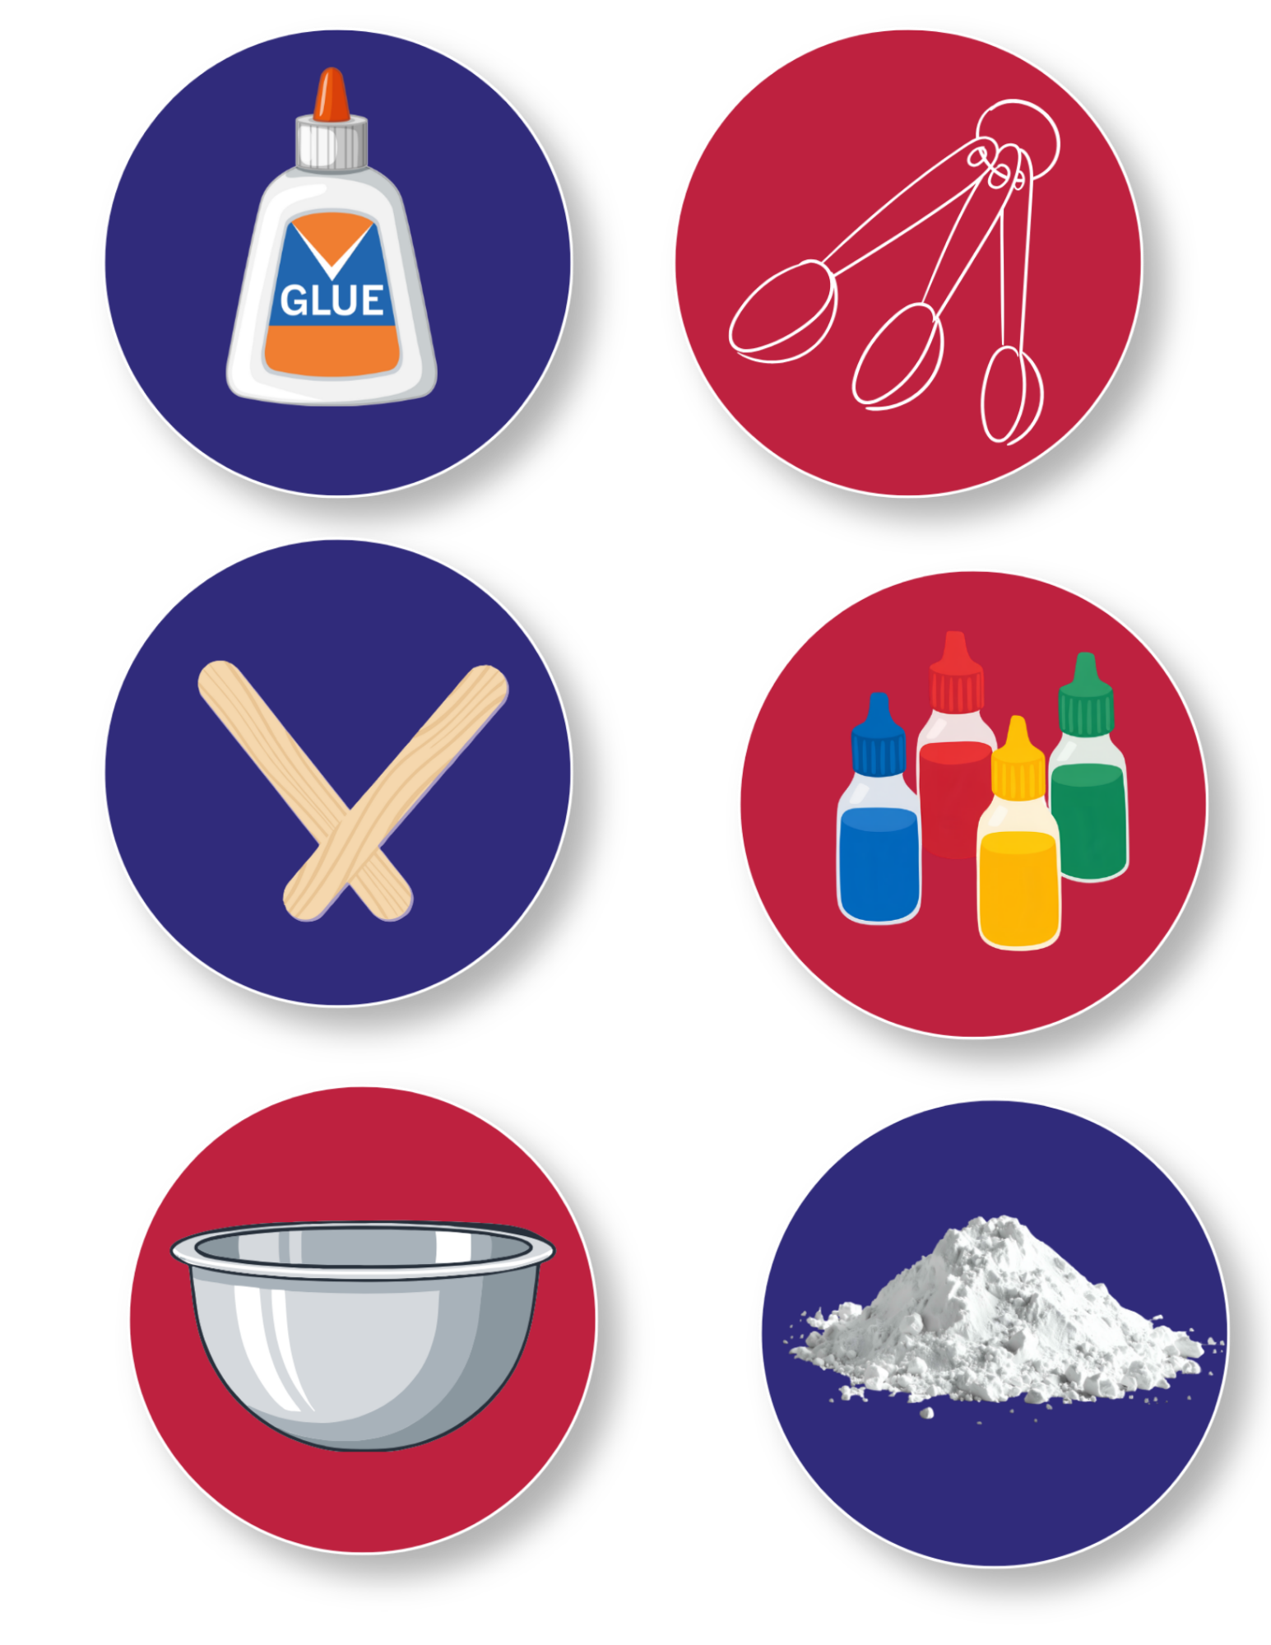
Today’s Materials
Glue
Craft Stick
Food Coloring
Spoon
Borax
½ Gallon Jug
Measuring Scoops
Mixing Bowl
Notes:
2 tablespoons of glue
4 drops of food coloring (optional)
2 tablespoons of Borax solution (see notes in Activity Directions for creating the solution)
1 mixing bowl
1 disposable spoon
1 craft stick (for facilitating glue removal from measuring spoon)
Materials Supplied (for sharing)
½ gallon jug (for creating Borax solution)
Borax container
[5] 1 tablespoon scoops
[5] 1 teaspoon scoops
[5] 1/8 teaspoon scoops

Slide 7
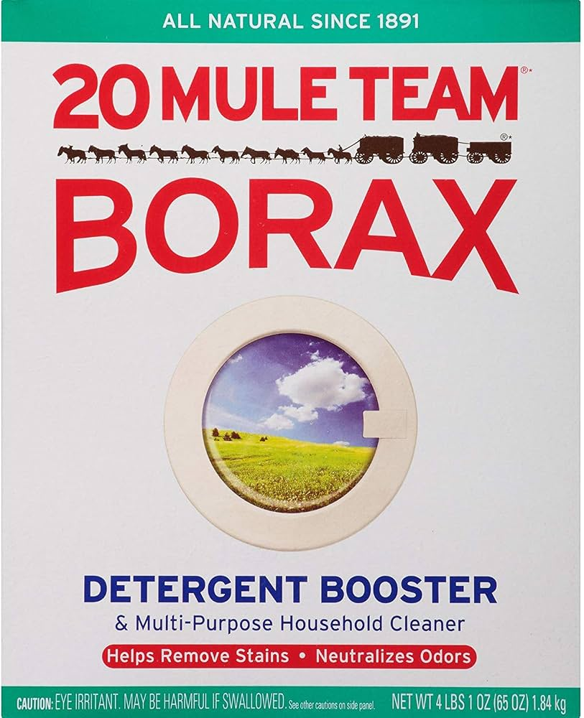
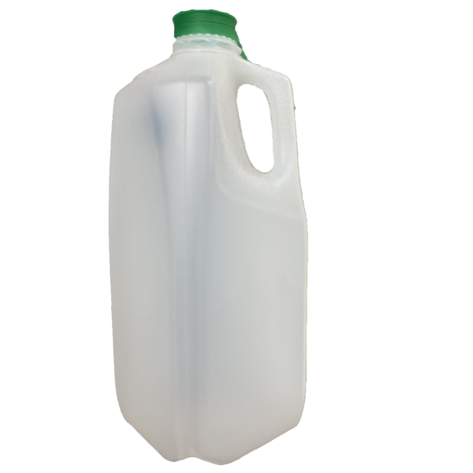

Step 1
Create the Borax Solution
Borax Solution
Mix 1.5 tablespoons of Borax powder in a ½ gallon of warm water to create the “Borax solution”
1
Tip:
You can use a rolled-up piece of paper or a folder to create a makeshift funnel to facilitate pouring Borax into the opening of the jug
Notes:
Teacher: Create the Borax solution
Mix 1.5 tablespoons of Borax powder in a ½ gallon of warm water to create the “Borax solution”
You can use a rolled up piece of paper or folder to create a makeshift funnel to facilitate pouring Borax into the opening of the jug

Slide 8
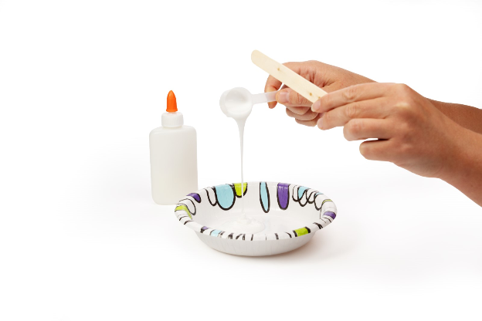
Step 2
Combine the Materials
Measure 2 tablespoons of glue and pour it into your bowl. Use your craft stick to help scrape remaining glue off the measuring spoon
2
Optional:
Mix ~four drops of food coloring into the glue, using your spoon
Notes:
Combine the Materials
Measure 2 tablespoons of glue and pour it into your bowl. Use your craft stick to help scrape remaining glue off of the measuring spoon
(Optional) Mix ~four drops of food coloring into the glue, using your spoon

Slide 9
Step 3
Add the Borax Solution
Add 2 tablespoons of the Borax solution slowly to the glue/food coloring mixture and stir with a spoon until the glue begins to separate from the bowl
3
Borax Solution
Notes:
Add the Borax solution
Add 2 tablespoons of the Borax solution slowly to the glue/food coloring mixture and stir with a spoon until the glue begins to separate from the bowl

Slide 10
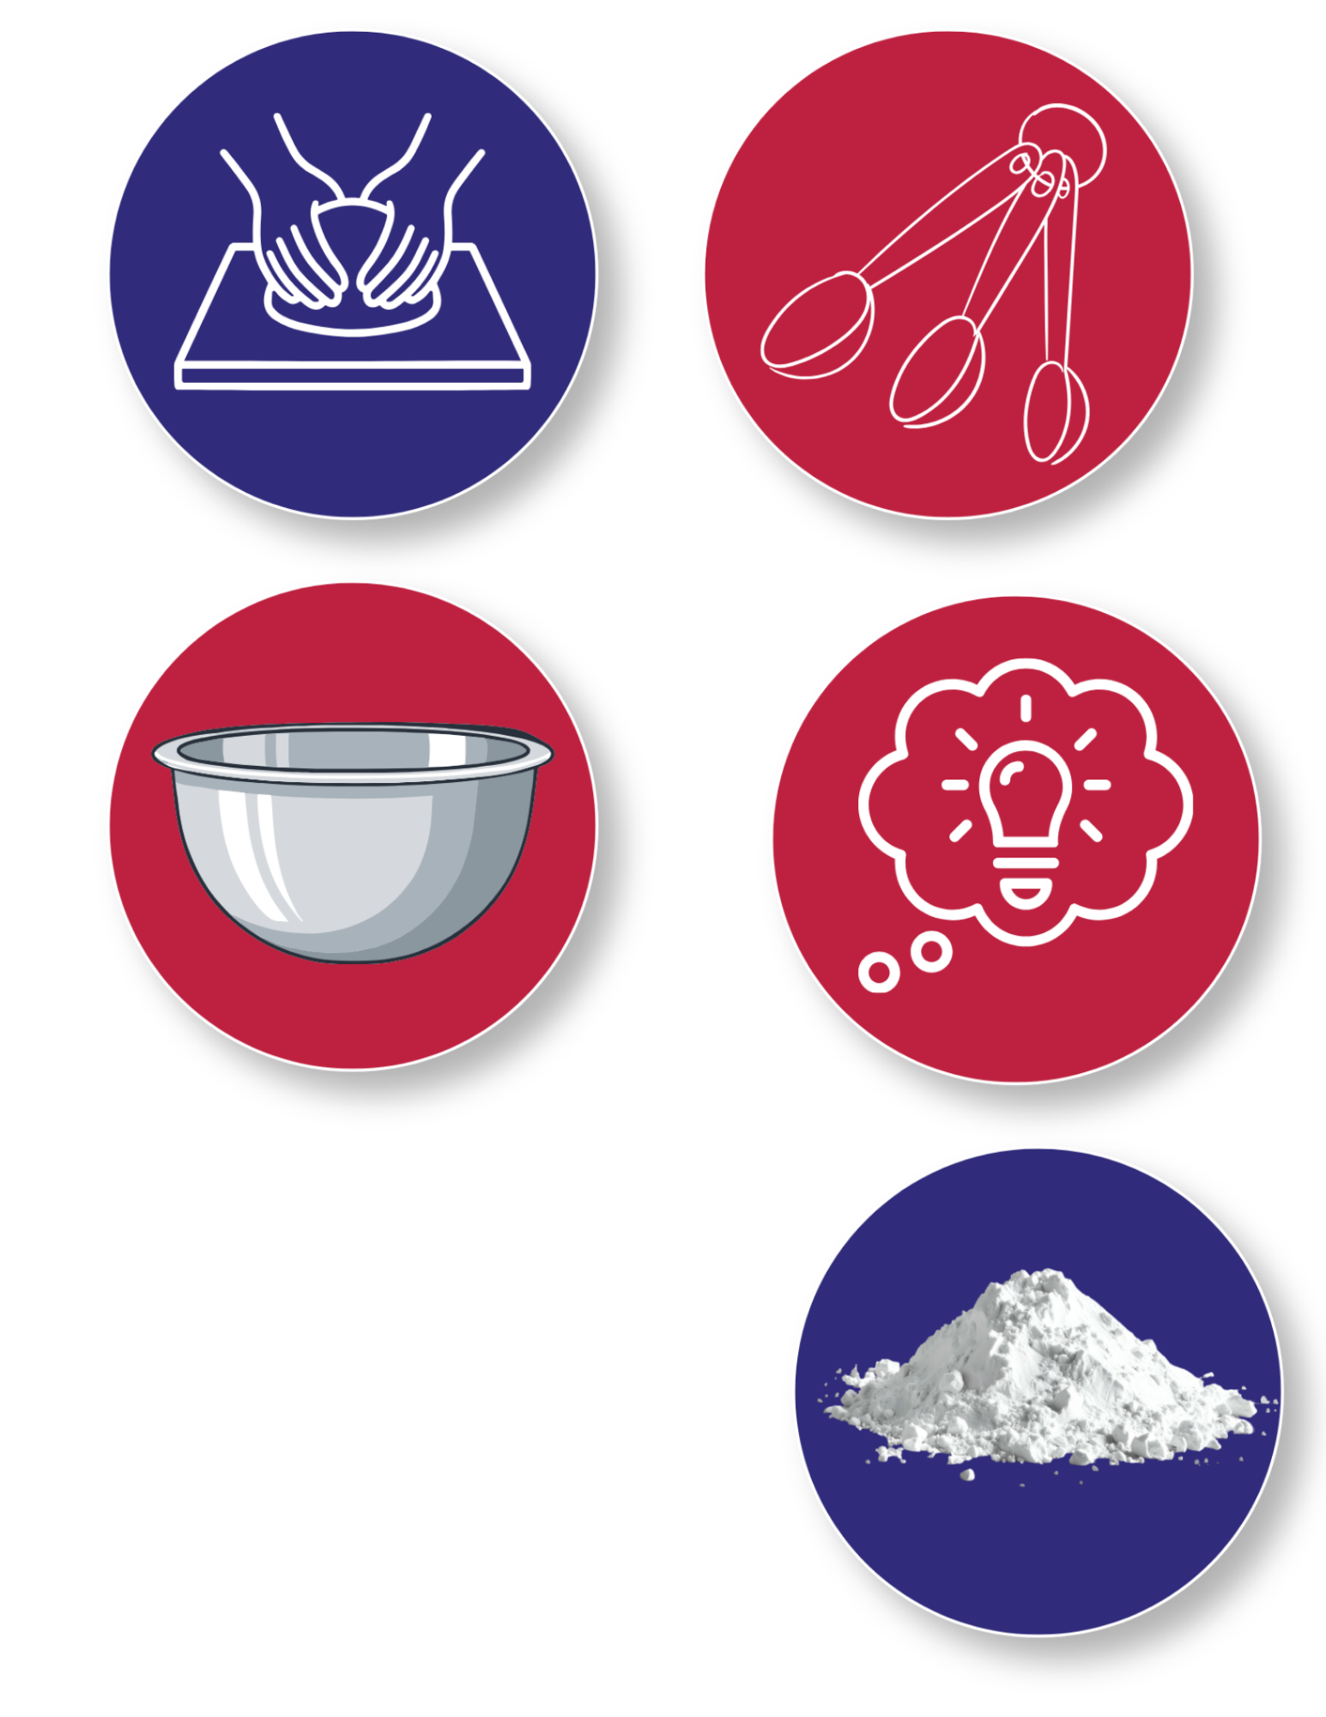
Step 4
Knead the Mixture
Once the glue has begun to separate from the bowl, knead the mixture in your hands until the putty begins to form
4
If your putty is too sticky, briefly dunk the putty back into the Borax solution and continue to knead with your hands until the desired consistency is achieved
5
Take Note:
allowing the putty to spend several minutes in the Borax solution will create a rubbery putty that no longer sticks to itself
Notes:
Knead the mixture
Once the glue has begun to separate from the bowl, knead the mixture in your hands until the putty begins to form
If your putty is too sticky, briefly dunk the putty back into the Borax solution and continue to knead with your hands until the desired consistency is achieved
Note: allowing the putty to spend several minutes in the Borax solution will create a rubbery putty that no longer sticks to itself

Slide 11
Step 5
Compare to the Teacher’s Comparison Batch
After having allowed the students to follow the same steps to create their material, small differences between students’ silly putty may have been observed.
5
The teacher’s “comparison batch” is used to more clearly demonstrate how changing one part of the process can change how a material behaves.
Notes:
Compare to the teacher’s “comparison batch”
After having allowed the students to follow the same steps to create their material, small differences between students’ silly putty may have been observed. The teacher’s “comparison batch” is used to more clearly demonstrate how changing one part of the process can change how a material behaves.

Slide 12
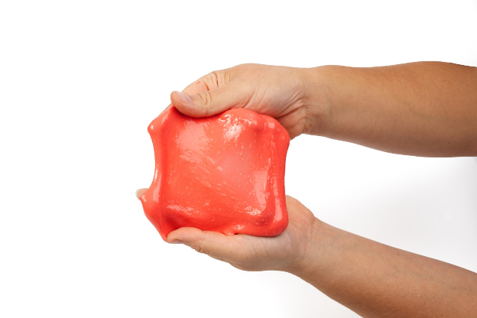
You made a mixture called Silly Putty!

Slide 13

Turn and
TALK TIME
If everyone uses the same ingredients, do you think everyone’s material will turn out exactly the same? Why or why not?
What could happen if a step is skipped or done differently?
How did your material turn out compared to the comparison batch?
Why do you think it might be important to try to make materials turn out the same outcome every time?
Notes:
If everyone uses the same ingredients, do you think everyone’s material will turn out exactly the same? Why or why not?
What could happen if a step is skipped or done differently?
How did your material turn out compared to the comparison batch?
Why do you think it might be important to try to make materials turn out the same outcome every time?

Slide 14
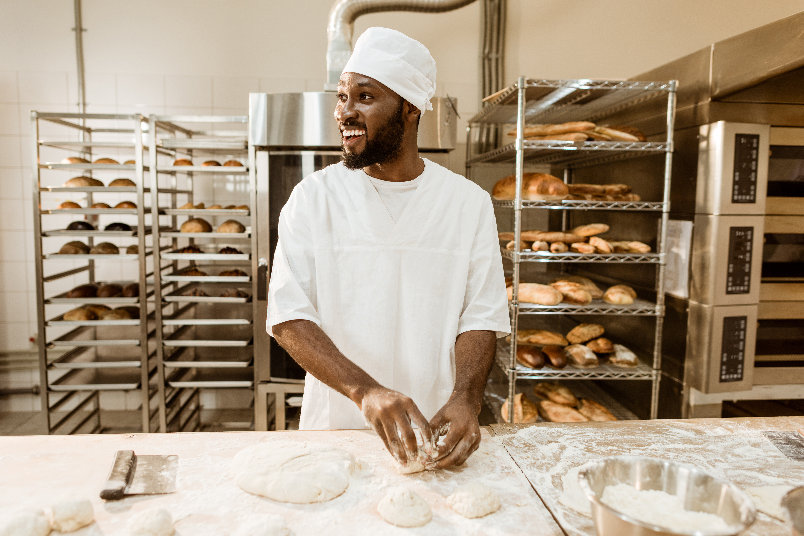


Career Exploration
Factory workers who run machines must carefully control how materials are mixed, heated, or formed.
Small changes in a process can cause big problems if materials don’t turn out the same each time.
Materials technicians help test and compare materials to see how they stretch, bend, or break. If a material doesn’t work the way it should, they help figure out what part of the process needs to change
Engineers decide what a material needs to do before it is made. They help cheese materials and design processes, so products are safe, strong, and reliable.
Some cooks and food developers test recipes again and again to get textures just right: chewy, soft, stretchy, or smooth. They change amounts and timing to control how food materials behave
Notes:
Materials technicians help test and compare materials to see how they stretch, bend, or break. If a material doesn’t work the way it should, they help figure out what part of the process needs to change
Some cooks and food developers test recipes again and again to get textures just right: chewy, soft, stretchy, or smooth. They change amounts and timing to control how food materials behave
Factory workers who run machines must carefully control how materials are mixed, heated, or formed. Small changes in a process can cause big problems if materials don’t turn out the same each time.
Engineers decide what a material needs to do before it is made. They help cheese materials and design processes so products are safe, strong, and reliable.

