Slide 1




Activity Overview
Smart Textiles

Slide 2
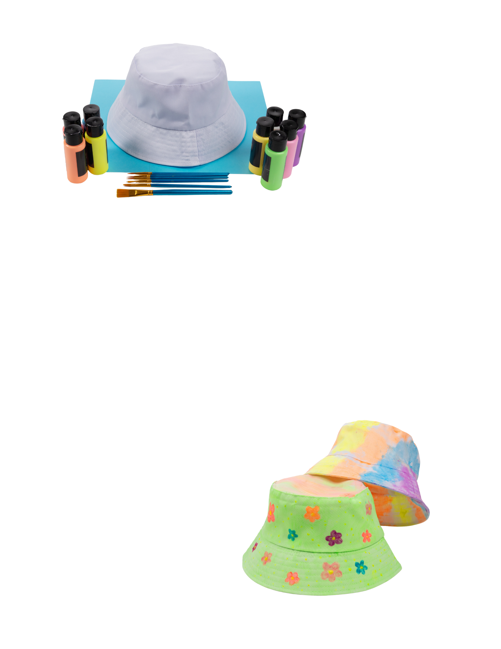


Smart Textiles

Slide 3

Smart Textiles: Designed to Respond
Have you ever seen clothing that changes color or glows in the dark? These changes don’t happen by accident. They are designed.
Smart textiles are fabrics that are made to react to their surroundings. Some smart textiles respond to heat, some respond to light, and others respond to movement. Engineers and manufacturers carefully choose materials that can change in visible ways when something in the environment changes.
In this activity, you are exploring these same ideas. By using glow-in-the-dark paint you will experience how smart textiles are designed to respond to their environment.
Notes:
Have you ever seen clothing that changes color or glows in the dark?
These changes don’t happen by accident. They are designed.
Smart textiles are fabrics that are made to react to their surroundings. Some smart textiles respond to heat, some respond to light, and others respond to movement. Engineers and manufacturers carefully choose materials that can change in visible ways when something in the environment changes.
Many smart materials respond to their environment. Heat from the sun, warmth from your body, or darkness in a room can all cause a smart material to behave differently. Engineers study how materials react to these conditions so they can design fabrics that work the way they want them to.
In advanced manufacturing, people do not just make clothes look nice. They think about what the fabric should do. A shirt might need to change color when it gets hot, glow so it can be seen in the dark, or help keep someone safe. Manufacturers test materials, observe how they respond, and improve designs so the final product works well in real life.
In this activity, you are exploring these same ideas. By using glow-in-the-dark paint you will experience how smart textiles are designed to respond to their environment.
Just like engineers, you will plan a design, test how it works, and think about how materials can be used to solve problems or improve everyday objects.

Slide 4
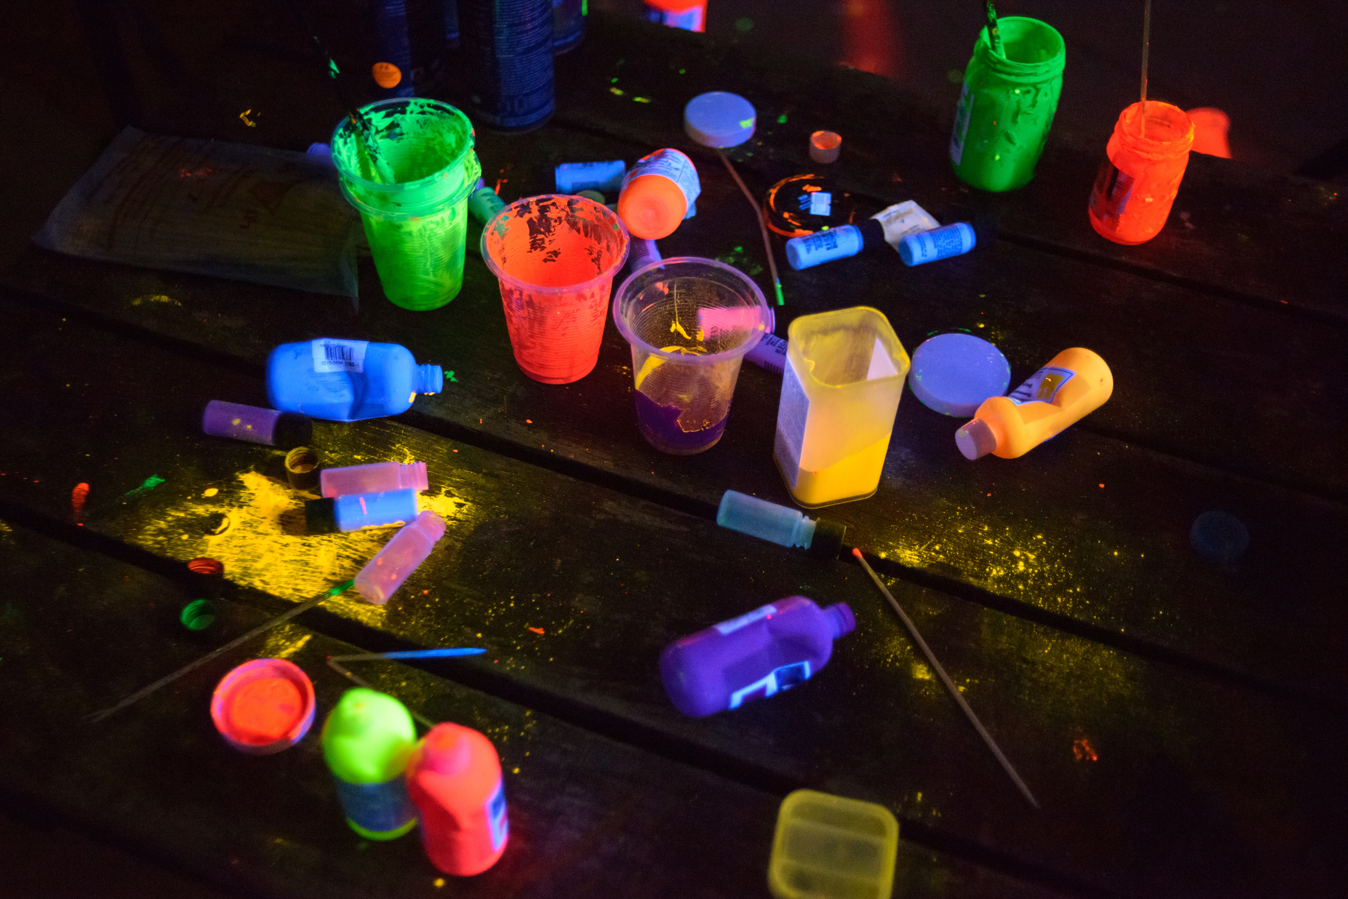

Smart Textiles: Designed to Respond
In advanced manufacturing, people do not just make clothes look nice. They think about what the fabric should do. A shirt might need to change color when it gets hot, glow so it can be seen in the dark, or help keep someone safe.
Manufacturers test materials, observe how they respond, and improve designs so the final product works well in real life.
Just like engineers, you will plan a design, test how it works, and think about how materials can be used to solve problems or improve everyday objects.
Notes:
Have you ever seen clothing that changes color or glows in the dark?
These changes don’t happen by accident. They are designed.
Smart textiles are fabrics that are made to react to their surroundings. Some smart textiles respond to heat, some respond to light, and others respond to movement. Engineers and manufacturers carefully choose materials that can change in visible ways when something in the environment changes.
Many smart materials respond to their environment. Heat from the sun, warmth from your body, or darkness in a room can all cause a smart material to behave differently. Engineers study how materials react to these conditions so they can design fabrics that work the way they want them to.
In advanced manufacturing, people do not just make clothes look nice. They think about what the fabric should do. A shirt might need to change color when it gets hot, glow so it can be seen in the dark, or help keep someone safe. Manufacturers test materials, observe how they respond, and improve designs so the final product works well in real life.
In this activity, you are exploring these same ideas. By using glow-in-the-dark paint you will experience how smart textiles are designed to respond to their environment.
Just like engineers, you will plan a design, test how it works, and think about how materials can be used to solve problems or improve everyday objects.

Slide 5
Key Words to Know
Smart Textile
Fabric materials that contain special structures or materials that allow the fabric to react to changes in the environment, such as heat or light
Technology
The application of scientific knowledge for practical purposes, helping people solve problems or improve everyday objects
Design
A plan for how something will look or work to solve a problem or meet a need
Material
What something is made of; engineers choose materials based on how they behave and what they can do
Notes:
Smart Textile: Fabric materials that contain special structures or materials that allow the fabric to react to changes in the environment, such as heat or light
Technology: The application of scientific knowledge for practical purposes, helping people solve problems or improve everyday objects
Design: A plan for how something will look or work in order to solve a problem or meet a need
Material: What something is made of; engineers choose materials based on how they behave and what they can do

Slide 6
Today’s Materials
Paint Brush
Bucket Hat
Glow in the Dark Paint

Slide 7

Step 1
Preparation and Material Distribution
If desired, cover student workspaces with paper or cardboard to help protect desks and tables
1
Each student should have 1 brush, 1 bucket hat, and access to share the glow-in-the-dark paint with others
2
Notes:
Step 1: Preparation and Material Distribution
If desired, cover student workspaces with paper or cardboard to help protect desks and tables
Each student should have 1 brush, 1 bucket hat, and access to share the glow-in-the-dark paint with others

Slide 8

Step 2
Time to Design!
Design the smart textile and allow the paint to dry
3
Notes:
Step 2: Design the smart textile and allow the paint to dry

Slide 9
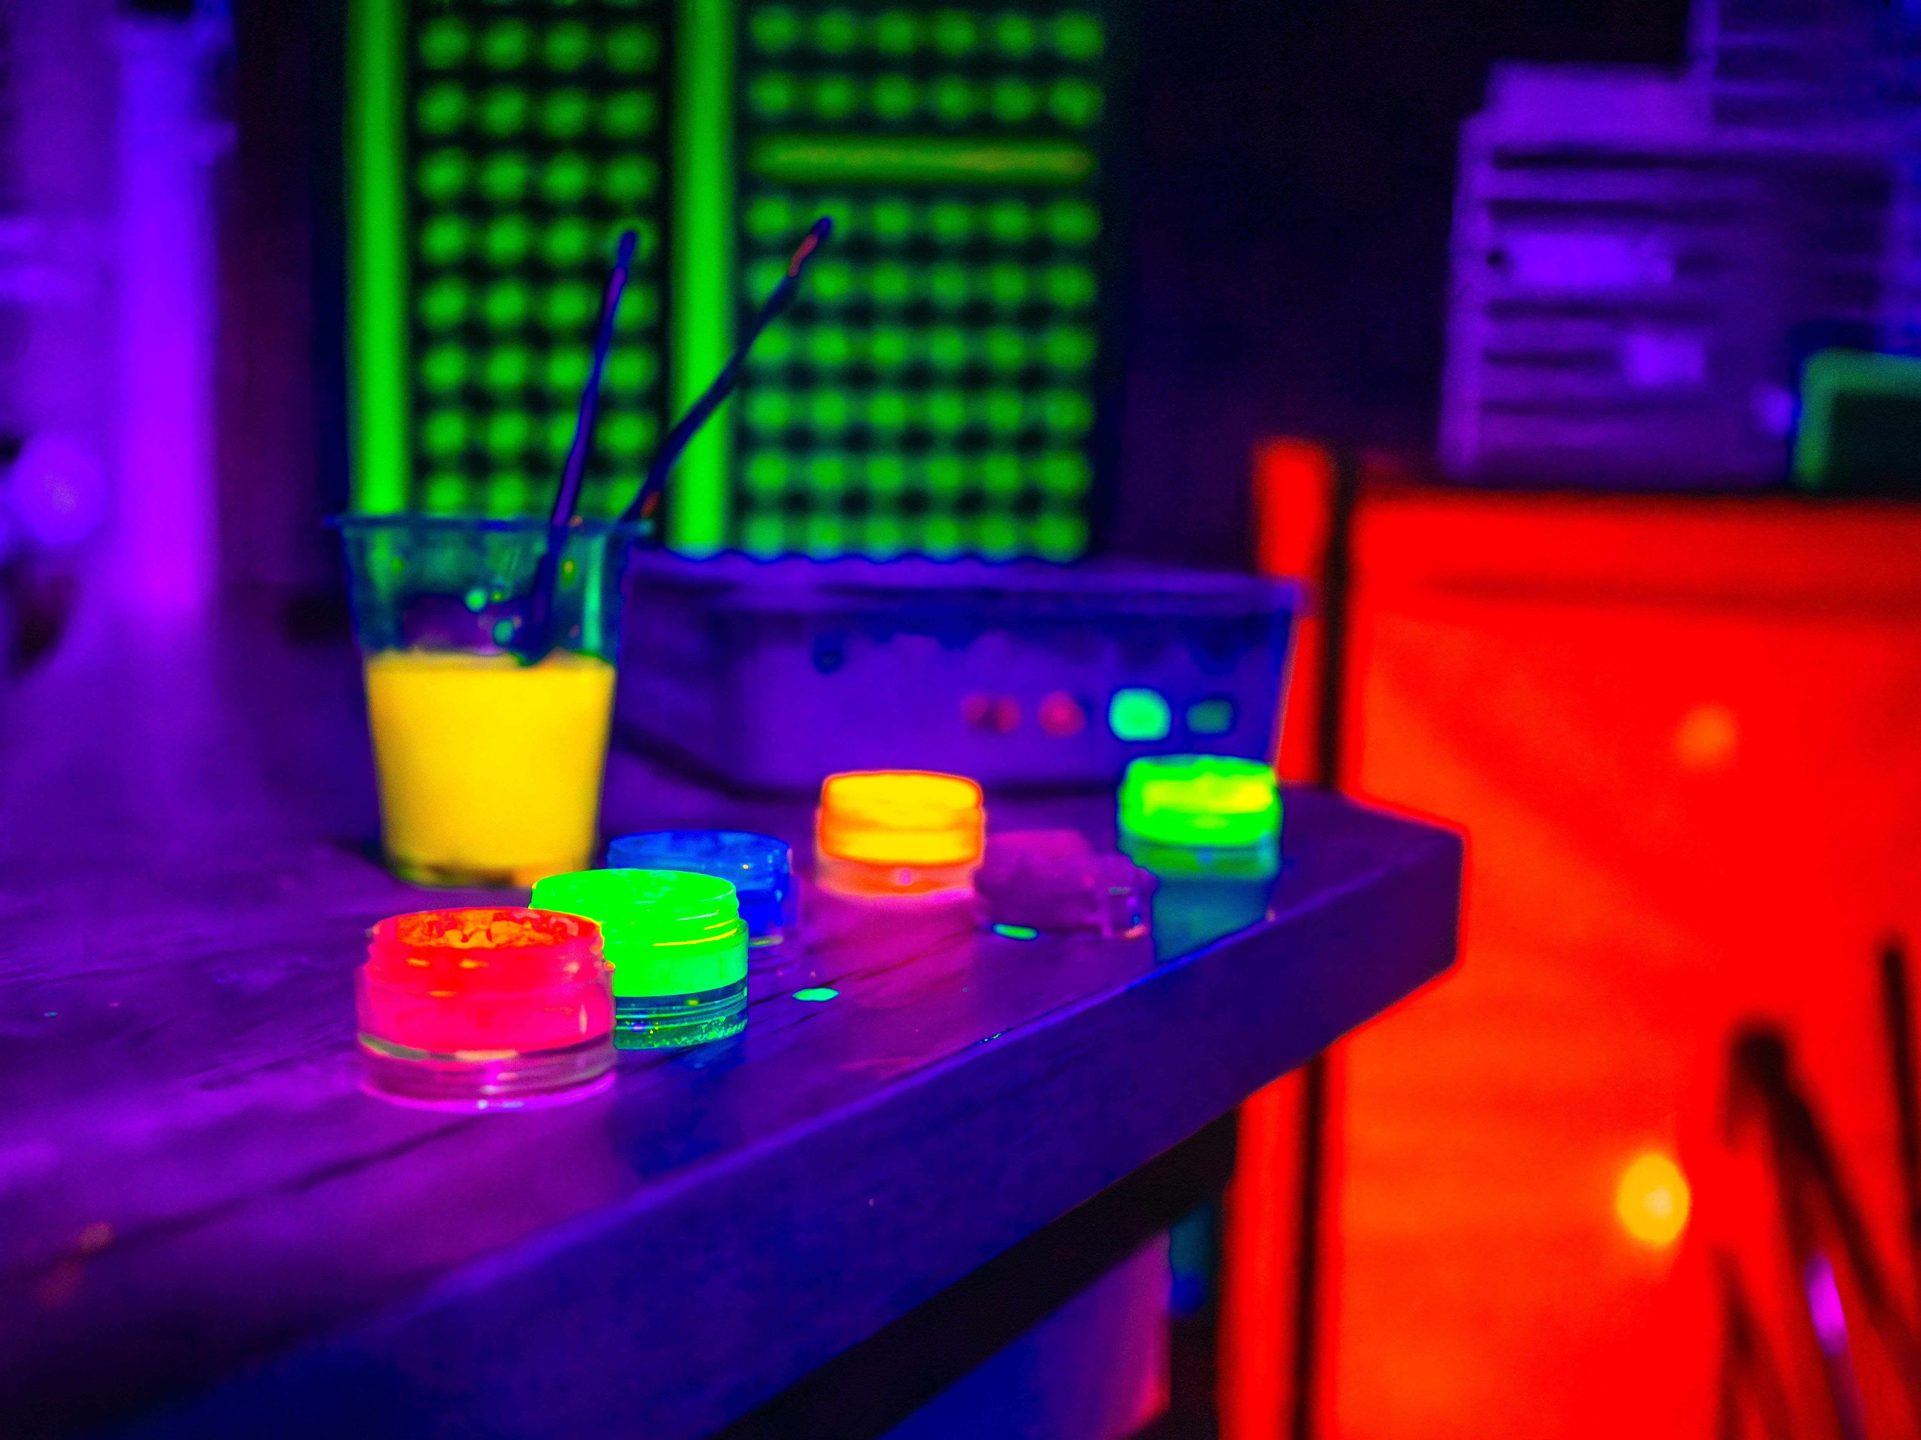
Step 3
Test the Smart Textile
Glow-in-the-dark paint works similarly to a flashlight battery. Before the students’ textiles can be tested, they will need to spend some time under some lights, or the sun.
4
Notes:
Step 3: Test the Smart Textile
Glow-in-the-dark paint works similarly to a flashlight battery. Before the students’ textiles can be tested, they will need to spend some time under some lights, or the sun.

Slide 10

Turn and
TALK TIME
How did your smart textile behave differently from regular clothing?
Why might someone want to use smart materials, like glow-in-the-dark paint?
How could glowing clothing help keep people safe?
What other materials do you think could be added to clothing to make it “smart”?
Notes:
How did your smart textile behave differently from regular clothing?
Why might someone want to use smart materials, like glow-in-the-dark paint?
How could glowing clothing help keep people safe?
What other materials do you think could be added to clothing to make it “smart”?

Slide 11
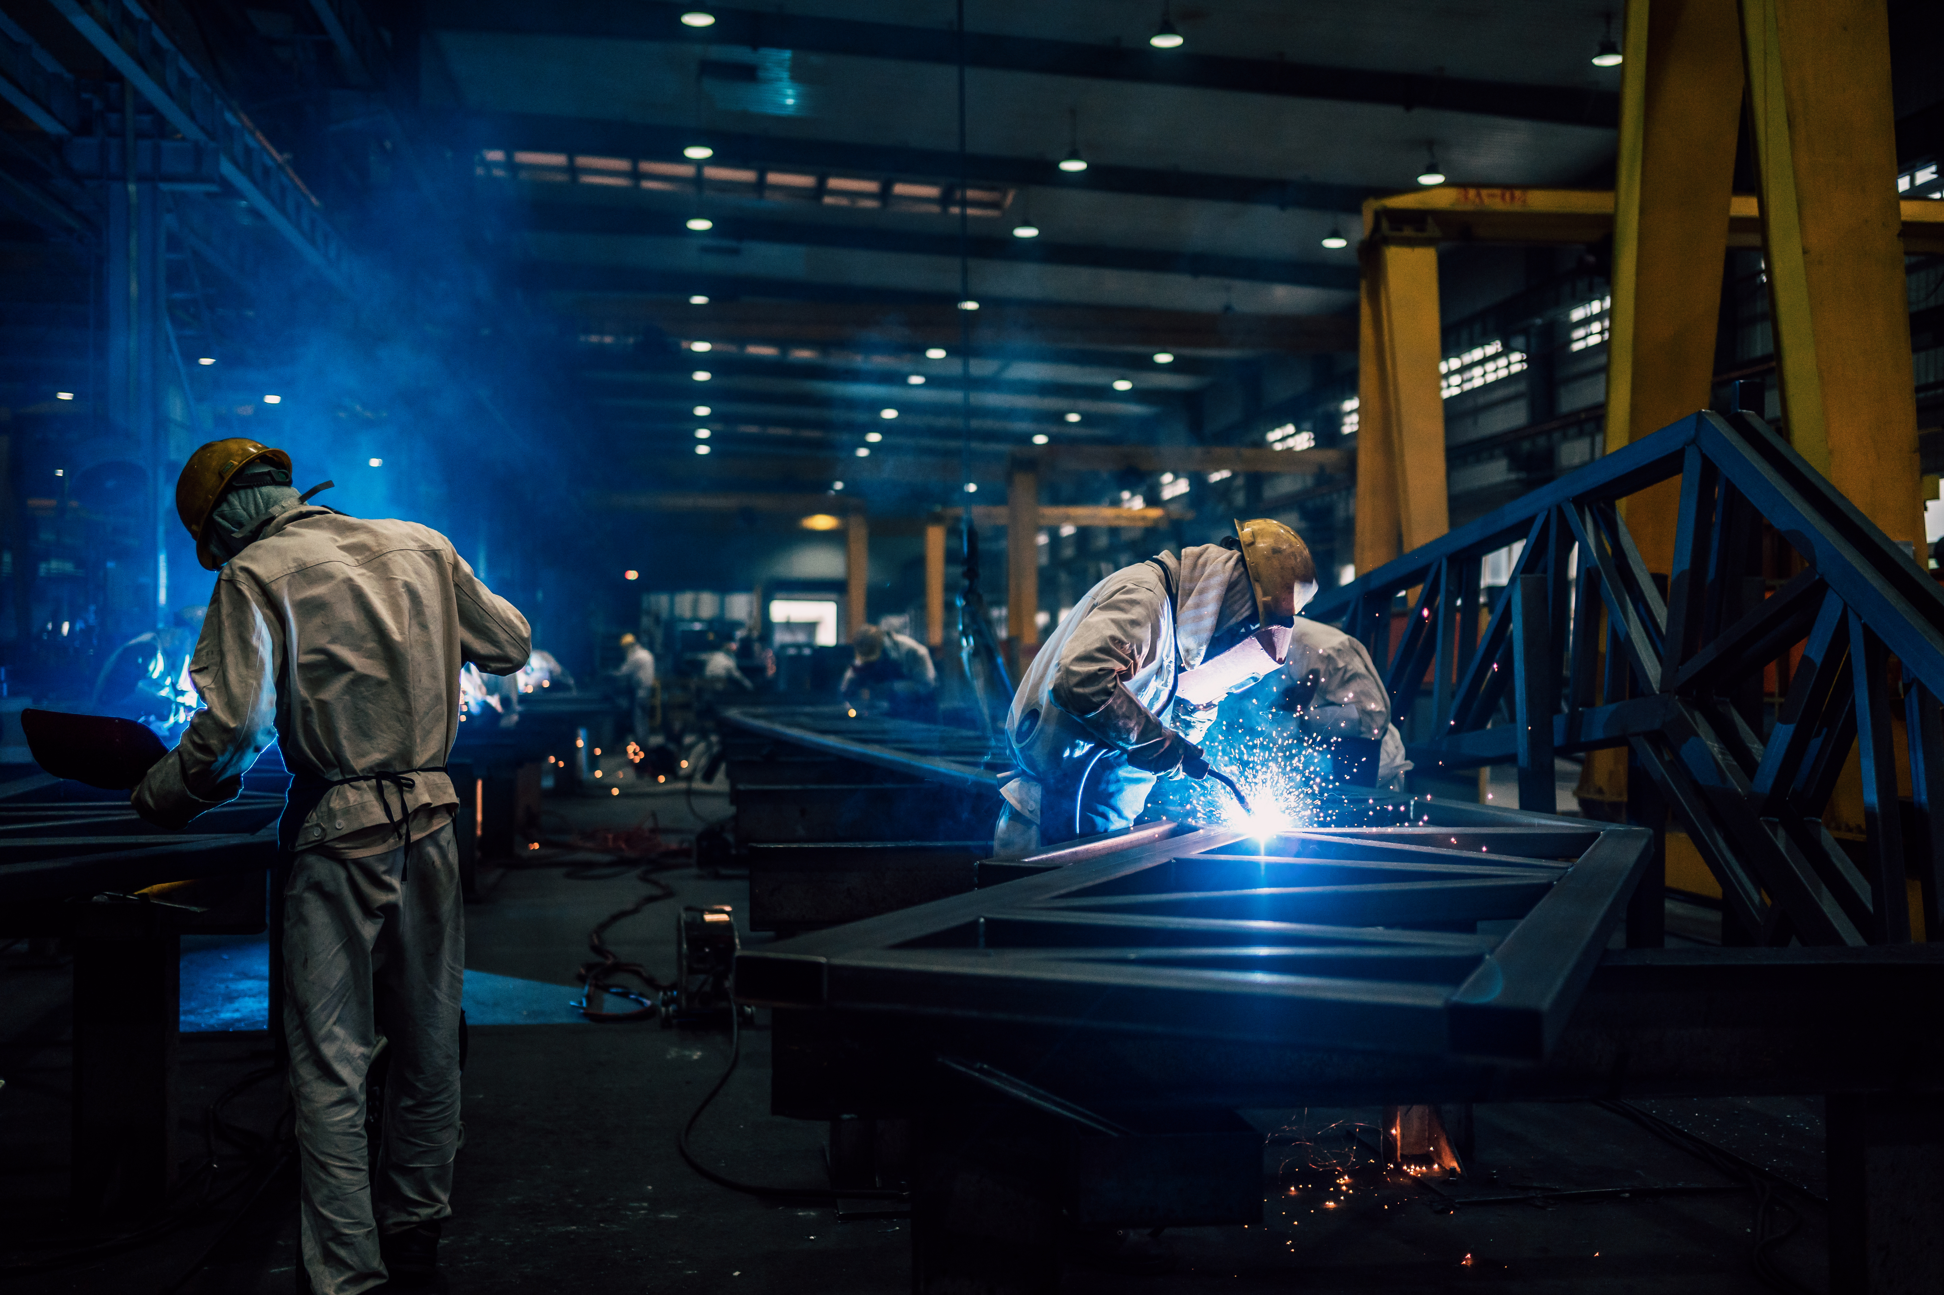

What Careers Did We Explore Today?
Clothing designers sometimes choose smart materials that reduce sweat, increase airflow, glow in the dark, or even light up
Materials testers check materials to see how they react to things like light or movement. They test materials to make sure they work the way they should
Technology designers think about new ways to add special features to everyday items. They help decide when something should glow, shine, or stand out
Factory workers rely on smart materials that may reflect light, glow, or make sound to alert them to potential danger
Notes:
Clothing designers sometimes choose smart materials that reduce sweat, increase airflow, glow in the dark, or even light up
Materials testers check materials to see how they react to things like light or movement. They test materials to make sure they work the way they should
Technology designers think about new ways to add special features to everyday items. They help decide when something should glow, shine, or stand out
Factory workers rely on smart materials that may reflect light, glow, or make sound to alert them to potential danger

