Slide 1




Activity Overview
Stick Structures

Slide 2

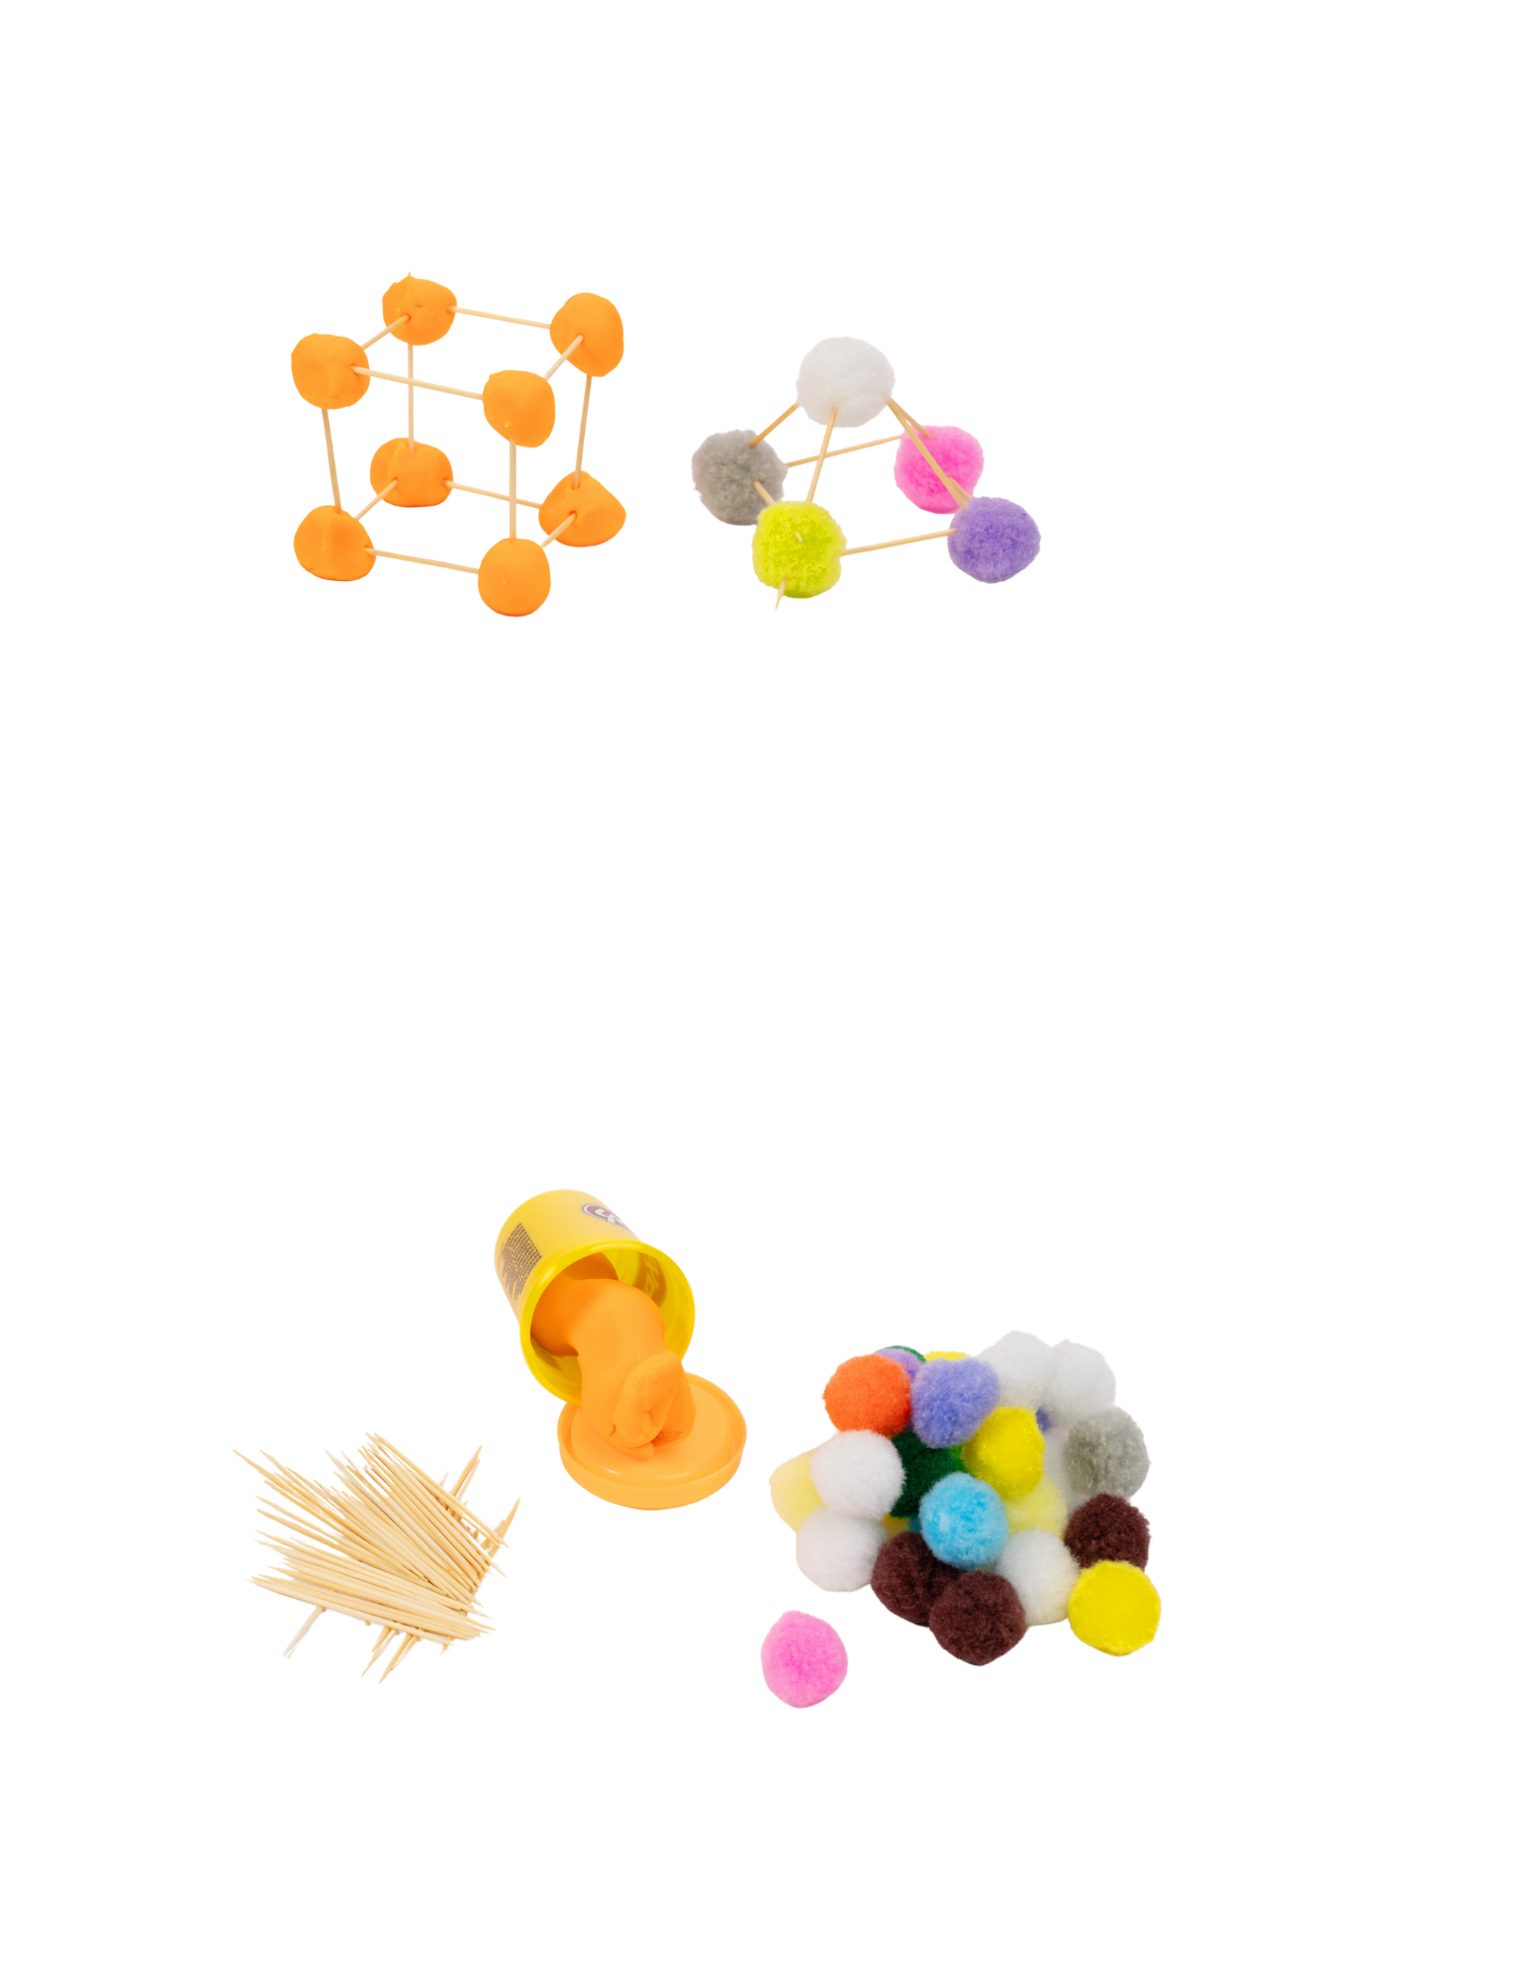

Stick Structures

Slide 3
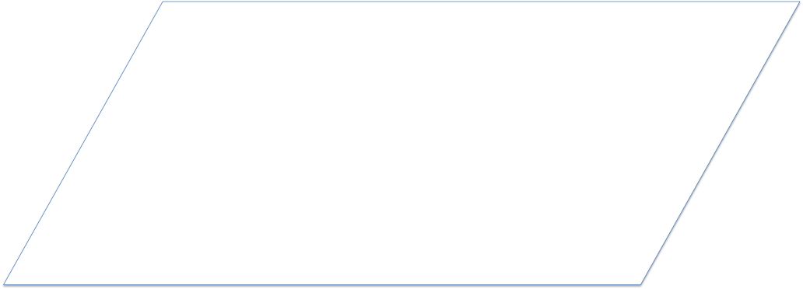
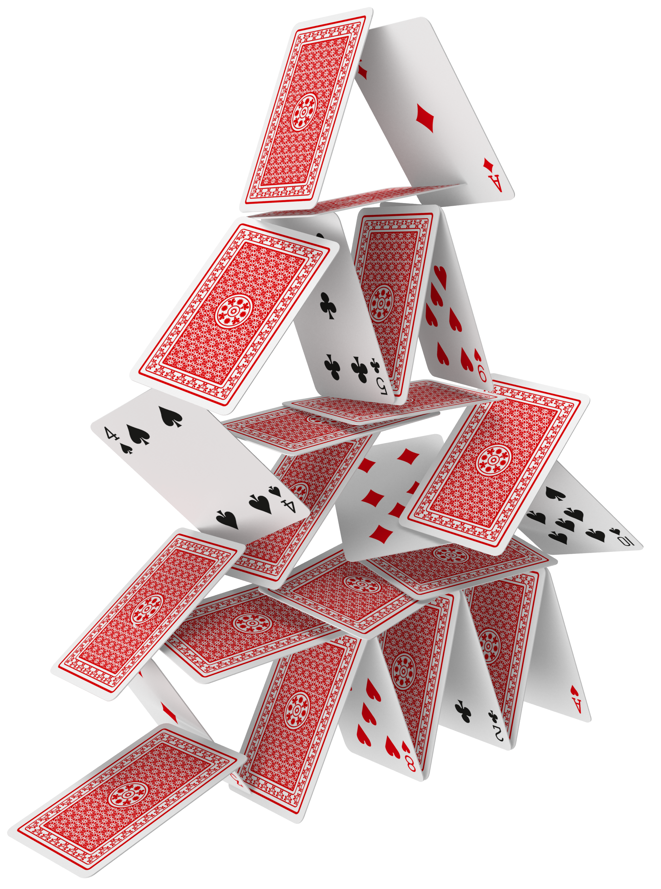
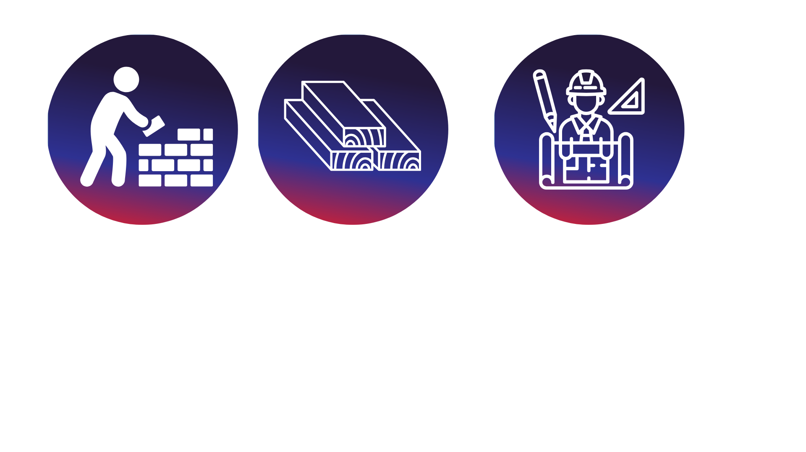
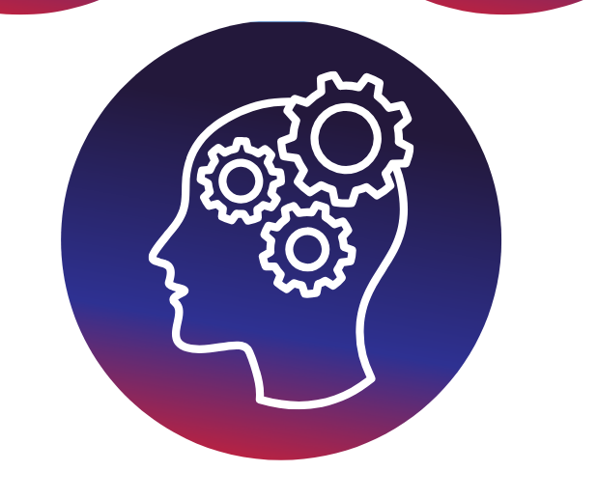
Materials Matter!
Have you ever built something fall and watched it fall over? Some structures stand up easily, and others need to be changed to stay standing.
Builders use shapes to make structures, like towers and bridges. Flat shapes can be connected and built upward to make structures that have height. How shapes are stacked and connected can help a structure stay standing.
In this activity, you will build using pom-poms and play dough to see how different materials affect the balance and strength
of your structure.
Materials matter, too. Some materials are soft and squishy, and other materials are more firm, and hold their shape.
As you build, test, and make changes, you will notice which shapes and materials help your structure stand up better. Builders and engineers do the same thing when they design and improve real structures.
Notes:
Have you ever built something fall and watched it fall over? Some structures stand up easily, and others need to be changed to stay standing.
Builders use shapes to make structures, like towers and bridges. Flat shapes can be connected and built upward to make structures that have height. How shapes are stacked and connected can help a structure stay standing.
Materials matter, too. Some materials are soft and squishy, and other materials are more firm, and hold their shape. In this activity, you will build using pom-poms and play dough to see how different materials affect the balance and strength of your structure.
As you build, test, and make changes, you will notice which shapes and materials help your structure stand up better. Builders and engineers do the same thing when they design and improve real structures.

Slide 4
Key Words to Know
Something that is built or put together using different parts, like a tower or bridge
STRUCTURE
SHAPES
The form of something, such as a triangle or square
BALANCE
How something stays steady without tipping or falling
CORNER
A place where two or more parts meet
Notes:
Structure - Something that is built or put together using different parts, like a tower or bridge
Shapes – The form of something, such as a triangle or square
Balance – How something stays steady without tipping or falling
Corner – A place where two or more parts meet

Slide 5
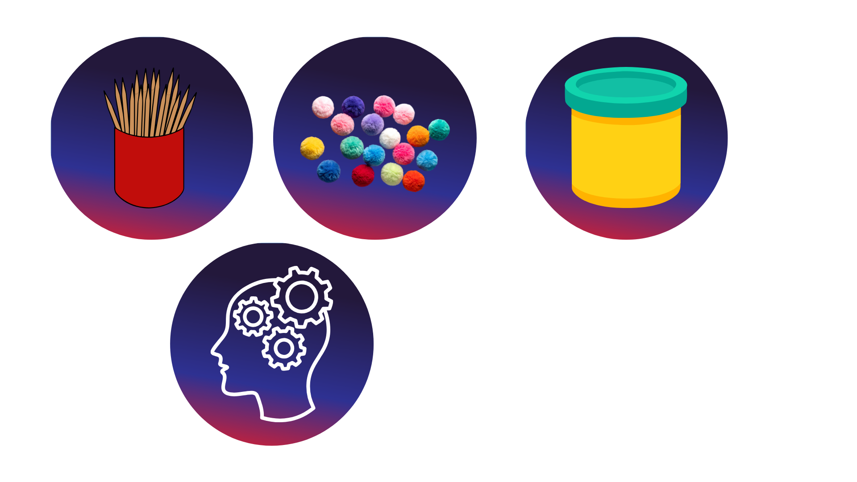
Today’s Materials
40 Toothpicks
40 Pom-Poms
Playdough
Notes:
Up to 40 toothpicks
Up to 40 pom-poms
Materials Supplied (for sharing)
Play dough (for rolling into small dough balls)

Slide 6
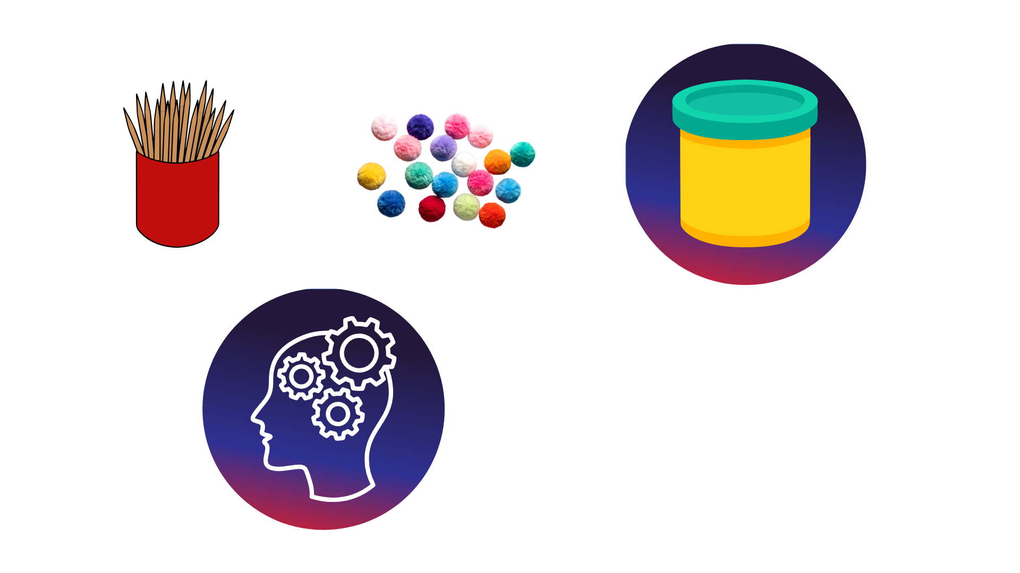
Step 1
Make the Base
Give each student three pom-poms (or three small play dough balls) and three toothpicks
1
Place the three pom-poms or play dough balls on the table in a triangle shape
2
Push one toothpick between each pair of pom-poms or play dough balls to connect them
3
Notes:
Make the Base
Give each student three pom-poms (or three small play dough balls) and three toothpicks
Place the three pom-poms or play dough balls on the table in a triangle shape
Push one toothpick between each pair of pom-poms or play dough balls to connect them

Slide 7
Step 2
Add Height
Give students three more pom-poms or play dough balls and six more toothpicks
Push a pom-pom or play dough ball into the top of each vertical toothpick
4
6
Push a toothpick upwards out of each pom-pom or play dough corner of the base
Connect the new layer of pom-poms or play dough balls by pushing toothpicks between each of them
5
7
Notes:
Add Height
Give students three more pom-poms or play dough balls and six more toothpicks
Push a toothpick upwards out of each pom-pom or play dough corner of the base
Push a pom-pom or play dough ball into the top of each vertical toothpick
Connect the new layer of pom-poms or play dough balls by pushing toothpicks between each of them

Slide 8
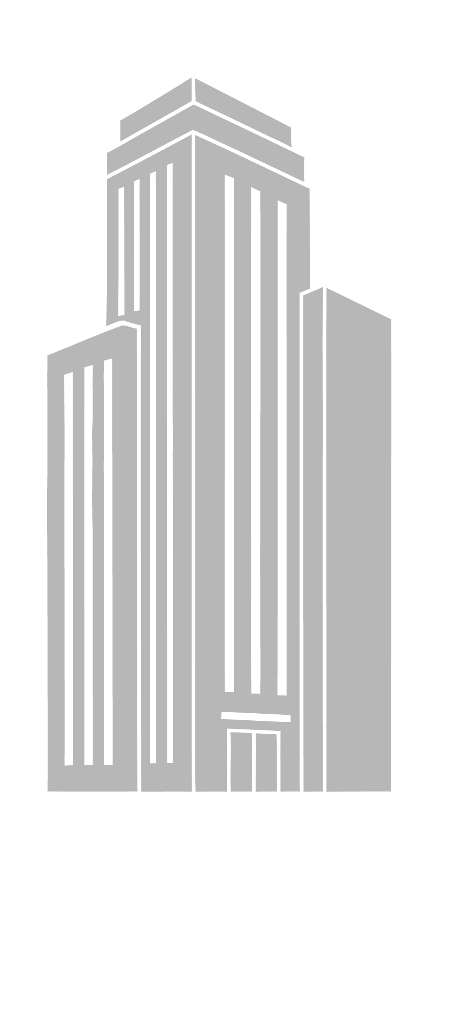
Step 3
Go Higher!
Repeat Step 2 to make the structure taller
8
Notes:
Repeat Step 2 to make the structure taller

Slide 9
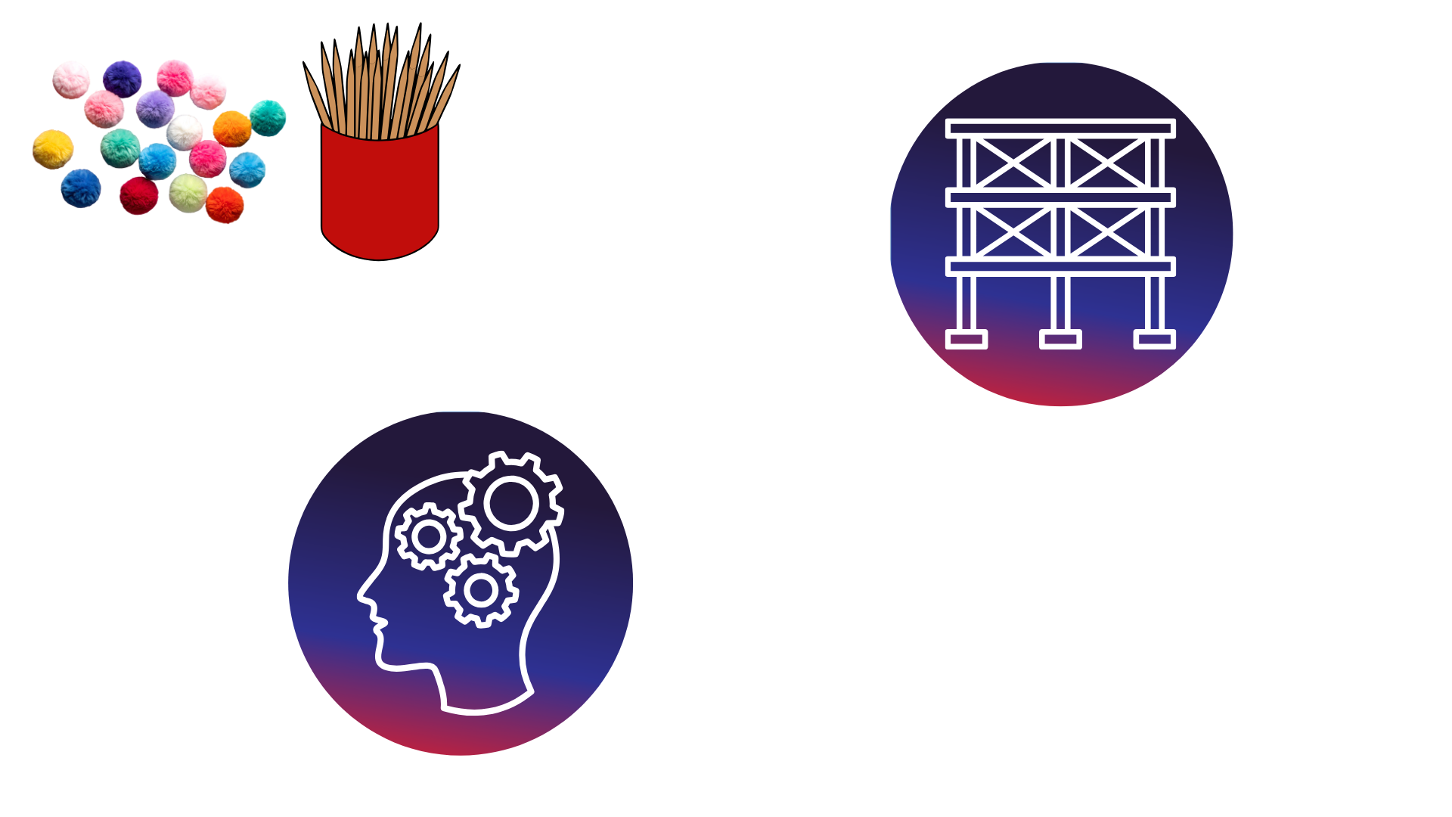
Free Build Time!
Now that students have the basics of making a 3-dimensional structure using corners and connectors down, it is their turn to design their own structures.
Their structure should stand on its own and have connected pieces.
Notes:
Free Build
Now that students have the basics of making a 3-dimensional structure using corners and connectors down, it is their turn to design their own structures. Their structure should stand on its own and have connected pieces.

Slide 10
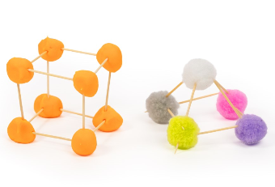
You just created a stick structure!

Slide 11

Turn and
TALK TIME
What did you build?
What helped your structure stay standing?
Was there anything that made your structure fall or lean?
Which shapes did you use to build your structure?
Notes:
What did you build?
What helped your structure stay standing?
Was there anything that made your structure fall or lean?
Which shapes did you use to build your structure?

Slide 12
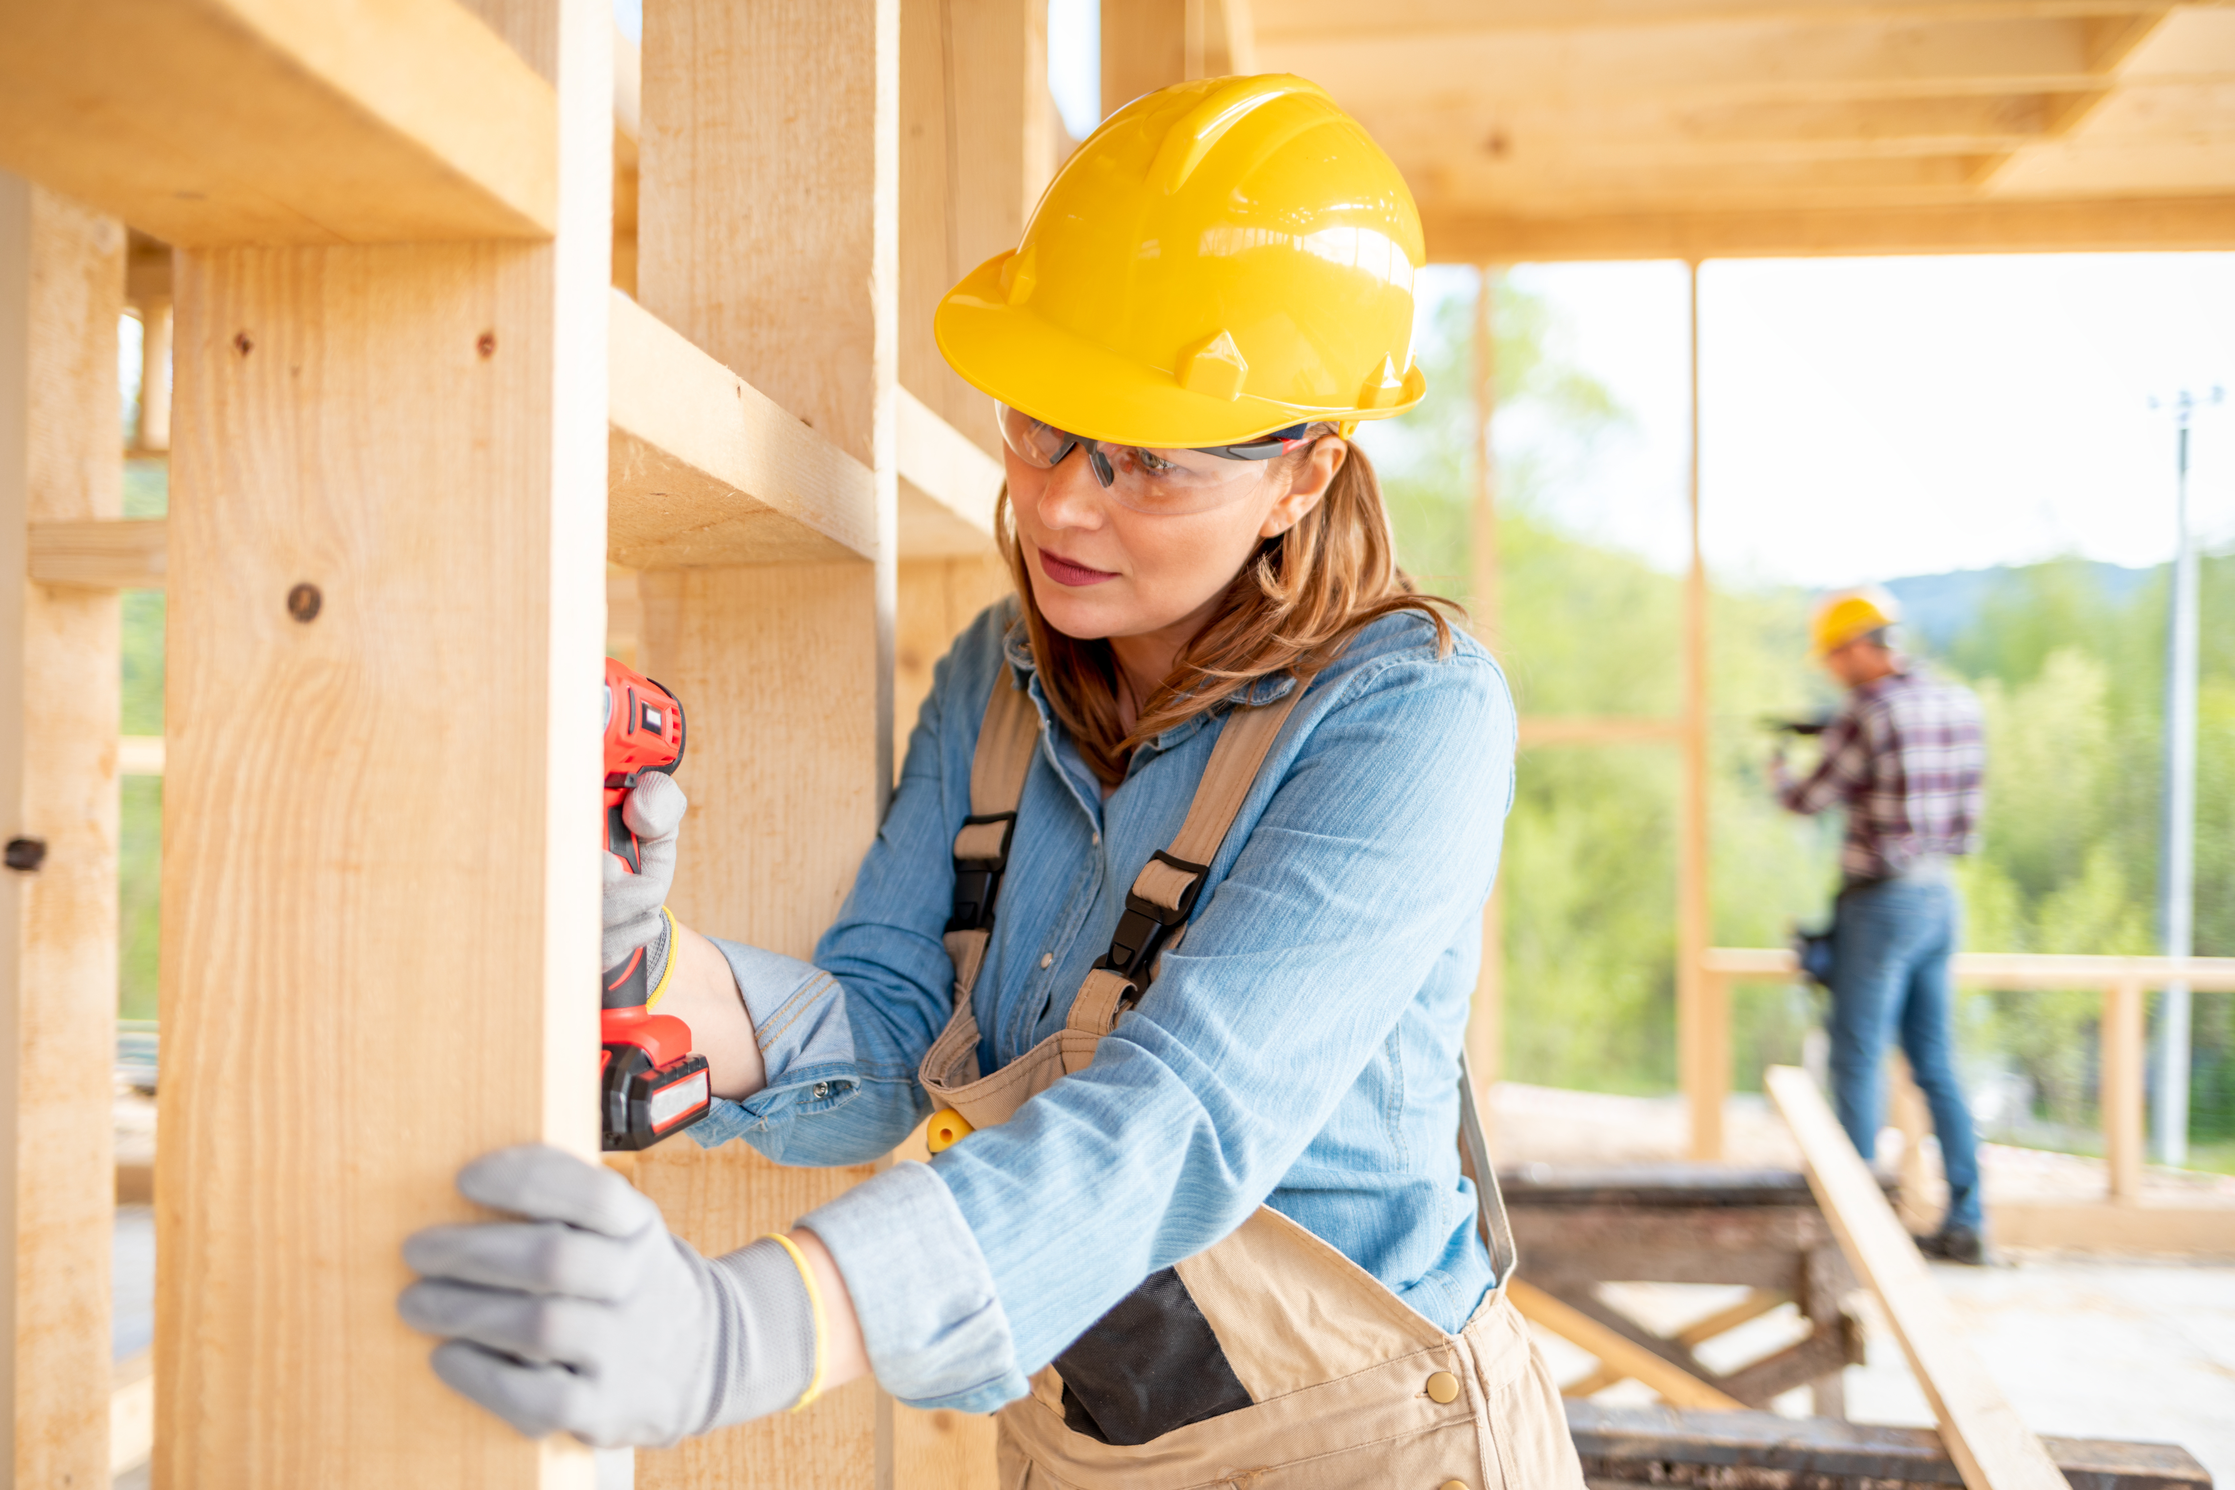

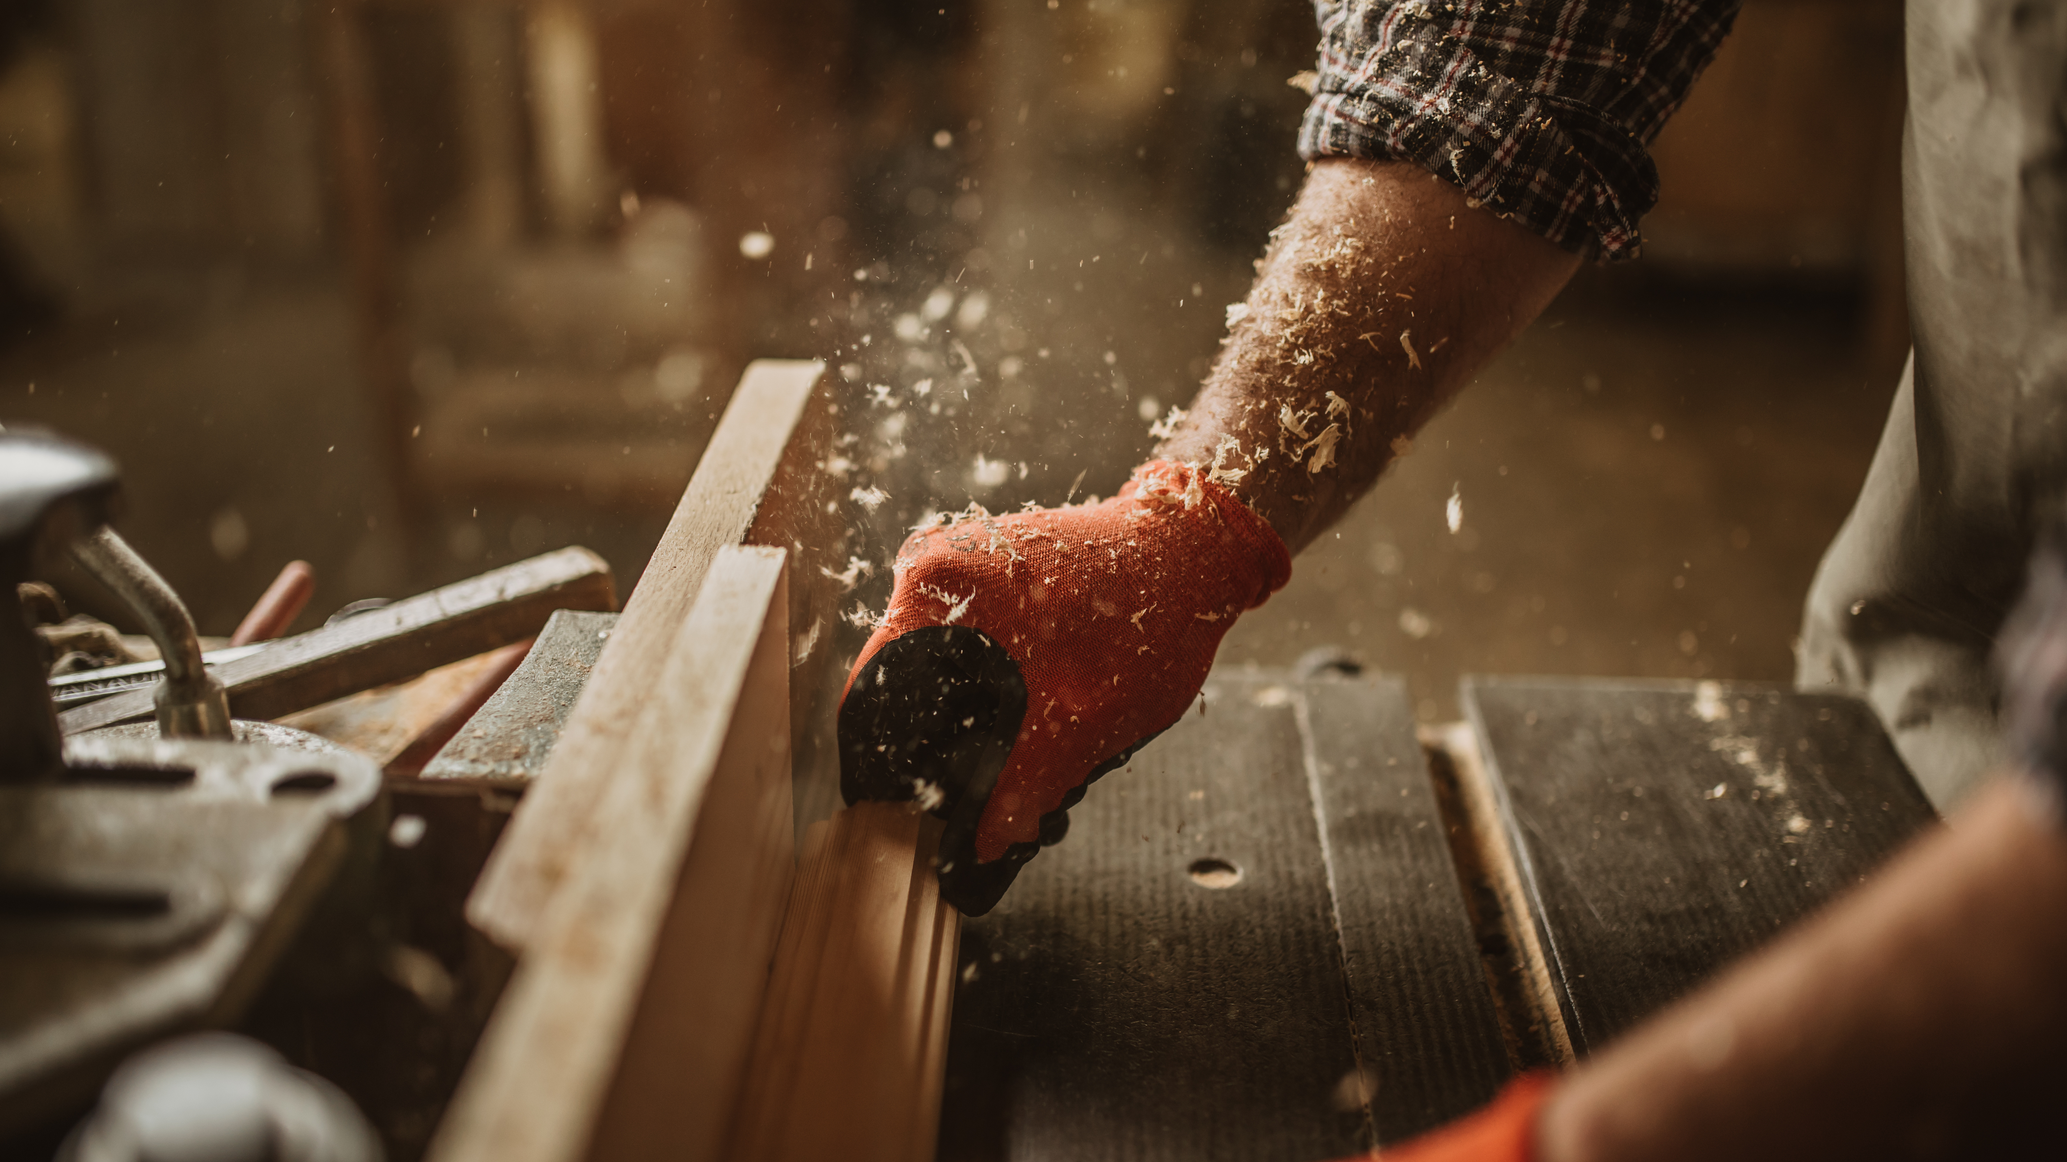
What Careers Did We Explore Today?
Builders and construction workers connect pieces together to make sure buildings do not fall over. They pay attention to corners and how parts are joined
Designers and engineers decide what shapes to use when building things. They test their ideas and change them if something tips or falls
Woodworkers build things out of wood, and carefully consider corners, connections, and balance when making things
Notes:
Builders and construction workers connect pieces together to make sure buildings do not fall over. They pay attention to corners and how parts are joined
Designers and engineers decide what shapes to use when building things. They test their ideas and change them if something tips or falls
Woodworkers build things out of wood, and carefully consider corners, connections, and balance when making things

