Slide 1




Activity Overview
The Reel Machine

Slide 2

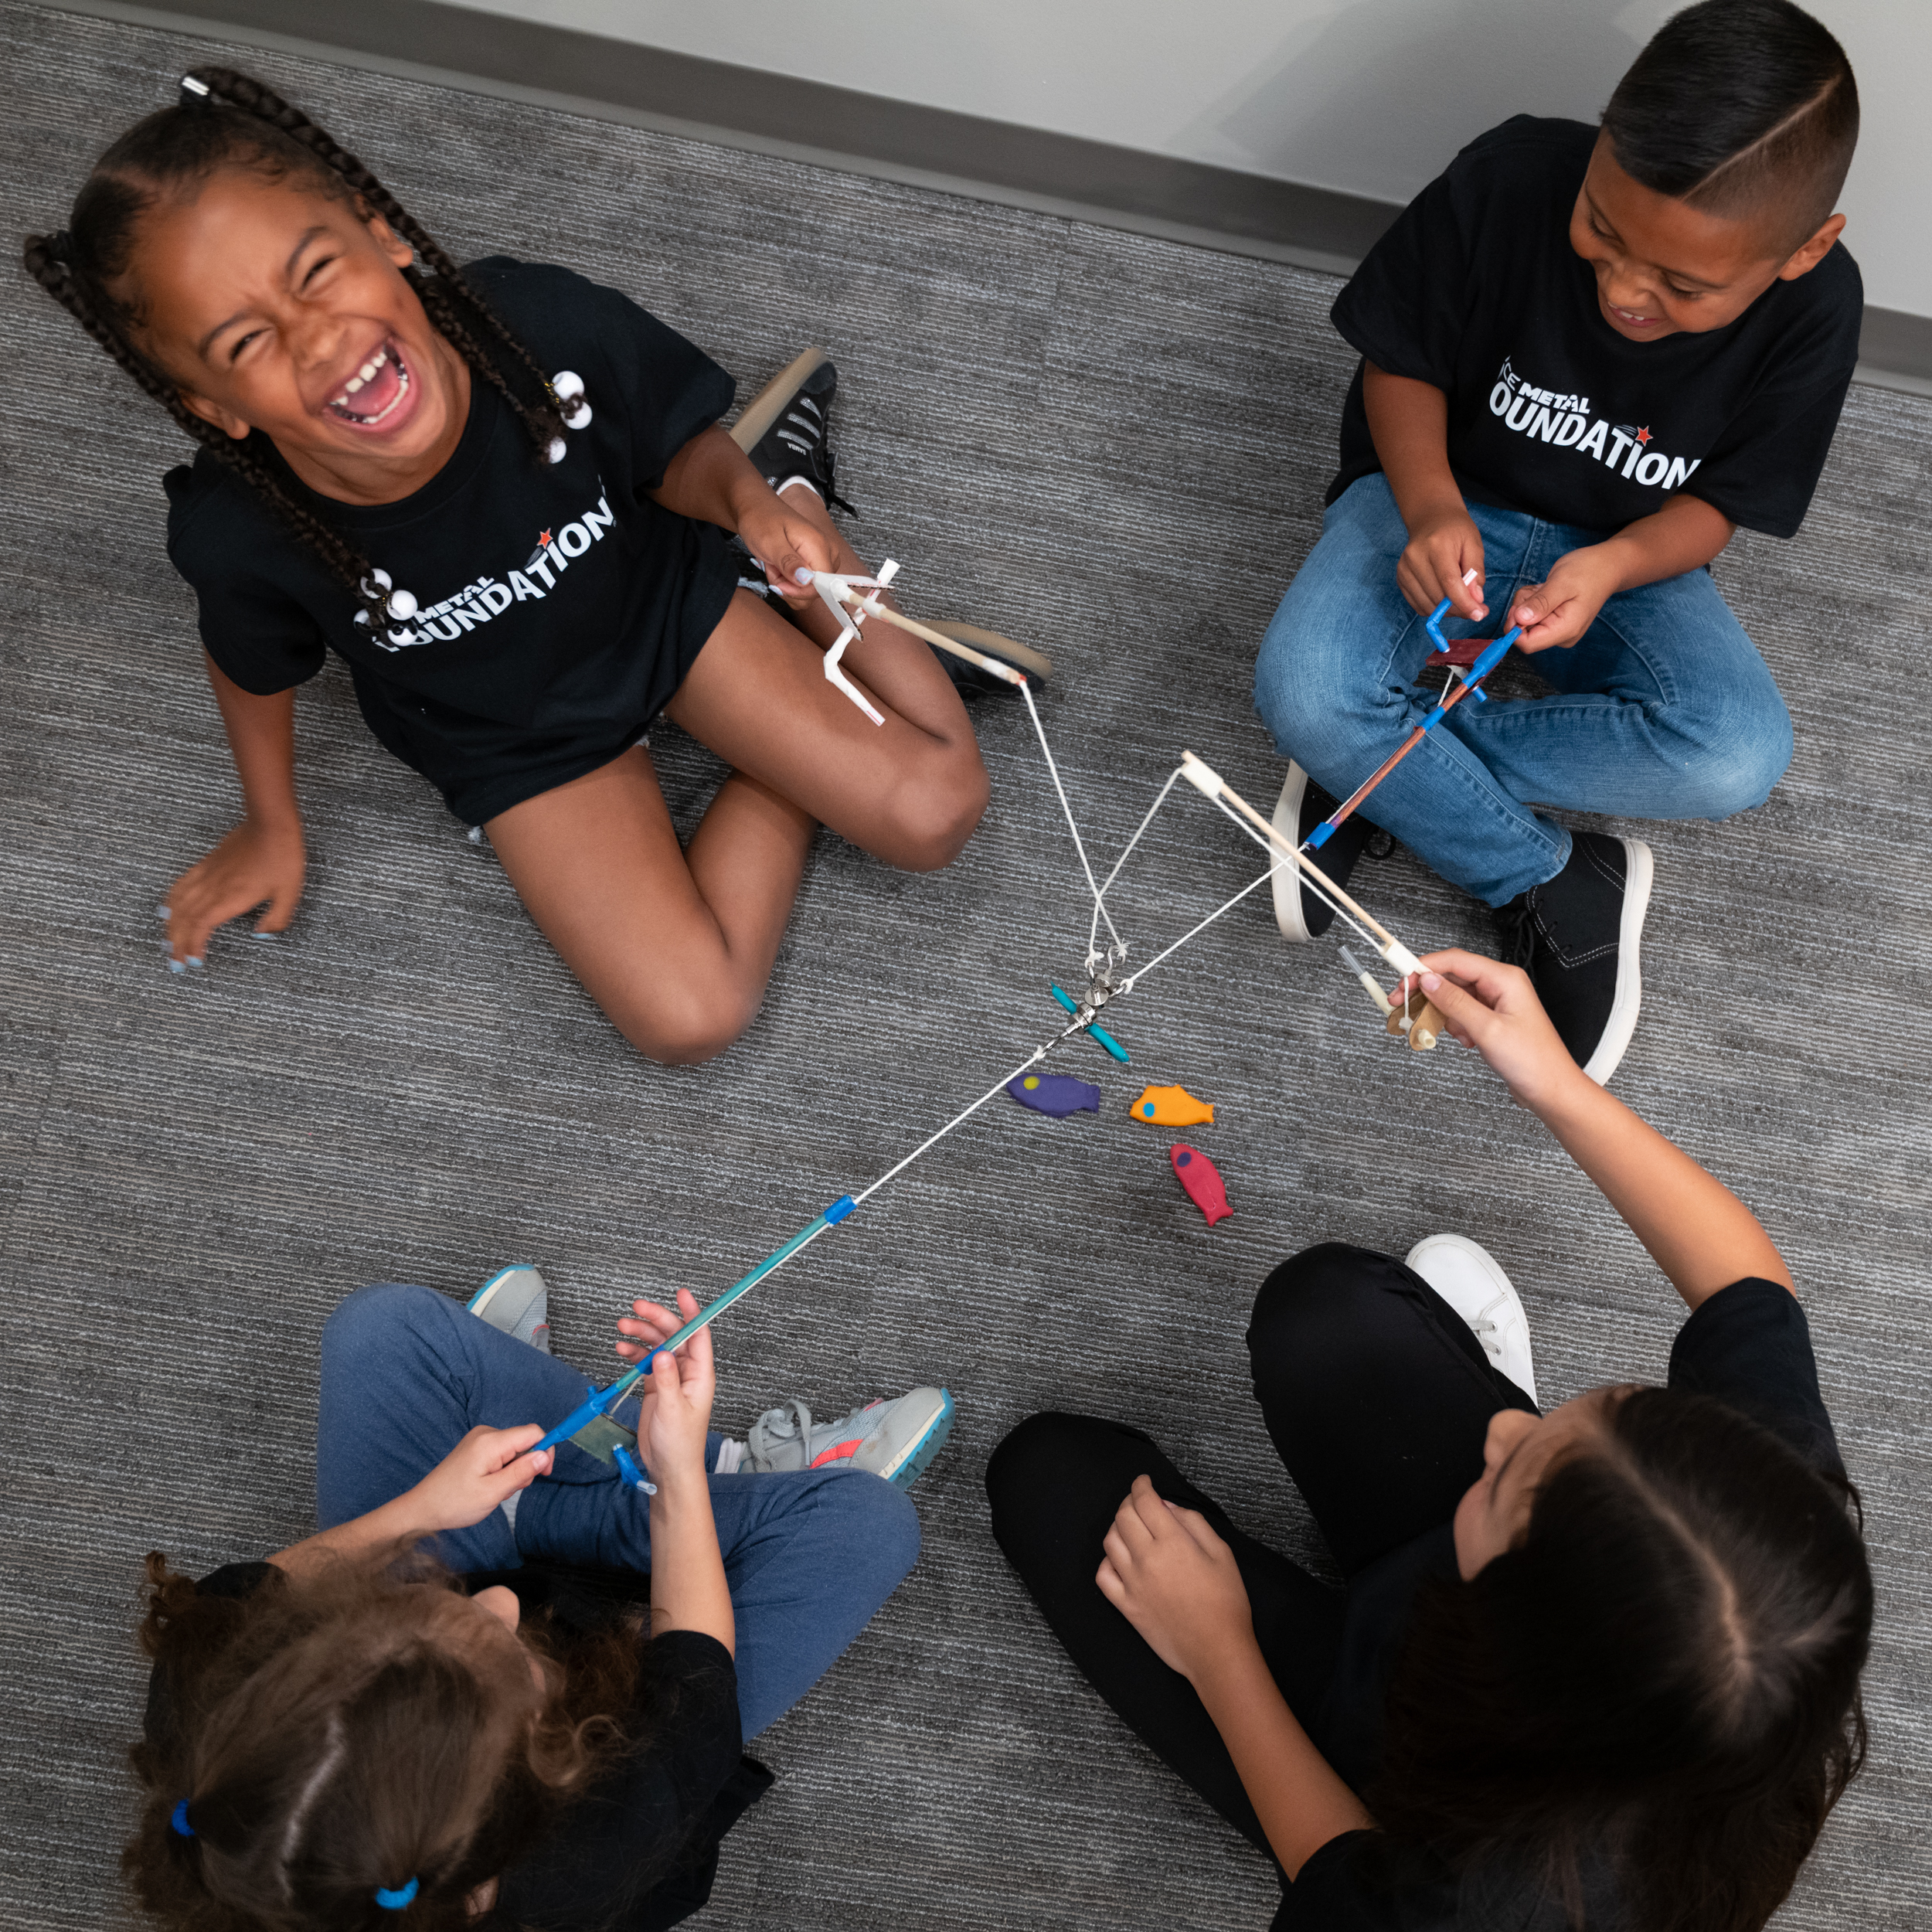


The Reel Machine

Slide 3
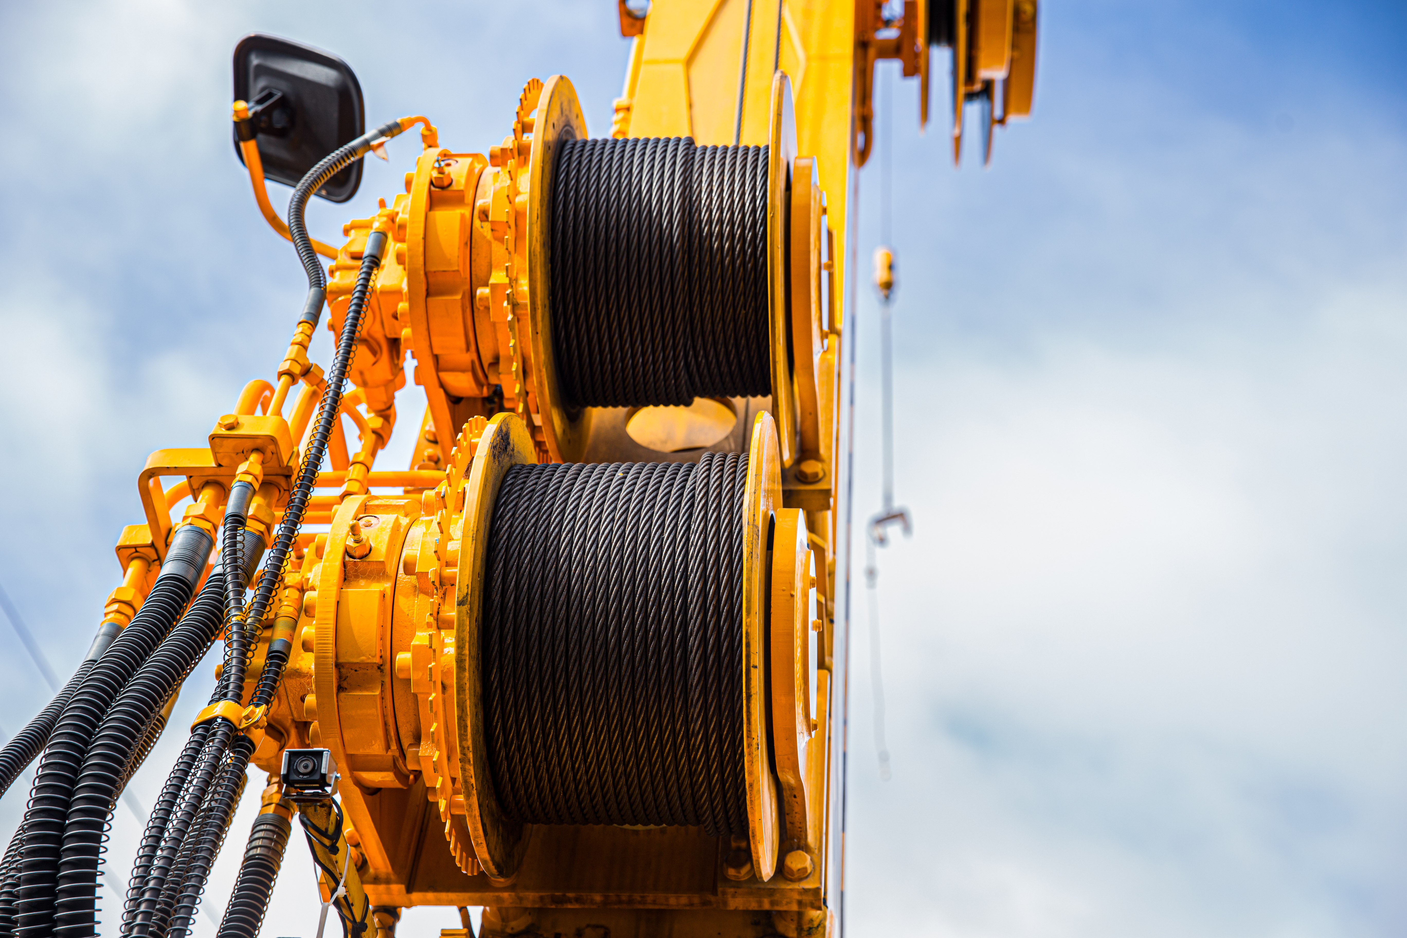
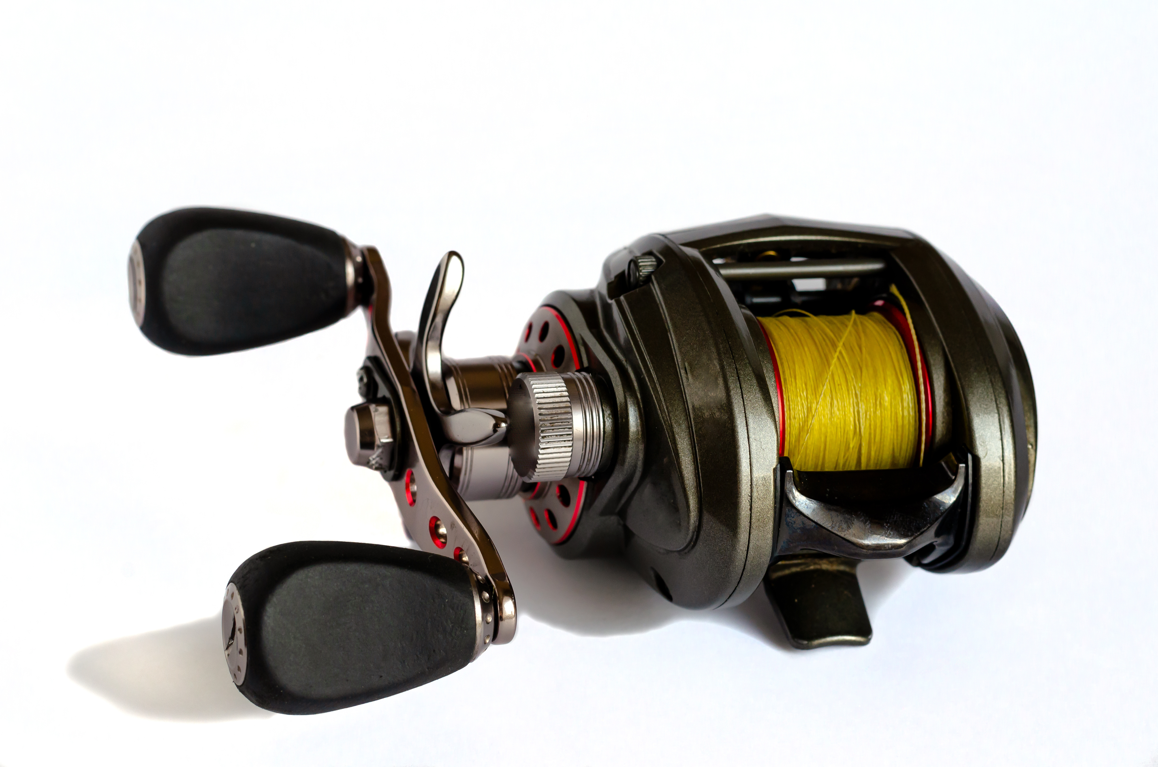
What is a Reel?
Reels are machines people use to make their jobs easier.
Here are some photos of reels:

Slide 4
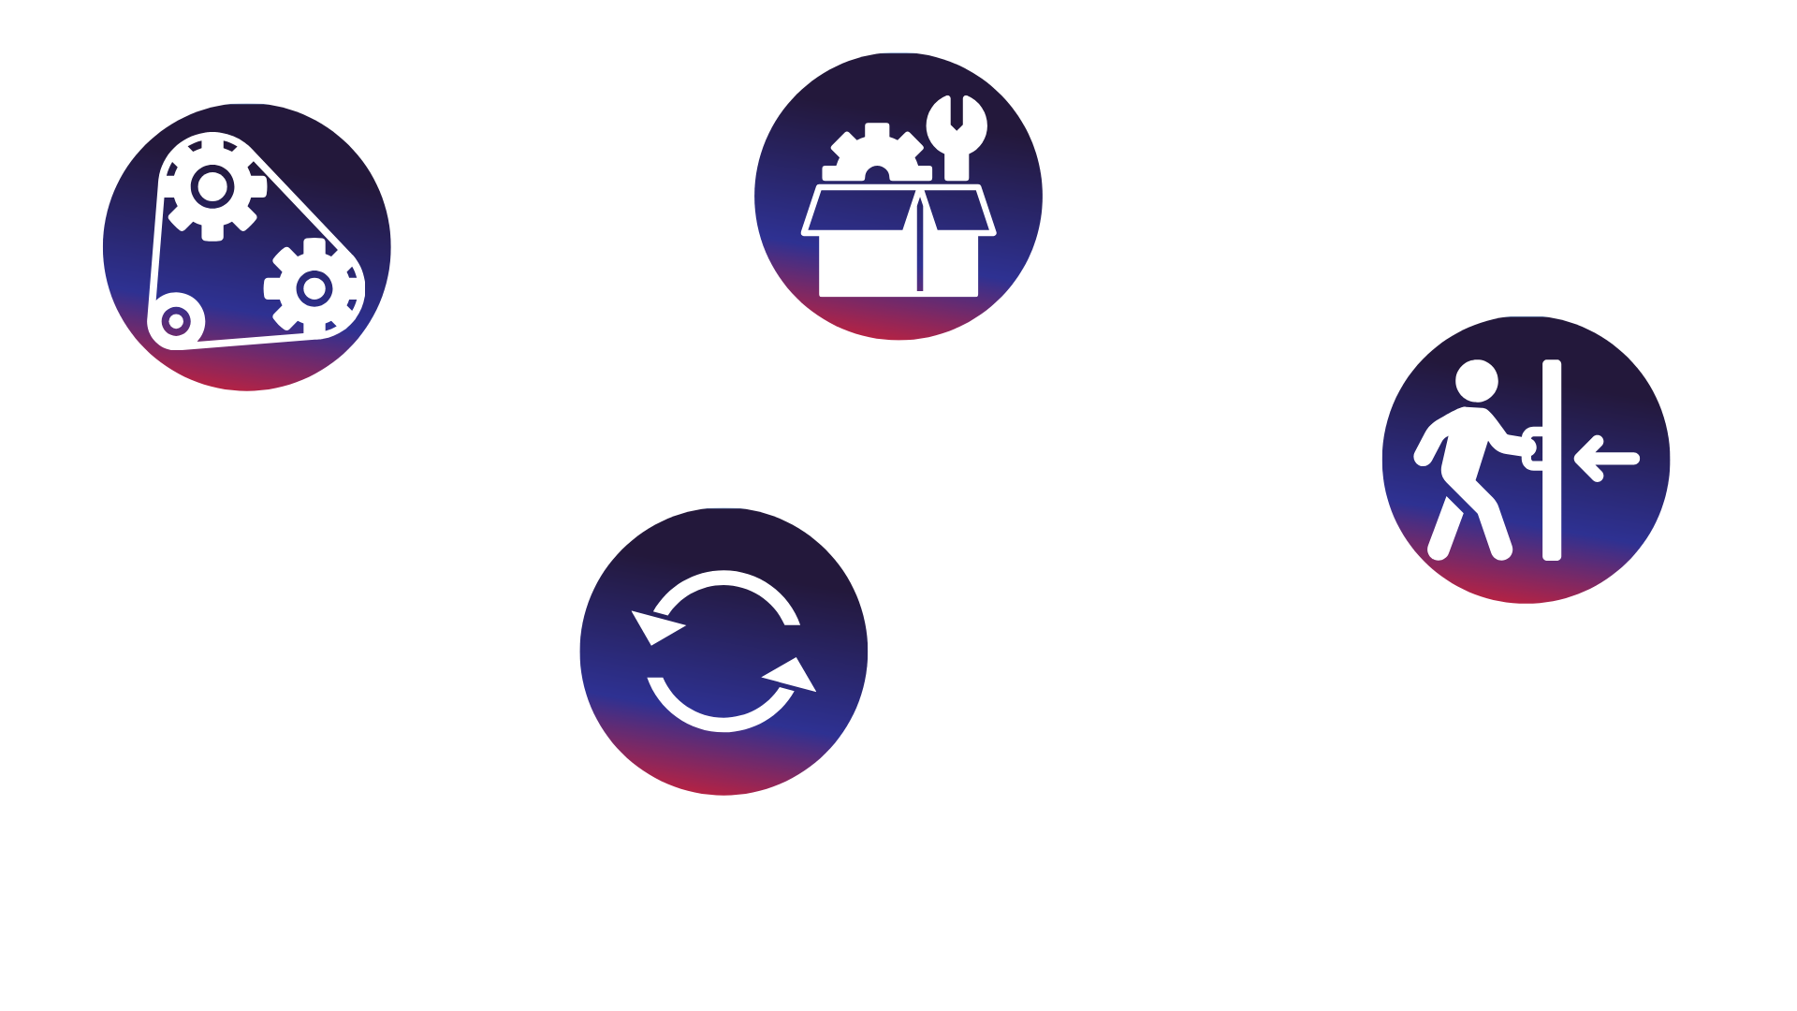
Key Words to Know
- Something people build to help them do work more easily
Machine
Parts
- Pieces that are put together to make a machine
Pull
- To move something closer
Turn
- To move something in a circle
Notes:
Here are some vocabulary words you might need to know:
Machine- something people build to help them do work more easily
Parts-pieces that are put together to make a machine
Pull-to move something closer
Turn-to move something in a circle

Slide 5
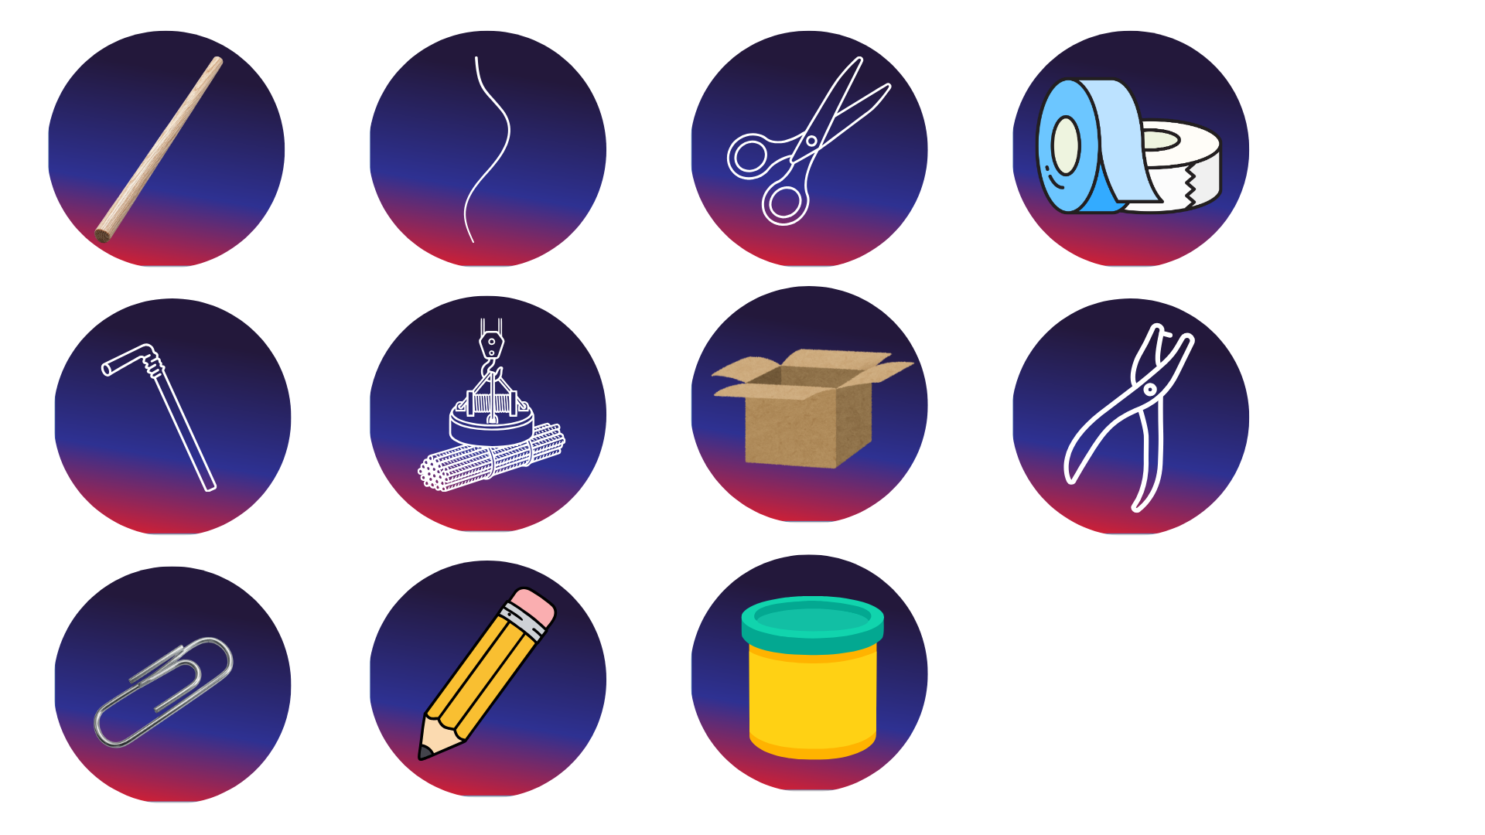
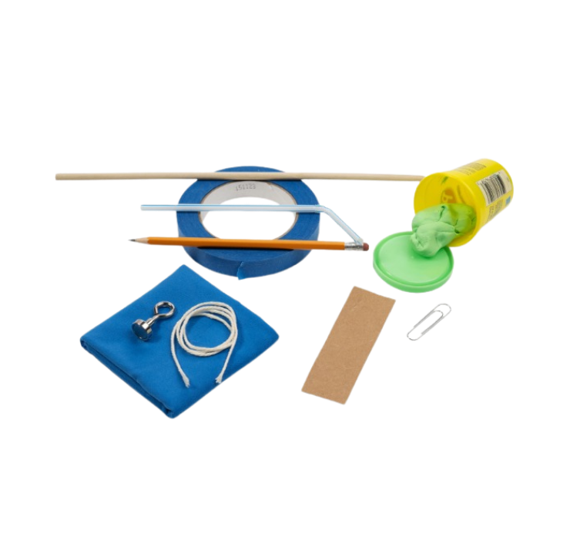
Today’s Materials
Dowel Rod
Kite String
Straw
Magnetic Hook
Paperclip
Pencil
Scissors
Cardboard
White or Blue Tape
Playdough
Hole Punch
Notes:
Materials
dowel rod
drinking straw
kite string
magnetic hook
paperclip
Pencil
Scissors
cardboard
Play dough
White or blue tape
Hole punch

Slide 6
Step 1
Prep Time!
You need a piece of cardboard that is 1 inch by 4 inches. Use a ruler to measure your piece of cardboard and see if it is the correct size.
1
2
Use the hole punch to punch a hole near one end of the cardboard.
3
Fold the piece of cardboard in half.
4
Punch a hole through the other side.
Notes:
You need a piece of cardboard that is 1 inch by 4 inches. Use a ruler to measure your piece of cardboard and see if it is the correct size.
Use the hole punch to punch a hole near one end of the cardboard.
Fold the piece of cardboard in half.
Punch a hole through the other side.

Slide 7
Step 2
Start to Construct!
Place a piece of tape along the folded edge of the cardboard to reinforce it
5
Tape the folded bracket to the dowel rod about 2-3 inches from one end
6
Use additional tape to secure the bracket firmly so it does not move
7
Notes:
Place a piece of tape along the folded edge of the cardboard to reinforce it
Tape the folded bracket to the dowel rod about 2-3 inches from one end
Use additional tape to secure the bracket firmly so it does not move

Slide 8
Step 3
Create the Reel Handle
Cut a 6-inch section from the drinking straw
8
Bend the straw about 1/3 from the end to form a right angle
9
Tape the bend so the straw keeps its L-shape
10
Notes:
Create the Reel Handle
Cut a 6-inch section from the drinking straw
Bend the straw about1/3 from the end to form a right angle
Tape the bend so the straw keeps its L-shape

Slide 9
Step 4
Install the Reel Handle
Insert the straight end of the straw through the two holes in the cardboard bracket
11
Position the bent handle on the left or right side, depending on student preference
12
Spin the handle to check that it turns freely. If needed, widen the holes slightly using a pencil
13
Notes:
Install the Reel Axle
Insert the straight end of the straw through the two holes in the cardboard bracket
Position the bent handle on the left or right side, depending on student preference
Spin the handle to check that it turns freely. If needed, widen the holes slightly using a pencil

Slide 10
Step 5
Secure the Reel
Wrap a small piece of tape around the straw on the opposite side of the handle (this prevents the straw from sliding out while allowing it to spin)
14
Notes:
Secure the Reel
Wrap a small piece of tape around the straw on the opposite side of the handle (this prevents the straw from sliding out while allowing it to spin)

Slide 11
Step 6
Add Line Guides
Cut two 1-inch pieces from the remaining straw
15
Tape one guide near the tip of the dowel rod and one close to the reel. These guides help keep the string aligned as it winds
16
Notes:
Add Line Guides
Cut two 1-inch pieces from the remaining straw
Tape one guide near the tip of the dowel rod and one close to the reel. These guides help keep the string aligned as it winds

Slide 12
Step 7
Add the Fishing Line and Hook
Thread the string through the straw guides
15
Tape one guide near the tip of the dowel rod and one close to the reel. These guides help keep the string aligned as it winds
16
17
Tie the magnet to the free end of the string.
Notes:
Add the Fishing Line and Hook
Thread the string through the straw guides
Tape one end of the string securely to the straw reel between the cardboard arms
Tie the magnet to the free end of the string.

Slide 13
Step 8
Test and Adjust the Reel Machine
Turn the handle and observe how the string wraps around the reel
18
Adjust the string position if it begins to bunch up
19
Notes:
Test and Adjust the Reel Machine
Turn the handle and observe how the string wraps around the reel
Adjust the string position if it begins to bunch up

Slide 14
Step 9
Make the Fish
Use just enough play dough to shape a fish around a large paper clip
18
Notes:
Make the Fish
Use just enough play dough to shape a fish around a large paper clip

Slide 15

You just created a Fishing Pole with a reel! What other machines could you construct that use a reel?

Slide 16

Turn and
TALK TIME
What happened to the string when you turned the handle?
How did turning the handle make the fish move?
What other machines might use a reel like this?
Why might people use a machine like this instead of pulling by hand?
Notes:
What happened to the string when you turned the handle?
How did turning the handle make the fish move?
What other machines might use a reel like this?
Why might people use a machine like this instead of pulling by hand?

Slide 17

Career Exploration
Construction Workers use machines with reels to lift and lower materials safely at building sites
Crane operators use reels and cables to raise heavy objects by turning controls that wind the cable
Fishing and Marine Workers use reels to pull in lines and nets in a controlled way
Manufacturing Technicians assemble machines with moving parts, making sure reels, handles, and cables turn smoothly
Notes:
Construction Workers use machines with reels to lift and lower materials safely at building sites
Crane operators use reels and cables to raise heavy objects by turning controls that wind the cable
Fishing and Marine Workers use reels to pull in lines and nets in a controlled way
Manufacturing Technicians assemble machines with moving parts, making sure reels, handles, and cables turn smoothly

