Slide 1




Activity Overview
Tools of the Trade

Slide 2

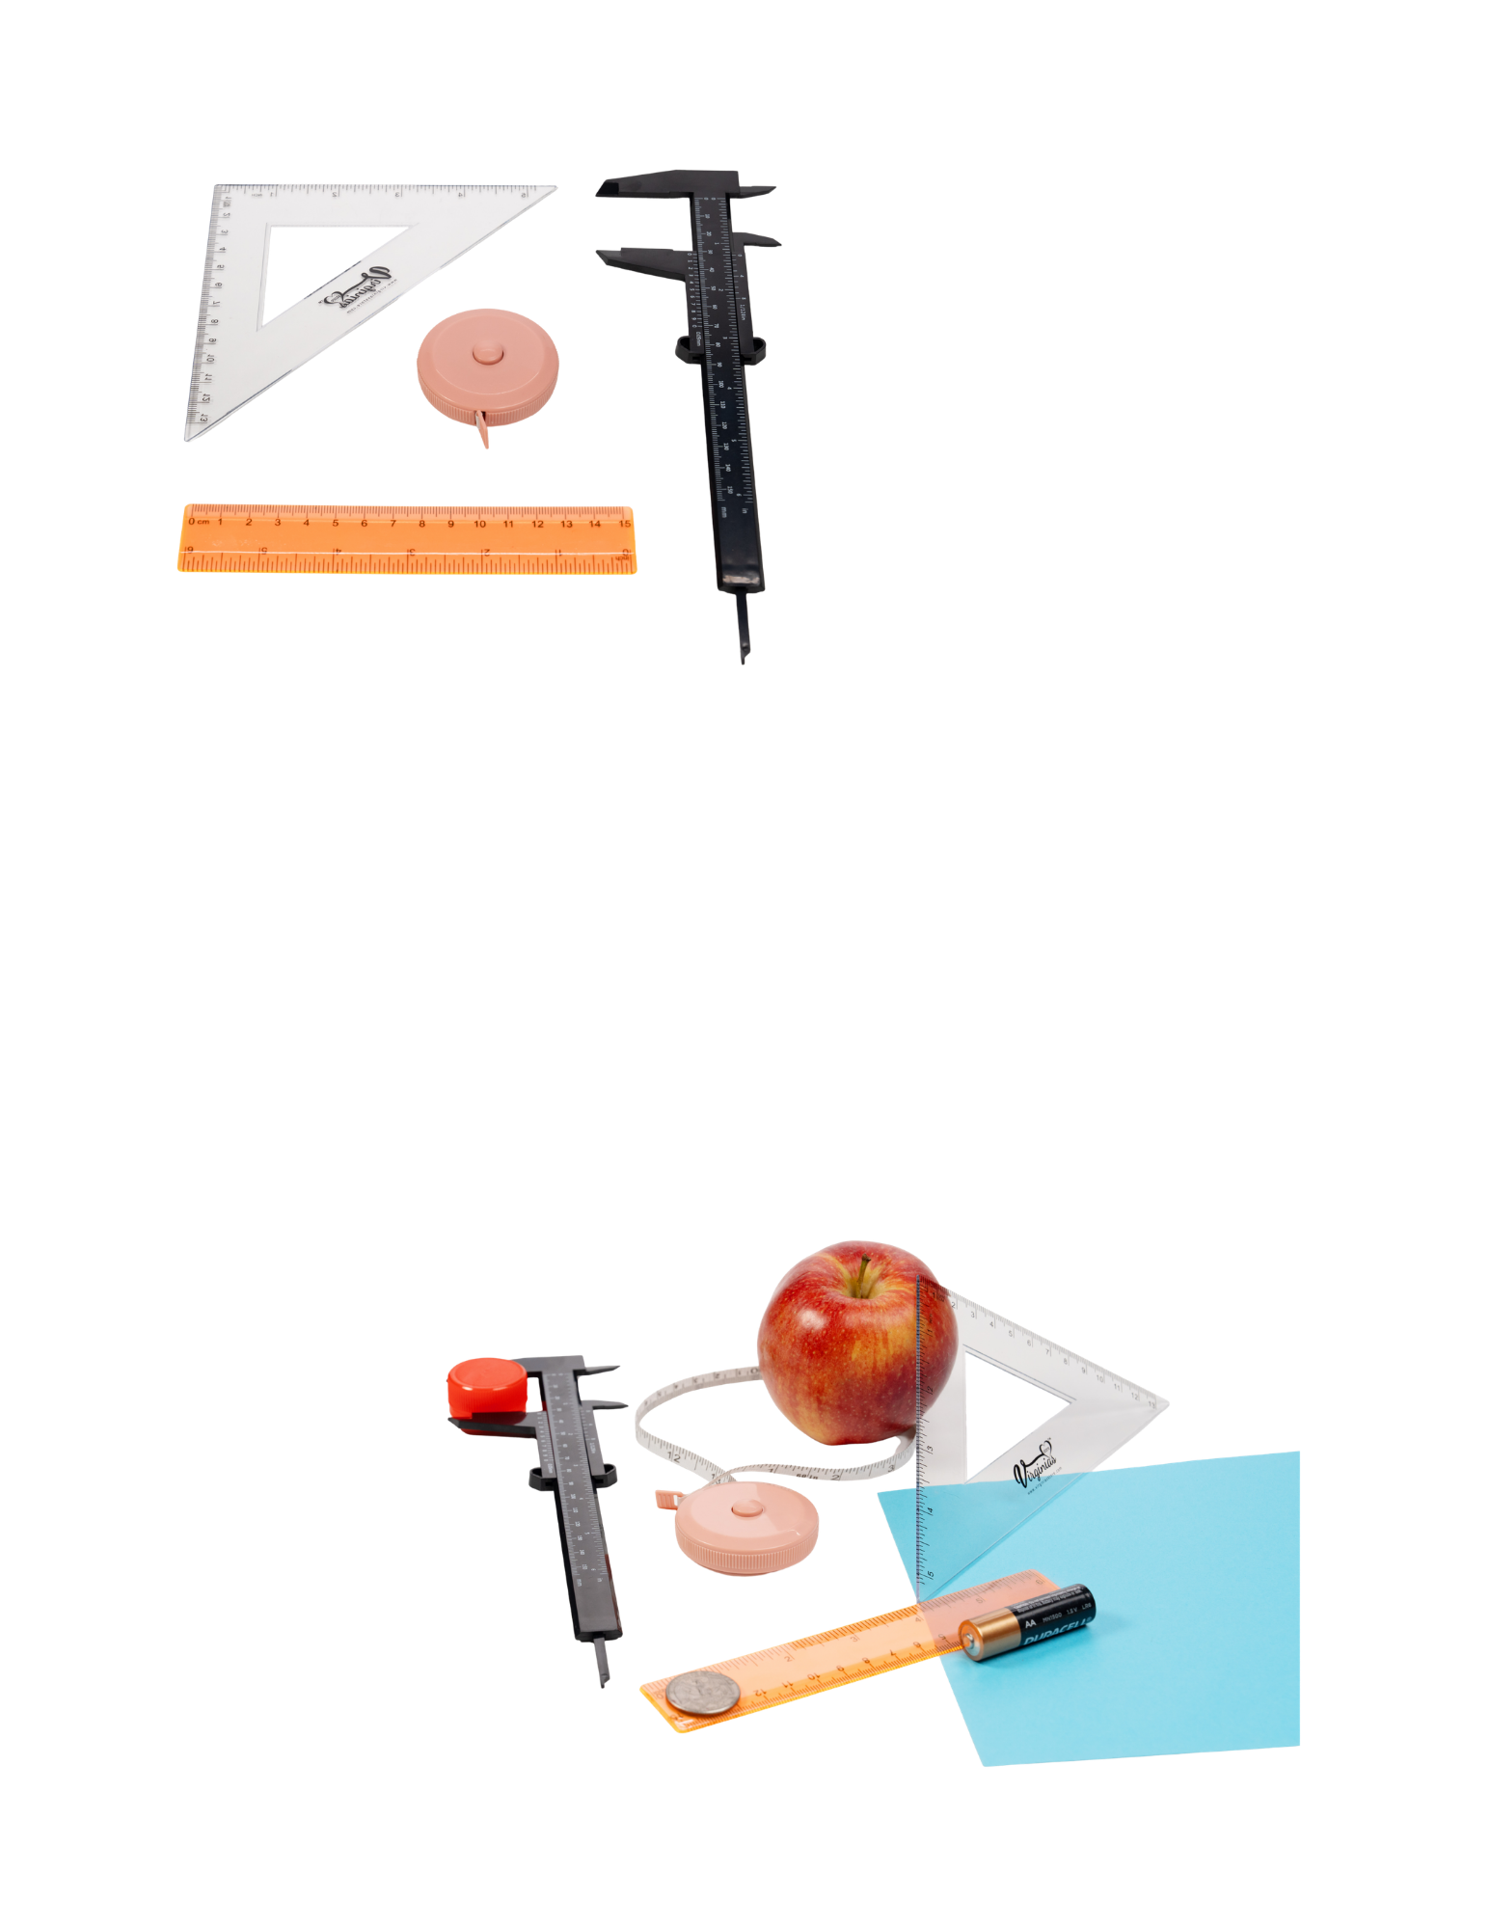


Tools of the Trade

Slide 3
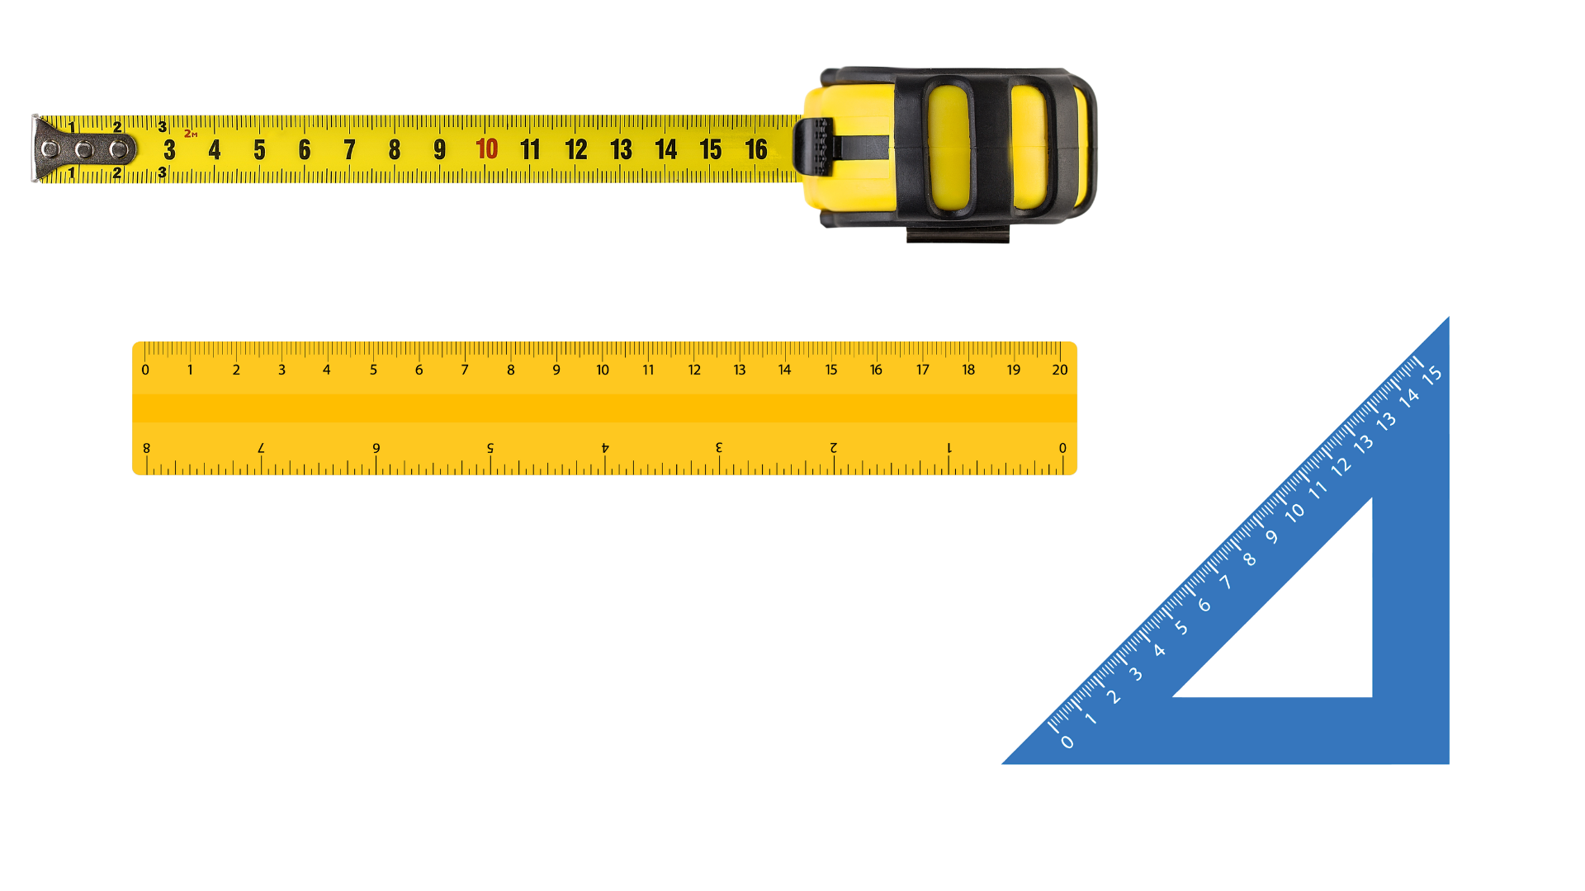
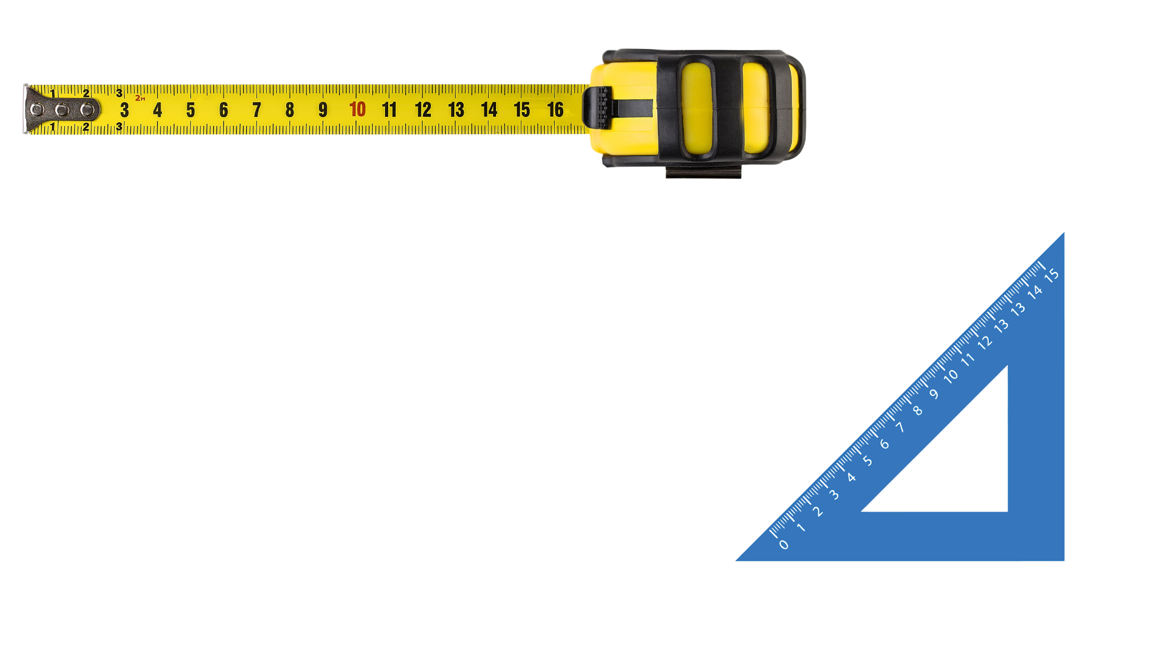
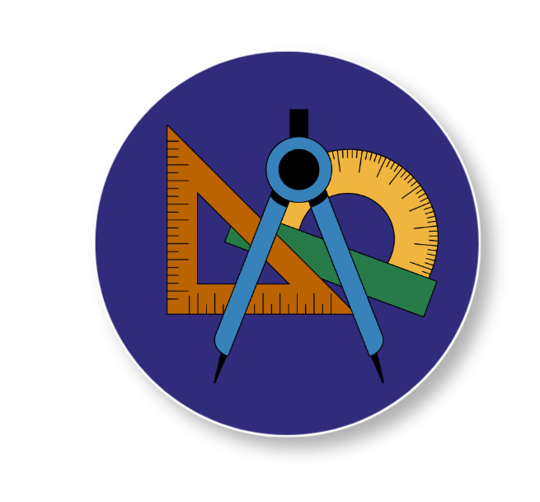
Why Standard Measurement Matters
Engineers, builders, and manufacturers use measuring tools to make sure their measurements match every time. When measurements match, things fit together, work correctly, and stay safe.
Before people used standard measuring tools, they often measured using their bodies: thumbs, hands, feet, or steps. These methods were easy to use, but they created problems because everyone’s body is a different size. That meant two people could measure the same object and get different answers, even if they were careful.
When people build or make things, measurements need to match. Parts must fit together. Objects need to line up. Materials must be the right size so they can be shipped, repaired, or replaced later. To solve these problems, people created standard measurement systems, such as inches, feet, centimeters, and meters
In this activity, you will see why using standard measurement tools helps people build and make things that work the way they are supposed to, and how different tools help people measure different things more carefully.
Notes:
Before people used standard measuring tools, they often measured using their bodies: thumbs, hands, feet, or steps. These methods were easy to use, but they created problems because everyone’s body is a different size. That meant two people could measure the same object and get different answers, even if they were careful.
When people build or make things, measurements need to match. Parts must fit together. Objects need to line up. Materials must be the right size so they can be shipped, repaired, or replaced later. To solve these problems, people created standard measurement systems, such as inches, feet, centimeters, and meters
These systems allow everyone to measure using the same units, no matter who they are or where they are working.
Engineers, builders, and manufacturers use measuring tools to make sure their measurements match every time. When measurements match, things fit together, work correctly, and stay safe. In this activity, you will see why using standard measurement tools helps people build and make things that work the way they are supposed to, and how different tools help people measure different things more carefully.

Slide 4
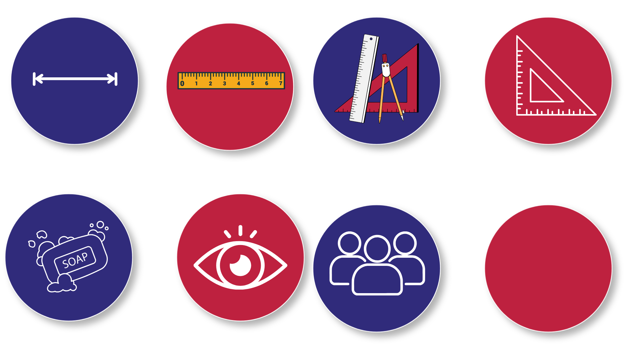
Key Words to Know
Measurement
- The process of determining the size, length, or amount of something using a tool
Unit
- A way to measure something, such as an inch or a centimeter
Standard Measurement
- A system of measurement that uses the same units for everyone
Measuring Tool
- An object used to measure size or length, such as a ruler or tape measure
Notes:
Measurement - The process of determining the size, length, or amount of something using a tool
Unit – A way to measure something, such as an inch or a centimeter
Standard Measurement – A system of measurement that uses the same units for everyone
Measuring Tool – An object used to measure size or length, such as a ruler or tape measure

Slide 5
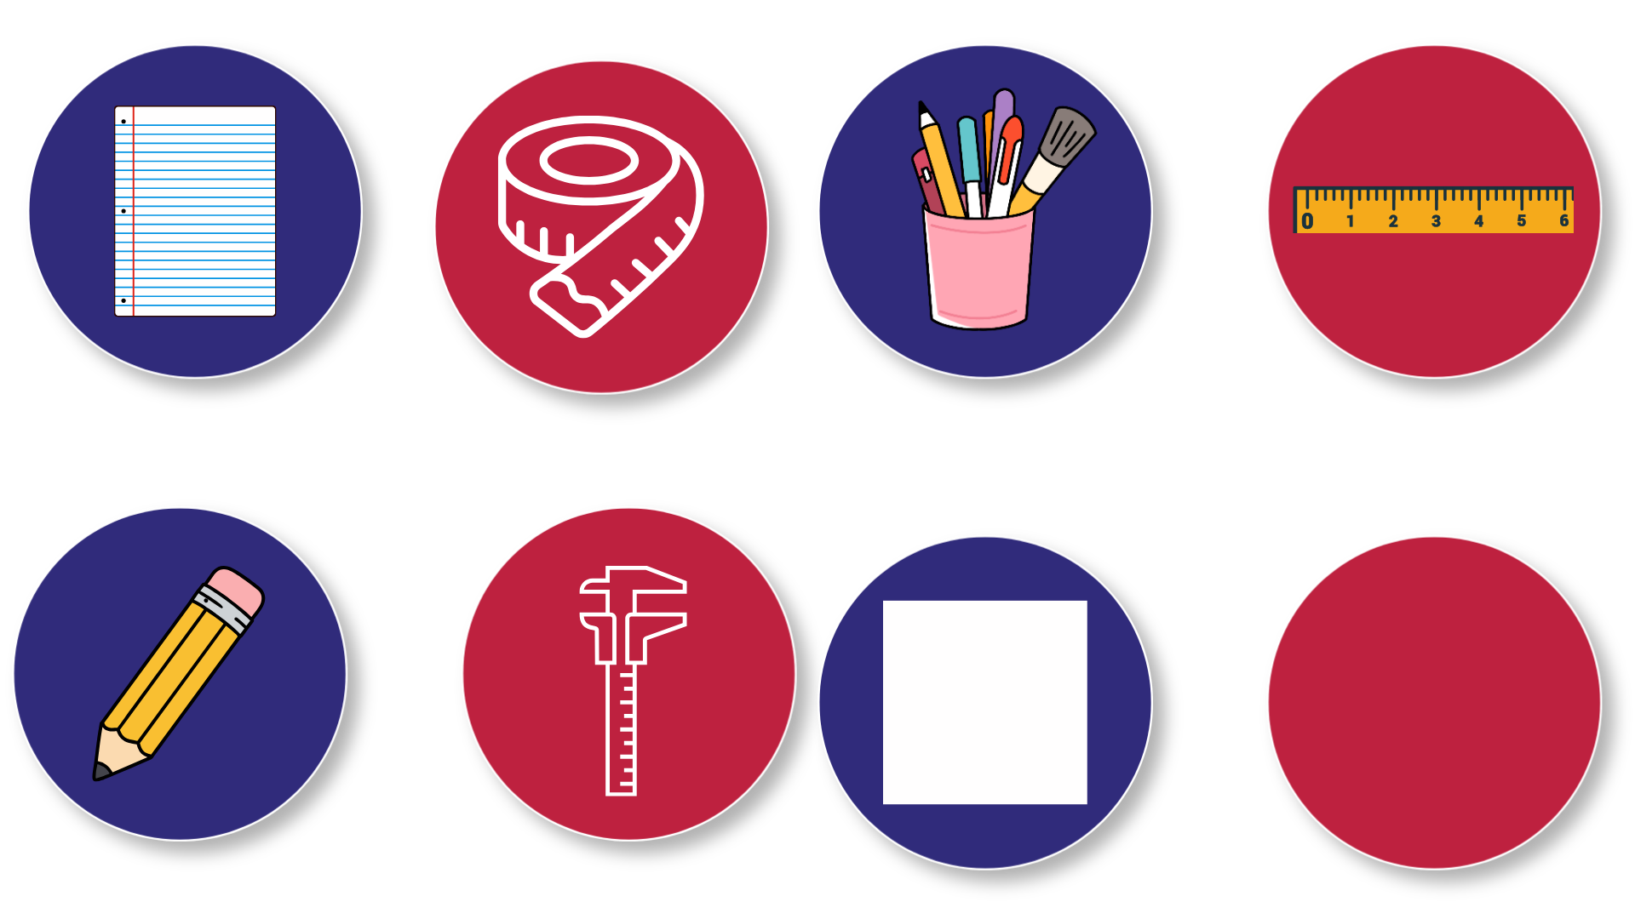
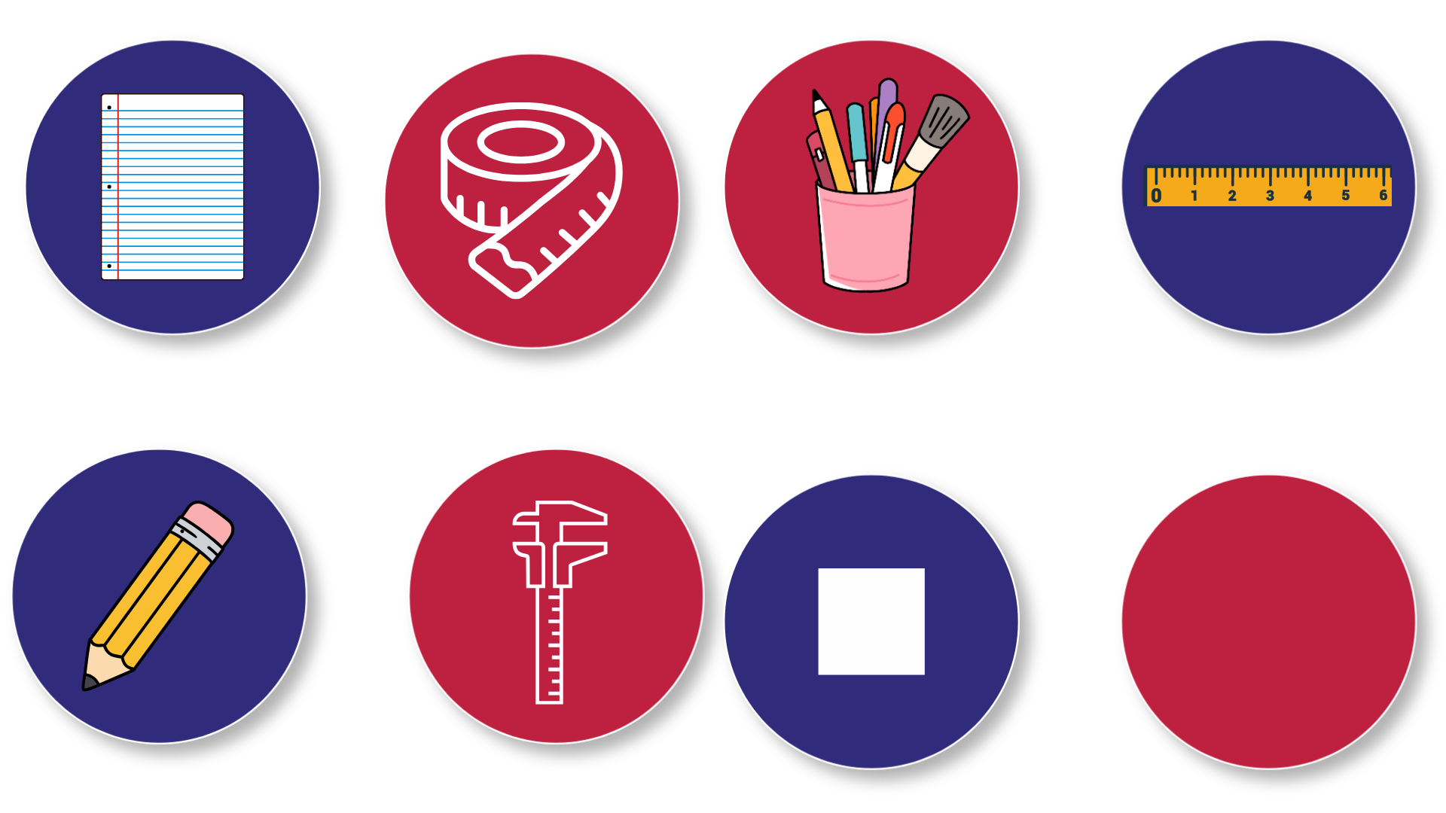
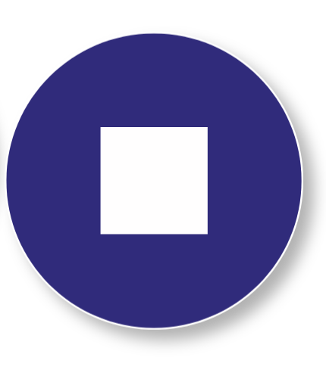
Today’s Materials
Notebook Paper
1 Retractable Soft Tape Measure
Classroom Projects
1 Six-Inch Ruler
Pencil
1 Pair of Calipers
1 Mini Square
Notes:
1 six-inch ruler
1 retractable soft tape measure
1 pair of calipers
1 mini square
Notebook paper
Classroom objects
Pencil

Slide 6
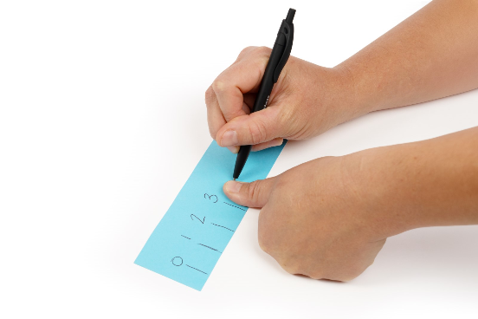

Step 1
Create a Personal Measurement Tool
1
Provide each student with a sheet of notebook paper
Have students fold the paper in half, lengthwise
Using the width of their own thumb, students mark equal spaces along the folded edge of the paper
Students create up to ten units and label them from 1 to 10
2
3
4
Notes:
Create a Personal Measurement Tool (Nonstandard Units)
Provide each student with a sheet of notebook paper
Have students fold the paper in half, lengthwise
Using the width of their own thumb, students mark equal spaces along the folded edge of the paper
Students create up to ten units and label them from 1 to 10

Slide 7
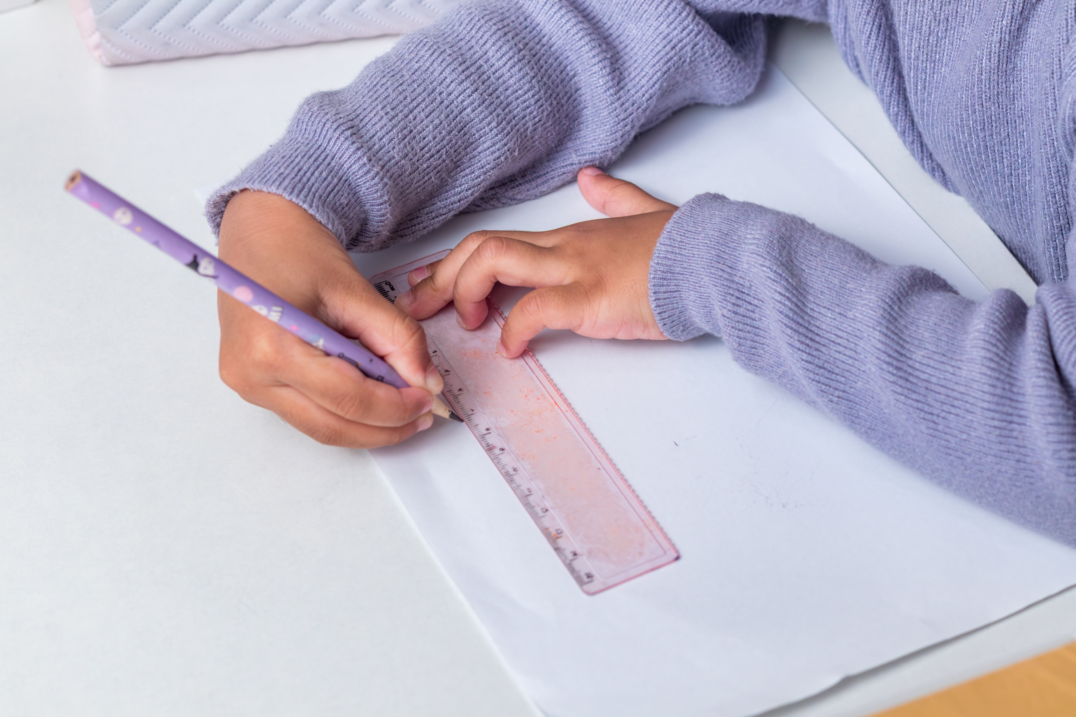
Step 2
Measure Using Personal Units
5
Assign several classroom objects for students to measure (such as a desk, table, whiteboard, or door)
Have students use their paper measurement tool to measure each object
Students record their measurements using personal units
6
7
Notes:
Measure Using Personal Units
Assign several classroom objects for students to measure (such as a desk, table, whiteboard, or door)
Have students use their paper measurement tool to measure each object
Students record their measurements using personal units

Slide 8

Step 3
Compare Measurements
Collect measurements from multiple students for the same object
8
Record results where students can see them
9
Notes:
Compare Measurements
Collect measurements from multiple students for the same object
Record results where students can see them

Slide 9
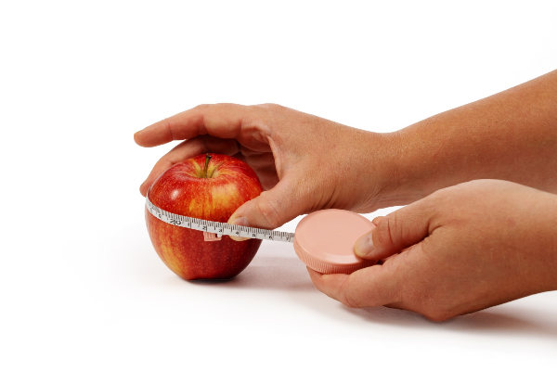
Step 4
Measure Using Standard Tools
10
Have students re-measure the same objects using standard units with the rulers or measuring tape
Record the measurements in inches
11
Observe that standard measurements are consistent across student results
12
Notes:
Measure Using Standard Tools
Have students re-measure the same objects using standard units with the rulers or measuring tape
Record the measurements in inches
Observe that standard measurements are consistent across student results

Slide 10
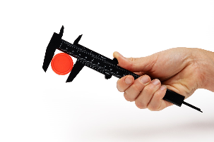
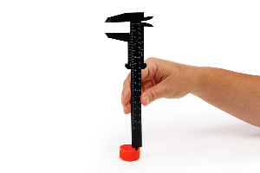
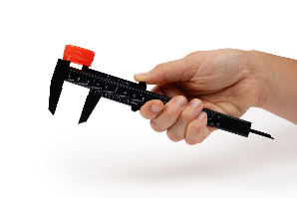
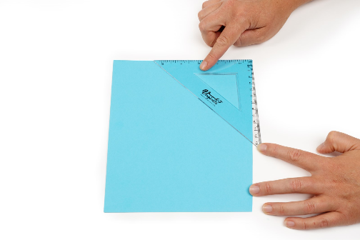

Step 5
Introduce Additional
Measurement Tools
Show students a set of calipers and explain that they are used when measurements need to be very exact
13
Demonstrate measuring with calipers by measuring the thickness of a book or the width of a small object by gently closing the caliper jaws around it
14
15
Point out that calipers can measure things that are hard to measure accurately with a ruler or tape, such as round objects
Think Like an Engineer!
Show the students an engineer’s square and explain that it is used to check whether corners are straight
Notes:
Introduce Additional Measurement Tools
Show students a set of calipers and explain that they are used when measurements need to be very exact
Demonstrate measuring with calipers by measuring the thickness of a book or the width of a small object by gently closing the caliper jaws around it
Point out that calipers can measure things that are hard to measure accurately with a ruler or tape, such as round objects
Show the students an engineer’s square and explain that it is used to check whether corners are straight

Slide 11
Step 6
Student Exploration (Optional)
Show the students an engineer’s square and explain that it is used to check whether corners are straight
16
Encourage students to try measuring familiar classroom objects ​
17
Notes:
Student Exploration (Optional) ​
Allow students to briefly explore measuring with tools such as calipers or an engineer’s square ​
Encourage students to try measuring familiar classroom objects ​

Slide 12
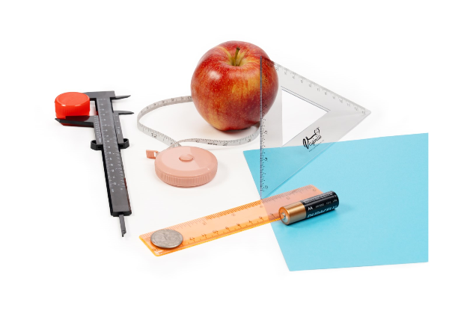
You just explored manufacturing measuring tools!

Slide 13

Turn and
TALK TIME
Why were our personal measurements different from each other?
Why do engineers rely on standard measurement systems?
When might a tape measure be better than a ruler?
Why might engineers need tools such as calipers instead of simple rulers?
Notes:
Why were our personal measurements different from each other?
Why do engineers rely on standard measurement systems?
When might a tape measure be better than a ruler?
Why might engineers need tools such as calipers instead of simple rulers?

Slide 14
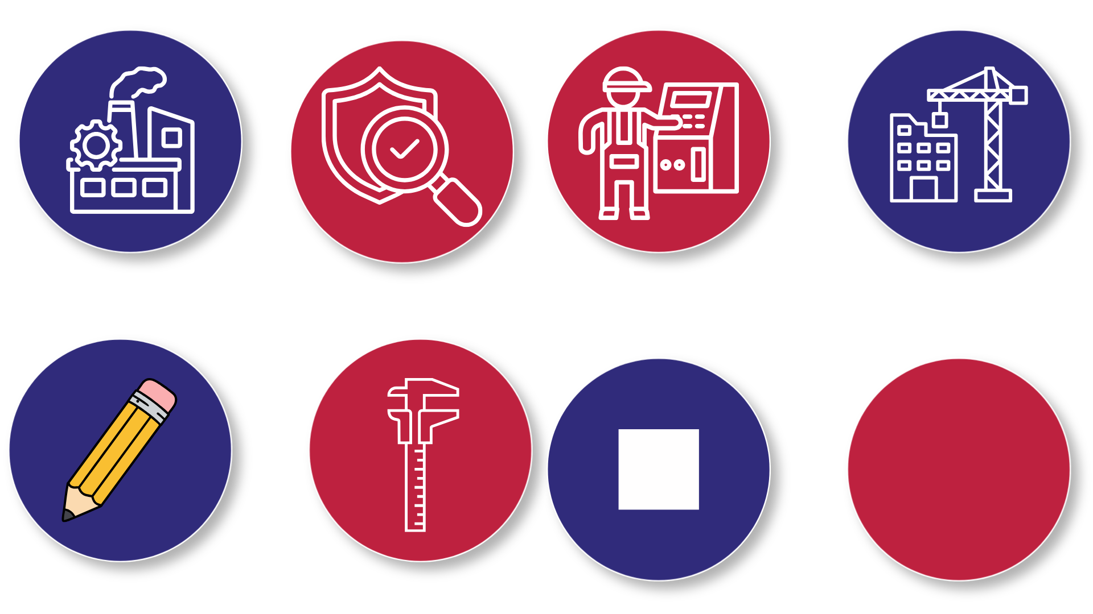
Career Exploration
Manufacturing engineers use precise measurement tools to ensure that parts are made to the correct size and shape.
Quality control technicians inspect parts using tools such as calipers and gauges to confirm that products meet specifications.
Construction engineers and technicians measure materials carefully so buildings and structures are aligned and safe.
CNC Machine Operators use computer-controlled machines to make precise parts and check that the finished pieces match the plan
Notes:
Manufacturing engineers use precise measurement tools to ensure that parts are made to the correct size and shape.
Quality control technicians inspect parts using tools such as calipers and gauges to confirm that products meet specifications.
Construction engineers and technicians measure materials carefully so buildings and structures are aligned and safe.
CNC Machine Operators use computer-controlled machines to make precise parts and check that the finished pieces match the plan

