Slide 1




Activity Overview
Water Powered Rocket

Slide 2

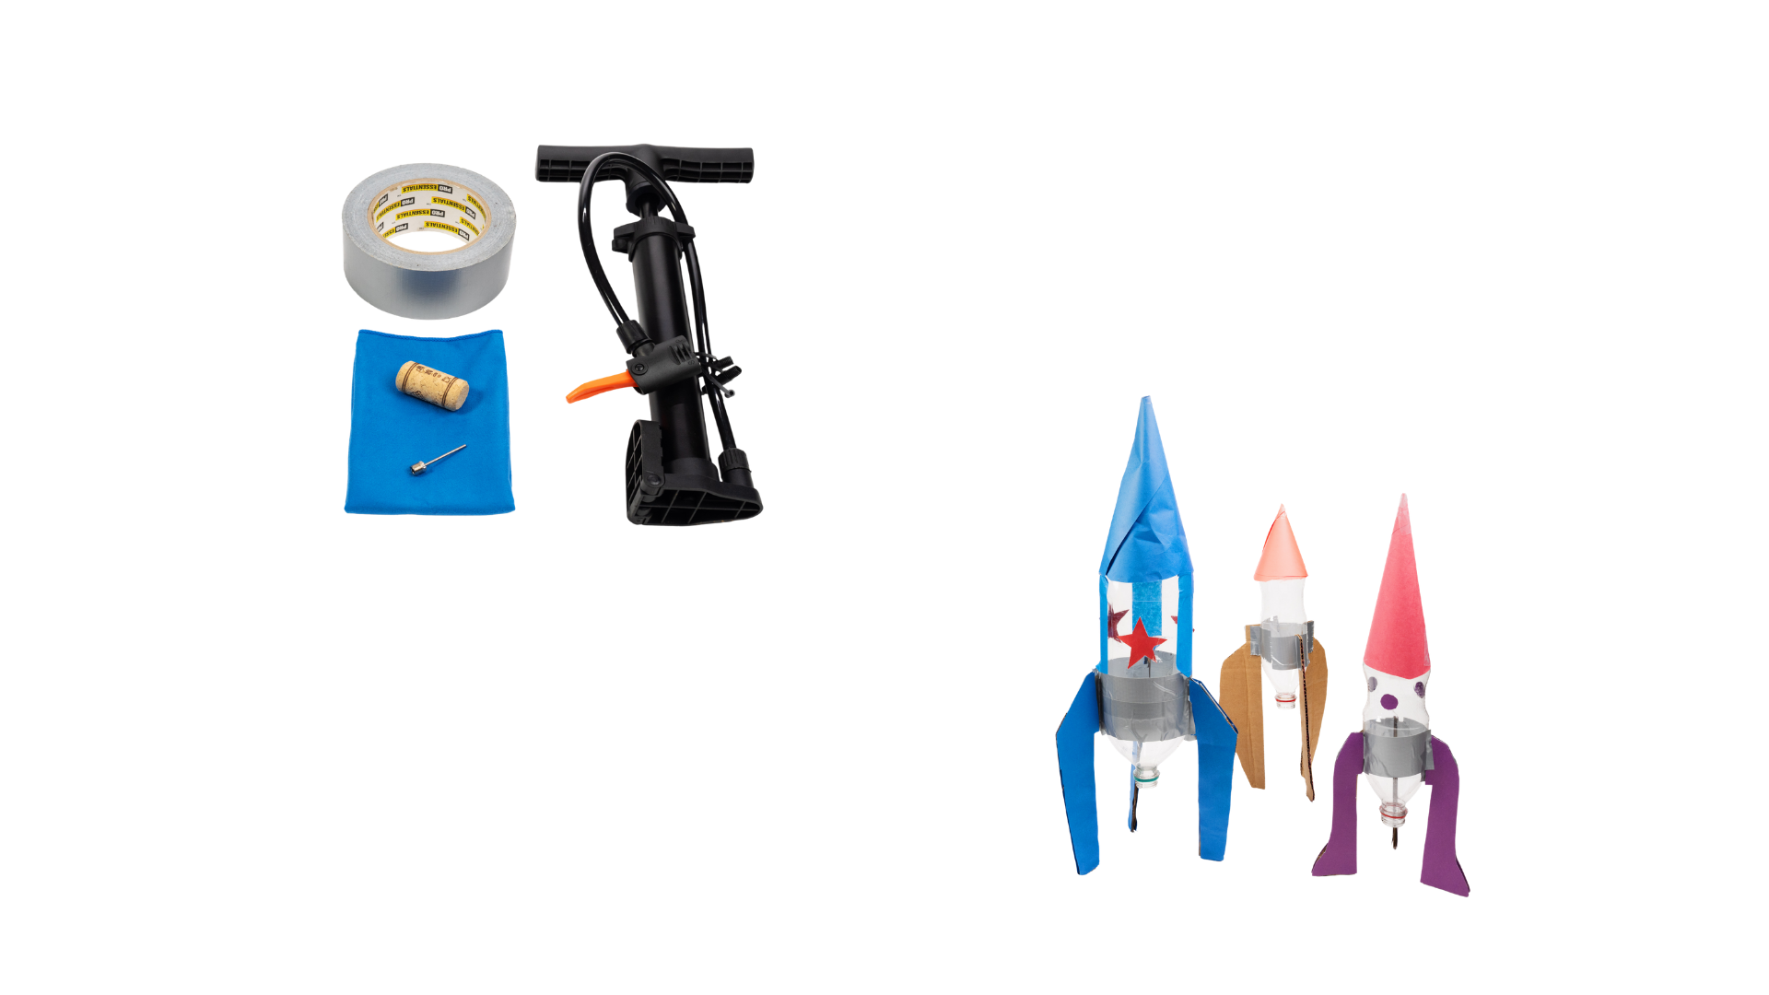


Water-Powered Rocket

Slide 3
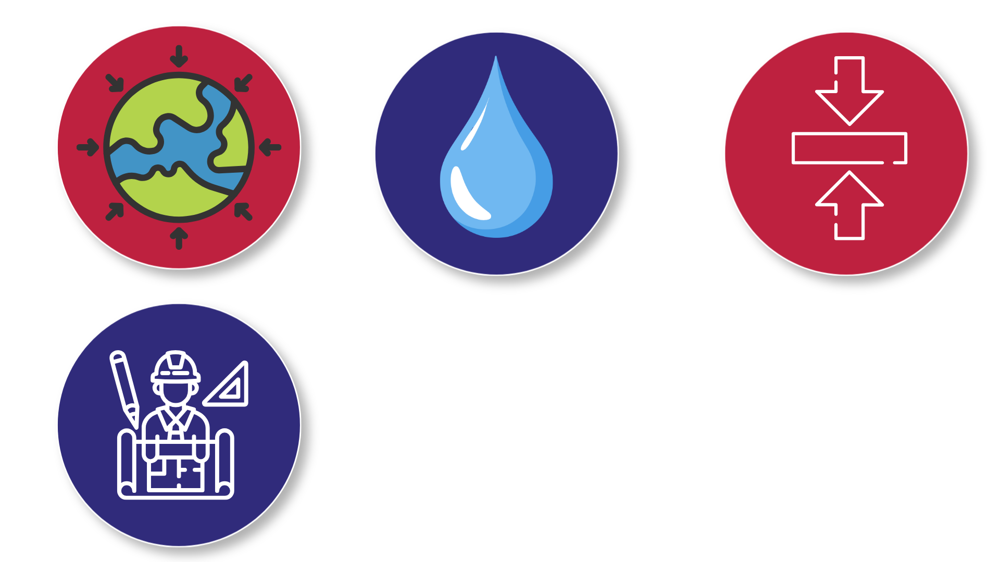

Foundations of Motion and Thrust
In this activity, air is pumped into a rocket that contains water. When the rocket launches, water is pushed forcefully downward. This creates a strong upward push on the rocket called thrust. At that moment, the upward force is stronger than gravity, so the rocket moves upward into the air.
Gravity is a force that always pulls objects on Earth downward.
For an object to move upward, another force must push upward with greater strength than gravity. When forces are not equal, they are called unbalanced forces, and motion changes.
As the water finishes spraying out, the upward push becomes weaker. Gravity then becomes the stronger force again. This causes the rocket to slow down, stop rising, and fall back toward the ground.
Engineers must think about gravity and other forces when designing rockets and deciding how strong the upward push needs to be.
Notes:
Gravity is a force that pulls objects on Earth downward at all times.
For an object to move upward, another force must push upward with greater strength than gravity. When forces are not equal, they are called unbalanced forces, and motion changes.
In this activity, air is pumped into a rocket that contains water. When the rocket launches, water is pushed forcefully downward. This creates a strong upward push on the rocket called thrust. At that moment, the upward force is stronger than gravity, so the rocket moves upward into the air.
As the water finishes spraying out, the upward push becomes weaker. Gravity then becomes the stronger force again. This causes the rocket to slow down, stop rising, and fall back toward the ground.
Engineers must think about gravity and other forces when designing rockets and deciding how strong the upward push needs to be.

Slide 4
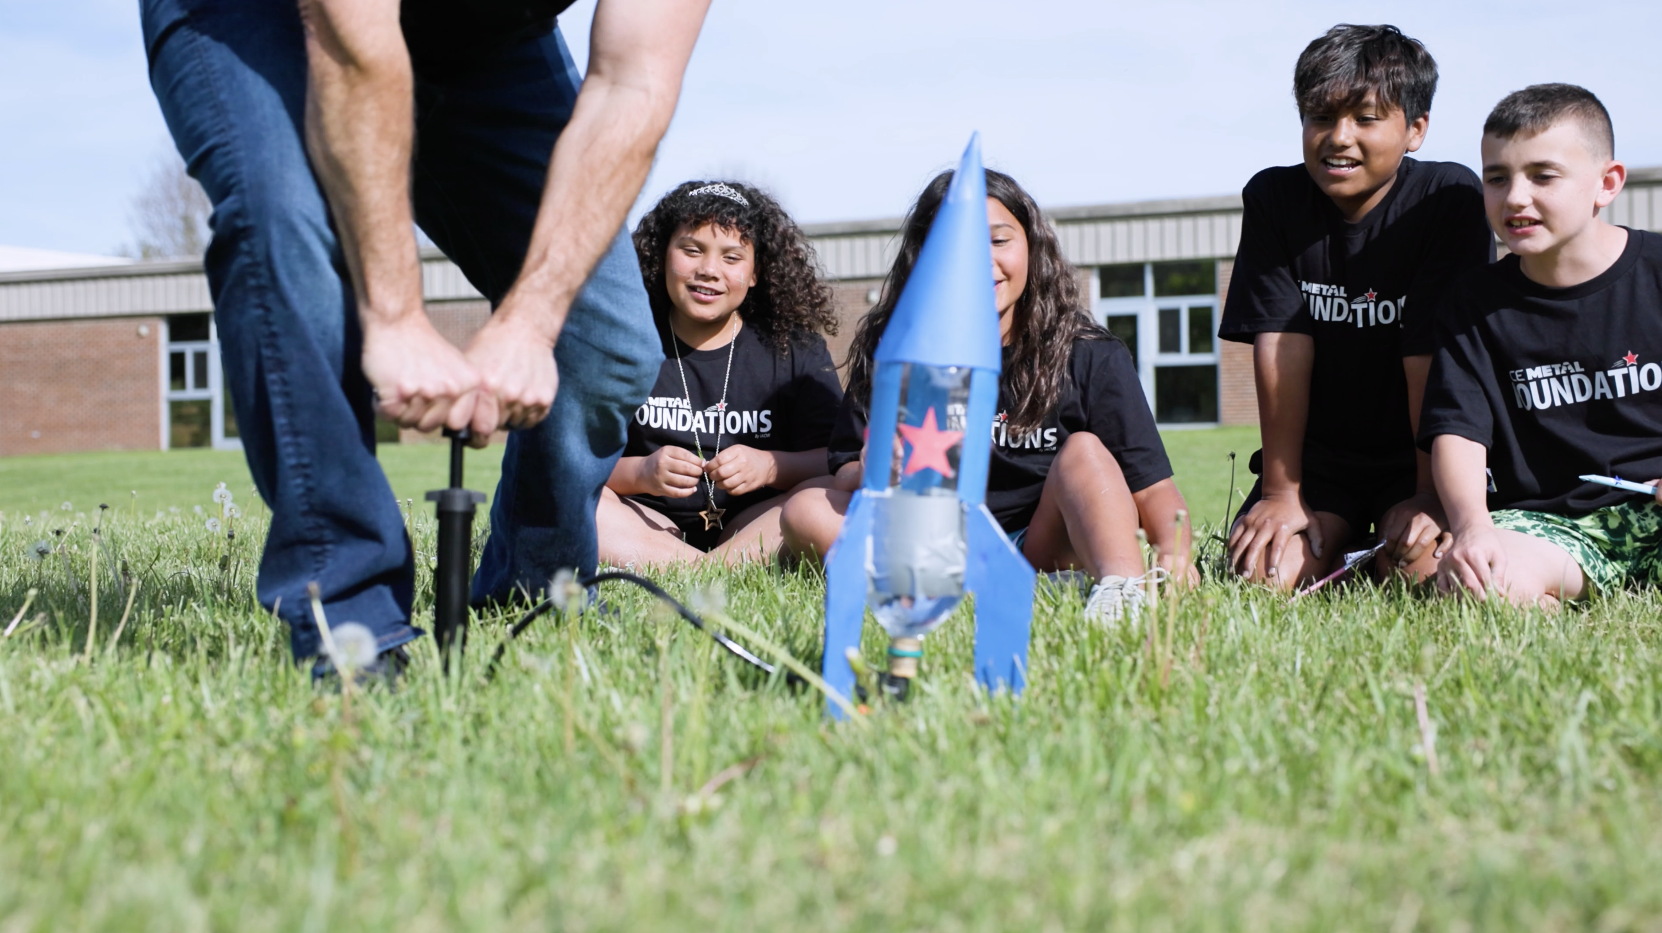
Key Words to Know
Force
A push or pull that can change how something moves
Gravity
A force that pulls objects towards the center of the earth
Unbalanced Forces
When forces are not equal and cause an object’s motion to change
Thrust
A strong push that moves a rocket upward
Notes:
Force: A push or pull that can change how something moves
Gravity: A force that pulls objects towards the ground
Unbalanced Forces: When forces are not equal and cause an object’s motion to change
Thrust: A strong push that moves a rocket upward

Slide 5
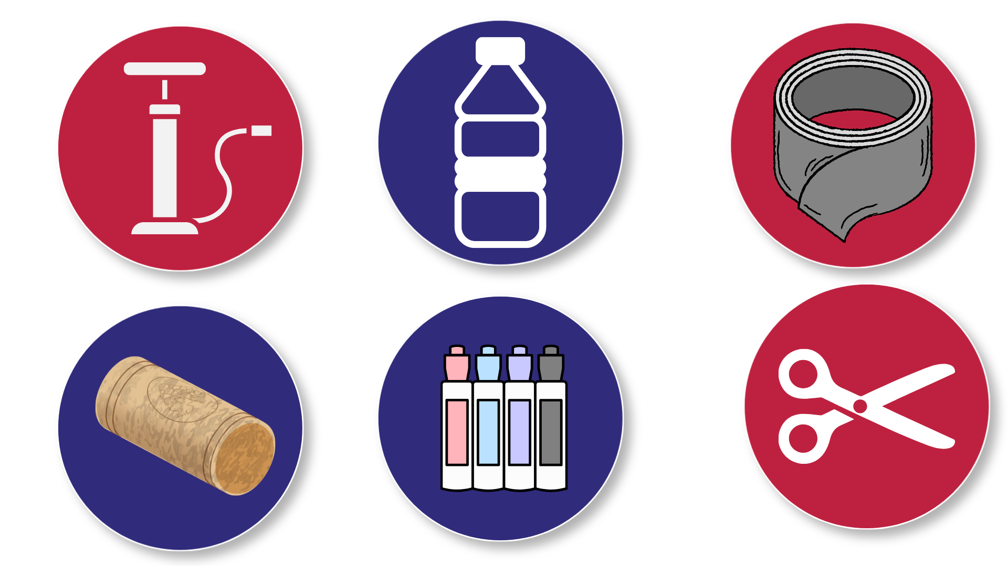
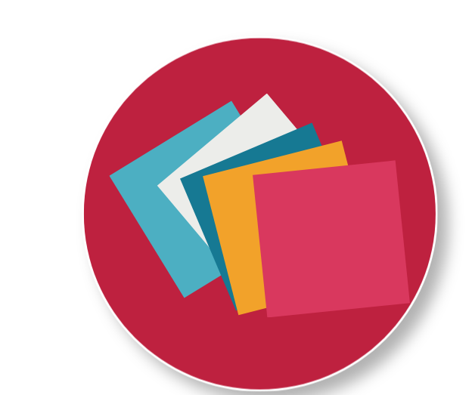
Today’s Materials
1 Air Pump with Air Needles
Plastic Water Bottle
1 Wine Cork
Scissors
1 Roll of Duct Tape
Markers
Construction Paper
Notes:
1 air pump with air needles
1 wine cork
1 roll of duct Tape
Teacher Supplied
Plastic water bottles of 20 oz soda bottles
Scissors
Markers (optional)
Construction paper (optional)

Slide 6
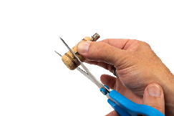
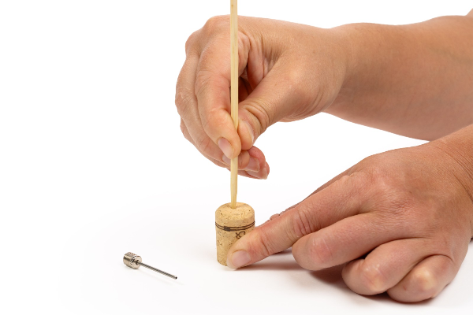
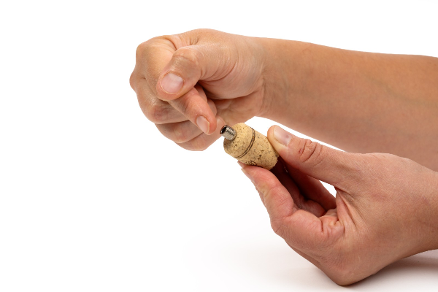
Step 1
Prepare the Cork
This step should be performed by an adult, not a student.
Prepare the cork by trimming it so that it is just a bit longer than the inflating needle
Insert a bamboo skewer into the center of the cork. It may help to pierce the cork from both ends several times. Use Caution.
Insert the inflating needle into the cork
Notes:
Prepare the Cork
This step should be performed by an adult, not a student.
Prepare the cork by trimming it so that it is just a bit longer than the inflating needle
Insert a bamboo skewer into the center of the cork. It may help to pierce the cork from both ends several times. Use caution
Insert the inflating needle into the cork

Slide 7
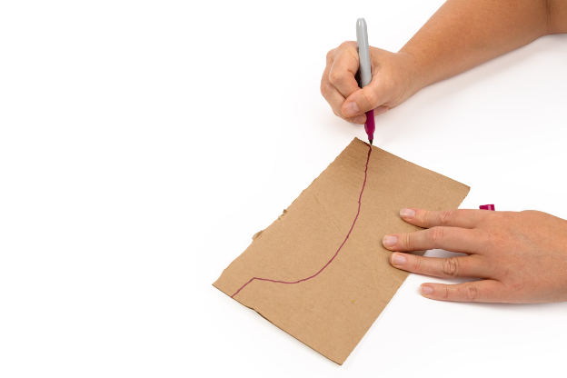
Step 2
Create Rocket Fins
Draw one rocket fin on the cardboard surface. The rocket fin will need to extend at least 4 inches below the bottle’s opening to ensure enough clearance for the pump for launch
Cut out the rocket fin and trace it onto the cardboard two more times to create two more fins and cut them out as well for a total of 3 equally sized fins
Notes:
Create the Rocket Fins
Draw one rocket fin on the cardboard surface. The rocket fin will need to extend at least 4 inches below the bottle’s opening to ensure enough clearance for the pump for launch
Cut out the rocket fin and trace it onto the cardboard two more times to create two more fins and cut them out as well for a total of 3 equally sized fins

Slide 8
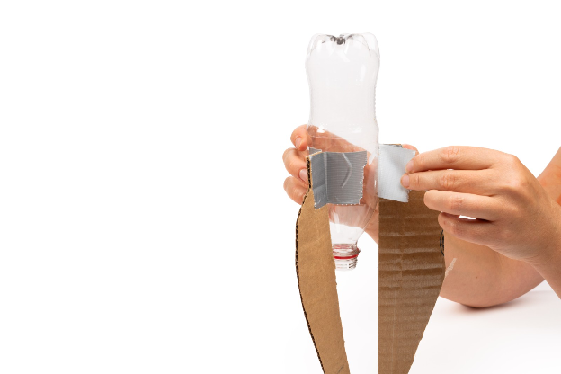
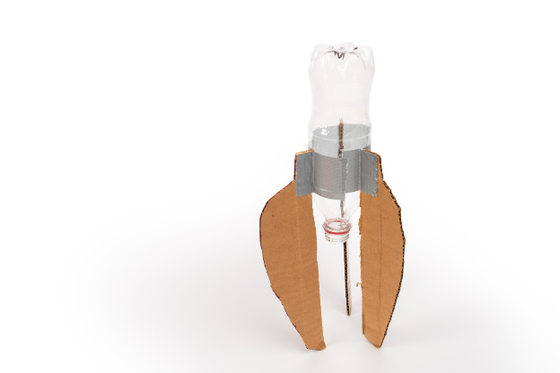
Step 3
Attach the Fins to the Rocket
Turn the bottle upside down so that the mouth of the bottle is facing downward
Use duct tape to attach the fins evenly near the bottom of the soda bottle
Tip:
Ensure that fins are evenly
spaced for stability
Notes:
Attach the Fins to the Rocket
Turn the bottle upside down so that the mouth of the bottle is facing downward
Use duct tape to attach the fins evenly near the bottom of the soda bottle
Ensure that fins are evenly spaced for stability

Slide 9

Step 4
Make the Nose Cone
Cut out a circle of construction paper
Cut a straight line from the edge of the circle to the center of the circle
Fold the circle to form a cone shape
Notes:
Make the Nose Cone (Optional)
Cut out a circle of construction paper
Cut a straight line from the edge of the circle to the center of the circle
Fold the circle to form a cone shape

Slide 10
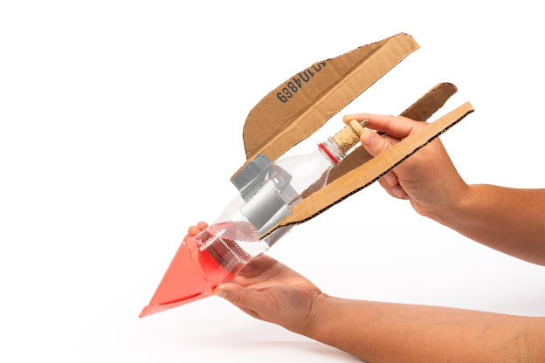
Step 5
Attach the Nose Cone
Place the cone on the top of the inverted bottle
Tape the nose cone to secure it to the rocket body
Notes:
Attach the Nose Cone
Place the cone on the top of the inverted bottle
Tape the nose cone to secure it to the rocket body

Slide 11
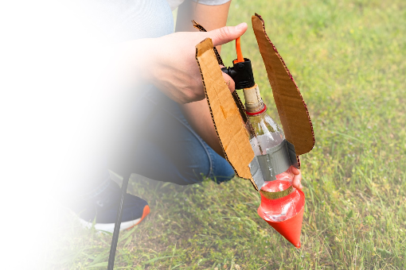
Step 6
Add the Water!
Fill the bottle one-third of the way with water
Notes:
Fill the bottle one-third of the way with water

Slide 12
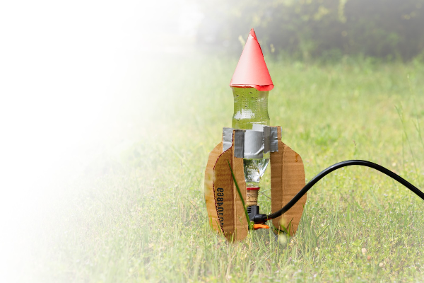
Step 7
Prepare for Launch!
Attach the air pump to the receiving end of the inflating needle
Insert the cork into the mouth of the bottle
Set the bottle down on a flat surface, away from rooftops, cars, etc.
Notes:
Attach the air pump to the receiving end of the inflating needle
Insert the cork into the mouth of the bottle
Set the bottle down on a flat surface, away from rooftops, cars, etc.

Slide 13

Step 8
Launch the Rocket!
Kneel to support the pump’s base and use the pump to add air to the bottle until the pressure causes the rocket to lift off
Notes:
Launch the Rocket
Kneel to support the pump’s base and use the pump to add air to the bottle until the pressure causes the rocket to lift off

Slide 14
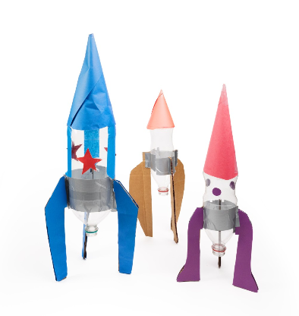
You just made a water-powered rocket!

Slide 15

Turn and
TALK TIME
What happened when
air-pressure built up inside the bottle?
Why did pushing water downward make the rocket move upward?
What could you change to make the rocket fly higher or straighter?
Notes:
What happened when air-pressure built up inside the bottle?
Why did pushing water downward make the rocket move upward?
What could you change to make the rocket fly higher or straighter?

Slide 16

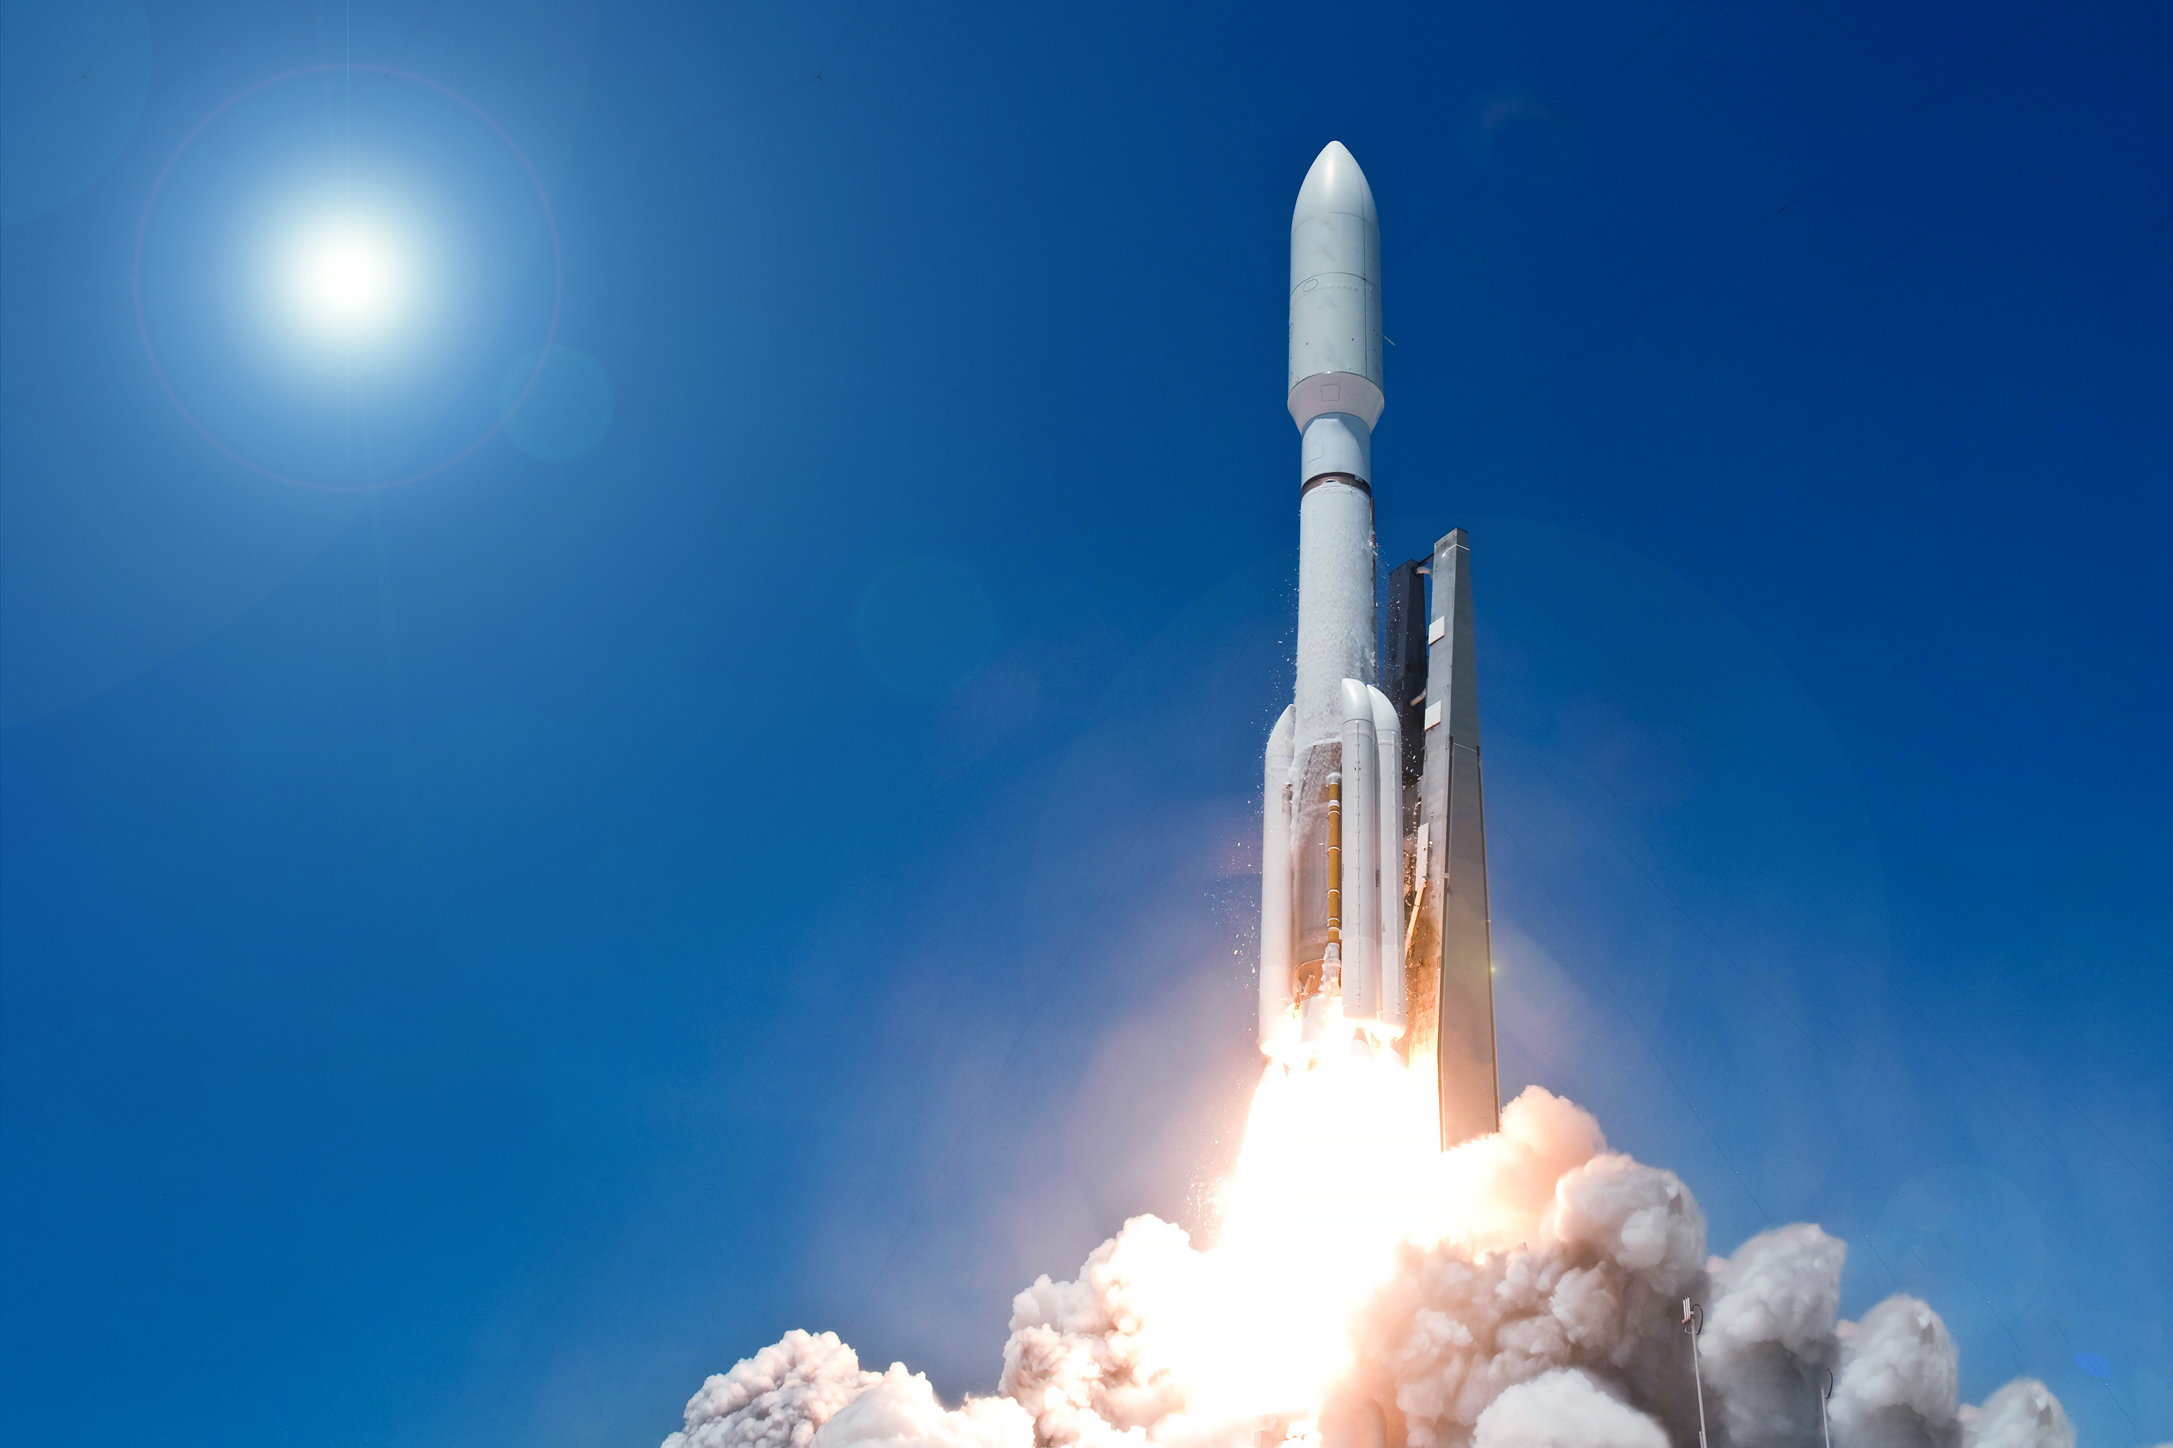
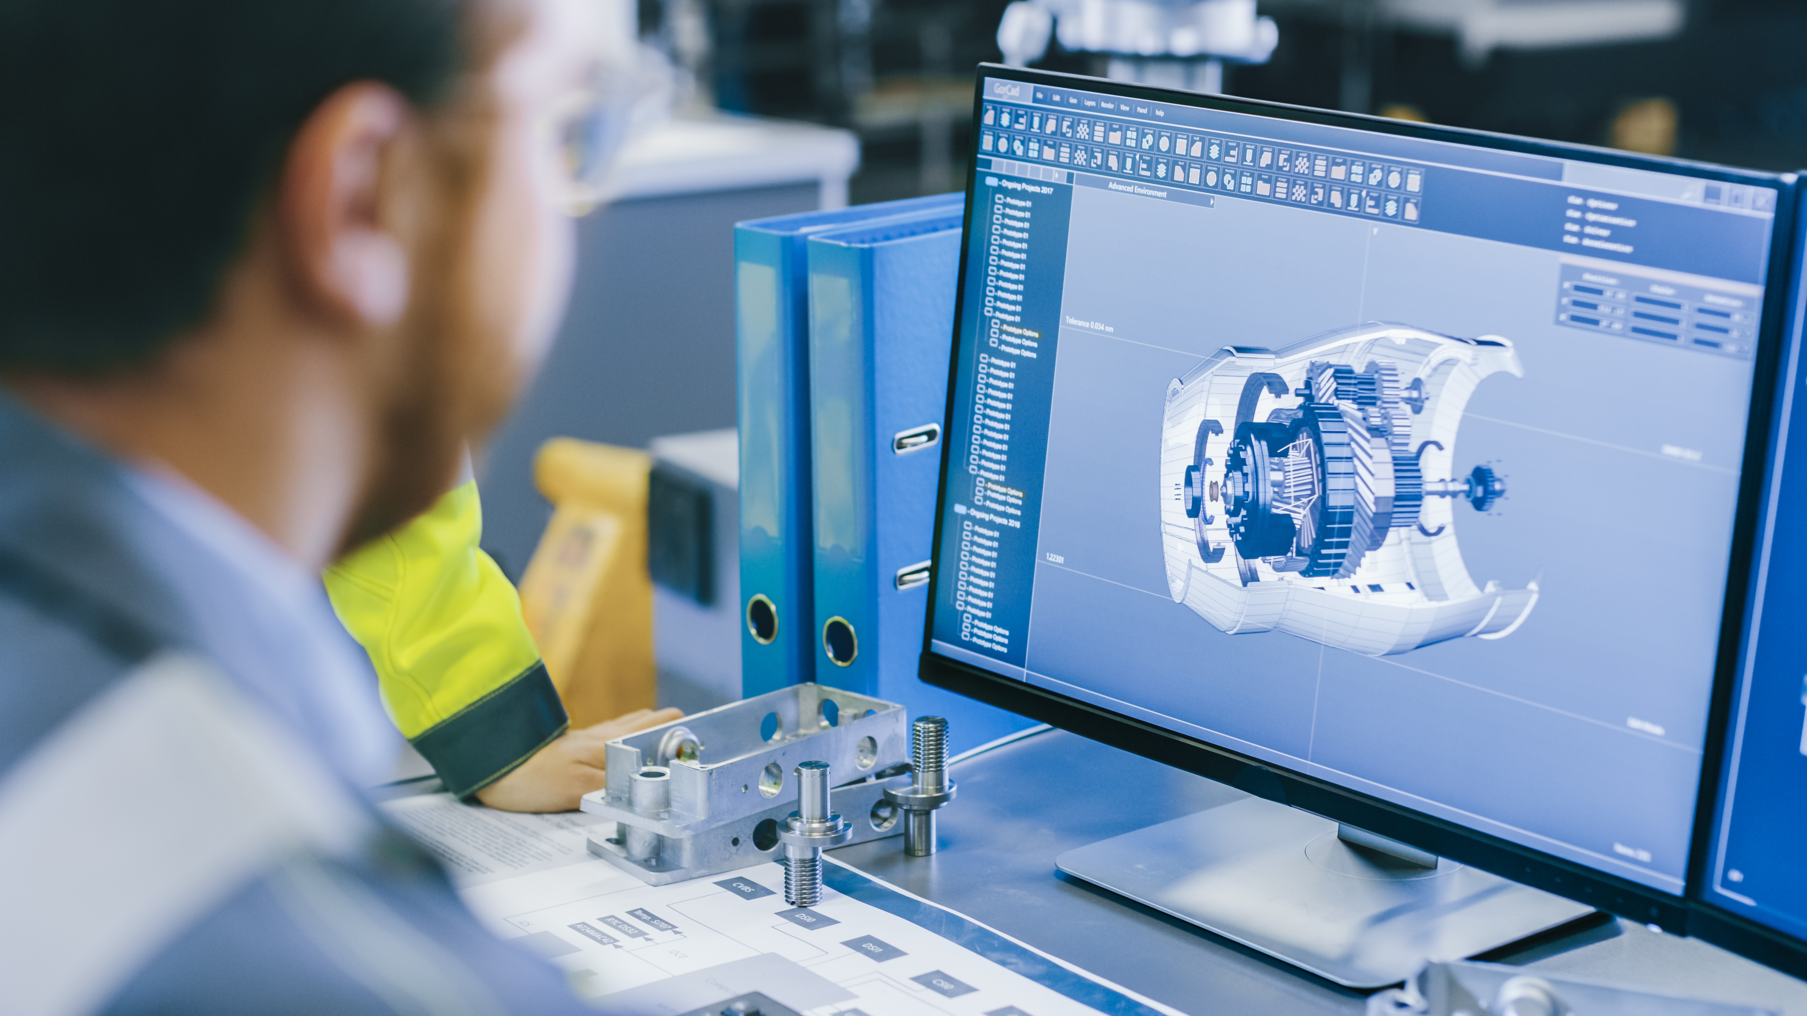

Career Exploration
Manufacturing Engineers build and test rocket parts to make sure they are safe and work correctly.
Technicians and Assemblers put rocket components together carefully so launches happen as planned.
Aerospace Engineers design rockets and spacecraft that launch into the air and travel through space.
Mechanical Engineers design systems that use force, pressure, and motion to move objects.
Notes:
Aerospace Engineers design rockets and spacecraft that launch into the air and travel through space.
Mechanical Engineers design systems that use force, pressure, and motion to move objects.
Manufacturing Engineers build and test rocket parts to make sure they are safe and work correctly.
Technicians and Assemblers put rocket components together carefully so launches happen as planned.

